Slide 1
Cryptography - Day 3
Defining Security

Slide 2
Review

Slide 3
XOR Operation
XOR is a binary "exclusive or” operation that is represented by ⊕

Slide 4
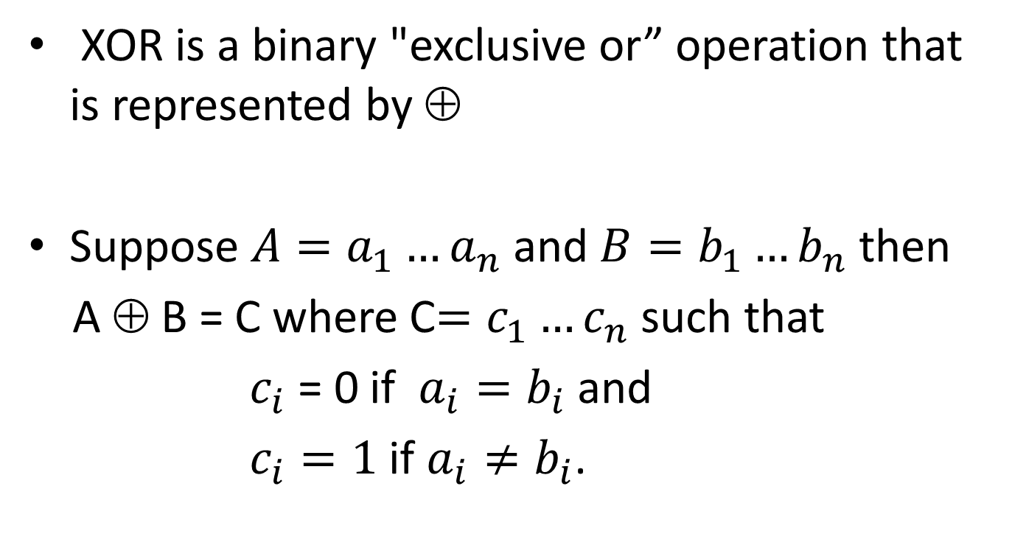
XOR Operation
XOR is a binary "exclusive or” operation that is represented by ⊕
Suppose $A=a_{1}…a_{n}$ and $B=b_{1}…b_{n}$ then
A ⊕ B = C where C$=c_{1}…c_{n}$such that
$c_{i}$ = 0 if $a_{i}=b_{i}$ and
$c_{i}=1$ if $a_{i}≠b_{i}$.

Slide 5

XOR Operation
Suppose $A=1001 0010$ and $B=0000 1110$

Slide 6

XOR Operation
Suppose $A=1001 0010$ and $B=0000 1110$
A ⊕ B = $1001 0010$
⊕ $0000 1110$

Slide 7
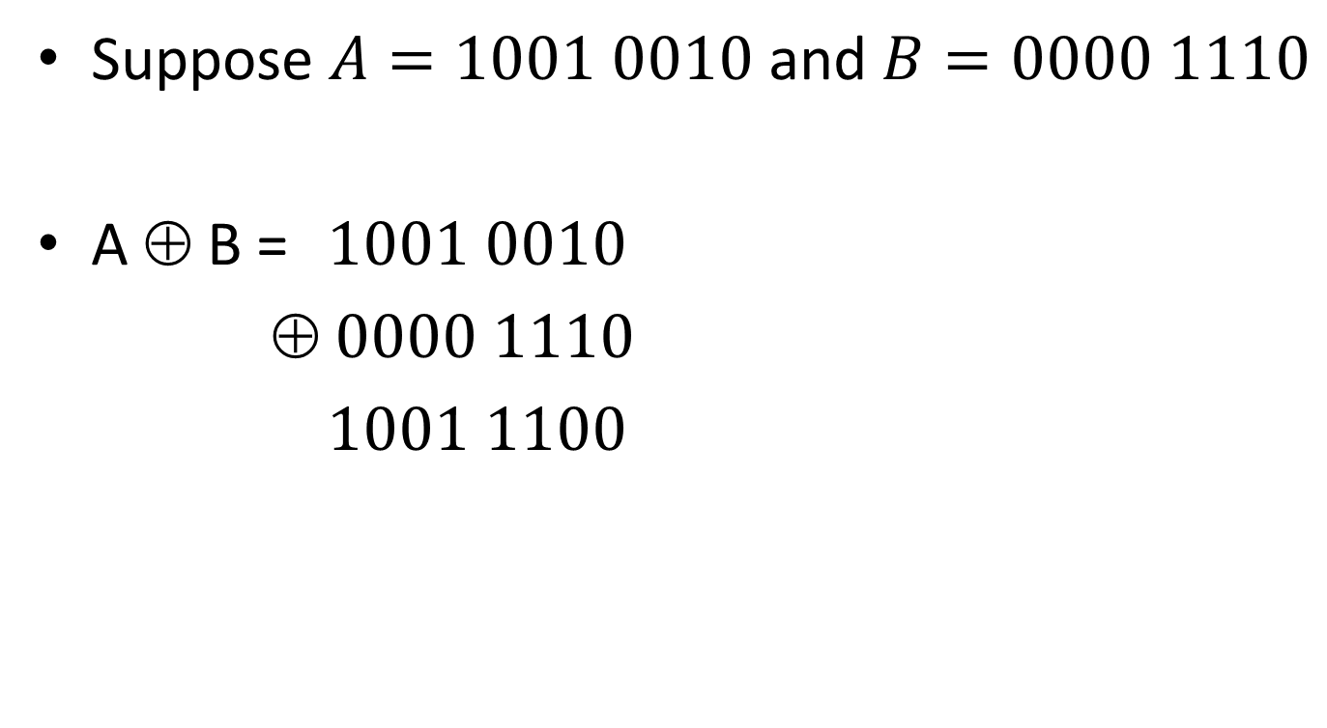
XOR Operation
Suppose $A=1001 0010$ and $B=0000 1110$
A ⊕ B = $1001 0010$
⊕ $0000 1110$
$1001 1100$

Slide 8
Byte-wise shift cipher
M = {strings of bytes}

Slide 9
Byte-wise shift cipher
M = {strings of bytes}
Gen: choose uniform byte k∈K = {0, …, 255}

Slide 10
Byte-wise shift cipher
M = {strings of bytes}
Gen: choose uniform byte k∈K = {0, …, 255}
Enc_{k}(m₁…m_{t}): output c₁…c_{t}, where c_{i} := m_{i} ⊕ k
Dec_{k}(c₁…c_{t}): output m₁…m_{t}, where m_{i} := c_{i} ⊕ k

Slide 11
Example
Say plaintext is “Hi” and key is 1111 0001

Slide 12
Example
Say plaintext is “Hi” and key is 1111 0001
“Hi” = 0x48 69 = 0100 1000 0110 1001

Slide 13
Example
Say plaintext is “Hi” and key is 1111 0001
“Hi” = 0x48 69 = 0100 1000 0110 1001
XOR with “Hi” with the key

Slide 14
Example
Say plaintext is “Hi” and key is 1111 0001
“Hi” = 0x48 69 = 0100 1000 0110 1001
XOR with “Hi” with the key
0100 1000 0110 1001 ⊕
1111 0001 1111 0001

Slide 15
Example
Say plaintext is “Hi” and key is 1111 0001
“Hi” = 0x48 69 = 0100 1000 0110 1001
XOR with “Hi” with the key
0100 1000 0110 1001 ⊕
1111 0001 1111 0001
= 1011 1001 1001 1000

Slide 16
Example
Say plaintext is “Hi” and key is 1111 0001
“Hi” = 0x48 69 = 0100 1000 0110 1001
XOR with “Hi” with the key
0100 1000 0110 1001 ⊕
1111 0001 1111 0001
= 1011 1001 1001 1000=0xB9 98=unprintable

Slide 17
Byte-wise Vigenère cipher
The key is a string of bytes
The plaintext is a string of bytes
To encrypt, XOR each character in the plaintext with the next character of the key
Wrap around in the key as needed
Decryption just reverses the process

Slide 18
Example
Say plaintext is “Hello!” and key is 0xA1 2F

Slide 19
Example
Say plaintext is “Hello!” and key is 0xA1 2F
“Hello!” = 0x48 65 6C 6C 6F 21

Slide 20
Example
Say plaintext is “Hello!” and key is 0xA1 2F
“Hello!” = 0x48 65 6C 6C 6F 21
XOR with 0xA1 2F A1 2F A1 2F

Slide 21
Example
Say plaintext is “Hello!” and key is 0xA1 2F
“Hello!” = 0x48 65 6C 6C 6F 21
XOR with 0xA1 2F A1 2F A1 2F
0x48 ⊕ 0xA1

Slide 22
Example
Say plaintext is “Hello!” and key is 0xA1 2F
“Hello!” = 0x48 65 6C 6C 6F 21
XOR with 0xA1 2F A1 2F A1 2F
0x48 ⊕ 0xA1
0100 1000 ⊕ 1010 0001

Slide 23
Example
Say plaintext is “Hello!” and key is 0xA1 2F
“Hello!” = 0x48 65 6C 6C 6F 21
XOR with 0xA1 2F A1 2F A1 2F
0x48 ⊕ 0xA1
0100 1000 ⊕ 1010 0001 = 1110 1001 = 0xE9

Slide 24
Example
Say plaintext is “Hello!” and key is 0xA1 2F
“Hello!” = 0x48 65 6C 6C 6F 21
XOR with 0xA1 2F A1 2F A1 2F
0x48 ⊕ 0xA1
0100 1000 ⊕ 1010 0001 = 1110 1001 = 0xE9
Ciphertext: 0xE9 4A CD 43 CE 0E

Slide 25
Attacking the (variant) Vigenère cipher
Two steps:
Determine the key length
Determine each byte of the key

Slide 26
Using plaintext letter frequencies

Slide 27
Useful observations
Only 128 valid ASCII chars (128 bytes invalid)
0x20-0x7E printable
0x41-0x7a includes upper/lowercase letters
Uppercase letters begin with 0x4 or 0x5
Lowercase letters begin with 0x6 or 0x7

Slide 28
Determining the key length
Let p_{i} (for 0 ≤ i ≤ 255) be the frequency of byte i in general English text
I.e., p_{i} =0 for i < 32 or i > 127
I.e., p₉₇ = frequency of ‘a’
The distribution is far from uniform

Slide 29
Determining the key length
If the key length is N, then every N^{th} character of the plaintext is encrypted using the same “shift”

Slide 30
Determining the key length
If the key length is N, then every N^{th} character of the plaintext is encrypted using the same “shift”
If we take every N^{th} character and calculate frequencies, we should get the p_{i}’s in permuted order

Slide 31
Determining the key length
If the key length is N, then every N^{th} character of the plaintext is encrypted using the same “shift”
If we take every N^{th} character and calculate frequencies, we should get the p_{i}’s in permuted order
If we take every Mth character (M not a multiple of N) and calculate frequencies, we should get something close to uniform

Slide 32
Determining the key length
Assume length is k
For key length k, tabulate q₀, …, q₂₅₅ and compute Σ q_{i}²

Slide 33
Determining the key length
Assume length is k
For key length k, tabulate q₀, …, q₂₅₅ and compute Σ q_{i}²
If close to uniform, Σ q_{i}² ≈ 256 · (1/256)² = 1/256
If a permutation of p_{i}, then Σ q_{i}² ≈ Σ p_{i}²
Could compute Σ p_{i}² (but somewhat difficult)
Key point: will be much larger than 1/256

Slide 34
Determining the key length
Assume length is k
For key length k, tabulate q₀, …, q₂₅₅ and compute Σ q_{i}²
If close to uniform, Σ q_{i}² ≈ 256 · (1/256)² = 1/256
If a permutation of p_{i}, then Σ q_{i}² ≈ Σ p_{i}²
Could compute Σ p_{i}² (but somewhat difficult)
Key point: will be much larger than 1/256
Compute Σ q_{i}² for each possible key length, and look for maximum value

Slide 35
Determining the i^{th} byte of the key
Assume the key length N is known

Slide 36
Determining the i^{th} byte of the key
Assume the key length N is known
Look at every N^{th} character of the ciphertext, starting with the i^{th} character
Call this the i^{th} ciphertext “stream”
Note that all bytes in this stream were generated by XORing plaintext with the same byte of the key

Slide 37
Determining the i^{th} byte of the key
Assume the key length N is known
Look at every N^{th} character of the ciphertext, starting with the i^{th} character
Call this the i^{th} ciphertext “stream”
Note that all bytes in this stream were generated by XORing plaintext with the same byte of the key
Try decrypting the stream using every possible byte value B
Get a candidate plaintext stream for each value

Slide 38
Determining the i^{th} byte of the key
Could use {p_{i}} as before, but not easy to find

Slide 39
Determining the i^{th} byte of the key
Could use {p_{i}} as before, but not easy to find
When the guess B is correct:
All bytes in the plaintext stream will be between 32 and 127

Slide 40
Determining the i^{th} byte of the key
Could use {p_{i}} as before, but not easy to find
When the guess B is correct:
Frequencies of lowercase letters (as a fraction of all lowercase letters) should be close to known English-letter frequencies
Tabulate observed letter frequencies q’₀, …, q’₂₅ (as fraction of all lowercase letters)
Should find Σ q’_{i} p’_{i} ≈ Σ p’_{i}² ≈ 0.065, where p’_{i} corresponds to English-letter frequencies
In practice, take B that maximizes Σ q’_{i} p’_{i}

Slide 41
Defining secure encryption

Slide 42
Crypto definitions (generally)
Security guarantee/goal
What we want to achieve and/or what we want to prevent the attacker from achieving
Threat model
What (real-world) capabilities the attacker is assumed to have

Slide 43
Recall
A private-key encryption scheme is defined by a message space M and algorithms (Gen, Enc, Dec):
Gen (key-generation algorithm): generates k
Enc (encryption algorithm): takes key k and message m ∈ M as input; outputs ciphertext c c ← Enc_{k}(m)
Dec (decryption algorithm): takes key k and ciphertext c as input; outputs m. m := Dec_{k}(c)

Slide 44

Private-key encryption
key
key
ciphertext
c
k
k
m
c := Enc_{k}(m)
m := Dec_{k}(c)
message/plaintext
decryption
encryption

Slide 45
Threat models for encryption
Ciphertext-only attack - obtain only ciphertext
Known-plaintext attack – obtain ciphertext with some knowledge of the message
Chosen-plaintext attack - obtain encryptions of
chosen messages
Chosen-ciphertext attack – obtain decryptions of chosen ciphertext

Slide 46
Goal of secure encryption?
How would you define what it means for encryption scheme (Gen, Enc, Dec) over message space M to be secure?
Against a (single) ciphertext-only attack

Slide 47
Secure encryption?
“Impossible for the attacker to learn the plaintext from the ciphertext”

Slide 48
Secure encryption?
“Impossible for the attacker to learn the plaintext from the ciphertext”
What if the attacker learns 90% of the plaintext?

Slide 49
Secure encryption?
“Impossible for the attacker to learn any character of the plaintext from the ciphertext”

Slide 50
Secure encryption?
“Impossible for the attacker to learn any character of the plaintext from the ciphertext”
What if the attacker is able to learn (other) partial information about the plaintext?
E.g., salary is greater than $75K

Slide 51
Perfect secrecy
“Regardless of any prior information the attacker has about the plaintext, the ciphertext should leak no additional information about the plaintext”

Slide 52
Example 1
Consider the shift cipher
So for all k ∈ {0, …, 25}, Pr[K = k] = 1/26
Say Pr[M = ‘a’] = 0.7, Pr[M = ‘z’] = 0.3
What is Pr[C = ‘b’] ?
Either M = ‘a’ and K = 1, or M = ‘z’ and K = 2
Pr[C=‘b’] = Pr[M=‘a’]·Pr[K=1] + Pr[M=‘z’] ·Pr[K=2] Pr[C=‘b’] = 0.7 · (1/26) + 0.3 · (1/26) Pr[C=‘b’] = 1/26

Slide 53
Example 2
Consider the shift cipher, and the distribution Pr[M = ‘one’] = ½, Pr[M = ‘ten’] = ½
Pr[C = ‘rqh’] = ?
= Pr[C = ‘rqh’ | M = ‘one’] · Pr[M = ‘one’] + Pr[ C = ‘rqh’ | M = ‘ten’] · Pr[M = ‘ten’]
= 1/26 · ½ + 0 · ½ = 1/52

Slide 54
Example 3
Consider the shift cipher, and the distribution Pr[M = ‘one’] = ½, Pr[M = ‘ten’] = ½
Take m = ‘ten’ and c = ‘rqh’
Pr[M = ‘ten’ | C = ‘rqh’] = ?
= 0
≠ Pr[M = ‘ten’]

Slide 55
Example 4
Shift cipher; Pr[M=‘hi’] = 0.3, Pr[M=‘no’] = 0.2, Pr[M=‘in’]= 0.5
Pr[M = ‘hi’ | C = ‘xy’] = ?
= Pr[C = ‘xy’ | M = ‘hi’] · Pr[M = ‘hi’]/Pr[C = ‘xy’]

Slide 56
Example 4, continued
Pr[C = ‘xy’ | M = ‘hi’] = 1/26
Pr[C = ‘xy’]
= Pr[C = ‘xy’ | M = ‘hi’] · 0.3 + Pr[C = ‘xy’ | M = ‘no’] · 0.2 + Pr[C=‘xy’ | M=‘in’] · 0.5 = (1/26) · 0.3 + (1/26) · 0.2 + 0 · 0.5 = 1/52

Slide 57
Example 4, continued
Pr[M = ‘hi’ | C = ‘xy’] = ?
= Pr[C = ‘xy’ | M = ‘hi’] · Pr[M = ‘hi’]/Pr[C = ‘xy’]
= (1/26) · 0.3/(1/52)
= 0.6
≠ Pr[M = ‘hi’]

Slide 58
Conclusion
The shift cipher is not perfectly secret!
At least not for 2-character messages
How to construct a perfectly secret scheme?

Slide 59
One-time pad
Patented in 1917 by Vernam
Recent historical research indicates it was invented (at least) 35 years earlier
Proven perfectly secret by Shannon (1949)

Slide 60
One-time pad
Let M = {0,1}^{n}
Gen: choose a uniform key k ∈ {0,1}^{n}
Enc_{k}(m) = k ⊕ m
Dec_{k}(c) = k ⊕ c
Correctness: Dec_{k}( Enc_{k}(m) ) = k ⊕ (k ⊕ m) = (k ⊕ k) ⊕ m = m

Slide 61
One-time pad
n bits
key
n bits
n bits
⊕
message
ciphertext

