Slide 1
Cryptography - Day 2
Implementations and Python

Slide 2
Review

Slide 3
Shift cipher

Slide 4
Shift cipher
M = {English word with lower case letters}
Gen: choose uniform k∈K = {0, …, 25}

Slide 5
Shift cipher
M = {English word with lower case letters}
Gen: choose uniform k∈K = {0, …, 25}
Enc_{k}(m₁…m_{t}): output c₁…c_{t}, where c_{i} =[ m_{i} + k mod26]
Dec_{k}(c₁…c_{t}): output m₁…m_{t}, where m_{i} =[ c_{i} - k mod26]

Slide 6
Shift cipher
M = {English word with lower case letters}
Gen: choose uniform k∈K = {0, …, 25}
Enc_{k}(m₁…m_{t}): output c₁…c_{t}, where c_{i} =[ m_{i} + k mod26]
Dec_{k}(c₁…c_{t}): output m₁…m_{t}, where m_{i} =[ c_{i} - k mod26]
Is this cipher secure?

Slide 7
Shift cipher
M = {English word with lower case letters}
Gen: choose uniform k∈K = {0, …, 25}
Enc_{k}(m₁…m_{t}): output c₁…c_{t}, where c_{i} =[ m_{i} + k mod26]
Dec_{k}(c₁…c_{t}): output m₁…m_{t}, where m_{i} =[ c_{i} - k mod26]
Is this cipher secure? No -- only 26 possible keys!

Slide 8
Shift cipher
M = {English word with lower case letters}
Gen: choose uniform k∈K = {0, …, 25}
Enc_{k}(m₁…m_{t}): output c₁…c_{t}, where c_{i} =[ m_{i} + k mod26]
Dec_{k}(c₁…c_{t}): output m₁…m_{t}, where m_{i} =[ c_{i} - k mod26]
Is this cipher secure? No -- only 26 possible keys!
Given a ciphertext, try decrypting with every possible key

Slide 9
Vigenere cipher

Slide 10
Vigenere cipher
M = {English word with lower case letters}
Gen: choose uniform word k=k₁…k_{r} ∈ M

Slide 11
Vigenere cipher
M = {English word with lower case letters}
Gen: choose uniform word k=k₁…k_{r} ∈ M
Enc_{k}(m₁…m_{t}): output c₁…c_{t}, where c_{i} = [m_{i} +k_{j} mod26]
Dec_{k}(c₁…c_{t}): output m₁…m_{t}, where m_{i} = [c_{i} -k_{j} mod26]

Slide 12
Vigenere cipher
M = {English word with lower case letters}
Gen: choose uniform word k=k₁…k_{r} ∈ M
Enc_{k}(m₁…m_{t}): output c₁…c_{t}, where c_{i} = [m_{i} +k_{j} mod26]
Dec_{k}(c₁…c_{t}): output m₁…m_{t}, where m_{i} = [c_{i} -k_{j} mod26]
Is this cipher secure?

Slide 13
Vigenere cipher
M = {English word with lower case letters}
Gen: choose uniform word k=k₁…k_{r} ∈ M
Enc_{k}(m₁…m_{t}): output c₁…c_{t}, where c_{i} = [m_{i} +k_{j} mod26]
Dec_{k}(c₁…c_{t}): output m₁…m_{t}, where m_{i} = [c_{i} -k_{j} mod26]
Is this cipher secure? No – We can find the key length and the shift of each key!

Slide 14
So far…

Slide 15
So far…
“Heuristic” constructions; construct, break, repeat, …

Slide 16
So far…
“Heuristic” constructions; construct, break, repeat, …
Can we prove that some encryption scheme is secure?

Slide 17
So far…
“Heuristic” constructions; construct, break, repeat, …
Can we prove that some encryption scheme is secure?
First need to define what we mean by “secure” in the first place…

Slide 18
Core principles of modern crypto

Slide 19
Core principles of modern crypto
Formal definitions
Precise, mathematical model and definition of what security means

Slide 20
Core principles of modern crypto
Formal definitions
Precise, mathematical model and definition of what security means
Assumptions
Clearly stated and unambiguous

Slide 21
Core principles of modern crypto
Formal definitions
Precise, mathematical model and definition of what security means
Assumptions
Clearly stated and unambiguous
Proofs of security
Move away from design-break-patch

Slide 22
Try Question 1

Slide 23
Quick Python!

Slide 24
First programming assignment
Implement the Vigenère cipher. Then encrypt the message provided online.
Will be posted after class.

Slide 25
Hexidecimal, ASCII, and XOR

Slide 26
Hexadecimal (base 16)
Hex | Bits (“nibble”) | Decimal
0 | 0000 | 0
1 | 0001 | 1
2 | 0010 | 2
3 | 0011 | 3
4 | 0100 | 4
5 | 0101 | 5
6 | 0110 | 6
7 | 0111 | 7
Hex | Bits (“nibble”) | Decimal
8 | 1000 | 8
9 | 1001 | 9
A | 1010 | 10
B | 1011 | 11
C | 1100 | 12
D | 1101 | 13
E | 1110 | 14
F | 1111 | 15

Slide 27
Hexadecimal (base 16)
0x10
0xAF

Slide 28
Hexadecimal (base 16)
0x10
0x10 =
0x10 =
0xAF

Slide 29
Hexadecimal (base 16)
0x10
0x10 = 16*1 + 0
0x10 = 0001 0000
0xAF

Slide 30
Hexadecimal (base 16)
0x10
0x10 = 16*1 + 0 = 16
0x10 = 0001 0000
0xAF

Slide 31
Hexadecimal (base 16)
0x10
0x10 = 16*1 + 0 = 16
0x10 = 0001 0000
0xAF
0xAF =
0xAF =

Slide 32
Hexadecimal (base 16)
0x10
0x10 = 16*1 + 0 = 16
0x10 = 0001 0000
0xAF
0xAF = 16*A + F
0xAF = 1010 1111

Slide 33
Hexadecimal (base 16)
0x10
0x10 = 16*1 + 0 = 16
0x10 = 0001 0000
0xAF
0xAF = 16*A + F = 16*10 + 15 = 175
0xAF = 1010 1111

Slide 34
ASCII
Characters (often) represented in ASCII
1 byte/char = 2 hex digits/char

Slide 35
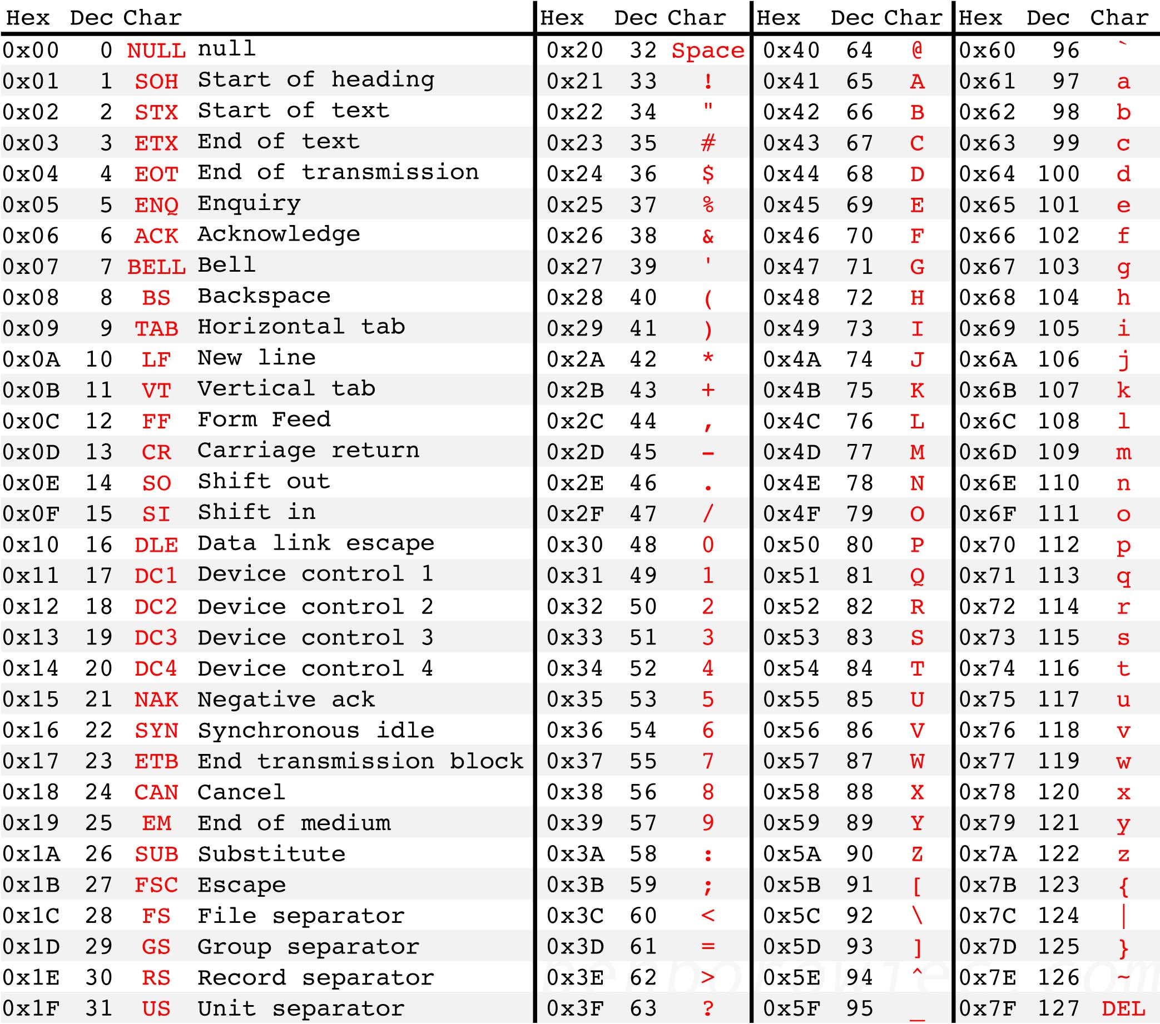
Source: http://benborowiec.com/2011/07/23/better-ascii-table/

Slide 36
ASCII
‘1’ = 0x31

Slide 37
ASCII
‘1’ = 0x31 = 0011 0001

Slide 38
ASCII
‘1’ = 0x31 = 0011 0001
‘F’ = 0x46

Slide 39
ASCII
‘1’ = 0x31 = 0011 0001
‘F’ = 0x46 = 0100 0110

Slide 40
ASCII
‘1’ = 0x31 = 0011 0001
‘F’ = 0x46 = 0100 0110
Note that writing 0x00 to a file is different from writing “0x00” to a file

Slide 41
ASCII
‘1’ = 0x31 = 0011 0001
‘F’ = 0x46 = 0100 0110
Note that writing 0x00 to a file is different from writing “0x00” to a file
0x00 = 0000 0000 (1 byte)
“0x00” = 0x30 78 30 30 = 0011 0000 0111 1000… (4 bytes)

Slide 42
Day 2 - Worksheet
Try Question 2 and Question 3 from the worksheet

Slide 43
Useful observations
Only 128 valid ASCII chars (128 bytes invalid)
0x20-0x7E printable
0x41-0x7a includes upper/lowercase letters
Uppercase letters begin with 0x4 or 0x5
Lowercase letters begin with 0x6 or 0x7

Slide 44
XOR Operation
XOR is a binary "exclusive or” operation that is represented by ⊕
XOR is true if and only if the arguments differ
Example: Evaluate the following.
0100 1011 ⊕ 1010 0001
0100 1000 ⊕ 0100 1000

Slide 45
Property of XOR
Lemma. Suppose that b and b’ are binary numbers such that b = b’. Then b ⊕ b’ = e where e is the binary representation of zero.

Slide 46
Byte-wise shift cipher
Work with an alphabet of bytes rather than (English, lowercase) letters
Works natively for arbitrary data!
Use XOR instead of modular addition
Essential properties still hold

Slide 47
Byte-wise shift cipher
M = {strings of bytes}
Gen: choose uniform byte k∈K = {0, …, 255}
Enc_{k}(m₁…m_{t}): output c₁…c_{t}, where c_{i} := m_{i} ⊕ k
Dec_{k}(c₁…c_{t}): output m₁…m_{t}, where m_{i} := c_{i} ⊕ k

Slide 48
Example

Slide 49
Example
Say plaintext is “Hi” and key is
1010 0001 1111 0001

Slide 50
Example
Say plaintext is “Hi” and key is
1010 0001 1111 0001
“Hi” = 0x48 69 = 0100 1000 0110 1001

Slide 51
Example
Say plaintext is “Hi” and key is
1010 0001 1111 0001
“Hi” = 0x48 69 = 0100 1000 0110 1001
XOR with “Hi” with the key

Slide 52
Example
Say plaintext is “Hi” and key is
1010 0001 1111 0001
“Hi” = 0x48 69 = 0100 1000 0110 1001
XOR with “Hi” with the key
0100 1000 0110 1001 ⊕
1010 0001 1111 0001

Slide 53
Example
Say plaintext is “Hi” and key is
1010 0001 1111 0001
“Hi” = 0x48 69 = 0100 1000 0110 1001
XOR with “Hi” with the key
0100 1000 0110 1001 ⊕
1010 0001 1111 0001
= 1110 1001 1001 1000

Slide 54
Example
Say plaintext is “Hi” and key is
1010 0001 1111 0001

Slide 55
Example
Say plaintext is “Hi” and key is
1010 0001 1111 0001
Ciphertext: 1110 1001 1001 1000

Slide 56
Example
Say plaintext is “Hi” and key is
1010 0001 1111 0001
Ciphertext: 1110 1001 1001 1000 = 0xE9 98

Slide 57
Byte-wise Vigenère cipher
The key is a string of bytes
The plaintext is a string of bytes
To encrypt, XOR each character in the plaintext with the next character of the key
Wrap around in the key as needed
Decryption just reverses the process

Slide 58
Example
Say plaintext is “Hello!” and key is 0xA1 2F

Slide 59
Example
Say plaintext is “Hello!” and key is 0xA1 2F
“Hello!” = 0x48 65 6C 6C 6F 21
XOR with 0xA1 2F A1 2F A1 2F

Slide 60
Example
Say plaintext is “Hello!” and key is 0xA1 2F
“Hello!” = 0x48 65 6C 6C 6F 21
XOR with 0xA1 2F A1 2F A1 2F
0x48 ⊕ 0xA1
0100 1000 ⊕ 1010 0001

Slide 61
Example
Say plaintext is “Hello!” and key is 0xA1 2F
“Hello!” = 0x48 65 6C 6C 6F 21
XOR with 0xA1 2F A1 2F A1 2F
0x48 ⊕ 0xA1
0100 1000 ⊕ 1010 0001 = 1110 1001

Slide 62
Example
Say plaintext is “Hello!” and key is 0xA1 2F
“Hello!” = 0x48 65 6C 6C 6F 21
XOR with 0xA1 2F A1 2F A1 2F
0x48 ⊕ 0xA1
0100 1000 ⊕ 1010 0001 = 1110 1001 = 0xE9

Slide 63
Example
Say plaintext is “Hello!” and key is 0xA1 2F
“Hello!” = 0x48 65 6C 6C 6F 21
XOR with 0xA1 2F A1 2F A1 2F
0x48 ⊕ 0xA1
0100 1000 ⊕ 1010 0001 = 1110 1001 = 0xE9
Ciphertext: 0xE9 4A CD 43 CE 0E

Slide 64
Attacking the (variant) Vigenère cipher
Two steps:
Determine the key length
Determine each byte of the key
Same principles as before…

Slide 65
Using plaintext letter frequencies

Slide 66
Determining the key length
Let p_{i} (for 0 ≤ i ≤ 255) be the frequency of byte i in general English text
I.e., p_{i} =0 for i < 32 or i > 127
I.e., p₉₇ = frequency of ‘a’
The distribution is far from uniform

Slide 67
Determining the key length
If the key length is N, then every N^{th} character of the plaintext is encrypted using the same “shift”
If we take every N^{th} character and calculate frequencies, we should get the p_{i}’s in permuted order
If we take every Mth character (M not a multiple of N) and calculate frequencies, we should get something close to uniform

Slide 68
Determining the key length
How to distinguish these two?
For some candidate key length, tabulate q₀, …, q₂₅₅ and compute Σ q_{i}²
If close to uniform, Σ q_{i}² ≈ 256 · (1/256)² = 1/256
If a permutation of p_{i}, then Σ q_{i}² ≈ Σ p_{i}²
Could compute Σ p_{i}² (but somewhat difficult)
Key point: will be much larger than 1/256
Compute Σ q_{i}² for each possible key length, and look for maximum value
Correct key length should yield a large value for every stream

Slide 69
Determining the i^{th} byte of the key
Assume the key length N is known
Look at every N^{th} character of the ciphertext, starting with the i^{th} character
Call this the i^{th} ciphertext “stream”
Note that all bytes in this stream were generated by XORing plaintext with the same byte of the key
Try decrypting the stream using every possible byte value B
Get a candidate plaintext stream for each value

Slide 70
Determining the i^{th} byte of the key
Could use {p_{i}} as before, but not easy to find
When the guess B is correct:
All bytes in the plaintext stream will be between 32 and 127
Frequencies of lowercase letters (as a fraction of all lowercase letters) should be close to known English-letter frequencies
Tabulate observed letter frequencies q’₀, …, q’₂₅ (as fraction of all lowercase letters)
Should find Σ q’_{i} p’_{i} ≈ Σ p’_{i}² ≈ 0.065, where p’_{i} corresponds to English-letter frequencies
In practice, take B that maximizes Σ q’_{i} p’_{i}

