Slide 1
Lecture 2
MATH1401
Fall 2021
Cause and Effect
Notes:
We will introduce some of the fundamental concepts involved in establishing cause and effect also known as causality.
One key in establishing a causal relationship will be Observation.
Let’s look at a few examples first

Slide 2
Announcements

Slide 3
Text Book – Chp 2 and Keywords
Individuals
Treatment
Outcome
Observational study
Association
Causality
Comparison
Treatment group
Control group
Confounding variable

Slide 4
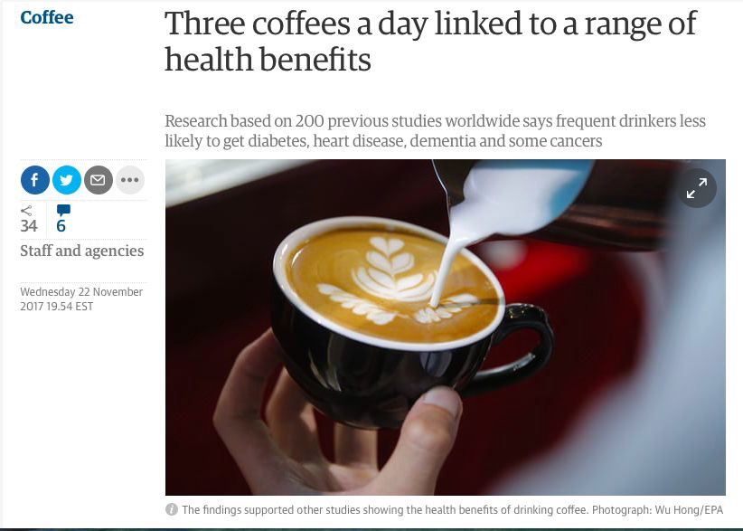
A Link
Guardian UK
Notes:
example of a study that links drinking coffee to numerous health benefits.
Such as less lower rates of heart disuease and dementia
We all see these types of articles online: which states positive benefits of some activity.

Slide 5

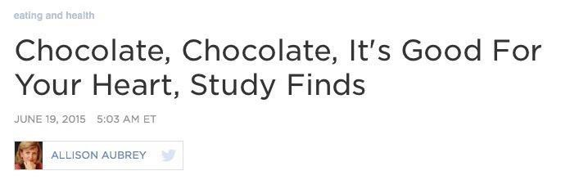
A Stronger Link?
npr.org (report on a study in heart.bmj.com)
Notes:
Another example here: shows a link between chocalte and heart health.
It tells us that chocalte is good for the hear.
In both of these articles we are trying to draw a conclusion about the world.

Slide 6
Observation
Notes:
In both examples we make an observation about indiviuals.

Slide 7
Observation
individuals, study subjects, participants, units
European adults
Notes:
These indiviuals may be people, groups of people, and even cars or countries
In the chocolate example: European adults are our indiviudals
Again its okay to think indiviuals are people but they may be more general then that
For example they could states of the usa in an experiment determining if the death penalty deters indiviuals

Slide 8
Observation
individuals, study subjects, participants, units
European adults
treatment
chocolate consumption
Notes:
Some treatment was applied to the indivuals
Again in our chocolate example the treatment is the adults eating chocolate.

Slide 9
Observation
individuals, study subjects, participants, units
European adults
treatment
chocolate consumption
outcome
heart disease
Notes:
Then we look at the outcome of the treatment
This is the effect we are wondering about.
For the chocolate study this is whether an indicual got heart disease or not.
The fundamental question we are asking is whether the treatment has an effect on the outcome

Slide 10
The first question
Is there any relation between chocolate consumption and heart disease?
association
any relation
link
Notes:
1. The first question to determine whether there is a cause and effect is:
2. Is there any relationship between the treatment and the outcome?
3.So in the chocolate study we ask is there any relation between chocolate consumption and heart disease
4. The word we use for this in statistics is association.
5. Association hust means a relationship of any kind.
6. Please note an association does not imply causation!

Slide 11
An answer
Some data:
Notes:
The newspaper claims yes. But if you look into here is the data.

Slide 12
An answer
Some data:
“Among those in the top tier of chocolate consumption, 12 percent developed or died of cardiovascular disease during the study, compared to 17.4 percent of those who didn’t eat chocolate.”
- Howard LeWine of Harvard Health Blog, reported by npr.org
Notes:
The data was looking at cardiovascular disease among particpantes
The groups of the particapents where based on chocolate consumption
They measured the rate of heart disease in each group.
Thos in the top tier devlopved more heart disease 12 percent while those that didn’t
Eat chocolate developed 17.4 percent.
So fewer chocolates gave rise to a higher percentage of heart disease.

Slide 13
An answer
Some data:
“Among those in the top tier of chocolate consumption, 12 percent developed or died of cardiovascular disease during the study, compared to 17.4 percent of those who didn’t eat chocolate.”
- Howard LeWine of Harvard Health Blog, reported by npr.org
Does this point to an association?
Notes:
is there an association between chocolate consumption and heart disease?
Yes there is an association between chocolate consumption and heart disease.
But we have not shown that heart disease is lessen by chocolate consumption!
The word we use in statistics for a cause and effect relationship is causal

Slide 14
The next question
Does chocolate consumption lead to a reduction in heart disease?
causality
This question is often harder to answer.
Notes:
The next question: Is it causal
Does chocolate consumption lead to less heart disease?
This is a much harder question to answer.
In this example the data we are given does not allow us to establish causality
You may have heard of the phrase: correlation does not imply causation
What this means is that the existence of a association does not prove there is a causal relationship

Slide 15
The next question
Does chocolate consumption lead to a reduction in heart disease?
causality
This question is often harder to answer.
“[The study] doesn’t prove a cause-and-effect relationship between chocolate and reduced risk of heart disease and stroke.”
- JoAnn Manson, chief of Preventive Medicine at Brigham and Women’s Hospital, Boston
Notes:
In this study, we have not proved causality but we may hypothesize that this is in fact true.

Slide 16
Association
Notes:
So lets talk a little more about association

Slide 17
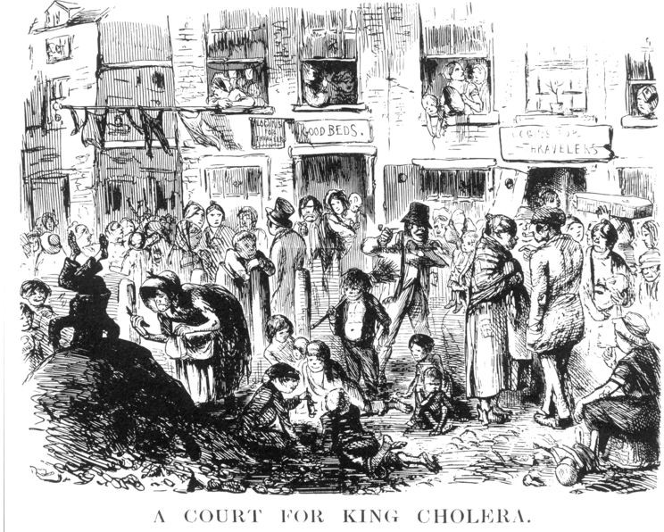
London, early 1850’s
Illustration from Punch
(1852).
Notes:
Lets discuss how we can establish causation from association.
2. The establishment of causality has on two steps : first an association is established and then a more careful analysis leads to a descion on causality
3. Think of causality as an extremely strong association.
4. One great example of an observation that was established to be causal relationship comes from 150 years ago in London.
5. London was one of the wealthiest cities but there where plenty of people impoverished.
6. In particular disease effected the pooer parts of the city called Cholera

Slide 18
Miasmas, miasmatism, miasmatists
Bad smells given off by waste and rotting matter
Believed to be the main source of disease
Notes:
At the time it was the theory of germs was not known
So they where trying to determine the cause of this disease.
The cause of disease was though to be miasmas.
The defining characteristic of miasmas was their rotton smell
These bad smell arising was though to arise from decaying matter.
This is close to reality. But not quite
There is a relation between unsanitary living and bad smells
But there is only an association.

Slide 19
Miasmas, miasmatism, miasmatists
Bad smells given off by waste and rotting matter
Believed to be the main source of disease
Suggested remedies:
“fly to clene air”
“a pocket full o’posies”
“fire off barrels of gunpowder”
Notes:
But London at the time was a smelly city at the time but to protect themselves people who could afford it held sweet smeeling things to their noses.
This is where some of the lines “a ocket full o’posies
11. Maisams was the leading belief by many respected Londoners

Slide 20
Miasmas, miasmatism, miasmatists
Bad smells given off by waste and rotting matter
Believed to be the main source of disease
Suggested remedies:
“fly to clene air”
“a pocket full o’posies”
“fire off barrels of gunpowder”
Staunch believers:
Florence Nightingale (founder of modern nursing)
Edwin Chadwick (Commissioner of the General Board of Health)
Notes:
12 Such as Florence nightingale is the the founder of modern nursing and she went around and cleaned meticuluouls the hosiptals she worked at.
13. Since badd smells was thought to cause the sickness.
14. It worked but for different reasons!

Slide 21
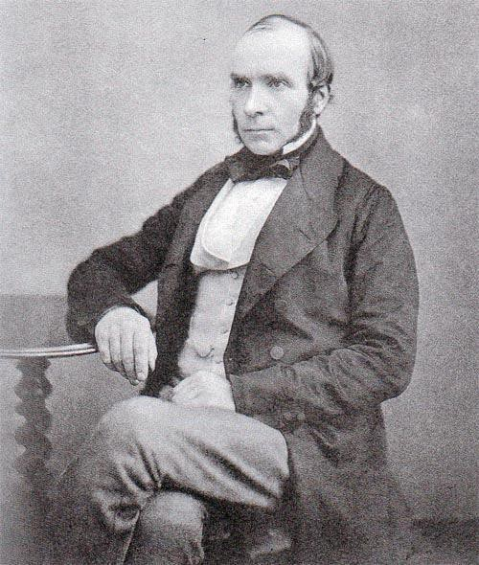
John Snow, 1813-1858
Notes:
However there was a anesthesilogist that did not believe this theory
This was John snow who is a modern hero to morden public health.
John Snow was skeptical of the miasma theory as he noticed that entire house holds could be wipted out by cholera while the neighbores where complete unaffected.
Cholera was a disease that could kill within a day of contracting it and could effect tens of thouasands.
For several years, Doctor John Snow had been following Waves of cholera that hit England time to time.
He gathered data and then he did something we do today.
He made a visualization of the data
8. to help him try to understand what might be going on and to try to identify some
possible patterns or some possible explanations. So

Slide 22
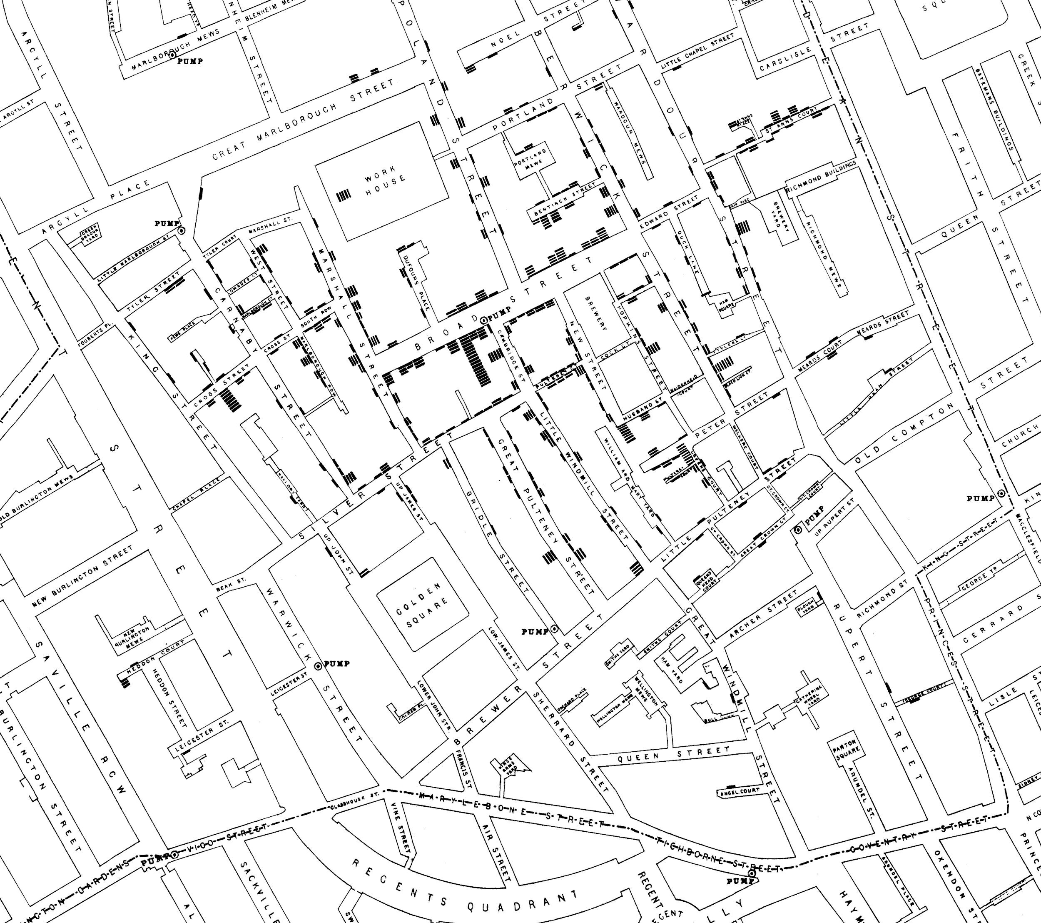
Notes:
this is a map of an area where there was a cholera outbreak
this is a map of an area where there was a cholera outbreak
3. he went and um talked to everyone in the neighborhood and he gathered data
4. on the deaths and he made a visualization of all the
deaths.
5. each one of these little bars these little rectangles represent someone who died. Okay so like over here you can see two
6. But Dr. Snow has noticed that the onset of cholear involved vomiting and diarrhea. He believe that the infection was caused by food or drink in particular contaminanted water
He studied the map carefully and was able to determine the deaths occurred near the broad street pump.

Slide 23
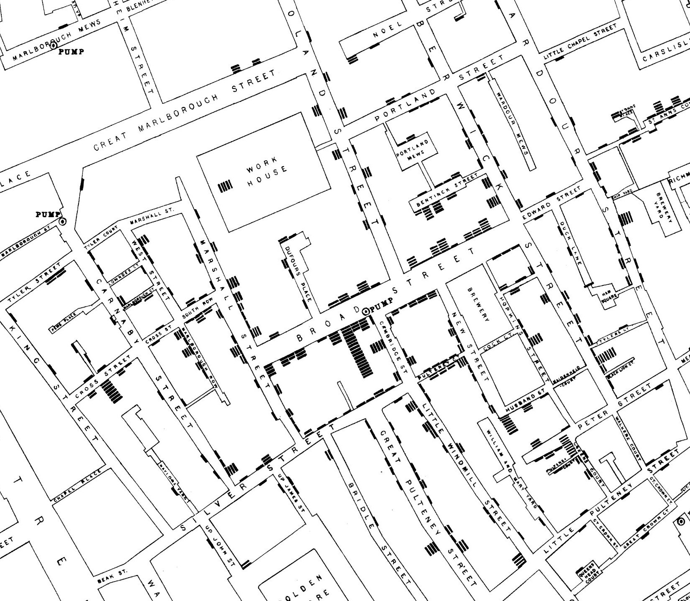
Notes:
There are various observations he made:
There where deaths nearer the Rupert street pump than the broad street pump. the residents of Rupert stree used the broad street pump because it was more convient to get too.
Another observation was that the lion breweywas ner by. But the workers drank what they brewed. If they wanted watr, brewey had its owne well.
Later is was discovered that a cesspit that was a few feet wawy had been leaking into the well , thus the pumps water was contaminated by sewage.
Snow conviced the Authorities to rmove th Broad Stret pump handle, and by doing so prevented many deaths from future waves of the disease.
Though Snow made a relation that cleanliness of water supply, affected populations from catching cholera.
His method was an example of comparison. 25. Scientist use comparions to identify an association between a treatment an outcome.
They compare the outcomes of a group of indiviuals who got the treatment wot the outcomes of the group who did not.
IF the results are different then this evidence for an association. More is needed to determine casusation

Slide 24
Causation
Notes:
1. Lets talk further about causeation

Slide 25
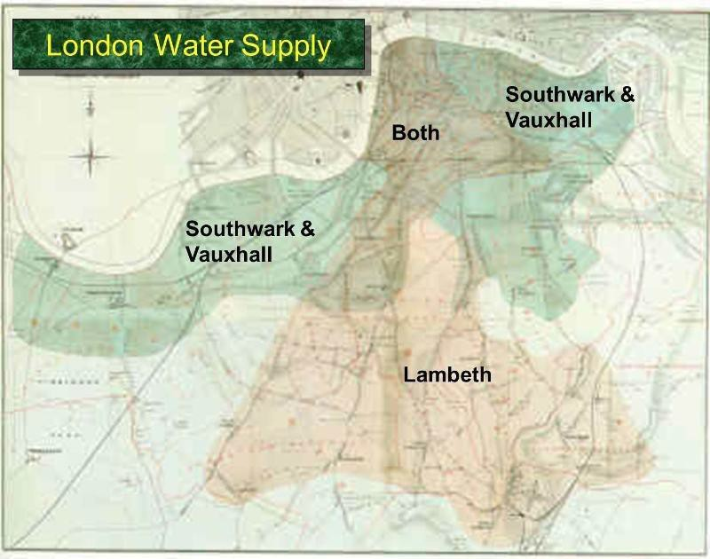
Notes:
Snow continued his analsus.
He gathered data on cholear deaths in an aeera of London that was provided by 2 water companies
The Lambeth Water company drew its water upriver from sewage
While Southwark and VauxHall drew its water below the seawage discharge
There was no systematics difference between the people who were supplied by S&V and thous supploed by Lambeth
The only difference was the water quality.

Slide 26
Comparison
treatment group
control group
does not receive the treatment
Notes:
In this experiment people supplied by Southwark and Vaux are the treatment group while thoue in the Lambeth houses are the control group.
Again both sets of people were comparable to each other.
The difference between these groups were water supply.
If the two groups had a difference such as one had a large population of fatory workers this would have been a proble
But the fact that both groups are comparable is the brillian observation.
if the treatment and control groups differ in ways other than treatment, it is difficult to make conclusions about causality.
A difference between the two groups is called a confounding factor, since it can cause errors when reaching for conclusions.
There was no systematics difference between the people who were supplied by S&V and thous supploed by Lambeth

Slide 27
Snow’s table
Supply Area | Number of houses | Cholera deaths | Deaths per 10,000 houses
S&V | 40,046 | 1,263 | 315
Lambeth | 26,107 | 98 | 37
Rest of London | 256,423 | 1,422 | 59
Notes:
this and let's just look whether there's an association for now.
let's figure out how we would look at. Well you might start by
3. looking at the number of cholera deaths in
S&V.
4. There's way more cholera deaths with S&V than with Lambeth.
5. A lot more deaths but that isn't really a fair comparison because S&V also has
more customers.
6. So to make it a fair comparison what we really need to do is the number of deaths
um divided by the number of customers in some sense
number of deaths per 10 000 houses let's say, and so that's why we have this last
column. If we look at the last column, then we see that
the number of deaths per customer is about almost 10 times higher for
S&V customers than for Lambeth customers.
Okay so um that clearly shows a higher rate of cholera death among S&V
customers so that indicates there's an association.
So we've answered the first question is there association yes there's a link.
There's some relationship.

Slide 28
Key to establishing causality
If the treatment and control groups are similar apart from the treatment, then differences between the outcomes in the two groups can be ascribed to the treatment.
Notes:
So now how do we go from association
to causality in this case.
the only difference between the treatment and the control group
between S&V and the Lambeth customers was whether they got dirty or
clean water.
So that's the only thing that could
possibly explain this difference in outcome.
Um in particular John Snow concluded that the dirty water must be causing
higher cholera deaths.
It since he was lucky there was no difference between the groups. Basically
To establish casualty we must logically remove all other causes. Which is difficult!

Slide 29
Confounding
Notes:
Lets talk about an issue with establishing causality
Cofounding errors

Slide 30
Trouble
If the treatment and control groups have systematic differences other than the treatment, then it might be difficult to identify causality.
Notes:
We may have a deifferencee between out groups that effect the out come after treatment is applied.
This may create problems in identifiny causality. This would be a confounding error
3. Confounding because it confounds us it's like ah I can't tell what's going on.
Counfoundingfactors can appear in observational studies.
So an observational study is where um
passive observational stance on the part of the
5.experimenter where the experimenter is not um is not intervening in any way
Um whenever you have an observational study,
4.these differences are often present. 6. An example of a condounding factor that could have occurred in jon snows study is economic difference.
It just so happens that this was not an issue

Slide 31
Trouble
If the treatment and control groups have systematic differences other than the treatment, then it might be difficult to identify causality.
Such differences are often present in observational studies.
When they lead researchers astray, they are called confounding factors.
Notes:
We may have a deifferencee between out groups that effect the out come after treatment is applied.
This may create problems in identifiny causality. This would be a confounding error
3. Confounding because it confounds us it's like ah I can't tell what's going on.
Counfoundingfactors can appear in observational studies.
So an observational study is where um
passive observational stance on the part of the
5.experimenter where the experimenter is not um is not intervening in any way
Um whenever you have an observational study,
4.these differences are often present. 6. An example of a condounding factor that could have occurred in jon snows study is economic difference.
It just so happens that this was not an issue

Slide 32
Randomize!
If you assign individuals to treatment and control at random, then the two groups are likely to be similar apart from the treatment.
Notes:
Awhy to deal with confounding issues is by assignin indiviuals to treatment and control group and random then adminstir the treatment to those who are assigned to the treatment group.
Randomization keeps the groups similar apart from the treatment

Slide 33
Careful ...
Regardless of what the dictionary says, in probability theory
Random ≠ Haphazard
Notes:
But Randomizaiton has 2 important consequences!
It allows us to for the possibility to make the treatment group and control group similar to each other.
It also allows us to disthinguish the differences between the control and treatment groups.
For now remember this: To establish causality, run a randomized controlled experiment
And if you are conduction a observational study. Its possible to establish assocaiton but it is harder to establish causation!

Slide 34
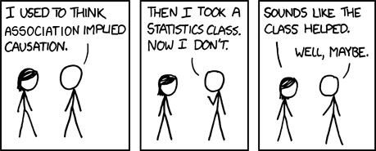
Credit: xkcd

