Slide 1
Arrays

Slide 2
Arrays
An array contains a sequence of values
All elements of an array should have the same type
Arithmetic is applied to each element individually
Adding arrays adds elements (if same length!)
A column of a table is an array
(Demo)

Slide 3
Ranges
A range is an array of consecutive numbers
np.arange(end):
An array of increasing integers from 0 up to end
np.arange(start, end):
An array of increasing integers from start up to end
np.arange(start, end, step):
A range with step between consecutive values
The range always includes start but excludes end

Slide 4
Ways to create a table
Table.read_table(filename) - reads a table from a spreadsheet
Table() - an empty table
and… select, where, sort and so on all create new tables

Slide 5
Example

Slide 6
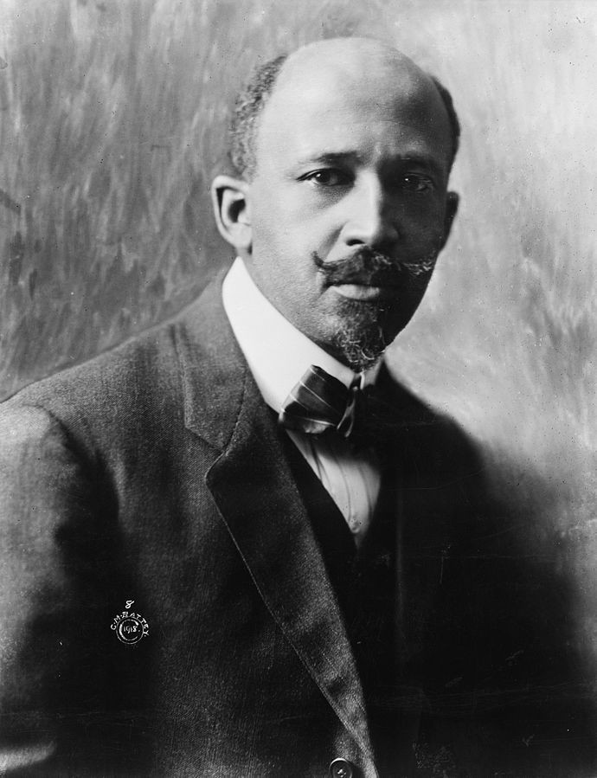
W. E. B. Du Bois, 1868-1963
Scholar, historian, activist, and data scientist
NAACP founder
Made a series of visualizations for the 1900 Paris Exposition
Goal: change the way people see Black Americans
Hundreds of photographs and patents
60+ handmade graphs in 3 months

Slide 7
(Demo)

Slide 8
Discussion Question
Use the table functions we learned this week to find the income bracket (“class”) that spent the highest percentage of their income on rent.

Slide 9
Table Methods
Creating and extending tables:
Table().with_column and Table.read_table
Finding the size: num_rows and num_columns
Referring to columns: labels, relabeling, and indices
labels and relabeled; column indices start at 0
Accessing data in a column
column takes a label or index and returns an array
Using array methods to work with data in columns
item, sum, min, max, and so on
Creating new tables containing some of the original columns:
select, drop
(Demo)

Slide 10
Another famous visualization

Slide 11
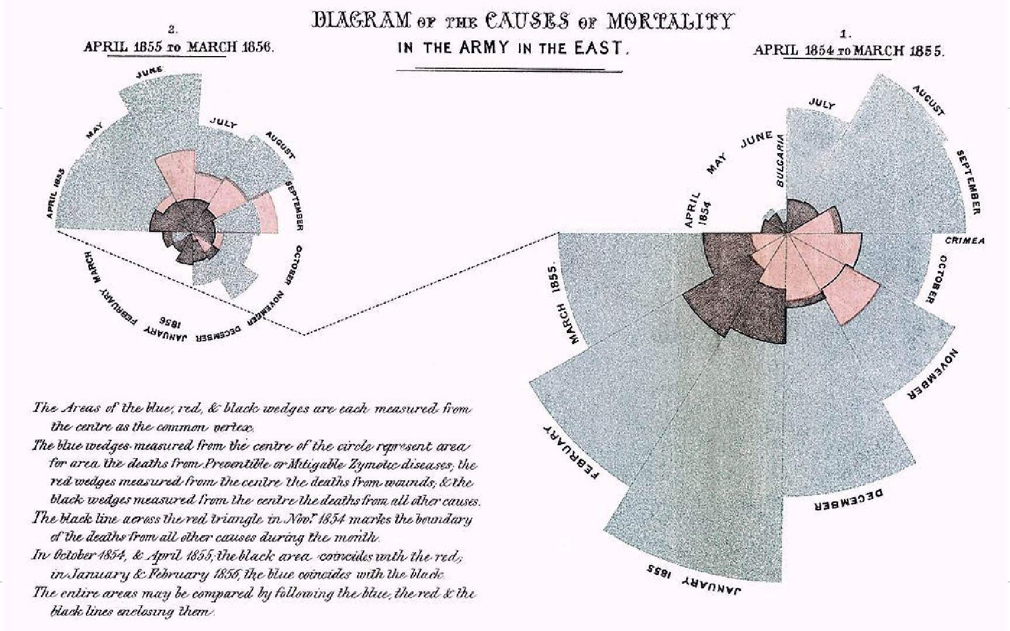
Manipulating Rows
● t.sort(column) sorts the rows in increasing order
● t.take(row_numbers) keeps the numbered rows
○ Each row has an index, starting at 0
● t.where(column, are.condition) keeps all rows for which a column's value satisfies a condition
● t.where(column, value) keeps all rows containing a certain value in a column
1858

Slide 12
Bonus Example

Slide 13
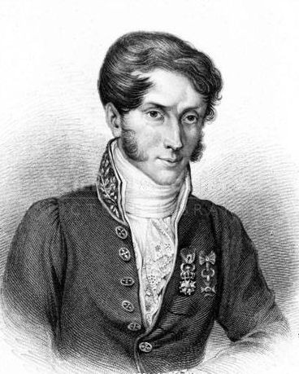
Charles Joseph Minard, 1781-1870
French civil engineer who created one of the greatest graphs of all time
Visualized Napoleon's 1812 invasion of Russia, including
the number of soldiers
the direction of the march
latitude and longitude
temperature on the return journey
dates in November and December

Slide 14
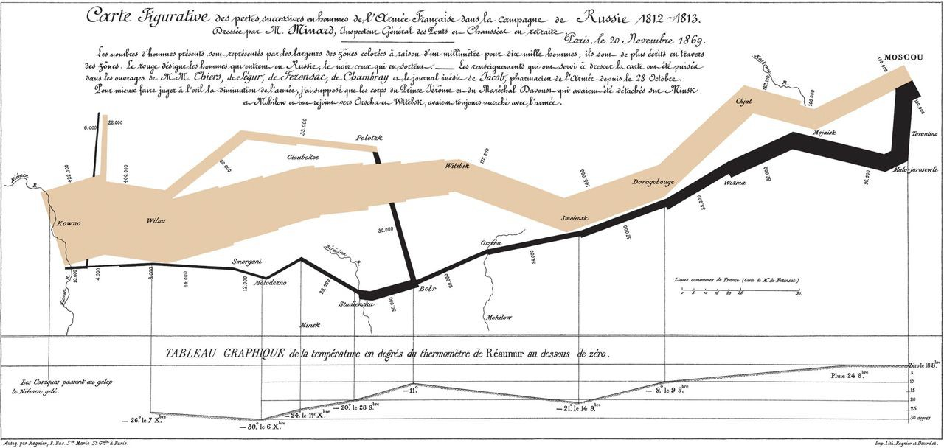

Slide 15
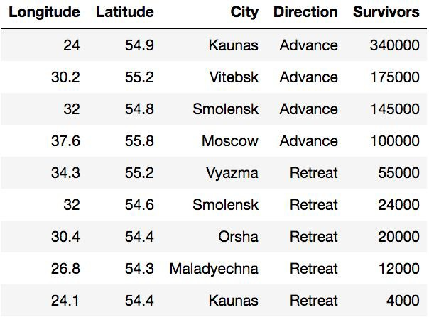
Some of Minard’s Data
(Demo)

Slide 16
Discussion Question
Use the table functions we learned this week to find the southernmost city along the army’s retreat.

