Slide 1
Table Review

Slide 2
Manipulating Rows
t.sort(column) sorts the rows in increasing order
t.sort(column, descending=True)sorts the rows in decreasing order
t.take(row_numbers) keeps the numbered rows
Each row has an index, starting at 0
t.where(column, are.condition) keeps all rows for which a column's value satisfies a condition
t.where(column, value) keeps all rows
for which a column's value equals some particular value
Same as t.where(column, are.equal_to(value))

Slide 3
Census Data

Slide 4
The Decennial Census
Every ten years, the Census Bureau counts how many people there are in the U.S.
In between censuses, the Bureau estimates how many people there are each year.
Article 1, Section 2 of the Constitution:
“Representatives and direct Taxes shall be apportioned among the several States … according to their respective Numbers …”

Slide 5
Census Table Description
Values have column-dependent interpretations
The SEX column: 1 is Male, 2 is Female
The POPESTIMATE2010 column: 7/1/2010 estimate
In this table, some rows are sums of other rows
The SEX column: 0 is Total (of Male + Female)
The AGE column: 999 is Total of all ages
Numeric codes are often used for storage efficiency
Values in a column have the same type, but are not necessarily comparable (AGE 12 vs AGE 999)
http://www2.census.gov/programs-surveys/popest/datasets/2010-2015/national/asrh/nc-est2015-agesex-res.pdf

Slide 6
Analyzing Census Data
Leads to the discovery of interesting features and trends in the population
(Demo)

Slide 7
Numerical Data

Slide 8

Anthony Daniels, actor
https://en.wikipedia.org/wiki/C-3PO

Slide 9
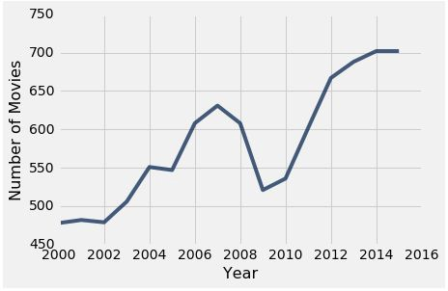
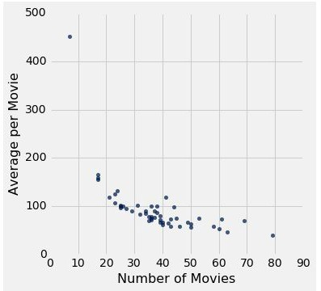
Plotting Two Numerical Variables
Line graph: plot
Scatter plot : scatter
(Demo)

Slide 10
When to use a line vs scatter plot?
Use line plots for sequential data: if...
...your x-axis has an order
...sequential differences in y values are meaningful
...there’s only one y-value for each x-value
Usually: x-axis is time or distance
Use scatter plots for non-sequential data
When you’re looking for associations

Slide 11
Categorical Data
(Demo)

Slide 12
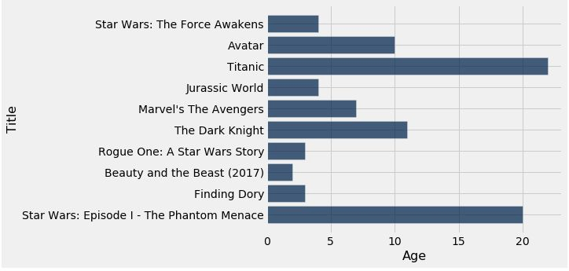
How Do You Generate This Chart?
Top 10 highest grossing movies
Number of years since release

