Slide 1
Charts (Followup)

Slide 2
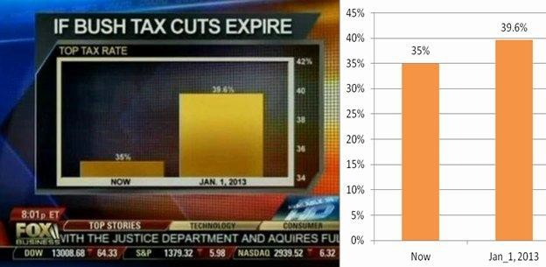
Importance of the Y-Axis

Slide 3
Distributions!

Slide 4
Terminology
Individuals: those whose features are recorded
Variable: a feature, an attribute
A variable has different values
Values can be numerical or categorical, and of many sub-types within these
Each individual has exactly one value of the variable
Distribution: For each different value of the variable, the frequency of individuals that have that value

Slide 5
Distributions of Categorical Variables
(Demo)

Slide 6
Visualization
Bar charts are commonly used to visualize categorical distributions
One axis is categorical, one numerical
(Demo)

Slide 7
Displaying a Categorical Distribution
The distribution of a variable (a column, e.g. Studios) describes the frequencies of its different values
The group method counts the number of rows for each
value in the column (e.g. the number of top movies released by each studio)
Bar charts can display the distribution of a categorical
variable (e.g. studios):
One bar for each category
Length of bar is the count of individuals in that category
You can choose the order of the bars

Slide 8
Distributions of Numerical Variables

Slide 9
Binning Numerical Values
Binning is counting the number of numerical values that lie within ranges, called bins.
Bins are defined by their lower bounds (inclusive)
The upper bound is the lower bound of the next bin
188, 170, 189, 163, 183, 171, 185, 168, 173, ...
The [185,190) bin
160
165
170
175
180
185
190
(Demo)

Slide 10
Area Principle

Slide 11
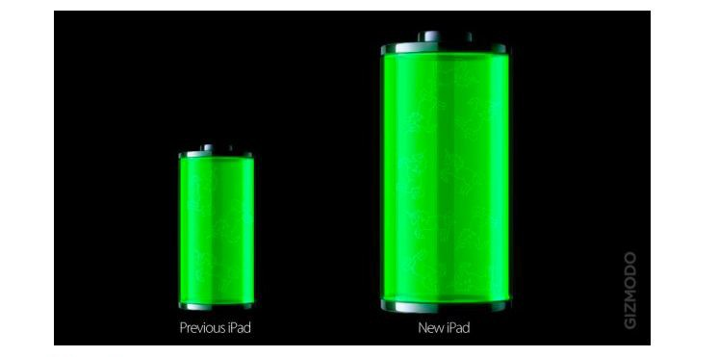
What Is Wrong With This Picture?
Caption: The new iPad battery is 100% bigger than the previous iPad.
Source

Slide 12
Area Principle
Areas should be proportional to the values they represent.
For example
If you represent 20% of a population by
Then 40% can be represented by:
But not by:

Slide 13
Drawing Histograms

Slide 14
Histogram
Chart that displays the distribution of a numerical variable
Uses bins; there is one bar corresponding to each bin
Uses the area principle:
The area of each bar is the percent of individuals in the corresponding bin
(Demo)

Slide 15
Density

Slide 16
Histogram Axes
By default, hist uses a scale (normed=True) that ensures the area of the chart sums to 100%
The area of each bar is a percentage of the whole
The horizontal axis is a number line (e.g., years), and the bins sizes don’t have to be equal to each other
The vertical axis is a rate (e.g., percent per year)
(Demo)

Slide 17
How to Calculate Height
The [40, 65) bin contains 51 out of 200 movies
“52 out of 200” is 25.5%
The bin is 65 - 40 = 25 years wide
25.5 percent
Height of bar =
25 years
= 1.02 percent per year

Slide 18
Height Measures Density
% in bin
---------------------
width of bin
Height =
The height measures the percent of data in the bin
relative to the amount of space in the bin.
Height measures crowdedness, or density.
Units: percent per unit on the horizontal axis

Slide 19
Area Measures Percent
Area of bar = % in bin = Height x width of bin
“How many individuals in the bin?” Use area.
“How crowded is the bin?” Use height.

Slide 20
Bar Chart or Histogram?
To display a distribution:
Bar Chart
Distribution of categorical variable
Bars have arbitrary (but equal) widths and spacings
height (or length) and
area of bars proportional to the percent of individuals
Histogram
Distribution of numerical variable
Horizontal axis is numerical: to scale, no gaps, bins can be unequal
Area of bars proportional to
the percent of individuals;
height measures density

Slide 21
Discussion Questions
2016 Income (millions)
Name
Jennifer Lawrence
61.7
Scarlett Johansson
57.5
Angelina Jolie
40
What is the height of each bar in this histogram?
Jennifer Aniston
24.75
Anne Hathaway
24
Melissa McCarthy
24
Bingbing Fan
20
Sandra Bullock
20
my_bins = make_array(0, 15, 25, 85) incomes.hist(1, bins = my_bins)
Cara Delevingne
15
Reese Witherspoon
15
Amy Adams
15
Kristen Stewart
12
Amanda Seyfried
10.5
What are the vertical axis units?
Tina Fey
10.5
Julia Roberts
10
Emma Stone
10
Natalie Portman
8.5
Margot Robbie
8
Meryl Streep
6
Mila Kunis
4.5

Slide 22
Answers
2016 Income (millions)
Name
Jennifer Lawrence
61.7
Scarlett Johansson
57.5
Angelina Jolie
40
Vertical axis units: Percent per million my_bins = make_array(0,15,25,85) [0, 15): (45%)/(15 million)
= 3 % per million [15, 25): (40%)/(10 million)
= 4 % per million [25, 85): (15%)/(60 million)
= 0.25 % per million
Jennifer Aniston
24.75
Anne Hathaway
24
Melissa McCarthy
24
Bingbing Fan
20
Sandra Bullock
20
Cara Delevingne
15
Reese Witherspoon
15
Amy Adams
15
Kristen Stewart
12
Amanda Seyfried
10.5
Tina Fey
10.5
Julia Roberts
10
Emma Stone
10
Natalie Portman
8.5
Margot Robbie
8
Meryl Streep
6
Mila Kunis
4.5

