Slide 1
Density
(Demo)

Slide 2
How to Calculate Height
The [40, 65) bin contains 51 out of 200 movies
“51 out of 200” is 25.5%
The bin is 65 - 40 = 25 years wide
25.5 percent
Height of bar =
25 years
= 1.02 percent per year

Slide 3
Height Measures Density
% in bin
---------------------
width of bin
Height =
The height measures the percent of data in the bin
relative to the amount of space in the bin.
Height measures crowdedness, or density.
Units: percent per unit on the horizontal axis

Slide 4
Area Measures Percent
Area of bar = % in bin = Height x width of bin
“How many individuals in the bin?” Use area.
“How crowded is the bin?” Use height.

Slide 5
Charts Review
(Demo)

Slide 6
Bar Chart or Histogram?
To display a distribution:
Bar Chart
Distribution of categorical variable
Bars have arbitrary (but equal) widths and spacings
height (or length) and
area of bars proportional to the percent of individuals
Histogram
Distribution of numerical variable
Horizontal axis is numerical: to scale, no gaps, bins can be unequal
Area of bars proportional to
the percent of individuals;
height measures density

Slide 7
Review: Charts
Scatter plot: relation between numerical variables
Line graph: sequential data (over time, etc.)
Bar chart: distribution of categorical data
Histogram: distribution of numerical data

Slide 8
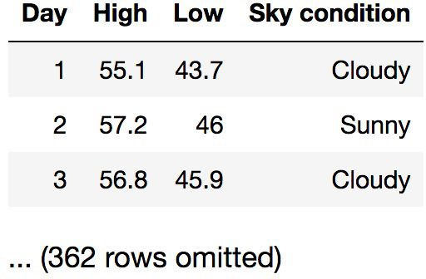
Discussion Question
You have data about daily temperatures as shown. Which type of chart would show the answer to each question?
Are there more cloudy than sunny days?
What percentage of days have a high above 72º?
Do hotter days tend to also have hotter nights?

Slide 9
Defining Functions

Slide 10
Def Statements
User-defined functions give names to blocks of code
Name Argument names (parameters)
def spread(values):
Return expression
return max(values) - min(values)
Body
(Demo)

Slide 11
Discussion Question
What does this function do? What kind of input does it take? What output will it give? What's a reasonable name?
def f(s):
return np.round(s / sum(s) * 100, 2)
(Demo)

Slide 12
Apply

Slide 13
Apply
The apply method creates an array by calling a function on every element in input column(s)
First argument:
Other arguments:
Function to apply The input column(s)
table_name.apply(function_name, 'column_label')
(Demo)

