Slide 1
Defining Functions

Slide 2
Def Statements
User-defined functions give names to blocks of code
Name Argument names (parameters)
def spread(values):
Return expression
return max(values) - min(values)
Body

Slide 3
Apply

Slide 4
Apply
The apply method creates an array by calling a function on every element in input column(s)
First argument:
Other arguments:
Function to apply The input column(s)
table_name.apply(function_name, 'column_label')
(Demo)

Slide 5
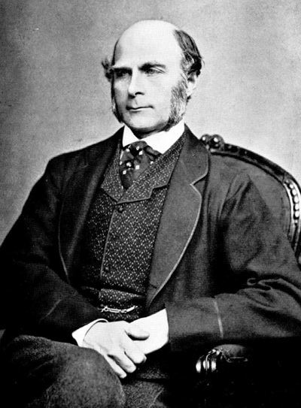
Sir Francis Galton
1822 - 1911 (knighted in 1909)
A pioneer in making predictions
Particular (and troublesome) interest in heredity
Charles Darwin's half-cousin

Slide 6
Prediction
(Demo)

Slide 7
Prediction Accuracy
(Demo)

Slide 8
Discussion Questions
How could we take gender into account when making predictions?
Do we make smaller errors on average when we do this?

Slide 9
Grouping

Slide 10
Grouping by One Column
The group method aggregates all rows with the same value for a column into a single row in the resulting table.
First argument:
Second argument:
Which column to group by (Optional) How to combine values
len — number of grouped values (default)
list — list of all grouped values
sum — total of all grouped values
(Demo)

Slide 11
Lists

Slide 12
Lists are Generic Sequences
A list is a sequence of values (just like an array), but the values can all have different types
[2+3, 'four', Table().with_column('K', [3, 4])]
Lists can be used to create table rows.
If you create a table column from a list, it will be converted to an array automatically
(Demo)

Slide 13
Grouping By Multiple Columns
The group method can also aggregate all rows that share the combination of values in multiple columns
First argument:
Second argument:
A list of which columns to group by (Optional) How to combine values
(Demo)

Slide 14
Pivot Tables

Slide 15
Pivot
Cross-classifies according to two categorical variables
Produces a grid of counts or aggregated values
Two required arguments:
First: variable that forms column labels of grid
Second: variable that forms row labels of grid
Two optional arguments (include both or neither)
values=’column_label_to_aggregate’
collect=function_to_aggregate_with
(Demo)

