Slide 1
Lists
(Demo)

Slide 2
Lists are Generic Sequences
A list is a sequence of values (just like an array), but the values can all have different types
[2+3, 'four', Table().with_column('K', [3, 4])]
Lists can be used to create table rows.
If you create a table column from a list, it will be converted to an array automatically.
Lists can even contain other lists.

Slide 3
Grouping
(Demo)

Slide 4
Grouping by One Column
The group method aggregates all rows with the same value for a column into a single row in the resulting table.
First argument:
Second argument:
Which column to group by (Optional) How to combine values
len — number of grouped values (default)
list — list of all grouped values
sum — total of all grouped values
etc.

Slide 5
Cross-Classification

Slide 6
Grouping By Multiple Columns
The group method can also aggregate all rows that share the combination of values in multiple columns
First argument:
Second argument:
A list of which columns to group by (Optional) How to combine values
(Demo)

Slide 7
Pivot Tables

Slide 8
Pivot
Cross-classifies according to two categorical variables
Produces a grid of counts or aggregated values
Two required arguments:
First: variable that forms column labels of grid
Second: variable that forms row labels of grid
Two optional arguments (include both or neither)
values=’column_label_to_aggregate’
collect=function_to_aggregate_with
(Demo)

Slide 9
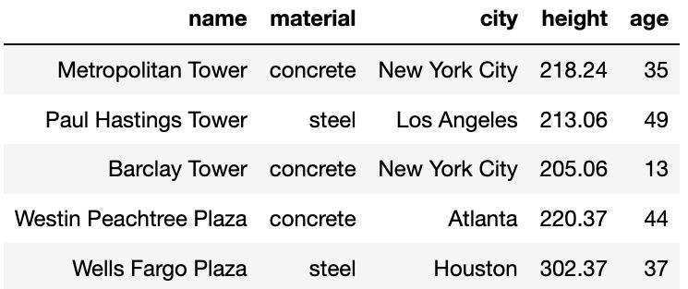
Challenge Question
For each city, what’s the tallest building for each material?
For each city, what’s the age difference between the oldest steel building and the oldest concrete building?
sky
(Demo)

Slide 10
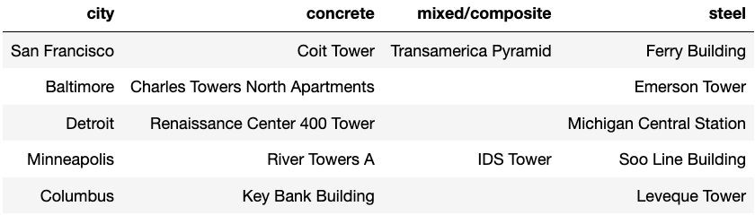
Take-Home Question
Generate a table of the names of the oldest buildings for each material for each city:

Slide 11
Group or Pivot?
For cross-classification:
Pivot Table
One combo of grouping variables per entry
Two grouping variables: columns and rows
Aggregate values of
values column
Missing combos = 0
Grouped Table
One combo of grouping variables per row
Any number of grouping variables
Aggregate values of all other columns in table
Missing combos absent
(or empty string)

Slide 12
Joins

Slide 13
Joining Two Tables
drinks.join('Cafe', discounts, 'Location')
Match rows in this table ...
… using values in this column ...
discounts
… with rows in that table ...
… using values in that column.
Columns from both tables
drinks
Drink | Cafe | Price
Milk Tea | Asha | 5.5
Espresso | Strada | 1.75
Latte | Strada | 3.25
Espresso | FSM | 2
Coupon | Location
10% | Asha
25% | Strada
5% | Asha
Cafe | Drink | Price | Coupon
Asha | Milk Tea | 5.5 | 10%
Asha | Milk Tea | 5.5 | 5%
Strada | Espresso | 1.75 | 25%
Strada | Latte | 3.25 | 25%
The joined column is sorted automatically
(Demo)

