Slide 1

Randomness
Conditionals, Iteration, and Simulations
Notes:
1. Important – make conclusions based on the data of random samples
2. We must understand what random samples are
3. To do so we must understand probabilities
4.We are able to simulate randomness for certain events using python
5. We will review how to simulate events using iterations and how to compute probabilities!

Slide 2
Control Statements
Notes:
1. First lets review conditionals and for loops

Slide 3
Control Statements
These statements control the sequence of computations that are performed in a program
The keywords if,elif,else and for begin control statements
The purpose of if is to define functions that choose different behavior based on their arguments
The purpose of for is to perform a computation for every element in a list or array
Notes:
In many events , actions and results depends on a specific set of conditions being satisfied
For example, an individual makes money if the price of their stocks increase from there initial value
We can translate this idea into coding using the condtional statements if, elif, or else ,for
A conditional statement is a multi-line statement that allows Python to choose different alternatives based on the truth value of an expression.
The purpose of a if statement is to produce a specific command if a condition is true.
Again for example: if somestarts with initial money stocks and the stocks increase in value then we could use an if statement to calculate the increase of their net worth
The puporse of a for statement is to repeat the same task until the condition is no longer true.
For example, we could reptivivel adding value to someone worth if a stock continued to increase
We also use for statements to simulate probability experiments

Slide 4
The Monty Hall Problem
Notes:
The monty hall problem has puzzled academic and statiticacns for 40 to 50 years.
The setting of the problem is a game show where behind two doors is a goat and behind the third door is a prize like a car.

Slide 5

Monty Hall Problem
https://probabilityandstats.files.wordpress.com/2017/05/monty-hall-pic-1.jpg
Notes:
The goal is to choose the door that contains the prize if you choose correctly then you get to keep it
The game is as follows:
The contest makes an initial choice but the door in not opened
The host opens one of the other doors to reveal a goat

Slide 6
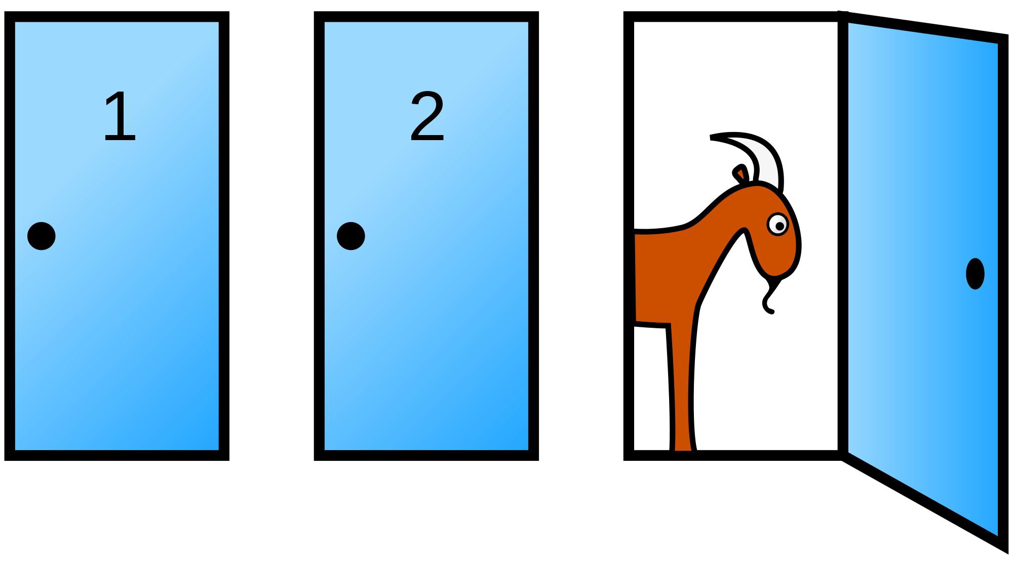
The Final Choice
(Demo)
https://en.wikipedia.org/wiki/Monty_Hall_problem
Notes:
Therefore at least one of the remaining doors has a prize and the other one has a goat
The contest now can choose to open the original door they picked or the remaining door.
Which option will lead to a higher chance of winning?
We optimally choice the door using probability!
First – before we make any choice initially,there is a 1/3 chance of the prize being chosen out of the ‘universe’
Then after the goat door is revealed, there leaves only two options in the universe
Eitther our original door which has a 1/3 chance of being correct or the complement choosing the other door
To compute the complement we take the universe 1 – the probability of our choice and arrive at 2/3
Therefore we should choice the other door! b/c it has a 2/3 chance of being correct!

Slide 7
Probability
Notes:
In this course we will think of probabilities as relative frequencies
We will now see the ways probabilities are calculated

Slide 8
Basics
Lowest value: 0
Chance of event that is impossible
Highest value: 1 (or 100%)
Chance of event that is certain
Notation- P(E)
Complement: P(~E) = 1-P(E) If an event has chance 70%, then the chance that it doesn’t happen is
100% - 70% = 30%
1 - 0.7 = 0.3
Notes:
By convention probailites are numbers between 0 and 1
Events that do not occur are given 0
Events that will/do occur are given 1
An example is events that happen half the time are given ½
We will use standard notation – p(E) todenote the probability that "event“ E happens,
Given that we know the probability that event E occurs we can compute the probability that event E does not occue
This is called the complement of envent
To compue the complement we take 1 miunes the probability of event e occuring

Slide 9
Equally Likely Outcomes
Assuming all outcomes are equally likely, the chance of an event A is:
number of outcomes that make A happen
P(A) =
total number of outcomes
Notes:
Provided that all outcomes are equally likely to occur we can compute the chance of event A occurring
This is given by all possible ways event A can occur divided by the total number of outcomes

Slide 10
Example
I have three cards: ace of hearts, king of diamonds, and queen of spades.
I shuffle them and draw two cards at random without replacement.
What is the chance that I get the Queen followed by the King?
Notes:
Lets look at an example
Suppose you have the following three cards
You shuffle them and draw 2 cards at randm without replacement
What is the chance that you get a queen followed by a king.
There are two ways of thinking about this first list all possile outcomes and divide it into the desired out come
Or treat it consecutive eveents

Slide 11
Example
I have three cards: ace of hearts, king of diamonds, and queen of spades.
I shuffle them and draw two cards at random without replacement.
What is the chance that I get the Queen followed by the King?
P(Q) = Queen – 1/3 chance
P(K) = King – 1/2 chance
P(Q then K)= Queen then King – 1/3*1/2
Notes:
The king has a 1/3 chance of being chosen
Then the deck has only two cards queen and jack therefore the queen has ½ chance of begin chosen
To compute the overall probability we multiple them together

Slide 12
Multiplication Rule (Order Matters)
Chance that two events A and B both happen
P(A then B)= P(A happens) x P(B happens given that A has happened)
The answer is less than or equal to each of the two chances being multiplied
The more conditions you have to satisfy, the less likely you are to satisfy them all
Notes:
This is called the multiplication rule
which is used when Event A happens then event B must happen
This produces a fraction of a fraction
Therefere the event is less then either event happnening
The more coniditons tha tre placed the less likely an event will occur
Note that the order of the event matters B then A is different evenT!

Slide 13
Another Example
I have three cards: ace of hearts, king of diamonds, and queen of spades.
I shuffle them and draw two cards at random without replacement.
What is the chance that one of the cards I draw is a King and the other is Queen?
Notes:
Suppose you have the following three cards
You shuffle them and draw 2 cards at randm with replacement
Meaning you put the cards back after you draw
What is the chance of getting a king and a queen
5. Note here order of cards do not matter

Slide 14
Another Example
I have three cards: ace of hearts, king of diamonds, and queen of spades.
I shuffle them and draw two cards at random without replacement.
What is the chance that one of the cards I draw is a King and the other is Queen?
P(K) = King – 1/3 chance
P(Q) = Queen – 1/3 chance
P(KQ or QK)= KingQueen or QueenKing – 1/3+1/3
Notes:
Suppose you have the following three cards
You shuffle them and draw 2 cards at randm with replacement
Meaning you put the cards back after you draw
What is the chance of getting a king and a queen
5. Note here order of cards do not matter

Slide 15
Addition Rule (Order does not matter )
If event A can happen in exactly one of two ways, then
P(A) = P(first way) + P(second way)
The answer is greater than or equal to the chance of each individual way
Notes:
an event can happen in more than one ways, the chance that it happens is a sum of chances, and hence bigger than the chance of either of the individual ways.
Therefore it is greater than any of theindiviual ways

Slide 16
Complement: At Least One Head
In 3 tosses:
Notes:
Suppose we flipped a coin 3 times and we wanted the probability that at least one lands on heads
We can think about this in terms of a complement

Slide 17
Complement: At Least One Head
In 3 tosses:
Any outcome except TTT
P(TTT) = (1/2) x (1/2) x (1/2) = 1/8
P(at least one head) = 1 - P(TTT) = 1 - (1/8) = 87.5%
Notes:
1.We want any outcome except all tails
The probability of tails is 1/2/12/12/
At least one head is the complement of no heads or all tails
Therefore the complelemnt is

Slide 18
Complement: At Least One Head
In 3 tosses:
Any outcome except TTT
P(TTT) = (1/2) x (1/2) x (1/2) = 1/8
P(at least one head) = 1 - P(TTT) = 1 - (1/8) = 87.5%
In 10 tosses:
1 - (1/2)**10 ≅ 99.9%
Notes:
As we increase the number of tosses we increase our rate of sucess~!
increasing the size of the random sample increases the chance that an individual is selected.

