Slide 1

Inference
Assessing Models

Slide 2
Review: Distributions
Any random quantity has a probability distribution:
All possible values it can take
The probability it takes each value
After repeated draws, it has an empirical distribution:
All observed values it took
The proportion of times it took each value
After many independent draws, the empirical distribution looks more and more like the probability distribution
(Demo)
Notes:
Any Random quantity has a probability distubtion
Probability distrubtions are theoretical or an entire data set and do not need an experiment to be computed!
An example of a probability distubtion is tossing a dice and the probability of landing on each face
Probaility distrubtions have two properties they display all possible values and the proability that value occurring
The other type of distrubtion is empirical.
This is observed data and needs an experiment/event to occue!
An example of a empirical distubitions is a sampling of an entire population!
The key is that empirical distubitoons are easy to find where probability distrubtions are hard to find.
However large empirical; distrubtions model probability distbutions very well because the law of averages!

Slide 3
Inference

Slide 4
Inference
Statistical Inference:
Making conclusions based on data in random samples
Example:
fixed
Use the data to guess the value of an unknown number
depends on the random sample Create an estimate of the unknown quantity
Notes:
The thing to remember is that we do not always have the entire populatin as in the last example
We would like to make educated conclusions about the entire population!
To do this we use random sampling!
Making conclusions based on random sampleing is called inference!
Making a conclusion based on a large random sample then give a great estimate of the conclusion for the entire population bc of the law of averages!

Slide 5
Terminology
Parameter
A number associated with the population
Statistic
A number calculated from the sample
A statistic can be used as an estimate of a parameter
(Demo)
Notes:
Recall that Numerical quantities associated with a population are called parameters
Where a number calculated from a sample is called a statistisc
We use statistics to estimate parameters!
The larger the sample used to compute a stastic the better!

Slide 6
Assessing Models
Notes:
In this chapter we will be testing Hypothesis
These hypothesis are how we model the world.
We will focus mainly on are facing yes-no questions about the world
we will answer these yes no question on conclusions from random samples and empirical distributions

Slide 7
Models
A model is a set of assumptions about the data
In data science, many models involve assumptions about processes that involve randomness
“Chance models”
Key question: does the model fit the data?
Notes:
A model is a set of assumptions about data.
Models include assumptions about chance processes used to generarte data
An example of a model would be how covid is not spread as much when the population is wearing masks
We need to decide whether or not their model are good
This leads to the key question: does the model fit the data?
We will use the methods developed here as the building blocks of a framework for testing hypotheses.

Slide 8
Approach to Assessment
If we can simulate data according to the assumptions of the model, we can learn what the model predicts.
We can then compare the predictions to the data that were observed.
If the data and the model’s predictions are not consistent, that is evidence against the model.
Notes:
To access the model we can use simulation and random sampling to see if the model and data agree!
We will first simulate the data according to the assumptions of the model
We then look at the models prediction and see if they match the data
If the data and the models prediction are not agreeing that is evidence against the model

Slide 9
Jury Selection

Slide 10
Swain vs. Alabama, 1965
Talladega County, Alabama
Robert Swain, black man convicted of crime
Appeal: one factor was all-white jury
26% of this population were black
Swain’s jury panel consisted of 100 men
8 men on the panel were black
Notes:
In the 1960's, in Talladega County in Alabama, a black man called Robert Swain was convicted of raping a white woman and was sentenced to death
He appealed his sentence, citing among other factors the all-white jury.
In the county, 26% of the eligible jurors were black, but there were only 8 black men among the 100 selected for the jury panel in Swain's trial. No black man was selected for the trial jury.
Note when jurys are selected there are two steps
First step an initial jury pool based on area demographics
Then from the initial jury pool the trial jury is selected

Slide 11
Supreme Court Ruling [in English]
The Supreme Court denied Robert Swain’s appeal
Paraphrase: 8/100 is less than 26%, but not different enough to show Black men were systematically excluded
Question: is 8/100 a realistic outcome if the jury panel selection process were truly unbiased?
Notes:
In 1965, the Supreme Court of the United States denied Swain's appeal. In its ruling, the Court wrote "... the overall percentage disparity has been small and reflects no studied attempt to include or exclude a specified number of Negroes.“
Translastion they thought that the results of the trial jury was fair
They though that 8 black men in the sample pool was within reason of randomness
The question we will look at is : is 8/10 a realistic outcome if the jury panel selection process were truly unbaised.

Slide 12
Sampling from a Distribution
Sample at random from a categorical distribution
sample_proportions(sample_size, pop_distribution)
Samples at random from the population
Returns an array containing the distribution of the categories in the sample
(Demo)
Notes:
We will look at testing this question
Remember: the assumption we are trying to affirm or disprove is the the jury selection was random and fair.
To do so we could set up an array of values and use the sample method from the last class
However we have a quicker way of sampling from a distribution using the following new function
Sample_proporitons(samplesize,arrau)
This returns an array contain the distrubiton of the cateriges in the sample!

Slide 13
A Genetic Model
Notes:
1. We will look at the another example

Slide 14
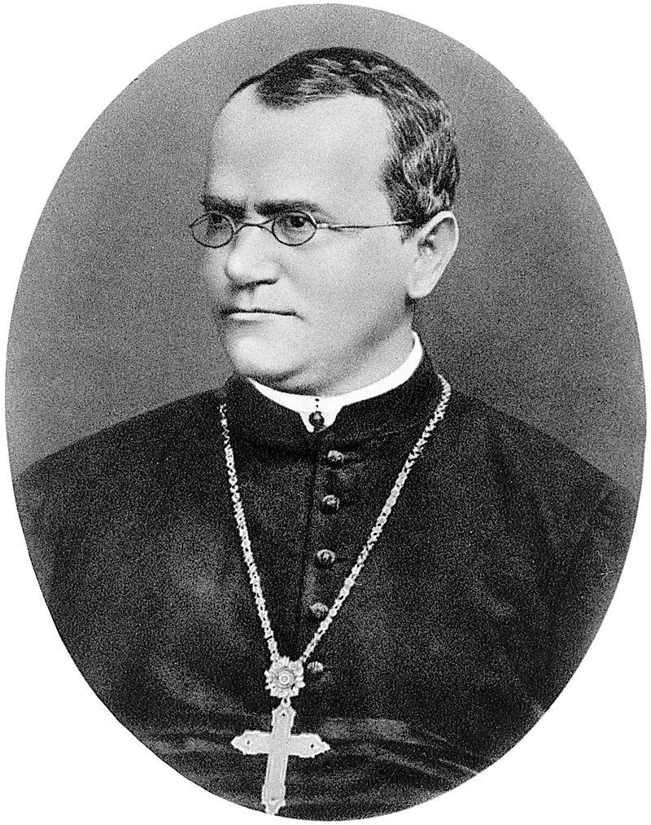
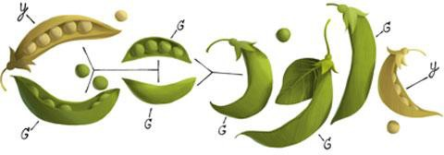
Gregor Mendel, 1822-1884
Notes:
Lets turn out atteiion to Mendel’s fundamental study of genetics
Mendel perform experiments on plants to come up with fundamental laws of genetics
He formulated sets of assumptions about each variety, these were his models.
He tested the validity of his models by growing the plants and tgathering the data
Mendel hypothesized that the plants should bear pruple or white flowered ar random intthe ration 3:1

Slide 15
A Model
Pea plants of a particular kind
Each one has either purple flowers or white flowers
Mendel’s model:
Each plant is purple-flowering with chance 75%,
regardless of the colors of the other plants
Question:
Is the model good, or not?
Notes:
Mendel perform experiments on plants to come up with fundamental laws of genetics
He formulated sets of assumptions about each variety, these were his models.
In one expiement he studied pea plants that had flowers that were either white or purple
He tested the validity of his models by growing the plants and gathering the data
Mendel hypothesized that the plants should bear pruple or white flowered ar random intthe ration 3:1
Or 75 percent of the time it would be purple
We will test and see if this was a good model!

Slide 16
Choosing a Statistic
Take a sample, see what percent are purple-flowering
If that percent is much larger or much smaller than 75, that is evidence against the model
Distance from 75 is the key
Statistic:
| sample percent of purple-flowering plants - 75 |
If the statistic is large, that is evidence against the
model
(Demo)
Notes:
To test this model we will take the following steps
Step 1: take a sample Mendels data and find the percentage of purple flowers
If the percentage of puple flowers is either much larger or smaller than this is evidence against the model
To measure how closs the percentage is from 75 percent we will calculate the distance
This is an example of a statstic!
The smaller our distance the better more accurate the model
However if the the distance is large this is evidence against the model!

Slide 17
Two Viewpoints

Slide 18
Model and Alternative
Jury selection:
Model: The people on the jury panels were selected at random from the eligible population
Alternative viewpoint: No, they weren’t
Genetics:
Model: Each plant has a 75% chance of having purple flowers
Alternative viewpoint: No, it doesn’t

Slide 19
Steps in Assessing a Model
Choose a statistic to measure discrepancy between model and data
Simulate the statistic under the model’s assumptions
Compare the data to the model’s predictions:
Draw a histogram of simulated values of the statistic
Compute the observed statistic from the real sample
If the observed statistic is far from the histogram, that is evidence against the model

