Slide 1
A/B Testing
Notes:
So far we have been looking at testing hypothesis with one sample
Today we will begin to look at testing hypothesis with two samples using Abtesting
Lets review what we saw last time

Slide 2
Review: Statistical Significance
Notes:
hypothesis are how we format our views of the world.
We can use hypthosis to make predictions.
Now checking if a hypthosis is valid is not so easy.
It is not always clear whether the data is consistent with one hypthesis or the other.
In the last example of the graduate students vs section 03, we saw that this was a decisions
That ultimately could go either way.
Last class we will introduced guidelines that you can follow to help determine which view is valid or not.
The value used to determine these guidelines was the p-value

Slide 3
Definition of the P-value
Notes:
p-value allows us to measure whether the null hypothesis (the hypthoesis we simulate) vs the alternative hypothesis is true.
We start by assuming the null hypthoesis is true
The p-value is the probability of obtaining test statistics at least as extreme as the observed statistic
Again The p-value measures how far the observed test statistic is from simulated test statistics.
The smaller the p-value the more likely the alternative hypothesiss is
To compute this value we general count up the imulated test statistics that are less then or equal to the observed test statistic and divide by the total number of test statsistics in our simulation.

Slide 4
Definition of the P-value
Assuming that the null hypothesis is correct:
The p-value is the probability of obtaining (simulated) test statistics at least as extreme as the observed test statistic.
Notes:
p-value allows us to measure whether the null hypothesis (the hypthoesis we simulate) vs the alternative hypothesis is true.
We start by assuming the null hypthoesis is true
The p-value is the probability of obtaining test statistics at least as extreme as the observed statistic
Again The p-value measures how far the observed test statistic is from simulated test statistics.
The smaller the p-value the more likely the alternative hypothesiss is
To compute this value we general count up the imulated test statistics that are less then or equal to the observed test statistic and divide by the total number of test statsistics in our simulation.

Slide 5
Definition of the P-value
Assuming that the null hypothesis is correct:
The p-value is the probability of obtaining (simulated) test statistics at least as extreme as the observed test statistic.
smaller p-value means the evidence is in favor of the alternative hypothesis.
Compute : Occurrences less than Observed Test Stat
--------------------------------------------------------
Total number of test statistics
Notes:
p-value allows us to measure whether the null hypothesis (the hypthoesis we simulate) vs the alternative hypothesis is true.
We start by assuming the null hypthoesis is true
The p-value is the probability of obtaining test statistics at least as extreme as the observed statistic
Again The p-value measures how far the observed test statistic is from simulated test statistics.
The smaller the p-value the more likely the alternative hypothesiss is
To compute this value we general count up the imulated test statistics that are less then or equal to the observed test statistic and divide by the total number of test statsistics in our simulation.

Slide 6
Conventions About Inconsistency
Notes:
1. A small p-value indicates graphically that the test statistic is in the tail of the distribution with a small area.
2. The smaller the tail the smaller the p-value.
3. The smaller the p-value , the more likely that the evidence sup[orts the alternative hypthoesis.
We say that:
If the area of the tail is less than 5% then the result is statiscally significant.
This indicates again the null hypothesis Is not likely
If the area of the tail is less than 1% then the result is highly statiscally significant
This indicates the null is extremely not likely

Slide 7
Conventions About Inconsistency
“Inconsistent with the null”: The test statistic is in the tail of the empirical distribution under the null hypothesis
Notes:
1. A small p-value indicates graphically that the test statistic is in the tail of the distribution with a small area.
2. The smaller the tail the smaller the p-value.
3. The smaller the p-value , the more likely that the evidence sup[orts the alternative hypthoesis.
We say that:
If the area of the tail is less than 5% then the result is statiscally significant.
This indicates again the null hypothesis Is not likely
If the area of the tail is less than 1% then the result is highly statiscally significant
This indicates the null is extremely not likely

Slide 8
Conventions About Inconsistency
“Inconsistent with the null”: The test statistic is in the tail of the empirical distribution under the null hypothesis
“In the tail,” first convention:
The area in the tail is less than 5%
The result is “statistically significant”
“In the tail,” second convention:
The area in the tail is less than 1%
The result is “highly statistically significant”
Notes:
1. A small p-value indicates graphically that the test statistic is in the tail of the distribution with a small area.
2. The smaller the tail the smaller the p-value.
3. The smaller the p-value , the more likely that the evidence sup[orts the alternative hypthoesis.
We say that:
If the area of the tail is less than 5% then the result is statiscally significant.
This indicates again the null hypothesis Is not likely
If the area of the tail is less than 1% then the result is highly statiscally significant
This indicates the null is extremely not likely

Slide 9
The GSI’s Defense
Notes:
Last class we were looking at whether Scetions 3 average midterm grade was within reason. I.E the lower average was due to randomness
Or if it was the teaching of the Graduate Student Teachers
The null hypothesis was that the grades were to randomness
4. The alternative hypthoesis was that the average score was to low and it was not due to randomness
5. To determine whos was correct. We assume the null is true and see whether the data supports the null
6. We randomly picked 27 students and calculated heir average score
7. Then we reran this epxierment 10000 times and compared the observed test statistic : the
Average grade gotten by class 03 to the simulated scores,

Slide 10
The GSI’s Defense
Null Hypothesis:
If we had picked a section at random from the whole class, we could have got an average like section 03.
Alternative Hypothesis:
The average score is too low. Randomness is not the only reason for the low scores.
Notes:
Last class we were looking at whether Scetions 3 average midterm grade was within reason. I.E the lower average was due to randomness
Or if it was the teaching of the Graduate Student Teachers
The null hypothesis was that the grades were to randomness
4. The alternative hypthoesis was that the average score was to low and it was not due to randomness
5. To determine whos was correct. We assume the null is true and see whether the data supports the null
6. We randomly picked 27 students and calculated heir average score
7. Then we reran this epxierment 10000 times and compared the observed test statistic : the
Average grade gotten by class 03 to the simulated scores,

Slide 11
The GSI’s Defense
Null Hypothesis:
If we had picked a section at random from the whole class, we could have got an average like section 03.
Alternative Hypothesis:
The average score is too low. Randomness is not the only reason for the low scores.
Simulation:
Pick 27 students and calculate their average
Repeat 10000 and compare simulation vs observed
Notes:
Last class we were looking at whether Scetions 3 average midterm grade was within reason. I.E the lower average was due to randomness
Or if it was the teaching of the Graduate Student Teachers
The null hypothesis was that the grades were to randomness
4. The alternative hypthoesis was that the average score was to low and it was not due to randomness
5. To determine whos was correct. We assume the null is true and see whether the data supports the null
6. We randomly picked 27 students and calculated heir average score
7. Then we reran this epxierment 10000 times and compared the observed test statistic : the
Average grade gotten by class 03 to the simulated scores,

Slide 12
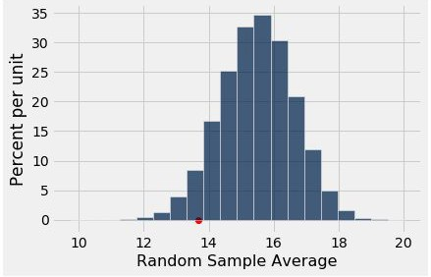
The P-Value as an Area
Empirical distribution of the test statistic under the null hypothesis
The red dot is the observed statistic.
Demo: Lecture 18
Notes:
The histogram is the distribution of the simulated average score.
The red dot is the observed statistic which is the average score of class 03
We want to know is this low grade due to randomness or not?
To decide we compute the p-value:
The p-value is the following probability: count all the average scores that are less then
The observed score then divide by the total number of simulations.
The area of a histogram represents percent.
So if we measure the area to the left of our observed statistic we obtain the percent of samples that had averages less then our equal to 13.667
Lets compute the p-value refast on lecture 18

Slide 13
A/B Testing
Notes:
So far all the hypothesis we have tested involved one sample.
It is common to have more then one sample when testing hypthosis.
3. We will now introduce A/B testing which allows us to compare two random samples with each other

Slide 14
Comparing Two Samples
A/B testing is a statistical test where two samples A and B of a single distribution are compared.
Notes:
1. AB testing Compares values of sampled individuals in Group A with values of sampled individuals in Group B.
2. This allows us to decide if Group A’s response to treatment differs from group B’s response to treatment.
3. We will explore AB testing using an example
4. Suppose we are given data about the baby's birth weight and whether or not the mother smoked during pregnancy
5. We eant to see whether maternal smoking was associated with birth weight.
6. We will do this by comparing the baby birth wights of mothers who smoked vs the baby birth weights of the mothers who did not smoke.
6.Or another way to put it if there is variation in birthweight, we would like to know if the difference is due to chance or not.

Slide 15
Comparing Two Samples
A/B testing is a statistical test where two samples A and B of a single distribution are compared.
Random sample of mothers of newborns. Compare:
(A) Birth weights of babies of mothers who smoked during pregnancy
(B) Birth weights of babies of mothers who didn’t smoke
Notes:
1. AB testing Compares values of sampled individuals in Group A with values of sampled individuals in Group B.
2. This allows us to decide if Group A’s response to treatment differs from group B’s response to treatment.
3. We will explore AB testing using an example
4. Suppose we are given data about the baby's birth weight and whether or not the mother smoked during pregnancy
5. We eant to see whether maternal smoking was associated with birth weight.
6. We will do this by comparing the baby birth wights of mothers who smoked vs the baby birth weights of the mothers who did not smoke.
6.Or another way to put it if there is variation in birthweight, we would like to know if the difference is due to chance or not.

Slide 16
Hypotheses
Null(assume is true):
In the population, the distributions of the birth weights of the babies in the two groups are the same.
Notes:
The null hypothesis we will be assuming is true is :
the distribution of birth weights of babies is the same for mothers who don't smoke as for mothers who do
This null hypothesis is saying that the difference in the sample is due to chance.
The alternative hypthoesis is that the babies of the mothers who smoked weigh less, on average, than the babies of the non-smokers.

Slide 17
Hypotheses
Null(assume is true):
In the population, the distributions of the birth weights of the babies in the two groups are the same.
Alternative:
In the population, the babies of the mothers who smoked weigh less, on average, than the babies of the non-smokers.
Notes:
The null hypothesis we will be assuming is true is :
the distribution of birth weights of babies is the same for mothers who don't smoke as for mothers who do
This null hypothesis is saying that the difference in the sample is due to chance.
The alternative hypthoesis is that the babies of the mothers who smoked weigh less, on average, than the babies of the non-smokers.

Slide 18
Test Statistic
Group A: non-smokers
Group B: smokers
Notes:
We will label the mothers that were nonsmokers to be in group A
While the mothers that were smokers are in group B
The alternative hypothesis compares the average birth weights of the two groups.
Further it says that the average for the mothers who smoke is smaller.
Therefore we should find the difference between the average weight of group B and Group A.
If There is no difference in wieghts then this statistic should be close to zero. This would imply that the null hypothesis is true
If the statistic is a negative value then this means the non smoker babies are heavier on average. This would mean that the alternative hypothesis is true.

Slide 19
Test Statistic
Group A: non-smokers
Group B: smokers
Statistic: Difference between average weights Group B average - Group A average
Notes:
We will label the mothers that were nonsmokers to be in group A
While the mothers that were smokers are in group B
The alternative hypothesis compares the average birth weights of the two groups.
Further it says that the average for the mothers who smoke is smaller.
Therefore we should find the difference between the average weight of group B and Group A.
If There is no difference in wieghts then this statistic should be close to zero. This would imply that the null hypothesis is true
If the statistic is a negative value then this means the non smoker babies are heavier on average. This would mean that the alternative hypothesis is true.

Slide 20
Test Statistic
Group A: non-smokers
Group B: smokers
Statistic: Difference between average weights Group B average - Group A average
Negative values of this statistic favor the alternative I.E – Smoking does effect birth weight
Notes:
We will label the mothers that were nonsmokers to be in group A
While the mothers that were smokers are in group B
The alternative hypothesis compares the average birth weights of the two groups.
Further it says that the average for the mothers who smoke is smaller.
Therefore we should find the difference between the average weight of group B and Group A.
If There is no difference in wieghts then this statistic should be close to zero. This would imply that the null hypothesis is true
If the statistic is a negative value then this means the non smoker babies are heavier on average. This would mean that the alternative hypothesis is true.

Slide 21
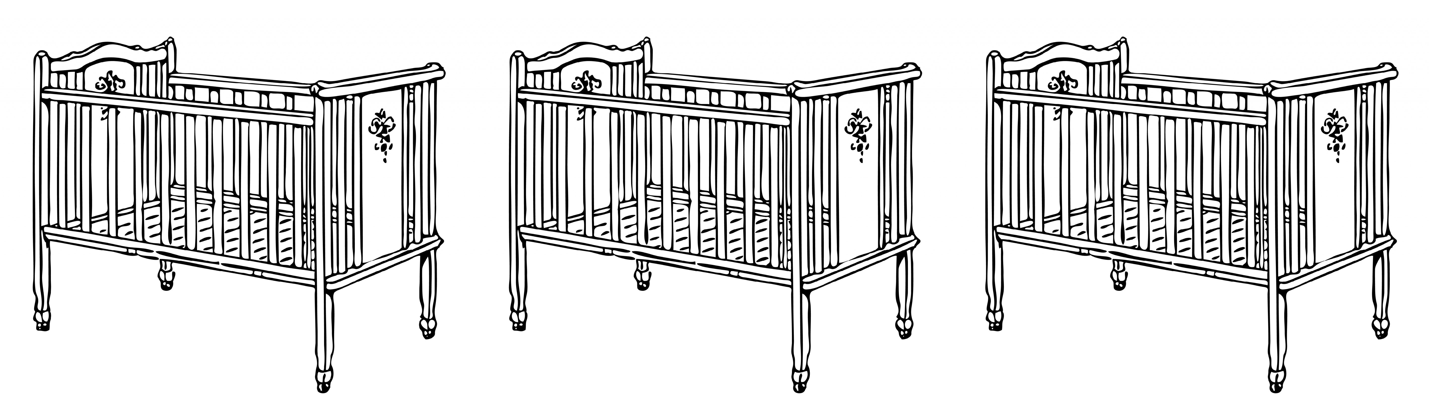
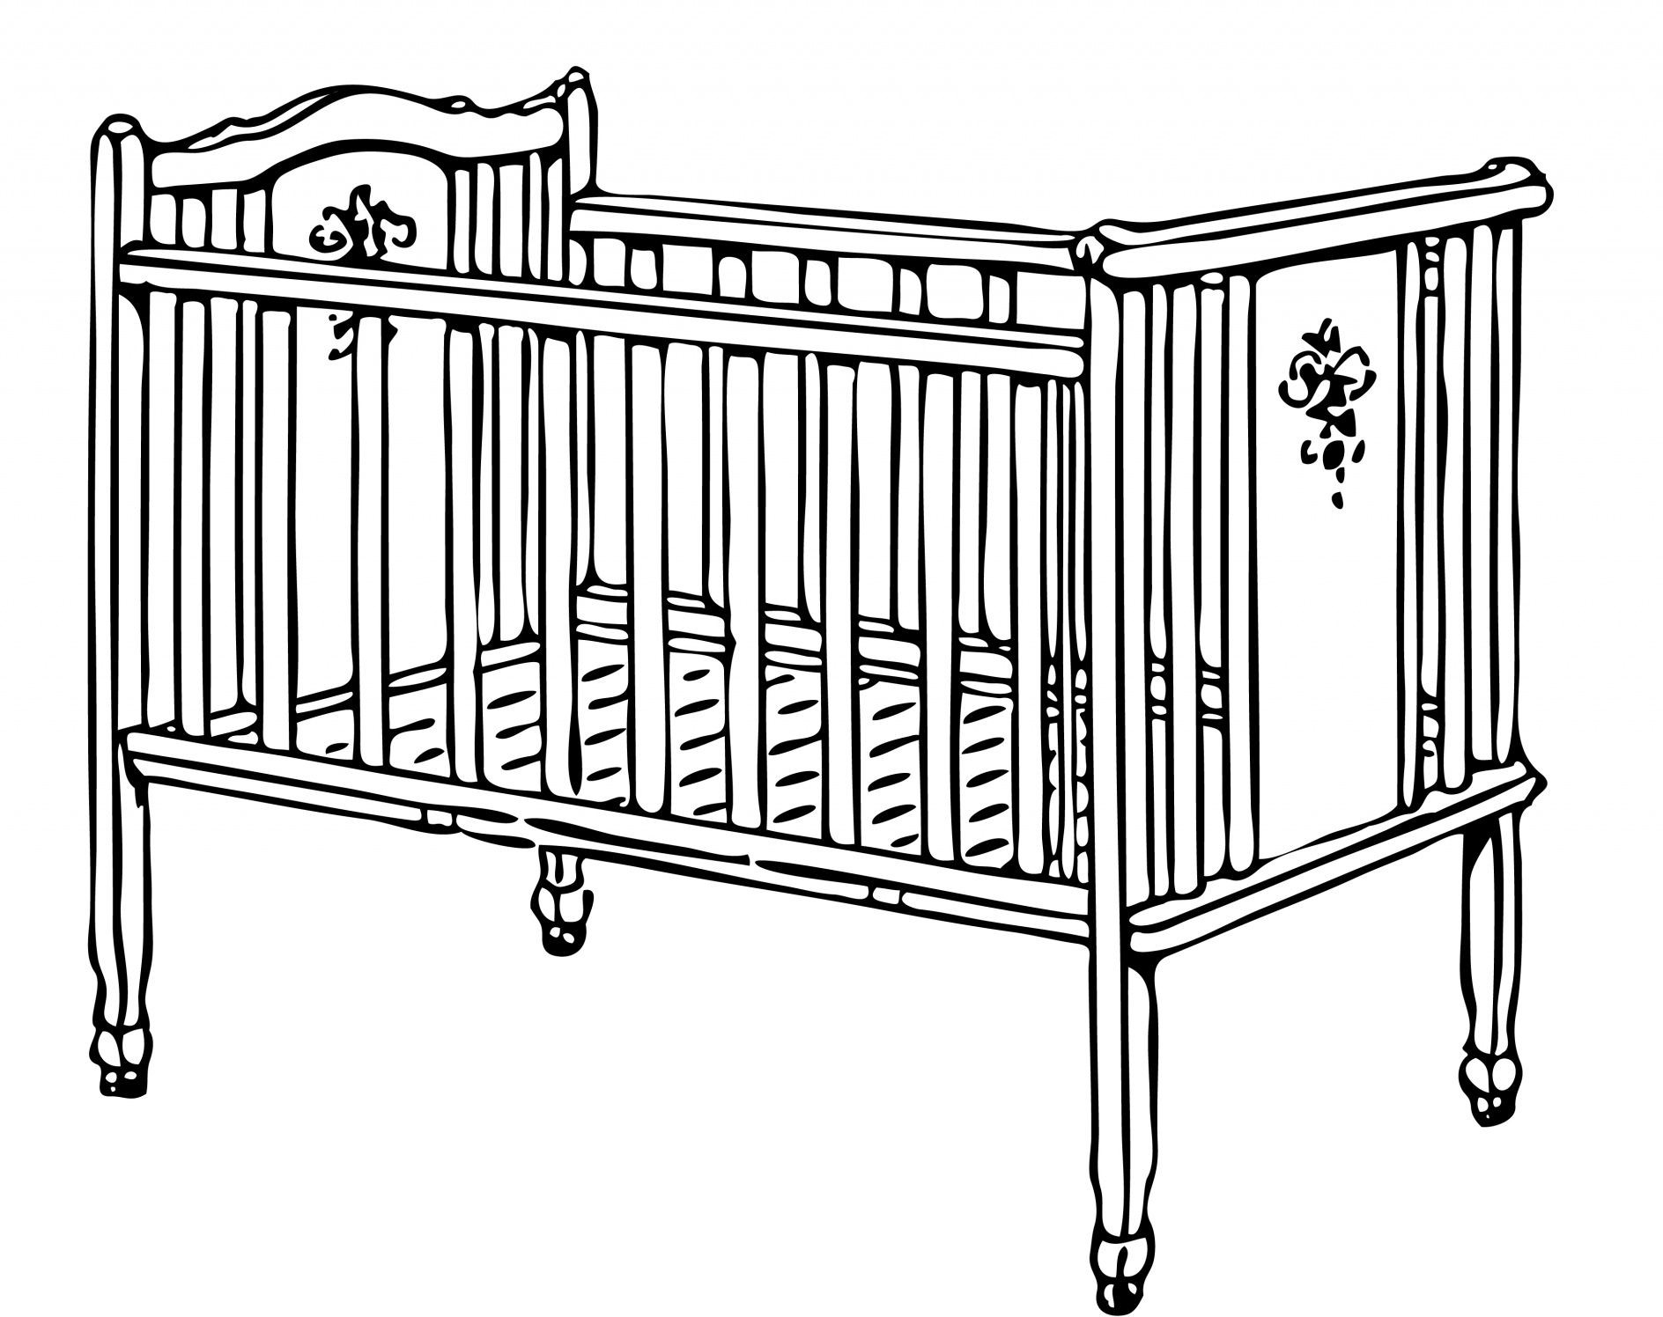
The Data
...
Non-smoker 117 oz
Non-smoker
120 oz
Non-smoker
113 oz
Smoker
128 oz
Smoker
108 oz
...
Notes:
to simulate the statistic under the null hypothesis we will use random permutations of the labels.
A random permutation is the assigning a random element to a given attribute.
Here we have non-smokers and smokers that were pregnant
If the null hypthoses is true then there will be not much of difference between their average weights

Slide 22
Shuffling Labels Under the Null
...
Smoker
120 oz
Non-smoker
113 oz
Non-smoker
128 oz
Smoker
108 oz
...
Smoker
117 oz
Notes:
1.Therefore if we randomly assign non-smoker and smoker attribute to each induvial in the group and compute the test statistic we should expect a number close to the observed test statistic
2. Lets look at the notebook 19

Slide 23
How We’ve Tested Thus Far

Slide 24
Hypothesis Testing Review
1 Sample: One Category (e.g. percent of flowers that are purple)
Test Statistic: empirical_percent, abs(empirical_percent - null_percent)
How to Simulate: sample_proportions(n, null_dist)
1 Sample: Multiple Categories (e.g. ethnicity distribution of jury panel)
Test Statistic: tvd(empirical_dist, null_dist)
How to Simulate: sample_proportions(n, null_dist)
1 Sample: Numerical Data (e.g. scores in a lab section)
Test Statistic: empirical_mean, abs(empirical_mean - null_mean)
How to Simulate: population_data.sample(n, with_replacement=False)
2 Samples: Numerical Data (e.g. birth weights of smokers vs. non-smokers)
Test Statistic: group_a_mean - group_b_mean,
group_b_mean - group_a_mean, abs(group_a_mean - group_b_mean)
How to Simulate: empirical_data.sample(with_replacement=False)

