Slide 1
Lecture 24
Confidence Intervals

Slide 2
Review: Estimation and the Boot Strap

Slide 3
Inference: Estimation

Slide 4
Inference: Estimation
How do we calculate the value of an unknown parameter?
Notes:
Recall a parameter is an attribute of a population.
Example if we had a database of all ung students we could compute the average age this is a parameter
Yeap so think of parameters as being computable attributes of a population

Slide 5
Inference: Estimation
How do we calculate the value of an unknown parameter?
If you have the whole population:
Just calculate the parameter and you’re done
Notes:
And so if we have the whole population we can just compute the parameter

Slide 6
Inference: Estimation
How do we calculate the value of an unknown parameter?
If you have the whole population:
Just calculate the parameter and you’re done
If you don’t have the whole population :
Take a random sample from the population
Use a statistic as an estimate of the parameter
Notes:
However if we don’t have the whole population we must take a radndom dample and compute the attribute of the sample
This is called a statistic
We think of a statistic as an estimate of the parameter

Slide 7
Variability of the Estimate

Slide 8
Variability of the Estimate
One sample ➜ One estimate
Notes:
The thing is one sample gives on estimation of the parameter

Slide 9
Variability of the Estimate
One sample ➜ One estimate
But the random sample could have come out differently
Notes:
so if we choose a different sample we will mostly get a different statistic.
This changes our estimate!

Slide 10
Variability of the Estimate
One sample ➜ One estimate
But the random sample could have come out differently
Question:
How different would it be if we did it again?
Notes:
So we would like to know how different our estimates can be !

Slide 11
Variability of the Estimate
One sample ➜ One estimate
But the random sample could have come out differently
Question:
How different would it be if we did it again?
One Answer:
To determine variability, take many random samples and compute statistic!
Notes:
One answer you can find the variability is to take as many random samples as you need
and computing the statistic of each sample
Then visualize the possible statistics by a histogram.
This would tell you how different each estimate is more or less

Slide 12
Quantifying Uncertainty

Slide 13
Quantifying Uncertainty
The estimate is usually not exactly right:
Estimate = Parameter + Error
Notes:
Again our statistic is just an estimation
The estimation most likely will never actually be the parameter but it should be close.
So we think of the estimate as the parameter with some small amount of error.

Slide 14
Quantifying Uncertainty
The estimate is usually not exactly right:
Estimate = Parameter + Error
How accurate is the estimate, usually?
Notes:
We would like to know how close the estimate is to the parameter.
To answer this question we need to know how large the error is.

Slide 15
Quantifying Uncertainty
The estimate is usually not exactly right:
Estimate = Parameter + Error
How accurate is the estimate, usually?
How big is a typical error?

Slide 16
Quantifying Uncertainty
The estimate is usually not exactly right:
Estimate = Parameter + Error
How accurate is the estimate, usually?
How big is a typical error?
With the population, we can do this by simulation
What if we have only one sample?
Notes:
If we have the entire population, we can do this again by simulating using loops and computing the statistic
The we would be able to find out the variability of the statistics this would give us a good idea of what the parameter actually is
But we have a problem what if we only have one sample ?

Slide 17
Where to Get Another Sample?

Slide 18
Where to Get Another Sample?
Suppose we only have the sample!
Notes:
If we ve only have one sample then it is difficult to really get an idea of what the error of our statistic is goin to be
So we need a way to find more samples, cheaply and quickly

Slide 19
Where to Get Another Sample?
Suppose we only have the sample!
To get many values of the estimate, we needed many random samples
Notes:
Since to get an idea of how accurate our estimate is we need a lot of statistics to compare it to!

Slide 20
Where to Get Another Sample?
Suppose we only have the sample!
To get many values of the estimate, we needed many random samples
If we have large original sample
then it resembles the population!
Notes:
Now if we have a large sample then we know from the law of large numbers that is should look like the Original sample
So this is were the idea of boot strapping came into play
Which is pretty slick

Slide 21
Where to Get Another Sample?
Suppose we only have the sample!
To get many values of the estimate, we needed many random samples
If we have large original sample
then it resembles the population!
So we sample at random from the original sample!
Notes:
We can take samples of our samples!!
This will give us a ton of samples that look similar to the population and allow us to run our simulations

Slide 22
The Bootstrap Principle
Notes:
Bootsraping is again something we can do when we do not have the whole data set

Slide 23
The Bootstrap Principle
The bootstrap principle:
Bootstrap-world sampling ≈ Real-world sampling
Notes:
Because large sample sets are similar to the population
And resamples are similar to large samples
Then resamples are similar to the population

Slide 24
The Bootstrap Principle
The bootstrap principle:
Bootstrap-world sampling ≈ Real-world sampling
Not always true!
… but reasonable if sample is large enough
Notes:
However bootstrapping does not always work
A requirement fo it to work is a large enough data set

Slide 25
The Bootstrap Principle
The bootstrap principle:
Bootstrap-world sampling ≈ Real-world sampling
Not always true!
… but reasonable if sample is large enough
Most of the time:
Variability of bootstrap estimate
Distribution of bootstrap errors
...are similar to what they are in the real world
Notes:
But if we do have a large enough data set then we are able ot look at the range of values of our bootstrap estimate
And also see the distrbutions of our bootstrap error!
This will usually be close enough to having the entire data set and taking random samples

Slide 26
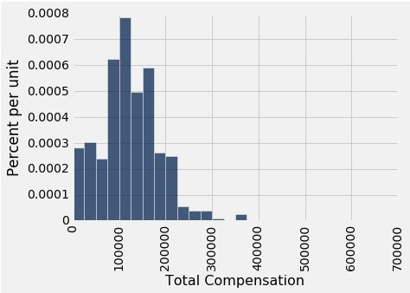
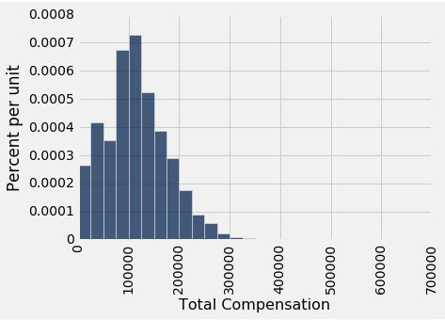
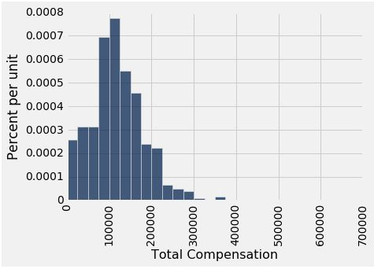
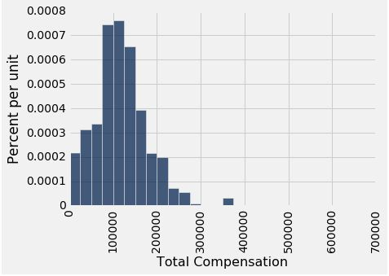
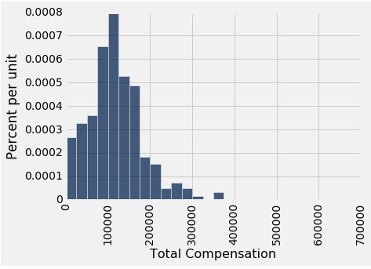

Why We Need the Bootstrap
resamples
population
sample
What we wish we could get
What we really get
Notes:
Remember the reason were are using bootstrapping is because we do not have the entire dataset
So if we have a sample we will continue to draw resamples from our only sample
These ressampes are a good approximation of our sample
And our sample is a good approximation of our population
Therefore we are able to simulate our population using resamples
We are able then to calculuate statistics of our bootstrapped samples a

Slide 27
Key to Resampling
Notes:
Lets look at the steps on how to use bootstrapping

Slide 28
Key to Resampling
From the original sample,
draw at random
with replacement
as many values as the original sample contained
Notes:
From our original sample we draw at random with replacement as many values as the original sampl
The size of the new sample is eqial to the size of the original sample

Slide 29
Key to Resampling
From the original sample,
draw at random
with replacement
as many values as the original sample contained
The size of the new sample has to be the same as the original one, so that the two estimates are comparable
(Demo)
Notes:
What we get is that the two samples are now comparable to each other and the we can compute the statistics of the resample
We can repeat this bootstrpaing process to get as many statistiscs as we need

Slide 30
Confidence Intervals
Notes:
SO we used bootstrapping to estimate parameters when are data set was not large enough
Now we want to know how accurate this estimation can be
This is where confidence intervals come into play

Slide 31
95% Confidence Interval

Slide 32
95% Confidence Interval
Interval of estimates of a parameter
Notes:
Lets recall our boostraping process
We resample a data set
Compute the statistic and we get an estimation of the parameter
Now if we reiterate this process 1000 times we will get 1000 estimations
We take the highest and lowest estimate as the boundary and each of the other estimations make up our a set
We Called this our interval of esimates of a parameter.

Slide 33
95% Confidence Interval
Interval of estimates of a parameter
The confidence is in the process that gives the interval:
It generates a “good” interval about 95% of the time.
Notes:
Now every time we create an estimation of a parameter there are two ppossibilites
Either it contains the actual parameter or It does not contain it.
If we take a certain percentage of the interval that estimates are parameter
For example 95,an if we repeat the process of making a n inteteval of estimates of the parameter
Then there is certain percent chance we get our parameter
Again if we choose 95, then if we repeat this process 100 times , 95 times we will get an interval containg our parameter.

Slide 34
95% Confidence Interval
Interval of estimates of a parameter
The confidence is in the process that gives the interval:
It generates a “good” interval about 95% of the time.
95% is called the confidence level
Could be any percent between 0 and 99
Higher level means wider intervals
(Demo)
Notes:
We call this percentage that our interval contains our parameter the confidence level.
The confidenece level can be anything from 0-99 percentage
The higher the number , the morelikely our interval contains the parameter, but tour estimates change more
SO the tradeoff is accuracy vs confidence of capturing the paramerter

Slide 35
Each line here is a confidence interval from a fresh sample from the population
Notes:
Draw a large random sample from the population.
Bootstrap your random sample and get an estimate from the new random sample.
Repeat ly bootstrap thousands of times, and get thousands of estimates.
Pick off the "middle 95%" interval of all the estimates.
If we repeat all these step 95 times we will 95 out of 100 times have a good intervals!
This intervals contain our parameter!
Here we see 100 confidence intervals
Remember each confidemce interval is made up of a simulation of thousands of estimates
It follows from the law of large numbers that 95 of these intervals contain our parameter
Whereas 5 do not contain the parameter

Slide 36
Use Methods Appropriately

Slide 37
Can You Use a CI Like This?
By our calculation, an approximate 95% confidence interval for the average age of the mothers in the population is (26.9, 27.6) years.
True or False:
About 95% of the mothers in the population were between 26.9 years and 27.6 years old.
Answer: False. We’re estimating that their average age is in this interval.

Slide 38
Is This What a CI Means?
An approximate 95% confidence interval for the average age of the mothers in the population is (26.9, 27.6) years.
True or False:
There is a 0.95 probability that the average age of mothers in the population is in the range 26.9 to 27.6 years.
Answer: False. The average age of the mothers in the population is unknown but it’s a constant. It’s not random. No chances involved.

Slide 39
When Not to Use The Bootstrap
If you’re trying to estimate very high or very low percentiles, or min and max
If you’re trying to estimate any parameter that’s greatly affected by rare elements of the population
If the probability distribution of your statistic is not roughly bell shaped (the shape of the empirical distribution will be a clue)
If the original sample is very small

Slide 40
Confidence Intervals For Testing

Slide 41
Using a CI for Testing
Null hypothesis: Population average = x
Alternative hypothesis: Population average ≠ x
Cutoff for P-value: p%
Method:
Construct a (100-p)% confidence interval for the population average
If x is not in the interval, reject the null
If x is in the interval, can’t reject the null

