Slide 1
Confidence Interval Review

Slide 2
Review: Quantifying Uncertainty
The estimate is usually not exactly right:
Estimate = Parameter + Error
get from sample: random
unknown, fixed
unknown,
random
How big is a typical error?
What if the sample had been different?
How can we express our uncertainty with numbers?

Slide 3
Review: Real vs. Bootstrap World
Real world (what we want): Bootstrap world:
True probability distribution ● (population)
→ Random sample 1
→ Estimate 1
Empirical distribution of original sample (“population”)
→ Bootstrap sample 1
→ Estimate 1
→ Bootstrap sample 2
→ Estimate 2
 | → Random sample 2
Can’t get th | ese :( | → Estimate 2
 | … → Random sample 10000 → Estimate 10000
...
→ Bootstrap sample 1000
→ Estimate 1000
Hope: these two scenarios are analogous

Slide 4
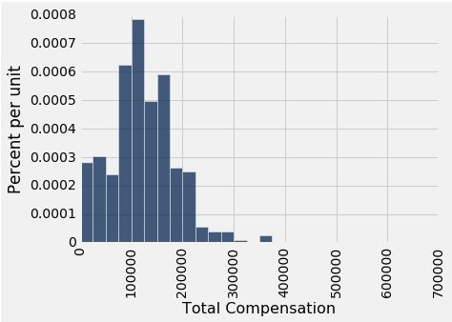

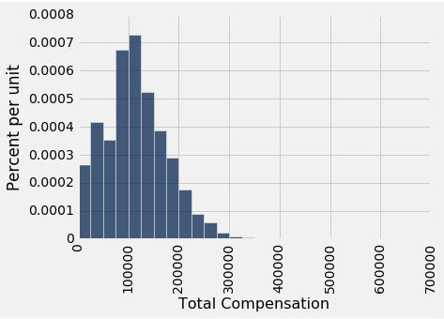
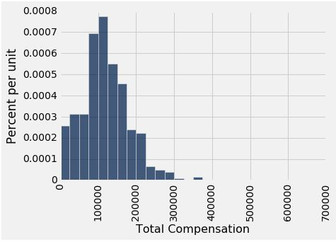
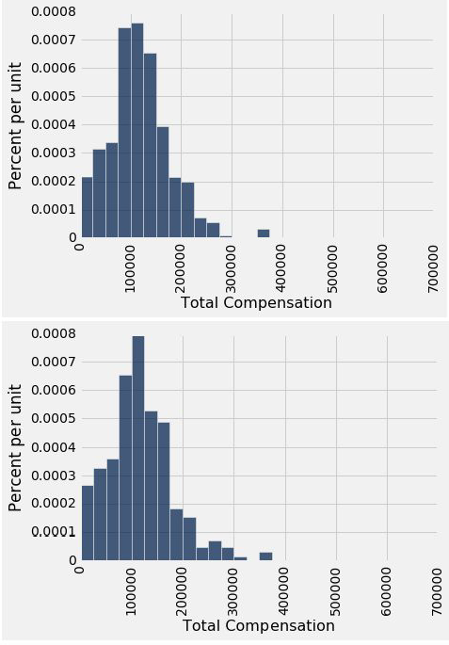

Review: Why We Need the Bootstrap
population
sample
Median:
Median:
Median:
Median:
Median:
What we wish we could get
What we really get
resamples

Slide 5
Resampling Review
From the original sample,
draw at random
with replacement
as many values as the original sample contained
The size of the new sample has to be the same as the original one, so that the two estimates are comparable.
Ideally we’d use fresh samples from the population, but this is the best we can do instead.

Slide 6
95% Confidence Interval
Interval of estimates of a parameter
Based on random sampling
95% is called the confidence level
Could be any percent between 0 and 100
Higher level means wider intervals
The confidence is in the process that gives the interval:
It generates a “good” interval about 95% of the time.
(Demo)

Slide 7
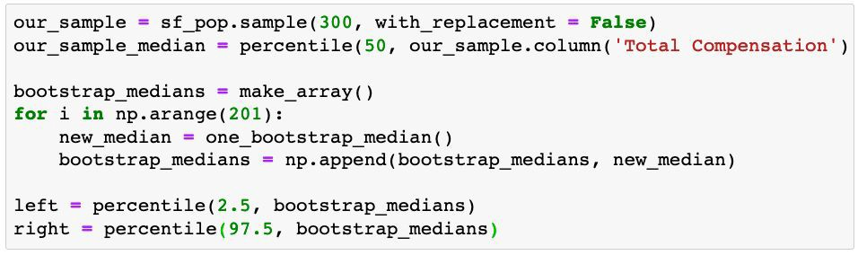
Discussion Question
Give two different ways to make our confidence interval smaller, and mark what you’d change in the code for each:

Slide 8
How to Interpret Confidence Intervals
(and how NOT to interpret them, too)

Slide 9
95% CI: Usage vs Interpretation
How to create it
Middle 95% of the bootstrapped estimates
How to interpret it
95% of samples will give a 95% CI that contains the true parameter

Slide 10
Each line here is a 95% confidence interval from a fresh sample from the population

Slide 11
Can You Use a CI Like This?
By our calculation, an approximate 95% confidence interval for the average age of the mothers in the population is (26.9, 27.6) years.
True or False:
About 95% of the mothers in the population were between 26.9 years and 27.6 years old.
Answer: False. We’re estimating that their average age is in this interval.

Slide 12
Is This What a CI Means?
An approximate 95% confidence interval for the average age of the mothers in the population is (26.9, 27.6) years.
True or False:
There is a 0.95 probability that the average age of mothers in the population is in the range 26.9 to 27.6 years.
Answer: False. The average age of the mothers in the population is unknown but it’s a constant. It’s not random. No chances involved.

Slide 13
When Not to Use The Bootstrap
If you’re trying to estimate very high or very low percentiles, or min and max
If you’re trying to estimate any parameter that’s greatly affected by rare elements of the population
If the probability distribution of your statistic is not roughly bell shaped (the shape of the empirical distribution will be a clue)
If the original sample is very small

Slide 14
Confidence Intervals For Testing

Slide 15
Using a CI for Testing
What if we want to do a hypothesis test, but we can’t simulate under the null?
Null hypothesis: Population average = x
Alternative hypothesis: Population average ≠ x
Cutoff for P-value: p%
Method:
Construct a (100-p)% confidence interval for the population average
If x is not in the interval, reject the null
If x is in the interval, can’t reject the null

Slide 16
Center and Spread

Slide 17
Questions
How can we quantify natural concepts like “center” and “variability”?
Why do many of the empirical distributions that we generate come out bell shaped?
How is sample size related to the accuracy of an estimate?

Slide 18
Average

Slide 19
The Average (or Mean)
Data: 2, 3, 3, 9 Average = (2+3+3+9)/4 = 4.25
Need not be a value in the collection
Need not be an integer even if the data are integers
Somewhere between min and max, but not necessarily halfway in between
Same units as the data
Smoothing operator: collect all the contributions in one big pot, then split evenly
(Demo)

Slide 20
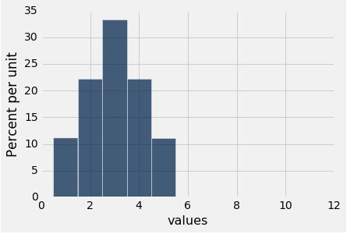
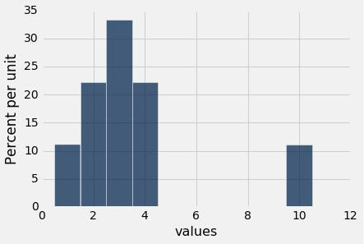
Discussion Question
Are the medians of these two distributions the same or different? Are the means the same or different? If you say “different,” then say which one is bigger.

Slide 21
Comparing Mean and Median
Mean: Balance point of the histogram
Median: Half-way point of data; half the area of histogram is on either side of median
If the distribution is symmetric about a value, then that value is both the average and the median.
If the histogram is skewed, then the mean is pulled away from the median in the direction of the tail.

Slide 22
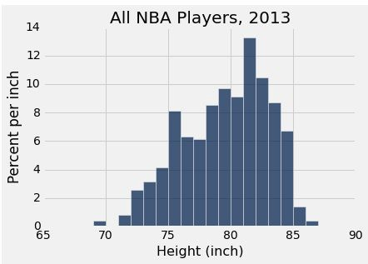
Discussion Question
Which is bigger?
mean
median

Slide 23
Standard Deviation

Slide 24
Defining Variability
Plan A: “biggest value - smallest value”
Doesn’t tell us much about the shape of the distribution
Plan B:
Measure variability around the mean
Need to figure out a way to quantify this
(Demo)

Slide 25
How Far from the Average?
Standard deviation (SD) measures roughly how far the data are from their average
SD = root mean square of deviations from average 5 4 3 2 1
SD has the same units as the data

Slide 26
Why Use the SD?
There are two main reasons.
The first reason:
No matter what the shape of the distribution,
the bulk of the data are in the range “average ± a few SDs”
The second reason:
Coming up in the next lecture.

