Slide 1
Confidence Intervals Review
Notes:
Last week we learned how to estimate an unknown parameter.
This was done with random sampling and computing statistics.
We ran into two difficulties while estimating :
How accurate is our estimations?
And what if we only had one random sample?
Lets review these topics

Slide 2
Review: Quantifying Uncertainty
The estimate is usually not exactly right:
Estimate = Parameter + Error
get from sample: random
unknown, fixed
unknown,
random

Slide 3
Review: Quantifying Uncertainty
The estimate is usually not exactly right:
Estimate = Parameter + Error
get from sample: random
unknown, fixed
unknown,
random
Notes:
an estimation is a statistic
statistics are computable attributes of samples or bootstrap samples
While the parameter is unknown a good estimate is the parameter with some small amount of error.

Slide 4
Review: Quantifying Uncertainty
The estimate is usually not exactly right:
Estimate = Parameter + Error
get from sample: random
unknown, fixed
unknown,
random
How big is a typical error?
Notes:
We would like to know how close the estimate is to the parameter.
To figure out how close our estimate is we need to know how large the typical error is.

Slide 5
Review: Quantifying Uncertainty
The estimate is usually not exactly right:
Estimate = Parameter + Error
get from sample: random
unknown, fixed
unknown,
random
How big is a typical error?
With the population, we can do this by simulation
Notes:
If we have the entire population, then we could simulate random samples and compute the statistic
We could then provide an interval of estimates for the unknown parameter

Slide 6
Review: Quantifying Uncertainty
The estimate is usually not exactly right:
Estimate = Parameter + Error
get from sample: random
unknown, fixed
unknown,
random
How big is a typical error?
With the population, we can do this by simulation
What if we have only one sample?
Notes:
The problem we ran into was what can we do if we only have one sample?
if we only one sample we could still simulating random samples and compute the statistics using bootstrapping!
This would also provide an interval of estimates for the unknown parameter

Slide 7
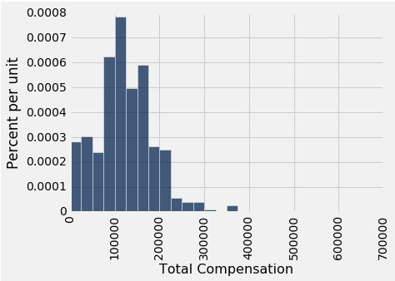
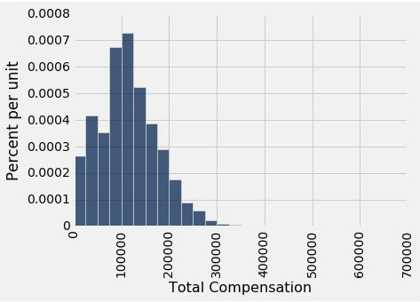
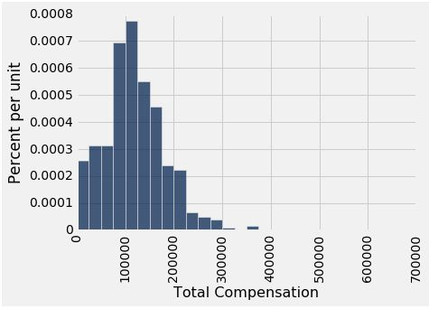
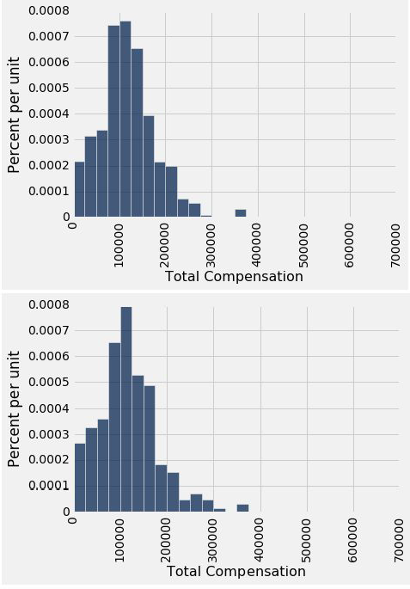

Review: Why We Need the Bootstrap
Population
population
sample

Slide 8
Review: Why We Need the Bootstrap
Population
population
sample
Notes:
The idea of bootstrapping is simply but the observation of why is works is subtle
suppose that you are only able to obtain one large sample

Slide 9
Review: Why We Need the Bootstrap
Population
population
sample
Notes:
The distribution of the sample is pretty similar to the population’s distribution
So if we would like to find estimates for a parameter and how accurate these estimates are we can draw samples , called resamples, from our original sample and use these!

Slide 10
Review: Why We Need the Bootstrap
Population
population
sample
resample
Notes:
Any attribute you compute with the resamples will be about the same as computing the same attribute from samples of the population

Slide 11
Resampling Review

Slide 12
Resampling Review
From the original sample,
draw at random with replacement
as many values as the original sample contained
Use the method .sample()
Notes:
To use a bootstrapping sample we must draw from our original sample randomly with replacement as many values as the original sample has
This can be done using the sample method

Slide 13
Resampling Review
From the original sample,
draw at random with replacement
as many values as the original sample contained
Use the method .sample()
The size of the new sample has to be the same as the original one, so that the two estimates are comparable.
Notes:
The size of the new sample is equal to the size of the original sample and has a similar distribution
We can now estimate a parameter by using the bootstrap sample
We can repeat this bootstraping process to get as many resamples and statistiscs as we need

Slide 14
95% Confidence Interval
Notes:
Now that we know we can always get an estimate we would still like to know how good our estimate is
This is what confidenece intervals let us do

Slide 15
95% Confidence Interval
Interval of estimates of a parameter
Notes:
So what is a confidence interval and how do we find it?
Well if we compute the statistic and we get an estimation of the parameter
Now if we take 1000 more random samples and we will get 1000 estimations
We take the highest and lowest estimate as the boundary and all ther other estimations make up our a set
Which we Call our interval of estimates of a parameter.

Slide 16
95% Confidence Interval
Interval of estimates of a parameter
A “good” interval contains the parameter
Notes:
Now every time we create an interval there are two ppossibilites
Either it contains the actual parameter or It does not contain it.
If it cotains the parameter It is called a good interval.

Slide 17
95% Confidence Interval
Interval of estimates of a parameter
A “good” interval contains the parameter
The confidence level is chance we have a good interval
Could be any percent between 0 and 100
Higher level means wider intervals
(Demo Homework 8)
Notes:
If we take a certain percentage of the interval, for example the middle 95 percent, Then there is 95 percent chance we get our parameter in our interval
We call this percentage that our interval contains our parameter the confidence level.
The confidenece level can be anything from 0-99 percentage
The higher the number , the more likely our interval contains the parameter,
We call the middle 95 percent of our interval the 95% confidence interval!
Note what do we mean there is a 95 percent chance we get the parameter in the confidence interval?
This means if we computed ;ets say 100 intervals of esimates of our parameter then 95% of our 95% confidence intervals would contain our parameter

Slide 18
How to Interpret Confidence Intervals
Notes:
So we just saw an example on how to find a confidence interval
But what do they mean?
confidence interval's measure how high or low your estimations of the parameter are
But Rembeer that with confidence intervals it is possible to still be uncertain of your estimation
Since it is possible to get an interval that does not contain the parameter at all !

Slide 19
How to find x% confidence interval
Notes:
Before we look at some more examples lets review how to find a confidence interval!

Slide 20
How to find x% confidence interval
Suppose we have an interval of estimations
Notes:
First suppose we have an interval of estimates and lets say you are trying to find the 95 percent confidenc ineterval

Slide 21
How to find x% confidence interval
Suppose we have an interval of estimations
If we wanted to find the 95% confidence interval

Slide 22
How to find x% confidence interval
Suppose we have an interval of estimations
If we wanted to find the 95% confidence interval
Middle 95% of the bootstrapped estimates
Take half of the the remaining area of the interval I.E 5/2 = 2.5
The middle 95 percent is between the 2.5 and 97.5 percentile.
Notes:
This would then be the middle 95 percentile of our interval of estimates
Therefore we need to find the lower bound and upper bound
Take half of the remaining area of the interval
5/2
The lower bound is then 2.5 and the upper bound is 100 – 2.5 = 97.5
Since the area between 0 to 2.5 and 97.5 and 100 add to 5
Our 95 percent confidence interval is all estimates being between 2.5 and 97.5 percentile
Now lets talk a little more about what the confidence interval is measuring

Slide 23
Each line here is a 95% confidence interval from a fresh sample from the population
Notes:
So if this class had 100 students
And each student found a 95 % confidence interval for a parameter
For example the estimates of the percentage of voters who voted for Imm Thai
Then we would have a picture like this
Here we see 100 confidence intervals
The red line is again our parameter
Most of these confidence intervals are good
Meaning they contain the parameter
But some are bad, in fact there should be about 5 that are bad
maybe a little more or a little less
This is what are 95% confidence interval is measuring, there should be about 95 good ones confidence intervals And 5 bad ones

Slide 24
Can You Use a CI Like This?
Notes:
Lets look at a few examples

Slide 25
Can You Use a CI Like This?
By our calculation, an approximate 95% confidence interval for the average age of the mothers in the population is (26.9, 27.6) years.
Notes:
Let\'s suppose that we are, we have a population of mothers and we want to know the average age of the mothers.
And we compute a 95% confidence interval using a bootstrapping on some sample.
And the confidence interval we get is the range 26.9-27.6 to years.

Slide 26
Can You Use a CI Like This?
By our calculation, an approximate 95% confidence interval for the average age of the mothers in the population is (26.9, 27.6) years.
True or False:
About 95% of the mothers in the population were between 26.9 years and 27.6 years old.
Notes:
Now true or false.
About 95% of the mothers in the population are between to 26.9-27.6years old.

Slide 27
Can You Use a CI Like This?
By our calculation, an approximate 95% confidence interval for the average age of the mothers in the population is (26.9, 27.6) years.
True or False:
About 95% of the mothers in the population were between 26.9 years and 27.6 years old.
Answer: False. We’re estimating that their average age is in this interval.
Notes:
This is false.
And the reason is that the confidence interval is estimating the average age of all the mothers in the population.
We are not told anything about the age of the mothers
But this probably spans a whole range from maybe 20 to 40 or something like that.
Again the confidence interval refers to the average of the ages of all the mothers in the population.
It\'s talking about the parameter.

Slide 28
Is This What a CI Means?
Notes:
So assume we have the confidence interval as before for the average age of the mothers in the population

Slide 29
Is This What a CI Means?
An approximate 95% confidence interval for the average age of the mothers in the population is (26.9, 27.6) years.
Notes:
the 95% confidence interval is that the average age of mothers is between 26.9 is to 27.6 .

Slide 30
Is This What a CI Means?
An approximate 95% confidence interval for the average age of the mothers in the population is (26.9, 27.6) years.
True or False:
There is a 0.95 probability that the average age of mothers in the population is in the range 26.9 to 27.6 years.
Notes:
True or false. There is a probability .95 that the average age of mothers in the population is in that range.

Slide 31
Is This What a CI Means?
An approximate 95% confidence interval for the average age of the mothers in the population is (26.9, 27.6) years.
True or False:
There is a 0.95 probability that the average age of mothers in the population is in the range 26.9 to 27.6 years.
Answer: False. The average age of the mothers in the population is unknown but it’s a constant. It’s not random. No chances involved.
Notes:
Its False!
The average age of mothers is a parameter there is nothing random about it
Parameters are only dependant on the population.
While we may not know what the true value for the average age of the mothers is
there still is an answer out there.
What the confidence interval is doing is estimating the parameter and how accurate our guess are
But our parameter does not need to be within our estimation interval
the confidence level is not the probability that the population parameter’s is in the confidence interval range.
the confidence level is the probability that confidence interval contains the population parameter
Again parameters are constants that only depend on a population
While estimations depend on samples

Slide 32
When Not to Use The Bootstrap
Notes:
The slogan for estimating is that estimations are not a single number.
They're a range, 'cause there's some uncertainty.
So when you are reporting results to others, it's often more helpful to report a range to reflect the uncertainty we have.
Okay, so you can use the bootstrap for this.
The bootstrap is something you can use for almost any population parameter
There are some rare cases when you should not use the bootstrap.

Slide 33
When Not to Use The Bootstrap
If you’re trying to estimate very high or very low percentiles, or min and max
Notes:
If you're trying to estimate a parameter that's a very high or a very low percentile the bootstrap is not a good measure.
For example if you are looking for min or max values

Slide 34
When Not to Use The Bootstrap
If you’re trying to estimate very high or very low percentiles, or min and max
If the probability distribution of your statistic is not roughly bell shaped (the shape of the empirical distribution will be a clue)
Notes:
if the probability distribution of your of the statistic is not bell shaped then the bootstrap's not appropriate.

Slide 35
When Not to Use The Bootstrap
If you’re trying to estimate very high or very low percentiles, or min and max
If the probability distribution of your statistic is not roughly bell shaped (the shape of the empirical distribution will be a clue)
If the original sample is very small
Notes:
Or if your original sample is very small then the bootstrap’s will not work

Slide 36
Confidence Intervals For Testing
Notes:
There's a super close connection for p-values in hypothesis testing and confidence intervals
In fact You can use confidence intervals for hypothesis testing.
Lets look at the connection between the 5% cutoff for a p-value in hypothesis testing and 95% confidence interval.

Slide 37
Using a CI for Testing

Slide 38
Using a CI for Testing
What if we want to do a hypothesis test, but we can’t simulate under the null?
Notes:
Suppose that we want to test our hypothesis but are unable to simulate using the null hypthoesis

Slide 39
Using a CI for Testing
What if we want to do a hypothesis test, but we can’t simulate under the null?
Null hypothesis: Population average = x
Alternative hypothesis: Population average ≠ x
Cutoff for P-value: p%
Notes:
and suppose that I have a null hypothesis says something like this.
My null hypothesis is that the population average is 30.
And my alternative hypothesis is the population average is not 30
So we wanna do a hypothesis test on this.
This means I need to find the p-value
Lets say our pvalue has a 5% cutoff.

Slide 40
Using a CI for Testing
What if we want to do a hypothesis test, but we can’t simulate under the null?
Null hypothesis: Population average = x
Alternative hypothesis: Population average ≠ x
Cutoff for P-value: p%
Method:
Construct a (100-p)% confidence interval for the population average
If x is not in the interval, reject the null
If x is in the interval, can’t reject the null
Notes:
then you can use a confidence interval to do this hypothesis test.
what you can do is you can calculate a 95% confidence interval for the population average
then check whether 30 is in that interval. And if it's not, if it falls outside the interval, then we reject the null hypothesis.
If 30 is in the interval, then the null remains plausible.
You do not reject the null.
So a confidence interval gives you a way to do a hypothesis test when you cannot simulate the null hypothesis test

Slide 41
Using a CI for Testing
What if we want to do a hypothesis test, but we can’t simulate under the null?
Null hypothesis: Population average = x
Alternative hypothesis: Population average ≠ x
Cutoff for P-value: p%
Method:
Construct a (100-p)% confidence interval for the population average
If x is not in the interval, reject the null
If x is in the interval, can’t reject the null
Homework 8
Notes:
One thing to note is that yf you have a 95% confidence interval for the population average, that is the range of values that would be accepted that if you took one of those values and stuck it in your null hypothesis, then you would not reject the null.

Slide 42
Average
Notes:
Weve been trying to estimate parameters of a population.
We have been working with random samples extenstivley to do this
a nice property of random samples is that some values such as averages are true regardless of the population
This is powerful tool for inference because we rarely know much about the data in the entire population.
For the rest if the weej we will study means and what they can tell us about the population

Slide 43
The Average (or Mean)
Data: 2, 3, 3, 9 Average = (2+3+3+9)/4 = 4.25
Need not be a value in the collection
Need not be an integer even if the data are integers
Somewhere between min and max, but not necessarily halfway in between
(Demo)
Notes:
The average is the sum of all values in the list divided by the total number of values
For example suppose we had a list of 4 numbers
Then by sum up and dividing by 4 we get the average is 4.25
The first thing to notice is that the average need not be in the collection
Or even measured in the same number system, I . E
If your average can be a float eveb if the collections are integers
Finally the average will always be between min and max
But the average is not necessarly halfwayetween
Thinks about the average as summarize your data with one number

Slide 44
Comparing Mean and Median
Mean: the center of ‘gravity’
Median: Half-way point of data; half the area of histogram is on either side of median
If the distribution is symmetric about a value, then that value is both the average and the median.
If the histogram is skewed, then the mean is pulled away from the median in the direction of the tail.
Notes:
So the mean is the balance point of the data
It indicates were the values in the data set tend too
On the other hand the median is the half way point of the data
Think of percentiles again
Half of the data lies on the left and half of the data lies on the right

