Slide 1
Center and Spread
Notes:
So far we have studied alot of different data using methods like hypothesis testing and estimation.
This allowed us to learn about the data set and form different opionions
One issue that we ran into is that maybe we do not have access to the entire population
And we used bootstrapping to solve this problem
so now we will continue to expand our tools so that we can further study incomplete data sets
Since we rarely have access to the entire population, we need more ways to draw information
out of the bootstrap sample
Since the mean is only dependent on the sample it allows us to make estimation about the entire population
Today we will study the mean and how it allows us to understand the general shape of data

Slide 2
Confidence Intervals For Testing
Notes:
1.Lets first review confidence intervals for testing
2. This is on the video quiz this week

Slide 3
Using a CI for Testing

Slide 4
Using a CI for Testing
What if we want to do a hypothesis test, but we can’t simulate under the null?
Notes:
There is a connection between p-value cutoffs and confidence intervals
Suppose that we need to do a hypothesis test howerever we can not simulate the null
Therefore we can not find any pvalues

Slide 5
Using a CI for Testing
What if we want to do a hypothesis test, but we can’t simulate under the null?
Null hypothesis: Population average = 30
Alternative hypothesis: Population average ≠ 30
Cutoff for P-value: 5%
Notes:
and suppose we have a null hypothesis that says the population average is 30.
And my alternative hypothesis is the population average is not 30
So if we determine which hypothesis the data supports we must find the p-value
Lets say our pvalue has a 5% cutoff.
But again we cannot find the p-value if the null hypothesis cannot be simulated

Slide 6
Using a CI for Testing
What if we want to do a hypothesis test, but we can’t simulate under the null?
Null hypothesis: Population average = 30
Alternative hypothesis: Population average ≠ 30
Cutoff for P-value: 5%
Method:
Construct a (100-p)% confidence interval for the population average
If x is not in the interval, reject the null
If x is in the interval, can’t reject the null
Notes:
However you can use a confidence interval to do this hypothesis test.
first calculate a 95% confidence interval for the population average using sampling
then check whether 30 is in that interval.
If 30 is not in the interval then we reject the null hypothesis.
If 30 is in the interval, then You do not reject the null.

Slide 7
Review of the median
Notes:
Lets also review the median as we will compare it to the mean

Slide 8
Review of the median
The xth percentile of a collection is the smallest value in the collection that is at least as large as x% of all the values.
Notes:
Lets first remeber the definition of the percentile
The xth percentile of a collection of numbers is the smallest value that is at least as large as the x percent of all the values

Slide 9
Review of the median
The xth percentile of a collection is the smallest value in the collection that is at least as large as x% of all the values.
Python Function - percentile(x,value_array)
Notes:
Remember we have a python function that allows us to compute the percentile
The first input is the percentile we want and the second input is the array of values
This function returns the percentil!

Slide 10
Review of the median
The xth percentile of a collection is the smallest value in the collection that is at least as large as x% of all the values.
Python Function - percentile(x,value_array)
The Median is the 50th percentile of a collection
Notes:
The median is just the 50th percentile
This is the value that is at least as large as 50 pecent of the values in the data set
So you can think of the median as the exact middle of the data set
Ithinking of the median in terms of arrays is very helpful
So pretend you have an ordered array of numbers then the median number is the number that is in the halfway posisition
Therefore medians refer to the ‘middle’ position in the data
In comparision the average has nothing to do with the position of the data and more to do with the distribution
We will discuss this in more detail soon

Slide 11
Review of the median
The xth percentile of a collection is the smallest value in the collection that is at least as large as x% of all the values.
Python Function - percentile(x,value_array)
The Median is the 50th percentile of a collection
Data: 2, 3, 3, 9
Notes:
Lets find the median of this data set
So we want the number that is larger then 50 percent of the numbers then this is 3!

Slide 12
Review of the median
The xth percentile of a collection is the smallest value in the collection that is at least as large as x% of all the values.
Python Function - percentile(x,value_array)
The Median is the 50th percentile of a collection
Data: 2, 3, 3, 9 - 3 is at least as large as 2,3
Notes:
Since 3 is as large as 2 and itself.

Slide 13
Center and Spread
Notes:
So far a lot of our datasets have been symmetrical or bell shaped
We will discuss and define what bellshaped and nonsymmetrical means in upcoming lectures
but regardless of the data set, we would like to be able to describe the general shape of it
Luckly we have two very intuitive topics that allow us to describe shape: center and length!
we will formally define the center of the data as the average
and the length from the center or variability of the data will be defined using standard deviation
These geometric properties are by numerical values
That are directly computed from the sample

Slide 14
Questions
Notes:
There are a few motivating questions that we should understand by the end of class

Slide 15
Questions
How can we quantify natural the “center” of a data set?
How can we measure the “distance” from the center?
Notes:
First how can we quantify the center of the data set?
Or why are we defining the mean to be the center of the data set?
Second how can we measure distances from this center?
A related question will be how can compare these distances to other distances in other distribtuions

Slide 16
Questions
How can we quantify natural the “center” of a data set?
Average Value
How can we measure the “distance” from the center?
Notes:
While we saw that the median is one way to define the center of a data set in terms of position in the data set
We will use the average as the center of a data set in terms of not position but the makeup of the set

Slide 17
Questions
How can we quantify natural the “center” of a data set?
Average Value
How can we measure the “distance” from the center?
Standard Deviation
Standard Unit
Notes:
Then we will quantify distance from the average using standard devation
This allows us to get a sense of variability of data or length from the average
We will introduce a measure called standard units so that we can compare standard deviations and their distances from the average value

Slide 18
Questions
How can we quantify natural the “center” of a data set?
Average Value
How can we measure the “distance” from the center?
Standard Deviation
Standard Unit
Why do we study these attributes of a data set?

Slide 19
Questions
How can we quantify natural the “center” of a data set?
Average Value
How can we measure the “distance” from the center?
Standard Deviation
Standard Unit
Why do we study these attributes of a data set?
Averages and SD are dependent on samples
Useful for inference
Notes:
So some key reasons why were are studying averages and standard devation are
that averages and standard deevation is only dependant on the sample
So we are able to compute them from just a sample
This allows us to use them for estimations on the entire population.

Slide 20
Average
Notes:
Okay lets review the basic defintinon of the mean
You have proablily seen this in high school and also even in middle school
So nothing new here
But we will also look at some basic properties and how we can interprate the mean

Slide 21
What is the Average?
.
Notes:
So one thing to note is that we will use the mean and average interchanably in this class
They are slightly different however in all the datasets we work with they will be the same

Slide 22
What is the Average?
The average of a collection of numbers is the sum of all the elements of the collection divided by the number of elements in the collection.
Notes:
Okay so the average value of a collection of numbers is the sum of the collection divided by the total number of elements

Slide 23
What is the Average?
The average of a collection of numbers is the sum of all the elements of the collection divided by the number of elements in the collection.
Data: 2, 3, 3, 9 Average = (2+3+3+9)/4 = 4.25
Notes:
For example suppose we had the following data set 2,3,3,9
Then the average is found by summing them up and dividing by 4

Slide 24
What is the Average?
The average of a collection of numbers is the sum of all the elements of the collection divided by the number of elements in the collection.
Data: 2, 3, 3, 9 Average = (2+3+3+9)/4 = 4.25
Python Function:
np.average(array_of_values)
np.mean(array_of_values)
Notes:
To calculuate the average using python we have two functions that we can use either np.average or np.mean

Slide 25
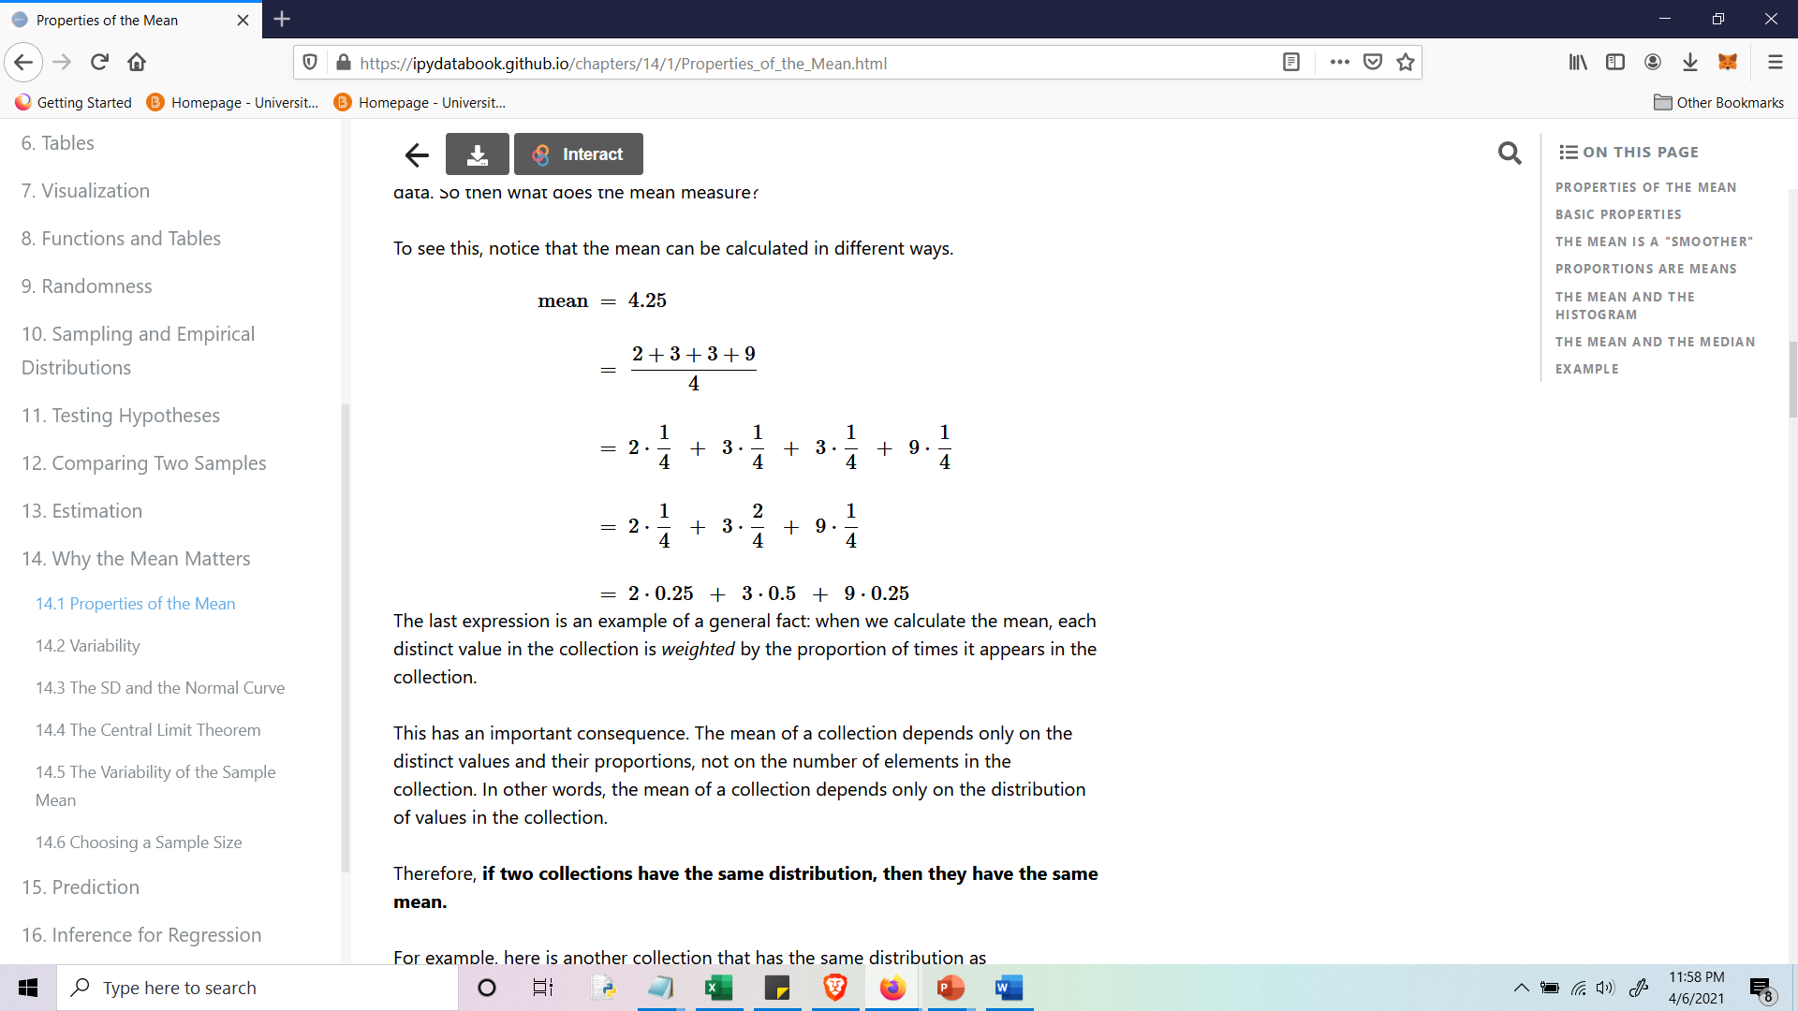
An interpretation of the Average
Data: 2, 3, 3, 9
Average = (2+3+3+9)/4 = 4.25
Notes:
So what do we mean when we say that the mean is the center of a data set?
Well what we will see is that the mean is ‘weighted’ center of the data set

Slide 26
An interpretation of the Average
Data: 2, 3, 3, 9
Average = (2+3+3+9)/4 = 4.25
Notes:
Lets see this by lookin at an example
Suppose we have the numbers 2,3,3,9
And we computed the average

Slide 27
An interpretation of the Average
Data: 2, 3, 3, 9
Average = (2+3+3+9)/4 = 4.25
Notes:
Then rewriting this as a sum we get the following

Slide 28
An interpretation of the Average
Data: 2, 3, 3, 9
Average = (2+3+3+9)/4 = 4.25
Notes:
We notice that 3 appears twice so we can combine them two be one term

Slide 29
An interpretation of the Average
Data: 2, 3, 3, 9
Average = (2+3+3+9)/4 = 4.25
Notes:
Therefore we now have this sum that has weights in front which represents the number of times the number
Appears in the distribution

Slide 30
An interpretation of the Average
Data: 2, 3, 3, 9
Average = (2+3+3+9)/4 = 4.25
Notes:
We see that 2 appears 25 percent of the time
3 appears 50 percent of the time
9 appears 25 percent of the time
The average value is then influenced by the number of times a value appears in the distribution
Roughly the more times a number appears in the data the stronger its influence is on the average
The average is thus the sum of all these proportions
This tells where ‘most’ of the data is near

Slide 31
An interpretation of the Average
Data: 2, 3, 3, 9
Average
Notes:
While this example was simple as the data set was small this idea holds true for any data set

Slide 32
An interpretation of the Average
Data: 2, 3, 3, 9
Average
Each distinct value in the collection is weighted by the proportion of times it appears in the collection
Notes:
We can find the proportion of times any number appears in the data and use the proportion as weight for that number
Then by adding them adding up this collection of values we get the weighted center of the collection
Which is where most the weight is located
Or the location where most of the values located around

Slide 33
An interpretation of the Average
Data: 2, 3, 3, 9
Average
Each distinct value in the collection is weighted by the proportion of times it appears in the collection
The average is the center of these weighted values
Notes:
Therefore we refer to the average as the weighted center of the data set

Slide 34
Some properties of the Average
Notes:
Some general properties of the average is
The average does not have to be a element in the collection
The average is always between the min and max but does not need to be in the halfway position
If our data is skewed then the average will skew in the same direction
Remebeer the median is the always in the halfway position between the min and max
Finally the average values has the same units as the daata

Slide 35
Some properties of the Average
Need not be a value in the collection
Notes:
The average does not have to be a element in the collection

Slide 36
Some properties of the Average
Need not be a value in the collection
Somewhere between min and max, but not necessarily halfway in between
Notes:
The average is always between the min and max but does not need to be in the halfway position
If our data is skewed then the average will skew in the same direction
Remebeer the median is the always in the halfway position between the min and max

Slide 37
Some properties of the Average
Need not be a value in the collection
Somewhere between min and max, but not necessarily halfway in between
Same units as the data
(Demo)
Notes:
Finally the average values has the same units as the daata

Slide 38
Comparing Mean and Median

Slide 39
Comparing Mean and Median
Mean: center of the weighted data
Notes:
The mean is dependent on the values of a data set
So if we change samples , the mean changes to fit that data set
Again we think of the mean as the weighted center of the data

Slide 40
Comparing Mean and Median
Mean: center of the weighted data
Median: value of halfway position of ordered data.
Notes:
On the other hand the median is the halfway position of our data
The median also changes with the sample but it is not effect by outliers
Since it only is really dependant on the position
This leads us to the following observations

Slide 41
Comparing Mean and Median
Mean: center of the weighted data
Median: value of halfway position of ordered data.
If the distribution is symmetric about a value, then that value is both the average and the median.
Notes:
If the distribution is symmetric or bell shaped about a value then the average and median are about equal to each other

Slide 42
Comparing Mean and Median
Mean: center of the weighted data
Median: value of halfway position of ordered data.
If the distribution is symmetric about a value, then that value is both the average and the median.
If the histogram is skewed, then the mean is pulled away from the median in the direction of the tail.
Notes:
If the distribution is skewed then the mean is pulled in the direction of the outliers or it is pulled in the direction of the tail
While the mean remains in the middle position of the data
Lets see an example of this

Slide 43
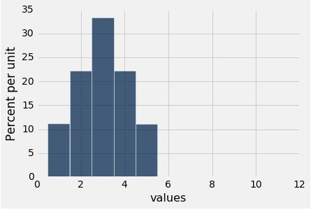
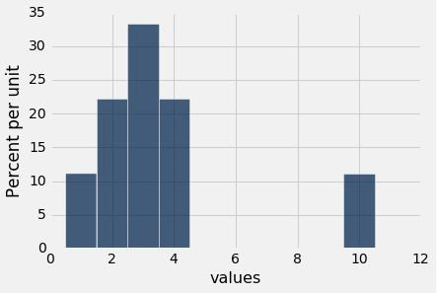
Example
Are the medians of these two distributions the same or different? Are the means the same or different? If you say “different,” then say which one is bigger.
Notes:
So we want to answer the following question
Are the medians of these distributions the same
Are means of this distribution the same
If they are different explain why

Slide 44
Discussion Question
Are the medians of these two distributions the same or different? Are the means the same or different? If you say “different,” then say which one is bigger.
Notes:
1.So the median values are always the halfway position in our order array
2.Therefore these distributions have the same median value because we only changed the last bar
3. These means the position in our array have not changed only the values at the end
3.But every position below the value 45 has not moved
4. And so The 50 percentile has not moved.
4. The median would only change if we moved more then 50 percent of the data

Slide 45
Discussion Question
Are the medians of these two distributions the same or different? Are the means the same or different? If you say “different,” then say which one is bigger.
Notes:
The mean values are seen in read
In the first distribution the mean should be equal to the median
Because most of the values are centered around middle value
In the second distribution the mean is pushed out towards the right
This is because we have an outlier piece of data
This outlier is pushing the average higher to account for the number of times it appears in the data set

Slide 46
Standard Deviation
Notes:
Alright so now we have a way of measuring the center of data
Again this is the average value
Now we want to be able to measure the length of the data or the variability
Along with having an understanding where most of the data lies
Do this will look at standard deviation and which measures data vairaibility and density from the mean!
Because what if we have two data sets with the same average but they have much different range of values
We would like to be able to distinguish between these data sets with the same average
But different variability
4. So we are looking at measuring variablilty which is in a sense the distance from the mean

Slide 47
Defining Variability
Notes:
So lets see how we could define variability

Slide 48
Defining Variability
Plan A: “biggest value - smallest value”
Doesn’t tell us much about the shape of the distribution
(Demo)
Notes:
So when way we could measure variablilty would be to find the biggest value and subtract by the smallest value
But this does not detect concentrations of data and will not tell us the shape of the histogram

Slide 49
Defining Variability
Plan A: “biggest value - smallest value”
Doesn’t tell us much about the shape of the distribution
(Demo)
Plan B:
Measure variability around the mean
Need to figure out a way to quantify this
(Demo)
Notes:
So instead we do not want to only measure the absolute length of the data set
But how values change in the data set
So to measure variability we will look at the the distance realitive to the average value
This means we will be looking at measuring how values change when we move further away from the mean
We are then going to measure variability with respect to the center of the data set
This will allow us to quantify how things are spread out in our data

Slide 50
How Far from the Average?

Slide 51
How Far from the Average?
Standard deviation (SD) measures roughly how far the data are from their average
Notes:
The standard deviation measures how far data is from the average
We will also see that is tells us how much data is with in a certain range

Slide 52
How Far from the Average?
Standard deviation (SD) measures roughly how far the data are from their average
SD has the same units as the data
Notes:
The standard deviation has the same units as the orgianal data

Slide 53
How Far from the Average?
Standard deviation (SD) measures roughly how far the data are from their average
SD has the same units as the data
SD = root mean square of deviations from average
5 4 3 2 1
Notes:
The idea again of standard deviation is that we want to know how far things are from our Mean on average
Because all values have a different distance from the average
So we are looking at quantifint how far all the data is from the mean on average
To comptue the square root you first find the average
Then find the deviations if each value from the average
Square these number
The find the mean – this is variance
Finall we take the square root

Slide 54
Why Use the SD?
Notes:
1.So why do we use the standard deviation?

Slide 55
Why Use the SD?
The first reason:
No matter what the shape of the distribution,
the bulk of the data are in the range “average ± a few SDs”
The second reason:
Coming up next time.
Notes:
2. Because not only does the SD give us a way of measuring how far values are from the mean
3. It also quantifies where large amounts of data live in the data set
3. This is convient because we can find the average and standar deviation no matter what the distribution looks like.
4. Whether the distribution is bellshaped or irregular we can find where most of the values live Using the average plus or means some standard deviations
5. We will see the other reason in the next section

Slide 56
Chebyshev's Inequality
Notes:
1. So now we will see that the standard deviation gives us a good guess where most of the
Data is at
2. This property comes from Chebyshev’s inequalilty

Slide 57
How Big are Most of the Values?
Notes:
1.So informally chebyshves inequality tells us that the bulk of the data lies with the range of values which is the average +- a few standard devations
2. Formally this is given by the following
3. The proportion of the values in the range average puls or minus z standardeviation is bounded below by 1-1divided by z^2

Slide 58
How Big are Most of the Values?
Chebyshev’s Inequality
No matter what the shape of the distribution,
Notes:
1.So informally chebyshves inequality is powerful bc it works on every distribution no matter how strange it looks
tells us that the bulk of the data lies with the range of values which is the average +- a few standard devations
2. Formally this is given by the following
3. The proportion of the values in the range average puls or minus z standardeviation is bounded below by 1-1divided by z^2

Slide 59
How Big are Most of the Values?
Chebyshev’s Inequality
No matter what the shape of the distribution,
the bulk of the data are in the range “average ± a few SDs”
Notes:
It tells us that the bulk of the data lies with the range of values which is the average +- a few standard devations

Slide 60
How Big are Most of the Values?
Chebyshev’s Inequality
No matter what the shape of the distribution,
the bulk of the data are in the range “average ± a few SDs”
the proportion of values in the range “average ± z SDs” is at least 1 - 1/z²
Notes:
2. Formally this is given by the following
3. The proportion of the values in the range of the average puls or minus z a standardeviation is bounded below by 1-1divided by z^2
4. Let s look at a few examples of this

Slide 61
Chebyshev’s Bounds
Range | Proportion
No matter what the distribution looks like
(Demo)
Notes:
Chebyshev’s bounds again work on any distrubtion and is the lower bound of the the amount values from the average
For example the proportion of values that within 2 standard deviation is 75 percent

Slide 62
Chebyshev’s Bounds
Range | Proportion
average ± 2 SDs | at least 1 - 1/4 (75%)
No matter what the distribution looks like
(Demo)
Notes:
This found using the equation from the last slide
This is saying that at least 75 percent of the values are within 2 standard devations
Maybe there is a higher percentage but there is never any less then 75 perceent

Slide 63
Chebyshev’s Bounds
Range | Proportion
average ± 2 SDs | at least 1 - 1/4 (75%)
average ± 3 SDs | at least 1 - 1/9 (88.888…%)
No matter what the distribution looks like
(Demo)
Notes:
For example the proportion of values that within 3 standard deviation is at least 88 percent
We can keep going here

Slide 64
Chebyshev’s Bounds
Range | Proportion
average ± 2 SDs | at least 1 - 1/4 (75%)
average ± 3 SDs | at least 1 - 1/9 (88.888…%)
average ± 4 SDs | at least 1 - 1/16 (93.75%)
No matter what the distribution looks like
(Demo)
Notes:
the proportion of values that are within 4 standard deviation is at least 88 percent

Slide 65
Chebyshev’s Bounds
Range | Proportion
average ± 2 SDs | at least 1 - 1/4 (75%)
average ± 3 SDs | at least 1 - 1/9 (88.888…%)
average ± 4 SDs | at least 1 - 1/16 (93.75%)
average ± 5 SDs | at least 1 - 1/25 (96%)
No matter what the distribution looks like
(Demo)
Notes:
For example the proportion of values that within 5 standard deviation is at least 96 percent
So this is saying how many standard devations to we need to go out from the mean to capture a certain amount of data
After demo
Again this is usfesul for knowing where the bulk of the data lies

Slide 66
Standard Units
Notes:
We would now like to measure data in terms of standard devation
This is done using standard units

Slide 67
Standard Units
Notes:
So we would a scsale for standard devation and know how far values are in terms of SD
The measurement in these terms are standard units
We use this to thinake about how far a value is above the average
Standard units are found by taking the value minus the average divide by the standard
Devitation
This allows us to compare different data in different distributiona
When we have a negative standard unit the value is below average
When we habe a positive standard unit the value is above average

Slide 68
Standard Units
How many SDs above average?
z = (value - average)/SD
(Demo)
Notes:
So we would a scsale for standard devation and know how far values are in terms of SD
The measurement in these terms are standard units
We use this to thinake about how far a value is above the average
Standard units are found by taking the value minus the average divide by the standard
Devitation
This allows us to compare different data in different distributiona
When we have a negative standard unit the value is below average
When we habe a positive standard unit the value is above average

Slide 69
Standard Units
How many SDs above average?
z = (value - average)/SD
Negative z: value below average
Positive z: value above average
z = 0: value equal to average
(Demo)
Notes:
So we would a scsale for standard devation and know how far values are in terms of SD
The measurement in these terms are standard units
We use this to thinake about how far a value is above the average
Standard units are found by taking the value minus the average divide by the standard
Devitation
This allows us to compare different data in different distributiona
When we have a negative standard unit the value is below average
When we habe a positive standard unit the value is above average

Slide 70
Standard Units
How many SDs above average?
z = (value - average)/SD
Negative z: value below average
Positive z: value above average
z = 0: value equal to average
When values are in standard units: average = 0, SD = 1
(Demo)
Notes:
So we would a scsale for standard devation and know how far values are in terms of SD
The measurement in these terms are standard units
We use this to thinake about how far a value is above the average
Standard units are found by taking the value minus the average divide by the standard
Devitation
This allows us to compare different data in different distributiona
When we have a negative standard unit the value is below average
When we habe a positive standard unit the value is above average

Slide 71
Standard Units
How many SDs above average?
z = (value - average)/SD
Negative z: value below average
Positive z: value above average
z = 0: value equal to average
When values are in standard units: average = 0, SD = 1
Chebyshev: At least 96% of the values of z are between -5 and 5
(Demo)
Notes:
So we would a scsale for standard devation and know how far values are in terms of SD
The measurement in these terms are standard units
We use this to thinake about how far a value is above the average
Standard units are found by taking the value minus the average divide by the standard
Devitation
This allows us to compare different data in different distributiona
When we have a negative standard unit the value is below average
When we habe a positive standard unit the value is above average

Slide 72
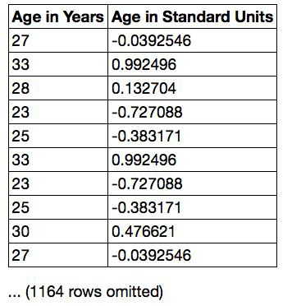
Discussion Question
Find whole numbers that are close to:
the average age
the SD of the ages (Demo)

