Slide 1
Announcements

Slide 2
Review: Standard Units
How many SDs above average?
z = (value - average)/SD
Negative z:
Positive z:
z = 0:
value below average value above average value equal to average
When values are in standard units: average = 0, SD = 1
Gives us a way to compare/understand data no matter what the original units

Slide 3
The SD and the Histogram
Usually, it's not easy to estimate the SD by looking at a histogram.
But if the histogram has a bell shape, then you can.

Slide 4
The SD and Bell-Shaped Curves
If a histogram is bell-shaped, then
the average is at the center
the SD is the distance between the average and the points of inflection on either side
(Demo)

Slide 5
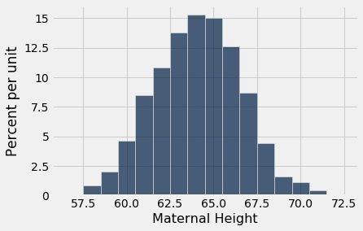
Point of Inflection

Slide 6
The Normal Distribution

Slide 7
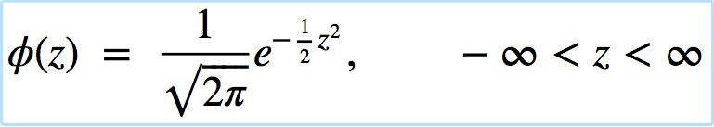
The Standard Normal Curve
A beautiful formula that we won’t use at all:

Slide 8
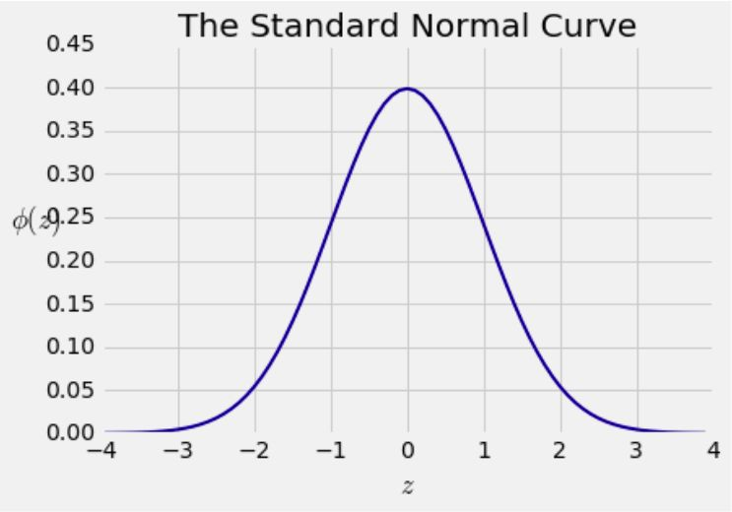
Bell Curve

Slide 9
Normal Proportions

Slide 10
How Big are Most of the Values?
No matter what the shape of the distribution,
the bulk of the data are in the range “average ± a few SDs”
If a histogram is bell-shaped, then
Almost all of the data are in the range “average ± 3 SDs”

Slide 11
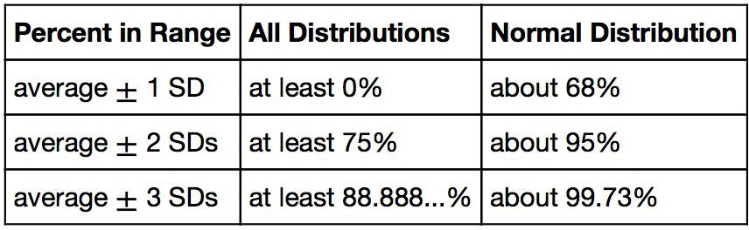
Bounds and Normal Approximations

Slide 12
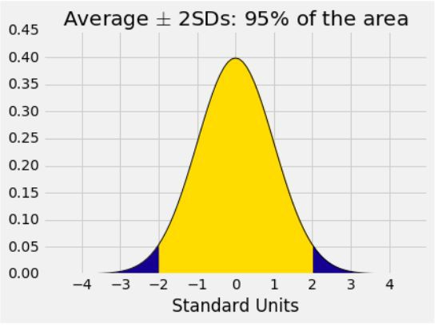
A “Central” Area

Slide 13
Central Limit Theorem

Slide 14
Sample Averages
The Central Limit Theorem describes how the normal distribution (a bell-shaped curve) is connected to random sample averages.
We care about sample averages because they estimate population averages.

Slide 15
Central Limit Theorem
If the sample is
large, and
drawn at random with replacement,
Then, regardless of the distribution of the population,
the probability distribution of the sample sum (or the sample average) is roughly normal
(Demo)

Slide 16
Distribution of the Sample Average

Slide 17
Why is There a Distribution?
You have only one random sample, and it has only one average.
But the sample could have come out differently.
And then the sample average might have been different.
So there are many possible sample averages.

Slide 18
Distribution of the Sample Average
Imagine all possible random samples of the same size as yours. There are lots of them.
Each of these samples has an average.
The distribution of the sample average is the distribution of the averages of all the possible samples.
(Demo)

Slide 19
Specifying the Distribution
Suppose the random sample is large.
We have seen that the distribution of the sample average is roughly bell shaped.
Important questions remain:
Where is the center of that bell curve?
How wide is that bell curve?

Slide 20
Center of the Distribution

Slide 21
The Population Average
The distribution of the sample average is roughly a bell curve centered at the population average.

Slide 22
Variability of the Sample Average

Slide 23
Why Is This Important?
Along with the center, the spread helps identify exactly which normal curve is the distribution of the sample average.
The variability of the sample average helps us measure how accurate the sample average is as an estimate of the population average.
If we want a specified level of accuracy, understanding the variability of the sample average helps us work out how large our sample has to be.
(Demo)

Slide 24
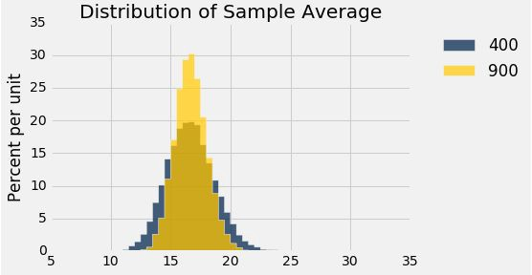
Discussion Question
The gold histogram shows the distribution of
values, each of which is .
(a) 900 (b) 10,000
a randomly sampled flight delay
an average of flight delays

Slide 25
The Two Histograms
The gold histogram shows the distribution of 10,000 values, each of which is an average of 900 randomly sampled flight delays.
The blue histogram shows the distribution of 10,000 values, each of which is an average of 400 randomly sampled flight delays.
Both are roughly bell shaped.
The larger the sample size, the narrower the bell.
(Demo)

Slide 26
Variability of the Sample Average
The distribution of all possible sample averages of a given size is called the distribution of the sample average.
We approximate it by an empirical distribution.
By the CLT, it’s roughly normal:
Center = the population average
SD = (population SD) / √sample size
(Demo)

Slide 27
Discussion Question
A city has 500,000 households. The annual incomes of these households have an average of $65,000 and an SD of $45,000. The distribution of the incomes [pick one and explain]:
is roughly normal because the number of households is large.
is not close to normal.
may be close to normal, or not; we can’t tell from the information given.

