Slide 1
The Normal Curve and The Central Limit Theorem
Notes:
Alright today we will begin looking at bell curves
So bell curves are very unique for a couple reasons
First there structure is very well understood
Second we are able to use this structure to understand the density of data around the center to a high degree of accuracy
Third it turns out that the disbtrition of averages computed from random samples will always have a normal distribution
This is called the central limit theorem
This is a really powerful result because with out any addiontional assumptions and for any sample or population we can use the average to make very accurate estimations

Slide 2
Standard Deviation and Standard Units
Notes:
Lets review standard deviation and standard units

Slide 3
How Far from the Average?

Slide 4
How Far from the Average?
Standard deviation (SD) measures roughly how far the data are from their average
Notes:
The standard deviation measures how far data is from the average

Slide 5
How Far from the Average?
Standard deviation (SD) measures roughly how far the data are from their average
SD has the same units as the data
Notes:
It has the same units as the original data

Slide 6
How Far from the Average?
Standard deviation (SD) measures roughly how far the data are from their average
SD has the same units as the data
SD = root mean square of deviations from average
5 4 3 2 1
Notes:
For a set of data , the definition of the standard deviation is the …
To compute it you take these steps starting at 1

Slide 7
How Far from the Average?
Standard deviation (SD) measures roughly how far the data are from their average
SD has the same units as the data
SD = root mean square of deviations from average
5 4 3 2 1
Python Function - np.std(array_of_values)
Notes:
But we have this python function np.std
This input is an array of values and the ouput is the standard deviation of those values!

Slide 8
Why Use the SD?
Notes:
1.So what is one reason we like using the standard deviation?

Slide 9
Why Use the SD?
Chebyshev’s Inequality
No matter what the shape of the distribution,
Notes:
2. Because of Chebyshev’s inequality
Chebyshev’s inequality is a very powerful tool for understanding the structure of any distribution
4because it works for every distribution no matter the shape

Slide 10
Why Use the SD?
Chebyshev’s Inequality
No matter what the shape of the distribution,
the bulk of the data are in the range “average ± a few SDs”
Notes:
It tells us that the bulk of the data lies with the range of values which is the average +- a few standard devations

Slide 11
Why Use the SD?
Chebyshev’s Inequality
No matter what the shape of the distribution,
the bulk of the data are in the range “average ± a few SDs”
the proportion of values in the range “average ± z SDs” is at least 1 - 1/z²
Notes:
2. The bulk of the data is The proportion of the values in the range of the average puls or minus z a standardeviation is bounded below by 1-1divided by z^2

Slide 12
Standard Units
Notes:
In the formula of chebyshevs inequlaty we also introduced standard units

Slide 13
Standard Units
Chebyshev’s Inequality
No matter what the shape of the distribution,
the proportion of values in the range “average ± z SDs” is at least 1 - 1/z²
Notes:
The z in this formula tells us how many standard deviations we are from the average

Slide 14
Standard Units
Chebyshev’s Inequality
No matter what the shape of the distribution,
the proportion of values in the range “average ± z SDs” is at least 1 - 1/z²
Notes:
This is what we defined as standard units

Slide 15
Standard Units
Chebyshev’s Inequality
No matter what the shape of the distribution,
the proportion of values in the range “average ± z SDs” is at least 1 - 1/z²
Standard units measure of how many SDs above average.

Slide 16
Standard Units

Slide 17
Standard Units
Standard units z = (value - average)/SD
Notes:
So again standard units measure how far values are in terms from the average
To compute the standard unit z we find the deviation from the average and divde by SD

Slide 18
Standard Units
Standard units z = (value - average)/SD
Negative z: value below average
Positive z: value above average
z = 0: value equal to average
(Demo 27)
Notes:
When we have a negative standard unit the value is below average
When we habe a positive standard unit the value is above average
When z is equal to zero then the value is equal to the average

Slide 19
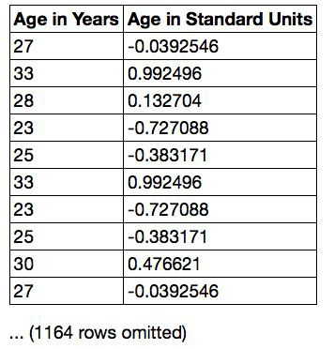
Discussion Question
Find whole numbers that are close to:
the average age
the SD of the ages (Demo 26)
Notes:
Lets do a bonus question
Here we have a set of data with ages in years and on the right hand side the age in standard units
So there are two questions
1. what is the average age
And 2. what is the SD of the ages
Right so the average can be found by looking at the which age in years has a standard devation of 0 or close to zero
For example 27 has a small standard devation .03 so the average is close to 27
To find the SD of the ages we look for SU that is closed to 1 subtract 33 and 27 and we get around 6

Slide 20
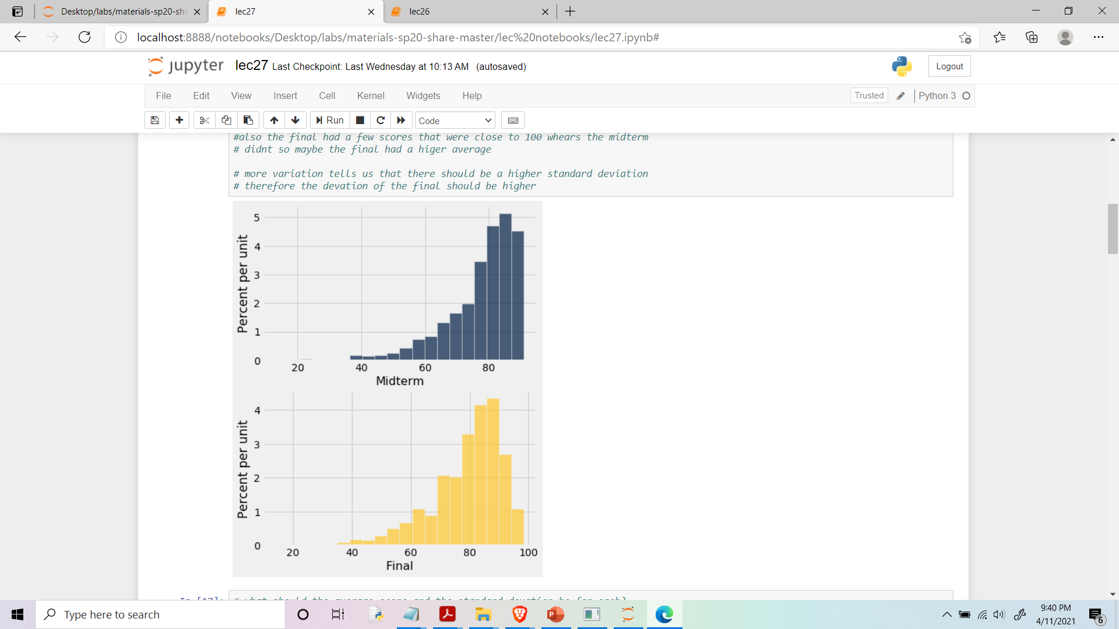
The SD and the Histogram
Usually, it's not easy to estimate the SD by looking at a histogram.
Notes:
So From these histgorams from earlier we could get rough idea whaat the averages was
But finding the standard devation by looking at them was not really possible
But for certain distributions its not only possible to find the mean by visual cues
but also the standard devation
This is true for our bellshaped curves
We will not consider either one of these curves as being bellshaped!

Slide 21
The SD and Bell-Shaped Curves
Notes:
So lets talk about bellshaped curves.
A bell shaped curve is a curve who has a max value at the middle of the curve
Values on the curve descrease as we get farther from the middle
So the curve begins to flatten and roughly looks like a bell
We will not formally define a bell shaped curve but it will either be obvious when a curve is bell shaped or we will tell you.

Slide 22
The SD and Bell-Shaped Curves
If a histogram is bell-shaped, then
Notes:
4. We will look at some example of these curves in a bit
5. But if you have data whose histogram is bell-shaped then you can find the mean, and SD by looking at the curve

Slide 23
The SD and Bell-Shaped Curves
If a histogram is bell-shaped, then
the average is at the center
Notes:
6. The average is at the center

Slide 24
The SD and Bell-Shaped Curves
If a histogram is bell-shaped, then
the average is at the center
the SD is the distance between the average and the points of inflection on either side
Notes:
7. The SD the distance from the center to the inflection point
8. We will also not formally define an inflection point
8. But Don’t worry about the definition of the inflection point to much
9. We will discuss how to find it visually
10 This is the only thing that you will be asked to do at this stage!

Slide 25
The SD and Bell-Shaped Curves
If a histogram is bell-shaped, then
the average is at the center
the SD is the distance between the average and the points of inflection on either side
(Demo 26)
Notes:
Lets look back at lecture 26 now

Slide 26
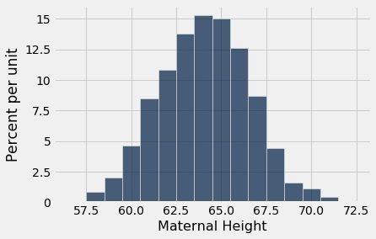
Point of Inflection
Notes:
Here we have our maternal height histogram
And we want to identidy quickly one standard devation above and below the average
Therefore we want to find the inflection points
So lets make sure we know where inflection points are located on bellchaped curves

Slide 27
Point of Inflection
Notes:
These bars represent our range of 1 standard unit
Now if we draw the curve between this range we get something like this

Slide 28
Point of Inflection
Notes:
This is the top of our hill where we pick up the most speed going down
This type of curve is called concave down.
We can define this using derivatives in calculus

Slide 29
Point of Inflection
Notes:
1.Then if we draw the remainder of the curve
2. These green pieces would be concave down
3. But at the point the red curve meets the green curve is our inflectio npoint
4. So our bell shaped curve has two inflection points
5. At each of the inflection porints we are one standard devation from the mean

Slide 30
The Normal Distribution
Notes:
An important property of bell shaped curves is that we can quickly find the mean and the average by looking at the middle and inflection points
However we will see that the structure of these curves can tells us much more then this
Formally bell shaped curves are modeled after normal curves and correspond to normal distributions
More specifically Bell shaped distributions are approximations normal distributions
But we will treat bellshaped curves as if they are full normal curvse

Slide 31
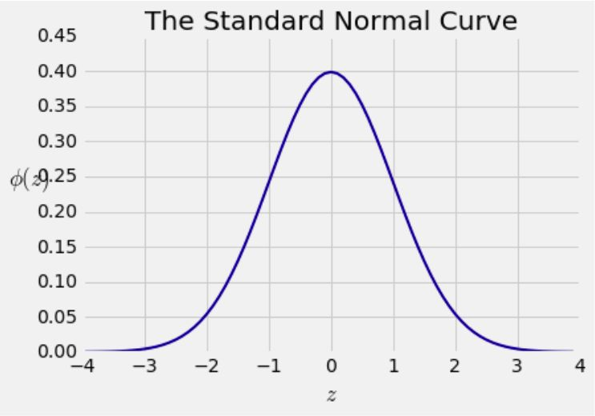
Bell Curve
Notes:
All bell-shaped histograms that we have seen look essentially look like this.
This is calle a standard normal curve
And really this shape is the basic shape of all normal distributions
Because all the curves can be drawn just by relabeling the axes appropriately.
In reality we will never see exactly this curve in our data
However many datasets will have a histogram that aporximates this shape.
We see that the mean value is centered at 0
And the SD is found at the inflection point
If we look at this inflection point we see that the SD corresponds to 1 on the x-axis

Slide 32
The Standard Normal Curve

Slide 33
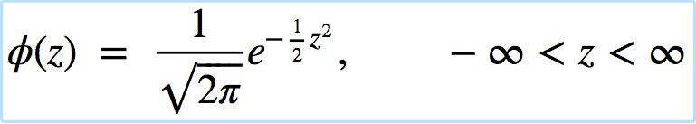
The Standard Normal Curve
A beautiful formula that we won’t use at all:
Notes:
So this is aformula for a standard normal curve
Don’t worry about this formula we will not use it in this class
But this is the formula we would study to learn about normal distributions
If you continue on in statistics this will show up again and again

Slide 34
The Standard Normal Curve
A beautiful formula that we won’t use at all:
The average is at the 0
The points of inflection are at 1,-1
The total area under the curve is 1
Notes:
2. This curve has a center at zero and a SD at 1 and -1
3. One other important aspect is that we can compute area under the curve.
4. Since we are we are thinking of the curve as a our approximate histogram,
5. Area under the curev represents proporitons of the total amount of data

Slide 35
Area under Normal Curve
Area under the normal curve use: stats.norm.cdf(Z)
Notes:
To find the area under the curve you can use stat.norm cdf
This functions takes inputs as any real number

Slide 36
Area under Normal Curve
Area under the normal curve use: stats.norm.cdf(Z)
Z is any real number

Slide 37
Area under Normal Curve
Area under the normal curve use: stats.norm.cdf(Z)
Z is any real number
Area under curve represents proportions of the total amount of data
Notes:
And the output will be the area staring at negative inifinity until z
The important thing to remember is the area under the curve represents the proporint of the data within that range
We will not use this function in any assignments but this will be good to know as this will give us bounds on the density of
Data for norma ldistributions

Slide 38
Area under Normal Curve
To find the area under the normal curve until 2
Notes:
Let suppose we wanted to find the area under the curve until2

Slide 39
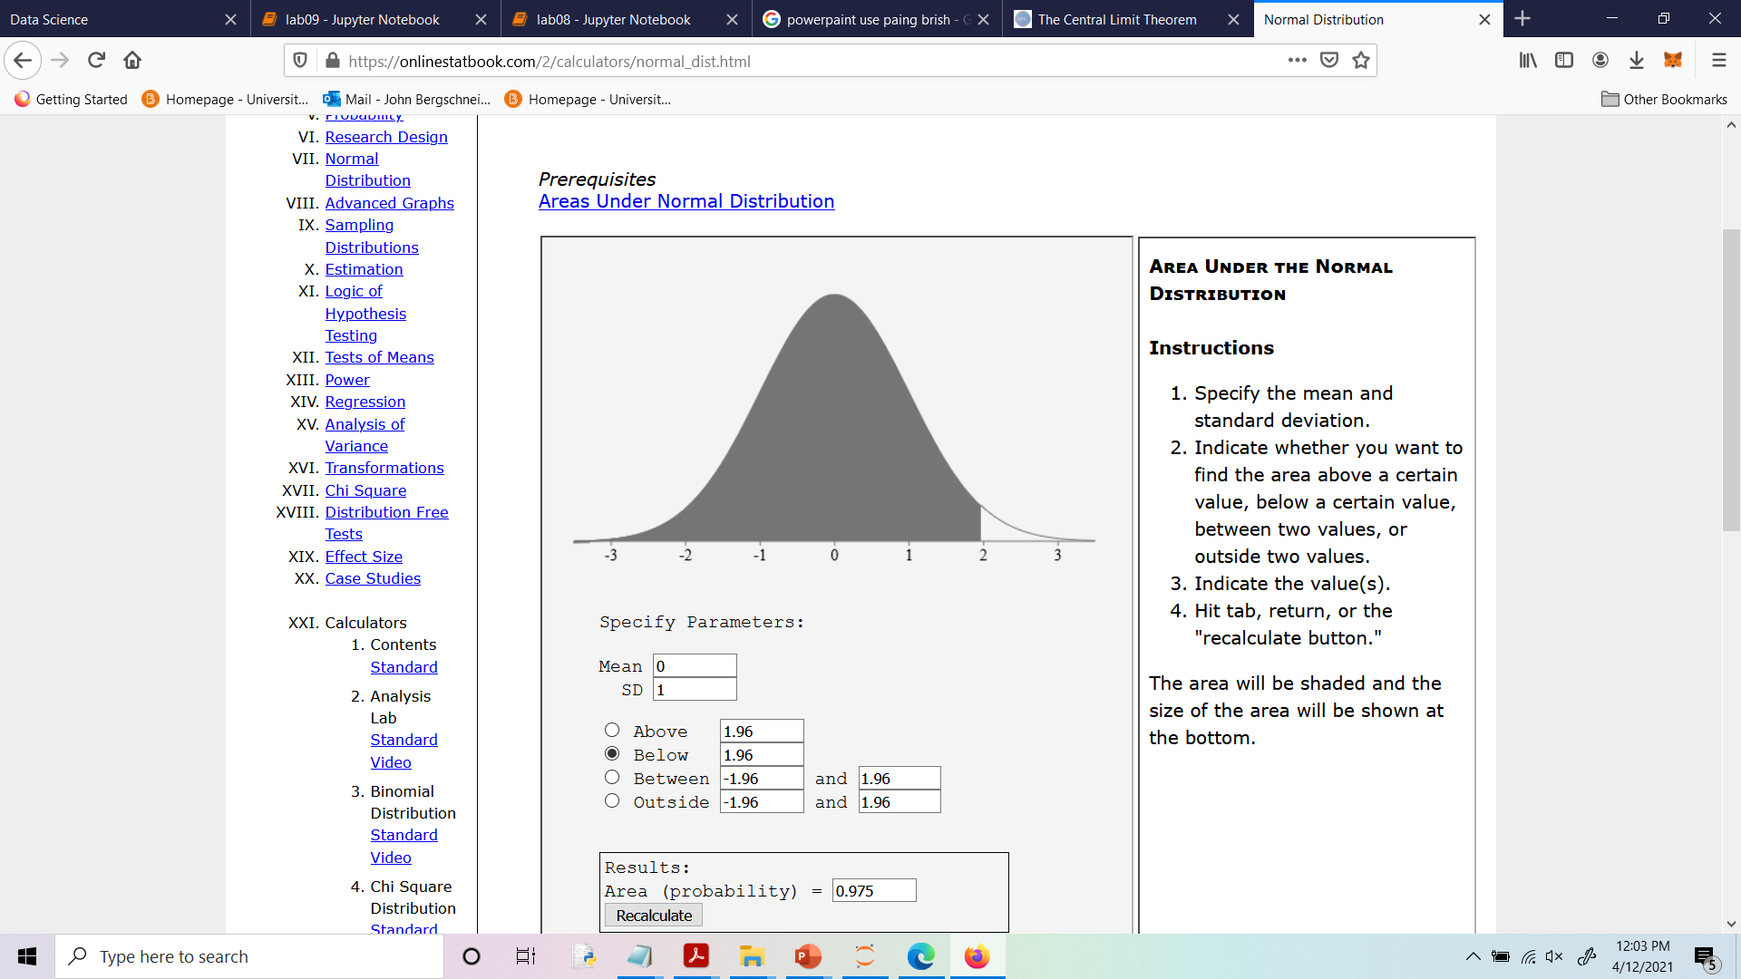
Area under Normal Curve
To find the area under the normal curve until 2
Notes:
We just plug into 2 into our function

Slide 40
Area under Normal Curve
To find the area under the normal curve until 2
stats.norm.cdf(2)=

Slide 41
Area under Normal Curve
To find the area under the normal curve until 2
stats.norm.cdf(2)=97.5
Notes:
And get that 97.5 percent of data in a normal distribution lives in this range
We will see that this gives better bounds for the poroptions of values in normal distribution then chebysevs ineqaulty did

Slide 42
Normal Proportions
Notes:
So now that we know what a normal distribution and how to find the area underneath the curve
We will look at more interesting properties

Slide 43
How Big are Most of the Values?
Notes:
So one question that we saw last week was how big are most values for some distribution
For every distrubtion we have a partial answer using chebyshevs inequality

Slide 44
How Big are Most of the Values?
No matter what the shape of the distribution,
the bulk of the data are in the range “average ± a few SDs”
Notes:
Chebyskevs inequality told us that if we know the average and the SD then we could caculate the lower bound for the proportion of indivuals that lie in that range
I.e we know the proportion of indivalus that live in a certain distance from the average
But remember this is only a lower bound

Slide 45
How Big are Most of the Values?
No matter what the shape of the distribution,
the bulk of the data are in the range “average ± a few SDs”
If a histogram is bell-shaped, then
Almost all of the data are in the range “average ± 3 SDs”
Notes:
if we have a normal distribution we can do even better.
It is not to hard to show using the function from the previous section then almost all data is between 3 SD from the mean value
Lets compare the proportion of indivuals between normal distribution and any distribution

Slide 46
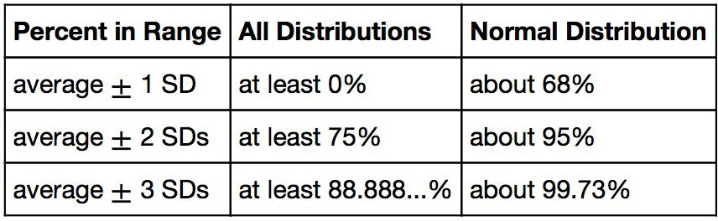
Bounds and Normal Approximations
Notes:
So here is the breakdown

Slide 47
Bounds and Normal Approximations
Notes:
For 1 standard deviation we cannot say anything about every distribution using Chebyshevs
however for a normal distribution 68 percent of the data is within 1 SD

Slide 48
Bounds and Normal Approximations
Notes:
For a range of 2 SD from the average, chebeyshevs inequality tells us that at least 75 percent of the indivuals lie in this range
While we can show that 95 perecent of the indivuals lie in this range for a normal distribution

Slide 49
Bounds and Normal Approximations
Notes:
Finally for a range of 3 SD, chebyshevs inequality tells us that 88.88 percent of the sample lives in this range
While 99 percent of the indivuals live within 3 SD for a normal distriubiton
So this one reason why normal distributions are nice
One We have an even better understanding of the density of indivuals from the average value
And two varaibaility is well mannered and contains not many outliers

Slide 50
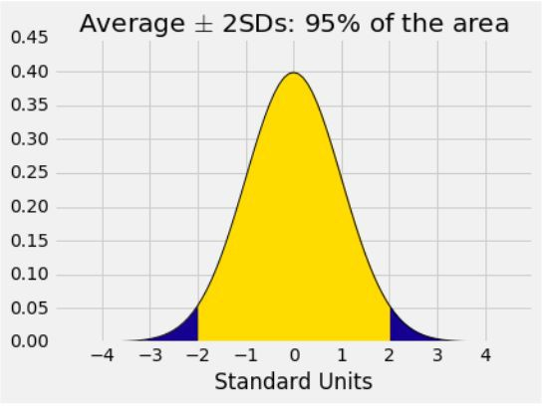
A “Central” Area
Notes:
So here is a picture of the bounds fpr 2 SD
The area under the curve represents the total percentage of indivuals in this range which is 95 percent

Slide 51
Central Limit Theorem
Notes:
So now lets talk about The cental limit theorem and how we can us normal distributions
This therem is really amazing in the sense that again this result will hold for any distribution
And gives us a away of making fairly accurate predicitons

Slide 52
Sample Averages
Notes:
Many times we are working with histogram of a statistic based on a random sample

Slide 53
Sample Averages
We care about sample averages because they estimate population averages.
Notes:
Often it’s the sample averages.
As we can make estimations on the population
It runs out we can completely classify the distribution of averages computed from random samples using the central limii theorem

Slide 54
Sample Averages
We care about sample averages because they estimate population averages.
The Central Limit Theorem describes how the normal distribution (a bell-shaped curve) is connected to random sample averages.
Notes:
In fact the central limit theorem tell us the that our random sample averages form a normal distribution

Slide 55
Central Limit Theorem
Notes:
So whenever we are looking to estiamate something
We need two things a number to describe the estimate and the variability of the estimate
So central limit theorem allows us to create a sense of confidence with our esimations of averages

Slide 56
Central Limit Theorem
If the sample is
large, and
drawn at random with replacement,
Notes:
if you have a large sample size and you draw your samples with replacement
Then every distribiton has the following property

Slide 57
Central Limit Theorem
If the sample is
large, and
drawn at random with replacement,
Then, regardless of the distribution of the population,

Slide 58
Central Limit Theorem
If the sample is
large, and
drawn at random with replacement,
Then, regardless of the distribution of the population,
the probability distribution of the sample sum (or the sample average) is roughly normal
(Demo)
Notes:
The porbility distrion of the sample average is roughly normal
This is really powerful because this works on every distribution
And This says that the average and the variability of the average is completely understood!
Its normal and we can find out bounds on our estimates exactly

