Slide 1
Average of Large Samples
Notes:
Last time we talked about the Central Limit Theorem
This theorem makes it possible to make esimations with very little knowledge about the population
Today we will extend the central limit theorem to include variability ranges on our estimates

Slide 2
Normal Curve
Notes:
We also formally introduced the Normal Curve
Informally this is the bellshaped curve
Lets review some basic properties as a refresher

Slide 3
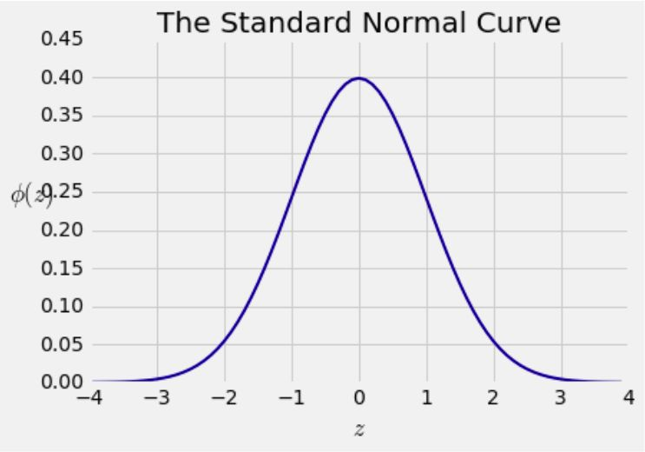
The Standard Normal Curve
Notes:
The normal curve is roughly shaped like a bell

Slide 4
The Standard Normal Curve
The average is at the 0
Notes:
The average is roughly centered at zero

Slide 5
The Standard Normal Curve
The average is at the 0
One SD is at 1 and -1
Notes:
The points of inflection at -1 and 1
This is means that we have a standard devation and 1,-1

Slide 6
The Standard Normal Curve
The average is at the 0
One SD is at 1 and -1
The total area under the curve is 1
Notes:
Area under the curve represents the proportion of the total population

Slide 7
Bounds and Normal Approximations
Notes:
Normal distrbutions are called bell-shaped
And the proportiosn of bell shaped curves are very well understood

Slide 8
Bounds and Normal Approximations
If a histogram is bell-shaped, then
Almost all of the data are in the range “average ± 3 SDs”
Notes:
For example we know that most data in a bell shaped curve lies in the range from 3 SD from the average
In fact we had some exact proportions from last time.

Slide 9
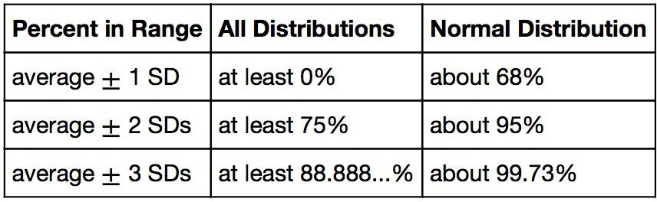
Bounds and Normal Approximations
If a histogram is bell-shaped, then
Almost all of the data are in the range “average ± 3 SDs”
Notes:
For example the propotion of indiviuals that are within 3 sd devations from the average is more then 99 percent.
This is extremely useful because the distribution of sample means turns out to be normal!
Because we know the proportions and SD we can make very accurate esimations!

Slide 10
Central Limit Theorem
Notes:
Lets review the cental limit theorem

Slide 11
Sample Averages

Slide 12
Sample Averages
We care about sample averages because they estimate population averages.
Notes:
So the central limit theorem deals with averages
More specifically it completely describes the distributions that sample averages arise in
This is nice because with just one sample we are able to predict the population’s average very accuratly

Slide 13
Sample Averages
We care about sample averages because they estimate population averages.
The Central Limit Theorem describes how the normal distribution (a bell-shaped curve) is connected to random sample averages.
Notes:
So the connection between our random sample averages and our normal distribution is given by the central limit theorem
It roughly states the the distribution of the sample averages form a normal distribution
Another positive is that this allows us to find the standard devation of our sample averages quickly!

Slide 14
Central Limit Theorem

Slide 15
Central Limit Theorem
If the sample is
large, and
drawn at random with replacement,
Notes:
if you have a large sample size and you draw your samples with replacement

Slide 16
Central Limit Theorem
If the sample is
large, and
drawn at random with replacement,
Then, regardless of the distribution of the population,
Notes:
Then every distribiton has the following property

Slide 17
Central Limit Theorem
If the sample is
large, and
drawn at random with replacement,
Then, regardless of the distribution of the population,
the probability distribution of the sample sum (or the sample average) is roughly normal
(Demo)
Notes:
The porbility distrion of the sample average is roughly normal
This is really powerful because this works on every distribution

Slide 18
Central Limit Theorem
If the sample is
large, and
drawn at random with replacement,
Then, regardless of the distribution of the population,
the probability distribution of the sample sum (or the sample average) is roughly normal
(Demo)
Notes:
And This says that the average and the variability of the average is completely understood!
Its normal and we can find out bounds on our estimates exactly

Slide 19
Todays Goals
Notes:
So lets breakdown what we want to look at today

Slide 20
Todays Goals
Sample Average need not be equal to population average.
it will have variability
Notes:
First sour sample averages do not have to be equal to the population average
Because There is be variablilty in our samples

Slide 21
Todays Goals
Sample Average need not be equal to population average.
it will have variability
By CLT, the distribution of sample averages is normal
Estimation is given by distribution
Variability is given by SD
Notes:
However the central limit theorem tell us the distribution of our sample averages is normal
We can estimate the parameter by the center distribution
And the variability of our estimate is given by the SD
since we can find the SD easily for a bell shaped curve we can determine a good range of estimations

Slide 22
Todays Goals
Sample Average need not be equal to population average.
it will have variability
By CLT, the distribution of sample averages is normal
Estimation is given by distribution
Variability is given by SD
Notes:
1.So today we will look at how to estimate the population average
2. And the variability of our guess

Slide 23
Distribution of Sample Average

Slide 24
Why is There a Distribution?
Notes:
1.So what do we mean by distribution of a sample average
2. Let me carefully walk you through this

Slide 25
Why is There a Distribution?
You have only one random sample, and it has only one average.
Notes:
1. Usually you will only get 1 random sample in real life and it will have 1 average
4. But the sample could have come out differently

Slide 26
Why is There a Distribution?
You have only one random sample, and it has only one average.
But the sample could have come out differently.

Slide 27
Why is There a Distribution?
You have only one random sample, and it has only one average.
But the sample could have come out differently.
And then the sample average might have been different.
Notes:
5. If your sample did come out differently then you would get a slightly different sample average

Slide 28
Why is There a Distribution?
You have only one random sample, and it has only one average.
But the sample could have come out differently.
And then the sample average might have been different.
So there are many possible sample averages.
Notes:
6. So there are many possibilities that the sample average could be if you take your randomsample and compute the random sample average
7. It all really depends on the random choice you made to include an individual in the sample or not
8. So that’s why there is a distribution, because the sample average depends on our random choice for our sample

Slide 29
Why is There a Distribution?
You have only one random sample, and it has only one average.
But the sample could have come out differently.
And then the sample average might have been different.
So there are many possible sample averages.
Notes:
So this is the distribution that we are talking about

Slide 30
Distribution of the Sample Average
Notes:
1. So lets conceptualize this distribution

Slide 31
Distribution of the Sample Average
Imagine all possible random samples of the same size as yours. There are lots of them.
Notes:
Imaginge that you took all possible random samples
For example you took all possible ways to choose 400 of the flights
This is a huge number of samples

Slide 32
Distribution of the Sample Average
Imagine all possible random samples of the same size as yours. There are lots of them.
Each of these samples has an average.
Notes:
1. Each of these samples has an average

Slide 33
Distribution of the Sample Average
Imagine all possible random samples of the same size as yours. There are lots of them.
Each of these samples has an average.
The distribution of the sample average is the distribution of the averages of all the possible samples.
Notes:
The distribution of the sample average is just the distribution of all those aaverages you get by looking at all possible samples

Slide 34
Distribution of the Sample Average
Imagine all possible random samples of the same size as yours. There are lots of them.
Each of these samples has an average.
The distribution of the sample average is the distribution of the averages of all the possible samples.
(Demo)
Notes:
So to summarize if you were to write down every possible sample, find all the averages, and you look at the distrbituion of those possible averages
that’s the distribution we are talking about

Slide 35
Specifying the Distribution
Notes:
Lets take about the shape of the distribution

Slide 36
Specifying the Distribution
Suppose the random sample is large.
We have seen that the distribution of the sample average is roughly bell shaped.
Notes:
We can see that our distribution of our average samples is bell shaped
The central limit theorem confirms that it is a normal distribution

Slide 37
Specifying the Distribution
Suppose the random sample is large.
We have seen that the distribution of the sample average is roughly bell shaped.
Important questions remain:
Where is the center of that bell curve?
How wide is that bell curve?
Notes:
The next questions to ask it where is the center and what is the spread
So where is the center of our bell curve
And how wide is it

Slide 38
Center of the Distribution
Notes:
1. We visually saw were the center is
2. The center looks like it is at the population mean in our example of flight delays

Slide 39
The Population Average
Notes:
It turns out this is always the case

Slide 40
The Population Average
The distribution of the sample average is roughly a bell curve centered at the population average.
(Demo)
Notes:
the distribution of the sample average is always a normal distribution and its centered at the population average
This holds no matter how large our sample is
Lets confirm this with a sample of another size

Slide 41
Variability of the Sample Average
Notes:
So what were are trying to do is measure the variability of the sample average
You wanna know how skinny is our curve because this tells us how much error there is in our estimate

Slide 42
Why is variability important?

Slide 43
Why is variability important?
The variability of the sample averages measures how accurate the sample average is as an estimate of the population average
Notes:
The variability of the sample average is a measure.
Its a numberical measure of how accurate the sample average is as an estimate of the population average

Slide 44
Why is variability important?
The variability of the sample averages measures how accurate the sample average is as an estimate of the population average
If you want a specified level of accuracy, understanding the variability of the sample average helps us work out how large our sample has to be.
(Demo)
Notes:
If you want a specified measure of accuracy for your estimation then we can find the exact sample size you need to get that level of accuracy
In particular we will see what kind of accuracy you can expect for a particular sample size
So we have this relationship between sample size and variability.
It tells us that sample size effects the error in the estimate
Lets try to discover this realtaion ship

Slide 45
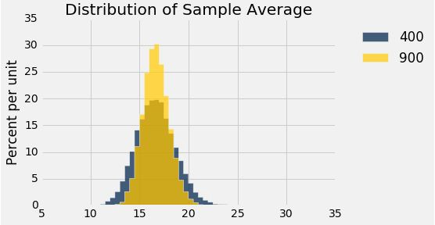
Discussion Question
The gold histogram shows the distribution of
values, each of which is .
(a) 900 (b) 10,000
a randomly sampled flight delay
an average of flight delays
Notes:
Lets see where your at.
Rember this overlaid histogram from earlier
We just want to complete the statement.
The gold histogram shows the distrubiton of blank values, wach of which is blank
So type your snawers into chat like ab or cb da
So the answer is BD. This histogram is the of 10000 values of the average of flight delays

Slide 46
Variability of the Sample Average

Slide 47
Variability of the Sample Average
The distribution of all possible sample averages of a given size is called the distribution of the sample average.
Notes:
Here is the pattern we learned

Slide 48
Variability of the Sample Average
The distribution of all possible sample averages of a given size is called the distribution of the sample average.
We approximate it by an empirical distribution.

Slide 49
Variability of the Sample Average
The distribution of all possible sample averages of a given size is called the distribution of the sample average.
We approximate it by an empirical distribution.
By the CLT, it’s roughly normal:
Center = the population average
SD = (population SD) / √sample size
Notes:
The distrubtion of all possible sample averages is a normal distribution
The CLT tells us that
The center of the distribution is at the population average
And the SD is given by population SD divided by the sqrt of the sample size
Basically the spread descreases with larger samples sizes But not proportionally
This lets us predict, how large the SD will be for the sample means for given sample size
Or how much error we can expect on an estimation of a certain sample size

Slide 50
Discussion Question
A city has 500,000 households. The annual incomes of these households have an average of $65,000 and an SD of $45,000. The distribution of the incomes [pick one]:
is roughly normal
is not close to normal.
we can’t tell from the information given.
Notes:
1.

Slide 51
Discussion Question
A city has 500,000 households. The annual incomes of these households have an average of $65,000 and an SD of $45,000.
Take a sample of 100 of these households. Take the average of this sample. What is the distribution of the sample averages for 10000 averages [pick one]:
is roughly normal (CLT)
is not close to normal.
we can’t tell from the information given.

Slide 52
Discussion Question
A city has 500,000 households. The annual incomes of these households have an average of $65,000 and an SD of $45,000.
Take a sample of 100 of these households. Take the average of this sample. About what is the error (SD) in the sample average distribution of 10000 [pick one]:
4500 SD = (population SD) / √sample size
5000 = 45,000 / sqrt(100)
we can't tell from the information given.

