Slide 1
The Regression Line
Notes:
Okay so today we will look at the regression lne

Slide 2
Announcement
D2L Quiz – Sample Averages
Due Today
D2L Quiz – Correlation
Due Friday
Lab 08
Due Sunday

Slide 3
Correlation (Review)
Notes:
1. Lets review correlation

Slide 4
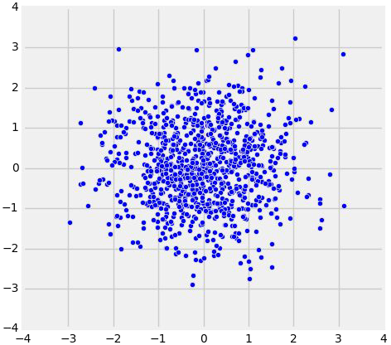
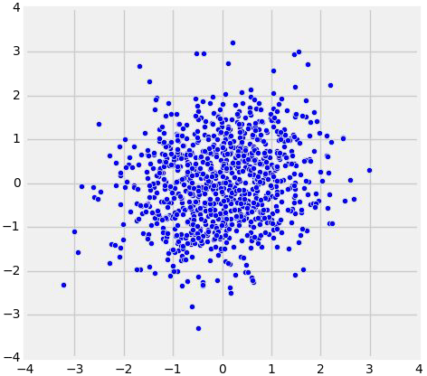
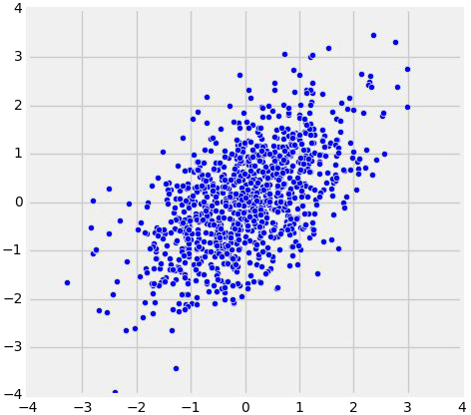
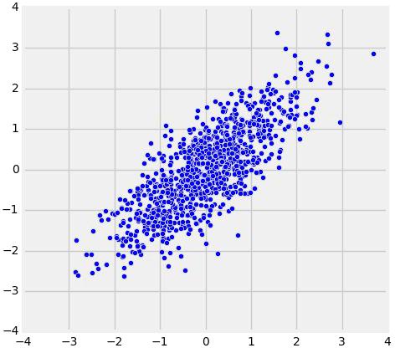
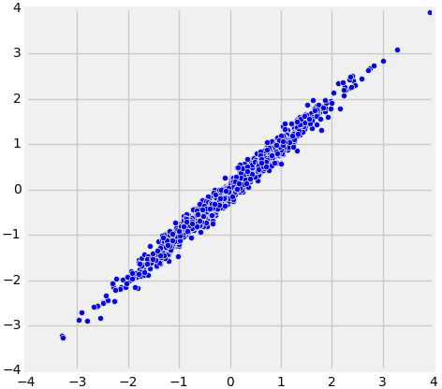
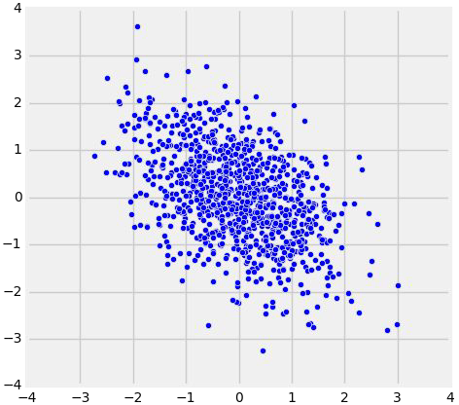
The Correlation Coefficient r
r = 0
r = 0.2
r = 0.5
r = 0.8
r = 0.99
r = -0.5

Slide 5
The Correlation Coefficient r
Measures linear association
r = 0
r = 0.2
r = 0.5
r = 0.8
r = 0.99
r = -0.5
Notes:
correlation is a measure of linear association
Intuitvly, this number measures how close points are clustered near a straight line

Slide 6
The Correlation Coefficient r
Measures linear association
Based on standard units
r = 0
r = 0.2
r = 0.5
r = 0.8
r = 0.99
r = -0.5
Notes:
to compute the correlation coefficient all values must be in standard units.
So given a point you need to convert both the x component and the y component to standard units

Slide 7
The Correlation Coefficient r
Measures linear association
Based on standard units
-1 ≤ r ≤ 1
r = 0
r = 0.2
r = 0.5
r = 0.8
r = 0.99
r = -0.5
Notes:
The correlation coefficient is always between -1 and 1.
And it is denoted by r

Slide 8
The Correlation Coefficient r
Measures linear association
Based on standard units
-1 ≤ r ≤ 1
r = 1: scatter is perfect straight line sloping up
r = -1: scatter is perfect straight line sloping down
r = 0: No linear association; uncorrelated
r = 0
r = 0.2
r = 0.5
r = 0.8
r = 0.99
r = -0.5
Notes:
When it is 1 we have a very strong positive assicaiton
When it is -1 we have a very strong negative assicaiton
If r is zero then there is a no association

Slide 9
The Correlation Coefficient r
Measures linear association
Based on standard units
-1 ≤ r ≤ 1
r = 1: scatter is perfect straight line sloping up
r = -1: scatter is perfect straight line sloping down
r = 0: No linear association; uncorrelated
r = 0
r = 0.2
r = 0.5
r = 0.8
r = 0.99
r = -0.5
Notes:
Down below we have a few examples
We see that when r= 0 there is no association
But as r increases the points begin to cluster around a line
For example when r = .8, the points are beginning to form a definitive shape
Then when r = .99 we see that the points are almost forming a straight line which shows the
X and y values have a very strong association

Slide 10
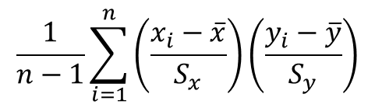
Definition of r
$$\frac{1}{n−1}\sum_{i=1}^{n}{\left(\frac{x_{i}−\overline{x}}{S_{x}}\right)}\left(\frac{y_{i}−\overline{y}}{S_{y}}\right)$$
Correlation Coefficient (r) =
average of | product of | x in standard units | and | y in standard units
Measures how clustered the scatter is around a straight line
Notes:
We can the correlation coefficient as follows

Slide 11
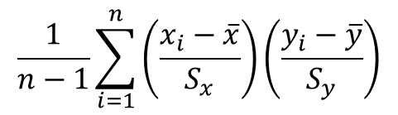
Definition of r
$$\frac{1}{n−1}\sum_{i=1}^{n}{\left(\frac{x_{i}−\overline{x}}{S_{x}}\right)}\left(\frac{y_{i}−\overline{y}}{S_{y}}\right)$$
Correlation Coefficient (r) =
1
1
average of | product of | x in standard units | and | y in standard units
Measures how clustered the scatter is around a straight line
Notes:
First make x and y components of the points in your scatterplot to be in standard units

Slide 12
Definition of r
$$\frac{1}{n−1}\sum_{i=1}^{n}{\left(\frac{x_{i}−\overline{x}}{S_{x}}\right)}\left(\frac{y_{i}−\overline{y}}{S_{y}}\right)$$
Correlation Coefficient (r) =
2
1
1
average of | product of | x in standard units | and | y in standard units
Measures how clustered the scatter is around a straight line
Notes:
Take the product of the corresponding x values and the y values

Slide 13
Definition of r
$$\frac{1}{n−1}\sum_{i=1}^{n}{\left(\frac{x_{i}−\overline{x}}{S_{x}}\right)}\left(\frac{y_{i}−\overline{y}}{S_{y}}\right)$$
Correlation Coefficient (r) =
3
2
1
1
average of | product of | x in standard units | and | y in standard units
Measures how clustered the scatter is around a straight line
Notes:
The correlation coefficient measures how closlesy clustered around a straight line
This line iscalled the line of best fit
And The correlation coefficeient turns out to be the slope for the line of best fit
Which is what we will be studying today

Slide 14
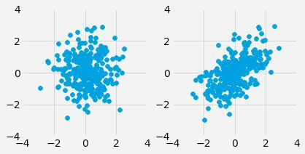
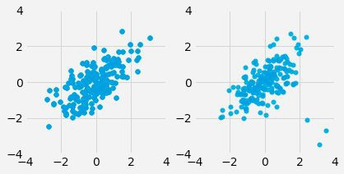
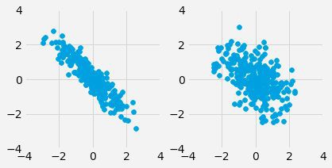
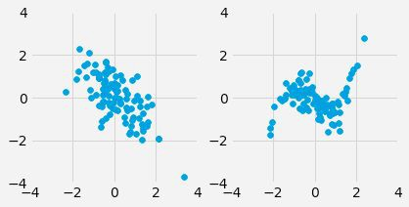
Discussion Question
For each pair, which one will have a higher* value of r?
a)
b)
c)
d)
* here, “higher” means “bigger on the number line”
Notes:
Lets look at this problem to test your understanding
For each pair find the graph that has the higher correlation coeffiecent
So we the correlation that is closer to 1
A- second because the points are clustered around a line
This says that the second graph as a strong positive associton

Slide 15
Discussion Question
For each pair, which one will have a higher* value of r?
a)
b)
c)
d)
* here, “higher” means “bigger on the number line”
Notes:
B while the shape is the same you can see some points on the outside of the second one this indicates therei s a little more spread to the data. So the first one has a higher value
Again the correlation coefficient is meaausuring how densely the points are conenctrated to a line

Slide 16
Discussion Question
For each pair, which one will have a higher* value of r?
a)
b)
c)
d)
* here, “higher” means “bigger on the number line”
Notes:
For part c. while the first one has a stronger negative correlation this means that the correlation is cloer to -1 then the other graph but wer are looking for the higher of the two correlatiosn so the second will be the answer

Slide 17
Discussion Question
For each pair, which one will have a higher* value of r?
a)
b)
c)
d)
* here, “higher” means “bigger on the number line”
Notes:
Finally for the last one again the first graph has a stronger negative correlation
The second graph has more negative correlation in the middle while the end points are a positive correlation
So the second graph should have a correlation close to zero

Slide 18
Discussion Question
For each pair, which one will have a higher* value of r?
a)
b)
c)
d)
* here, “higher” means “bigger on the number line”

Slide 19
More Questions
True or False?
If x and y have a correlation of 1, then one must cause the other.
If the correlation of x and y is close to zero, then knowing one will never helps us predict the other
If x and y have a correlation of -0.8 then they have a negative association
Notes:
Read the statement
This is false ! Because correlation does not imply causation

Slide 20
More Questions
True or False?
If x and y have a correlation of 1, then one must cause the other. False.
If the correlation of x and y is close to zero, then knowing one will never helps us predict the other.
If x and y have a correlation of -0.8 then they have a negative association.
Notes:
2. Read the statement.
3. False – Last time we saw daltons example with a correlation of .3 which is relatively close to zero.
This low correlation allowed us to make a fuzzy prediction that higher midparent height trended with higher child height.

Slide 21
More Questions
True or False?
If x and y have a correlation of 1, then one must cause the other. False.
If the correlation of x and y is close to zero, then knowing one will never helps us predict the other. False.
If x and y have a correlation of -0.8 then they have a negative association.
Notes:
3. Last one – read it
4. This one is true. Assming that we hold the data set constant.
5. The statement though does not need to be true if we restrict a data set to a subset.
6. We saw a counterexample last time where price decreased with MPG

Slide 22
More Questions
True or False?
If x and y have a correlation of 1, then one must cause the other. False.
If the correlation of x and y is close to zero, then knowing one will never helps us predict the other. False.
If x and y have a correlation of -0.8 then they have a negative association. True.

Slide 23
More Questions
True or False?
If x and y have a correlation of 1, then one must cause the other. False.
If the correlation of x and y is close to zero, then knowing one will never helps us predict the other. False.
If x and y have a correlation of -0.8 then they have a negative association. True.

Slide 24
Prediction
Notes:
1. Lets review a prediction method that we saw last time

Slide 25
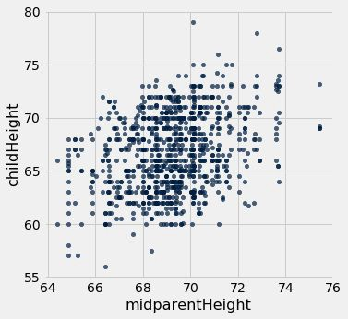
Galton's Heights
Oval shaped
Moderate positive correlation
How can we predict child height from mid-parent height?
Notes:
We were looking at the association between the height of parents and the heigh of children.
And we wanted to predict the height of the child using midparent height
This was the scatter plot that we used were the x-axis is the midparent height and the childheight is the y-axis
What we noticed is that the dataset had a general oval shape that signifacted a positive correlation
Now we want use this general shape of the data to make a prediction

Slide 26
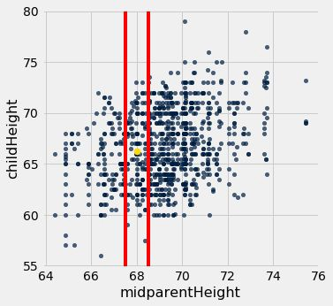
Galton's Heights
Notes:
The way that we did this before was as follows.
Suppose we had a child whose midparent height was 68
Then we find all the children whose midparent height is near 68 and find the average value of those childrens height
This average value is what we would use for our prediction
In this case we this is our yellow point
And for our child whose midparent heigt is 68 we would guess they grow up to have a height of 66
So if we compute a prediction for each midparent height we would get a prediction line that looks like this

Slide 27
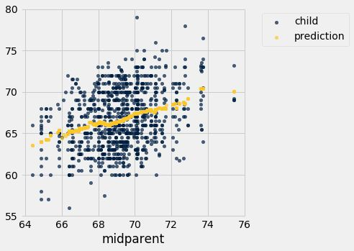
Galton's Heights
Notes:
So for the most part our predictions fall on a straight line
Today we will be taking a similar approach to this method and find a line that can be used for predicting values

Slide 28
Nearest Neighbor Regression
Notes:
The formal name for the method that we just showed is called the nearest neighbo prediction
To use this method we group each x value with similar x-values

Slide 29
Nearest Neighbor Regression
A method for prediction:
Group each x with similar (nearby) x values
Average the corresponding y values for each group
Notes:
Then find the average of the corresponding y values for each group
The prediction that we use for each x value is this average y value

Slide 30
Nearest Neighbor Regression
A method for prediction:
Group each x with similar (nearby) x values
Average the corresponding y values for each group
For each x value, the prediction is the average of the y values in its nearby group.

Slide 31
Nearest Neighbor Regression
A method for prediction:
Group each x with similar (nearby) x values
Average the corresponding y values for each group
For each x value, the prediction is the average of the y values in its nearby group.
The graph of these predictions is the “graph of averages”.
Notes:
The graph of all these predictions is called the graph of averages

Slide 32
Nearest Neighbor Regression
A method for prediction:
Group each x with similar (nearby) x values
Average the corresponding y values for each group
For each x value, the prediction is the average of the y values in its nearby group.
The graph of these predictions is the “graph of averages”.
If the association between x and y is linear, then points in the graph of averages tend to fall on a line.
Notes:
Finally if we have an association between x and y that is linear then the points in the graph of averages tend to fall on a line.

Slide 33
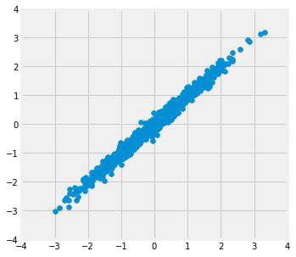
Where is the prediction line?
r = 0.99
Notes:
So know we want to replace our graph of averages with a prediction line.
To do this we need to find a slope and intercept for our prediction line
This is what we will be doing today and during the next lecture.
In this example here inurtively we can see a good prediction line.
Just place a line smack dap in the middle of the graph

Slide 34
Where is the prediction line?
r = 0.99
Notes:
But what about a more complicated data set?

Slide 35
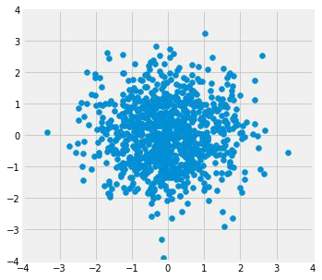
Where is the prediction line?
r = 0.0
(Demo)
Notes:
How do we find a prediction line for something like this?
Again we need to find a slope and a intercept
We know how to find the slope that this correlation coefficient
But that leaves us with a lot of lines.
So

Slide 36
Where is the prediction line?
r = 0.0
(Demo)
Notes:
So today we will focus on finding the line by finding the intercept

Slide 37
Where is the prediction line?
r = 0.0
(Demo)
Notes:
Which in this case is just zero.
So lets examine these cases in more detail

Slide 38
Linear Regression
Notes:
One note is that if you are unsure if you have a linear or a non linear regression then the nearest neighbor regression will work
But if we know that we have a linear assocaiton then finding a straight line for predictions will be much more efficient
This method of prediction is called linear regression

Slide 39
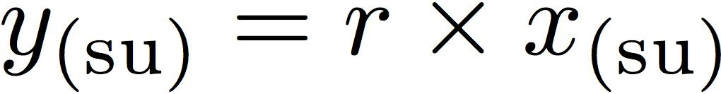
Linear Regression
Regression Line
Correlation
Notes:
There are two ways to represent linear regression
We will first look at the linear regression in standard unites

Slide 40
Linear Regression
A statement about x and y pairs
Measured in standard units
Describing the deviation of x from 0 (the average of x's)
And the deviation of y from 0 (the average of y's)
On average, y deviates from 0 less than x deviates from 0
Regression Line
Correlation
Notes:
Suppose that x and y are in standard units
recall that standard units measure how far away we are from the average value.
This means that both values have been normalized at zero.
Essentially standard units measures the distance from zero

Slide 41
Linear Regression
A statement about x and y pairs
Measured in standard units
Describing the deviation of x from 0 (the average of x's)
And the deviation of y from 0 (the average of y's)
On average, y deviates from 0 less than x deviates from 0
Regression Line
Correlation
Notes:
Since our values have been normalized at zero, we get a liner equation with no y-intercept
The equation is given by y= rx
This is called the regression line whose slope is given by the correlation coeffienct

Slide 42
Linear Regression
A statement about x and y pairs
Measured in standard units
Describing the deviation of x from 0 (the average of x's)
And the deviation of y from 0 (the average of y's)
On average, y deviates from 0 less than x deviates from 0
Regression Line
Correlation
Not true for all points — a statement about averages
Notes:
This tells us that if we want make prediction that the x values times our correlation coefficient will be a solid preditction
The regression line gives you predictions about average values
So these predictions are a rough prediction in the sense that I predicts strong linear relations but only gives an idea for relations that have a correlation coeffeicent closer to 0

Slide 43
Regression Line Equation
In original units, the regression line has this equation:
estimated y in standard units x in standard units
Lines can be expressed by slope & intercept
Notes:
So what happens if we have our x and y value in the given units
Then our regresiion line equation looks like this

Slide 44
Regression Line Equation
In original units, the regression line has this equation:
estimated y in standard units x in standard units
Lines can be expressed by slope & intercept
Notes:
This is just by replacing our x and y in standard units with the equation for standard units

Slide 45
Regression Line Equation
In original units, the regression line has this equation:
estimated y in standard units x in standard units
Lines can be expressed by slope & intercept
Notes:
If we solve for the estimate of y, we end up with a traditional equation of a line

Slide 46
Regression Line Equation
In original units, the regression line has this equation:
estimated y in standard units x in standard units
Lines can be expressed by slope & intercept
Notes:
The slope intercept form no longer has a slope that is the correlation coefficient
We rewrite equation this way so that we can draw our regrsiion line on the prginal scatter plot

Slide 47
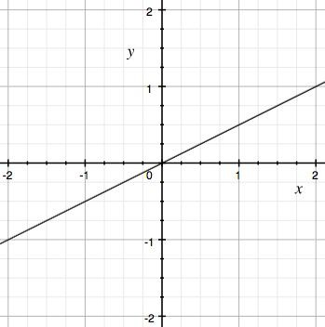
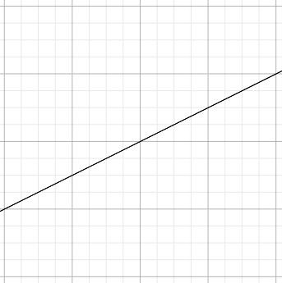

Regression Line
Standard Units
Original Units
(Average x, Average y)
(0, 0)
r
r * SD y
1
SD x
Notes:
So if we draw our regression line through a bunch of points this is our best prediction line
It passes through 00 and has a slope of r

Slide 48
Regression Line
Standard Units
Original Units
(Average x, Average y)
(0, 0)
r
r * SD y
1
SD x
Notes:
So if we draw our regression line through a bunch of points this is our best prediction line
It passes through 00 and has a slope of r
If we convert to original units, it has the same shape
The regression line still goes through the center but the center is now the mean of x and the mean of y
So what is the slope?
When we go from standard units to regular units we expand
We expand by the standard devation
So the x values are multilpled by SD of x
And the y values are mutipled by the standard devation of y times the correlation coefficient
So the slope ithe r times the sd of y divided by the SD of X

Slide 49
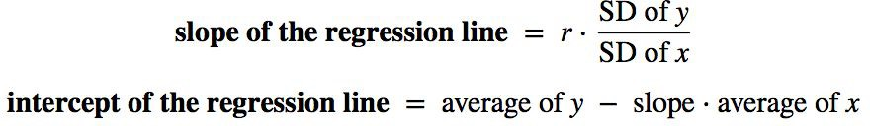
Slope and Intercept
estimate of y = slope * x + intercept
(Demo)
Notes:
SO we end up with the following equation for the regression line
The slope of the line is r times SD of y divided by SD of x
The intercept is found by just solving for the intercept with the given slope

Slide 50
Discussion Question
A course has a midterm (average 70; standard deviation 10) and a really hard final (average 50; standard deviation 12)
If the scatter diagram comparing midterm & final scores for students has an oval shape with correlation 0.75, then...
What do you expect the average final score would be for students who scored 90 on the midterm?
How about 60 on the midterm?

