Slide 1
Lecture 4
MATH1401
Fall 2021
Data Types

Slide 2
Review

Slide 3
Lecture 3 Checklist
Use operators +,-,*,/, **
Assign values to a name
Call functions min, max, abs
Select columns of a table
Sort columns of a table
Filter rows of a table by a condition

Slide 4
Review: Table Operations
t.select(label) - constructs a new table with just the specified columns
t.drop(label) - constructs a new table in which the specified columns are omitted
t.sort(label) - constructs a new table with rows sorted by the specified column
t.where(label, condition) - constructs a new table with just the rows that match the condition
(Demo)

Slide 5
Overview

Slide 6
Class Checklist
Lab 1 – Due Date : Tuesday 8/31 – 5 PM
Graded Questions : 3.1.2, 3.3.1, 3.3.2, 4.1.1, 5.1, 5.1.1
Homework 1 – Due Date : Friday 9/3 – 5 PM
Graded Questions : 1.1, 2.1,2.1.1, 2.2, 3.1-3.3, 4.1-4.3, 5.1-5.4, 7.1
Quiz 2 – Tuesday: 8/31 – Covers Chapter 3
Quiz 3 – Thursday: 9/2 – Covers Chapter 4

Slide 7
Lecture 4 Checklist – Chapter 4
int/floats
strings
bools
comparisons

Slide 8
Lecture 4 Checklist - Programming
Use strings, integers, floats, booleans
Be able to use the string methods:
s.upper, s.replace(s1,s2), str(),concatention
Make comparisons between numerical values and strings
Be able to use the type functions: type(),str(),int(),float()

Slide 9
Numbers

Slide 10
Ints and Floats
Python has two real number types
int:
float:
an integer of any size
a number with an optional fractional part
An int never has a decimal point; a float always does

Slide 11
Ints and Floats
Python has two real number types
int:
float:
an integer of any size
a number with an optional fractional part
An int never has a decimal point; a float always does A float might be printed using scientific notation

Slide 12
Ints and Floats
Python has two real number types
int:
float:
an integer of any size
a number with an optional fractional part
An int never has a decimal point; a float always does A float might be printed using scientific notation Three limitations of float values:
They have limited size (but the limit is huge)
They have limited precision of 15-16 decimal places
After arithmetic, the final few decimal places can be wrong
(Demo)

Slide 13
Strings

Slide 14
Text and Strings
A string value is a snippet of text of any length
'a'
'word'
"there can be 2 sentences. Here's the second!"

Slide 15
Text and Strings
A string value is a snippet of text of any length
'a'
'word'
"there can be 2 sentences. Here's the second!"
Strings consisting of numbers can be converted to numbers
int('12')
float('1.2')

Slide 16
Text and Strings
A string value is a snippet of text of any length
'a'
'word'
"there can be 2 sentences. Here's the second!"
Strings consisting of numbers can be converted to numbers
int('12')
float('1.2')
Any value can be converted to a string
str(5)

Slide 17
Text and Strings
A string value is a snippet of text of any length
'a'
'word'
"there can be 2 sentences. Here's the second!"
Strings consisting of numbers can be converted to numbers
int('12')
float('1.2')
Any value can be converted to a string
str(5)

Slide 18
String Methods
String_name.upper()
"there can!".upper() -> “THERE CAN!”

Slide 19
String Methods
String_name.upper()
"there can!".upper() -> “THERE CAN!”
String_name.replace(s1,s2)
"there can!".replace(‘there’,’cannoli’) -> “cannoli can!”
(Demo)

Slide 20
Discussion Question
Assume you have run the following statements:
x = 3
y = '4'
z = '5.6'
What's the source of the error in each example?
x + y
x + int(y + z)
str(x) + int(y)
y + float(z)

Slide 21
Types

Slide 22
Every value has a type
We’ve seen 5 types so far:
int: 2
float: 2.2
str: 'Red fish, blue fish'
builtin_function_or_method: abs
Table

Slide 23
Every value has a type
We’ve seen 5 types so far:
int: 2
float: 2.2
str: 'Red fish, blue fish'
builtin_function_or_method: abs
Table
The type function can tell you the type of a value
type(2)
type(2 + 2)

Slide 24
Every value has a type
We’ve seen 5 types so far:
int: 2
float: 2.2
str: 'Red fish, blue fish'
builtin_function_or_method: abs
Table
The type function can tell you the type of a value
type(2)
type(2 + 2)
An expression’s “type” is based on its value, not how it looks
x = 2
type(x)

Slide 25
Conversions
Strings that contain numbers can be converted to numbers
int('12')
float('1.2')
float('one point two') # Not a good idea!
(Demo)

Slide 26
Conversions
Strings that contain numbers can be converted to numbers
int('12')
float('1.2')
float('one point two') # Not a good idea!
Any value can be converted to a string
str(5)
(Demo)

Slide 27
Conversions
Strings that contain numbers can be converted to numbers
int('12')
float('1.2')
float('one point two') # Not a good idea!
Any value can be converted to a string
str(5)
Numbers can be converted to other numeric types
float(1)
int(1.2) # DANGER: loses information!
(Demo)

Slide 28
Comparisons

Slide 29
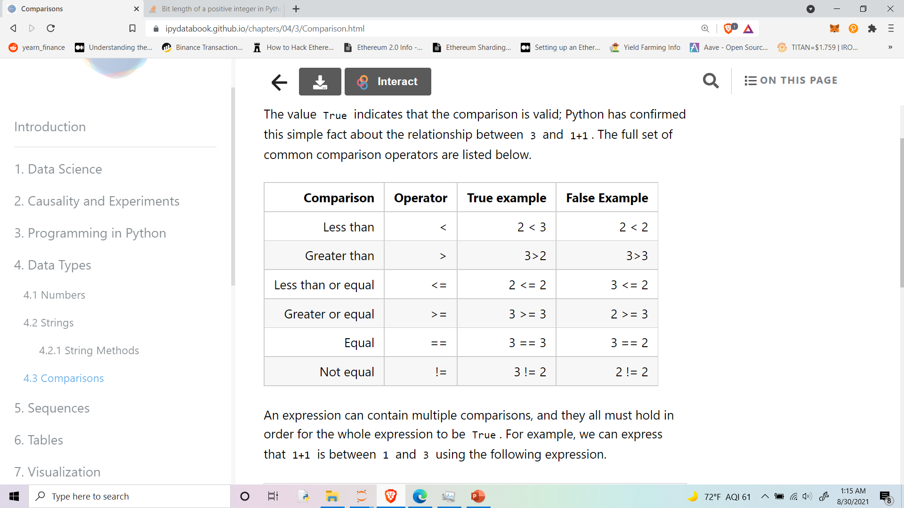
Conversions

Slide 30
Booleans
A Boolean represents True or False value.
True
False
Every comparison that is made results in a bool
3 > 10 -> False
‘hello’ != ‘hi’ -> True

