Slide 1

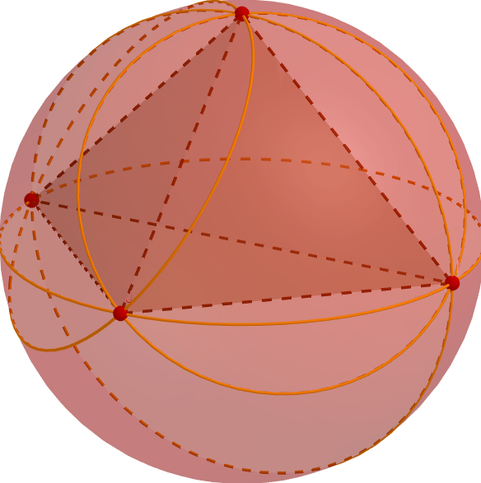
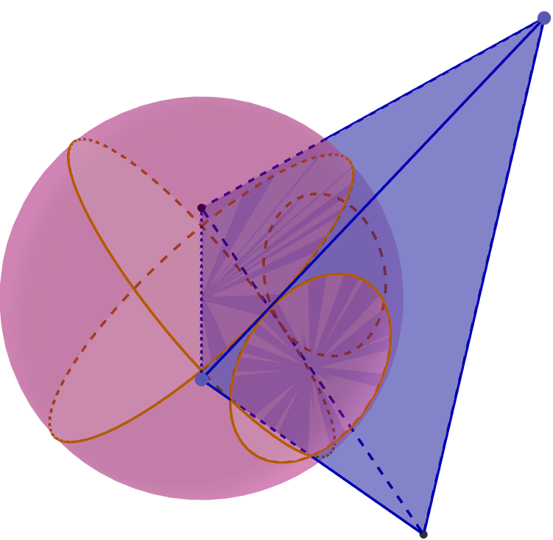
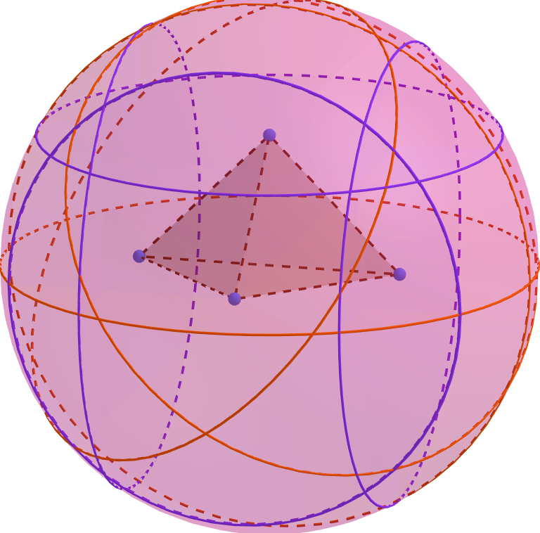























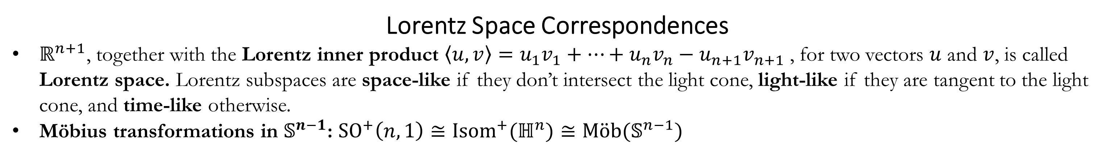










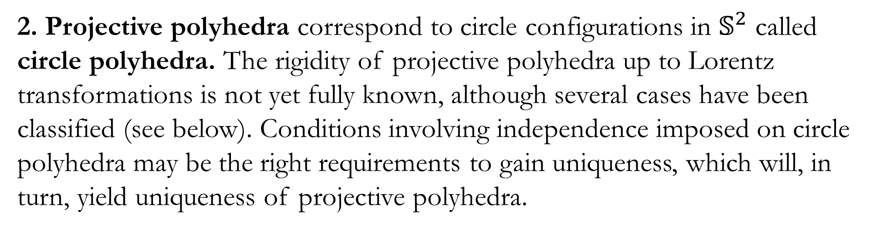

















Rigidity of Configurations of Points and Spheres
Opal Graham • ograham@math.fsu.edu • Florida State University
Abstract
The rigidity of collections of ideal points and collections of circles in two dimensions is proven by Beardon and Minda using a maximal amount of conformal invariant information. Crane and Short do the same for collections of ideal points and spheres in higher dimensions. In order to uniquely place collections of ideal points in ­$ℝ_{∞}^{n}$, the cross ratio of every 4-tuple of points must be known. Similarly, rigidity of a collection of spheres in ­$ℝ_{∞}^{n}$ uses the inversive distance between every pair of spheres. When these configurations are additionally required to have an independent subcollection, the amount of necessary conformal invariant information is considerably decreased by way of basic linear algebra in Lorentz space. We also consider ways to generalize to rigidity of collections of points and spheres together, touch upon the role of independence in rigidity of inversive distance circle packings, and its potential utility in rigidity of projective polyhedra.
Lorentz Space Correspondences
$ℝ^{n+1}$, together with the Lorentz inner product $\left\langle u,v\right\rangle =u_{1}v_{1}+…+u_{n}v_{n}−u_{n+1}v_{n+1}$, for two vectors $u$ and $v$, is called Lorentz space. Lorentz subspaces are space-like if they don’t intersect the light cone, light-like if they are tangent to the light cone, and time-like otherwise.
Möbius transformations in $𝕊^{n−1}$: ${SO}^{+}\left(n,1\right)≅{Isom}^{+}(ℍ^{n})≅M\ddot{o}b(𝕊^{n−1})$
Future Research
1. Inversive Distance Circle Packings (IDCPs) are
configurations of circles on $𝕊^{2}$ with an underlying triangulation encoding inversive distance information.
IDCPs are not globally rigid in general:
Bowers and Bowers provide a counterexample in [5] using an octahedral graph.
By adding in extra inversive distance information strategically, independence can be used to “rigidify” the collection of circles.
$$C$$
$$ℝ^{n+1}$$
$(n−2)$-spheres in $𝕊^{n−1}$ $↔$
Time-like Lorentz
subspaces of $ℝ^{n+1}$ $↔$
Space-like Lorentz vectors
Fact: The Lorentz inner product of two space-like vectors is equal to inversive distance of the corresponding $\left(n−2\right)$-spheres.
$$ℝ^{n+1}$$
Ideal points in $𝕊^{n−1}$ $↔$
Light-like Lorentz Subspaces $↔$
Light-like Lorentz vectors
Fact: For four ideal points $a,b,c,d$,
$\left|a,b,c,d\right|=\frac{\left\langle v_{a},v_{b}\right\rangle \left\langle v_{c},v_{d}\right\rangle }{\left\langle v_{a},v_{c}\right\rangle \left\langle v_{b},v_{d}\right\rangle }$, where $v_{a}, v_{b}, v_{c}, v_{d}$ are chosen light-like vectors intersecting their respective points.
$$C^{′}$$
$$\left(C,C^{′}\right)$$
$$ℍ^{n}$$
$$𝕊^{n−1}$$
$$ℍ^{n}$$
$$𝕊^{n−1}$$
Conformal Invariants
Inversive distance $(C,C^{′})$ is a real number equipped to two circles (or spheres, in higher dimensions), $C$ and $C^{′}$(for more info, see [1]). It is…
An invariant under Möbius transformations.
Not a true distance:
Does not satisfy the triangle
inequality
Can be negative.
A tool commonly used in
circle configurations.
The Absolute cross ratio
$|a,b,c,d|$ is a real number
equipped to four points $a,b,c,d$
in $ℝ_{∞}^{N}$, given by the formula
$\left|a,b,c,d\right|=\frac{\left|a−b\right|\left|c−d\right|}{\left|a−c\right|\left|b−d\right|}$.
It is also invariant under
Möbius transformations.
Motivation
Beardon and Minda in [2] showed:
In $ℂ_{∞}$, two collections of finitely many
disjoint disks have a Möbius
transformation taking one collection to
the other if and only if each
corresponding pair of disks in the
collections has equal inversive distance.
For two collections of finitely many points
in $ℂ_{∞}$, there is a Möbius transformation
taking one collection to the other if and
only if each corresponding 4-tuple of
points has equal absolute cross ratio.
Crane and Short build on this in [3] by
generalizing each of Beardon and Minda’s
results:
$(N−1)$-spheres in $ℝ_{∞}^{N}$ and points in $ℝ_{∞}^{N}$.
Spheres may intersect,
Collections may be countably infinite.
Both sets of results utilize a maximal amount of conformal invariant information. Rigidity can be achieved with less conformal invariant information with an appropriate additional condition.
$$ℝ^{n}$$
$$ℝ^{n}$$
Independence of Circles
A collection of $\left(N−2\right)$-spheres in $𝕊^{N−1}⊂ℝ^{N+1}$ is independent if their corresponding Lorentz vectors are linearly independent.
Lemma. Let $\{C_{1},…,C_{n+1}\}$ be a collection of fixed independent spheres in $𝕊^{n−1}⊂ℝ^{n+1}$. For spheres $C$ and $C′$,
$$\left[\left(C_{i},C\right)=\left(C_{i},C^{′}\right) ∀i\right]⇔C=C^{′}.$$
Analogous to:
Infinite choices Two choices One choice
Rigidity of Configurations of Lorentz Vectors
Theorem. Let $\{v_{α}:α∈𝒜\}$ and $\{v_{α}^{′}:α∈𝒜\}$ be two collections of vectors in $ℝ^{n+1}$, indexed by the same set, with at least n$+1$ elements ${\{v}_{i}\}$ and $\{v_{i}^{′}\}$, respectively, that form linearly independent sets. Then $\left\langle v_{α},v_{i}\right\rangle =\left\langle v_{α}^{′},v_{i}^{′}\right\rangle$ for $i=1,…,n+1$ if and only if there is a Lorentz transformation $f$ such that $f\left(v_{α}\right)=v_{α}′$ for each $α$ in $𝒜$.
Remark. Independence greatly reduces the amount of necessary conformal invariant information to gain rigidity in each geometric interpretation.
Geometric Interpretations
Spheres. Two collections of $\left(n−2\right)$-spheres in
$𝕊^{n−1}⊂ℝ^{n+1}$, $\{C_{α}\}$ and $\left\{C_{α}^{′}\right\},$ with independent
subcollections. ${\left\{C_{i}\right\}}_{i=1}^{n+1}$ and ${\left\{C_{i}^{′}\right\}}_{i=1}^{n+1}$ are Möbius
equivalent if and only if $\left(C_{α},C_{i}\right)=(C_{α}^{′},C_{i}^{′})$ for
$i=1,…, n+1$.
Points. Two collections $\{p_{α}\}$ and $\{p_{α}^{′}\}$ of points in $ℝ_{∞}^{n−1}$ with independent subcollections of
$n+1$ points have a Möbius transformation taking one to another if and only if
$\left|p_{1},p_{2},p_{3},p_{α}\right|=|p_{1}^{′},p_{2}^{′},p_{3}^{′}, p_{α}^{′}|$ for chosen $p_{1},p_{2},p_{3}$ in the independent subcollection.
$$θ$$
$$θ$$
$$0≤\left(C,C^{′}\right)=cos\left(θ\right)<1$$
$$−1<\left(C,C^{′}\right)=cos\left(θ\right)≤0$$
2. Projective polyhedra correspond to circle configurations in $𝕊^{2}$ called circle polyhedra. The rigidity of projective polyhedra up to Lorentz transformations is not yet fully known, although several cases have been classified (see below). Conditions involving independence imposed on circle polyhedra may be the right requirements to gain uniqueness, which will, in turn, yield uniqueness of projective polyhedra.
$$θ=0$$
$$θ=π$$
$$a$$
$$a$$
$$a$$
$$\left(C,C^{′}\right)=1$$
$$\left(C,C^{′}\right)=−1$$
$$b$$
$$b$$
$$a$$
$$b$$
$$c$$
$$d_{H}(x,y)$$
$$d_{H}(x,y)$$
Hyperbolic polyhedra :
Andre’ev [6]
Rivin & Hodgson [7]▼
Hyperideal polyhedra :
Bao & Bonahon [9]
Bowers, Bowers, Pratt [10]▼
$$1<\left(C,C^{′}\right)<∞$$
$$−∞<\left(C,C^{′}\right)<−1$$
$$ℝ^{n+1}$$
$$∃ f∈{SO}^{+} (n,1)$$
▲Ideal Polyhedra:
Rivin [8]
$$C_{i}$$
$$C_{j}$$
$$ℝ^{n+1}$$
$$𝕊^{2}$$
$$𝕊^{n−1}$$
References
Bowers, P. & Hurdal, M. (2002). An Inversive Distance Primer. Planar Conformal Mappings of Piecewise Flat Surfaces. (pp. 7-12)
Beardon, A., & Minda, D. (2008). Conformal automorphisms of finitely connected regions. In P. Rippon & G. Stallard (Eds.), Transcendental Dynamics and Complex pp. 37-73.
Crane, E., & Short, I. (2009). Rigidity of configurations of balls and points in the N-sphere.
Ratcliffe, J. (1994). Foundations of Hyperbolic Manifolds.
Bowers, J., Bowers, P. (2018). Ma-Schlenker C-Octahedra in the 2-Sphere.
Andre’ev, E, (1970). On Convex Polyhedra in Lobačevskiĭ Space., Mat. Sbornik. 81(123), pp.445-478.
Rivin, I., & Hodgson, C., (1993). A Characterization of Compact Convex Polyhedra in Hyperbolic 3-Space, Inven. Math., 111:77-111.
Rivin, I., (1996). A Characterization of Ideal Polyhedra in Hyperbolic 3-Space, Ann. of Math., 143:51-70.
Bao, X., & Bonahon, F., (2002). Hyperideal polyhedra in hyperbolic 3-space. Bull. Soc. Math. France, 130(3): 457-491.
Bowers, J., Bowers, P., & Pratt, K. (2017). Rigidity of Circle Polyhedra in the 2-Sphere and of Hyperideal Polyhedra in Hyperbolic 3-Space.
$$C_{j}^{′}$$
$$∃ f∈ M\ddot{o}b\left(𝕊^{2}\right)$$
$$∃ f∈ M\ddot{o}b\left(𝕊^{n−1}\right)$$
$$C_{i}^{′}$$
$$𝕊^{2}$$
$$𝕊^{n−1}$$
Points and Spheres. One possible approach is to
transform collections of points and spheres into
collections of spheres only:
For each pair of points in the collection, use a sphere in the collection to find a unique circle orthogonal to the sphere that passes through both the points.
Use this circle to find a unique sphere orthogonal to the circle, intersecting the circle at the two points.
If the newly formed collections of spheres satisfies the independent rigidity requirements above, then there is a Möbius transformation taking one original collection to the other.
Note: Points in collection cannot lie on spheres in original collection.

