Slide 1

















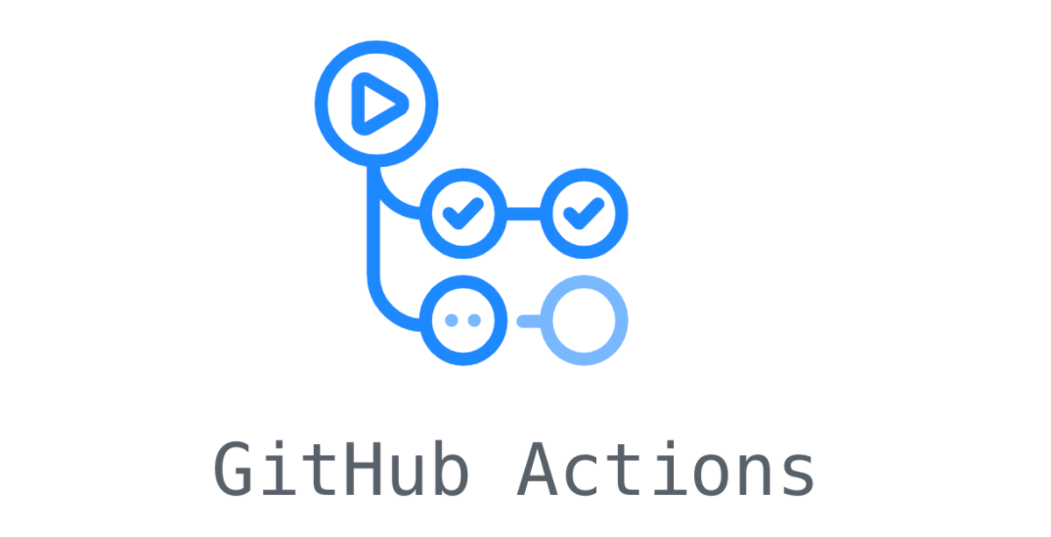


User
Domain
Presentation
Data
CI/CD

