Slide 1



















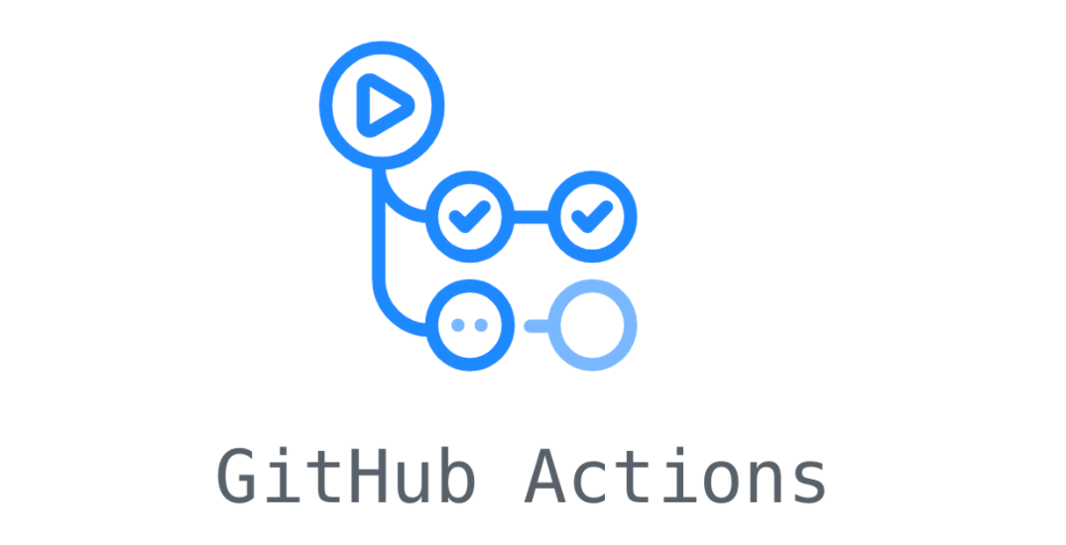


User
Domain
Presentation
Data
CI/CD

Slide 2
User
Domain
Presentation
Data
CI/CD

