Slide 1
















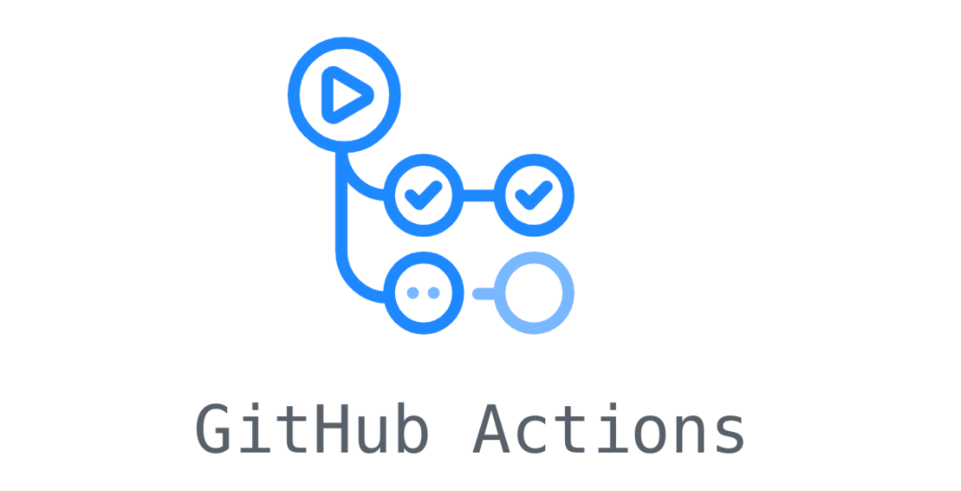






Domain
Presentation
User
Data
CI/CD

Slide 2

User
Domain
Presentation
Data
CI/CD

