Slide 1
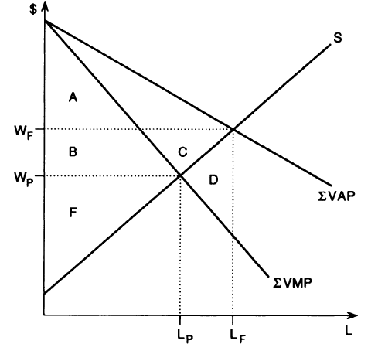







$$D_{1}$$
$$D_{2}$$
$$G_{1}$$
$$G_{2}$$
$$W_{I}$$
$$H_{1}$$
$$H_{2}$$

