Slide 1

Global ancestry estimation and data repository for the TCGA pan-cancer resource
Creed JH, Gerke TA
Jordan Creed, MPH
Department of Cancer Epidemiology
jhcreed

Slide 2

TCGA can inform biology of health disparities research
resource for clinical and -omics profiles from 33 cancer types
follow up updated in 2013 and 2016
data standardized across tissue types
self-reported race missing in 1,323 patients (12.08%)
possible misclassification with self-reported race (PMC3681827)
opportunity to leverage genomic data to estimate ancestry
Notes:
The range of missingness for race varies across cancer types. For example prostate which has known differences in incidence and outcomes by race, race is missing for 69% of the individuals.

Slide 3
Estimation of ancestry from TCGA is challenging
controlled data requiring dbGap access
hardware/computational demands
storage: 546G
computational time: over 800 hours run time
Model-based global ancestry estimation (ADMIXTURE)
1000 Genomes Phase 3 (n=2504) reference
over 700,000 variants utilized
All available samples from TCGA Legacy Archive (n=22963)
Notes:
ADMIXTURE provides global estimates - “proportion of ancestry from each contributing population, considered as an average over the individual’s entire genome” not local estimates - “genome is divided into chromosome segments of definite ancestral origin” . ADMIXTURE uses the same underlying approach as structure. Model-based estimation “estimate ancestry coefficients as the parameters of a statistical model. Algorithmic approaches use techniques from multivariate analysis, chiefly cluster analysis and principal component analysis (PCA), to discover structure within the data in a less parametric way”. EIGENSTRAT is an example of algorithmic estimation. (PMCID: PMC2752134)

Slide 4
Self-reported race vs dominant ancestry estimate
Notes:
For those with multiple samples, POP based off blood derived normal > solid tissue normal > primary solid tumor > other. Describe that you estimated probabilities of belonging to each of 5 superpopulations, and spell out abbreviations

Slide 5
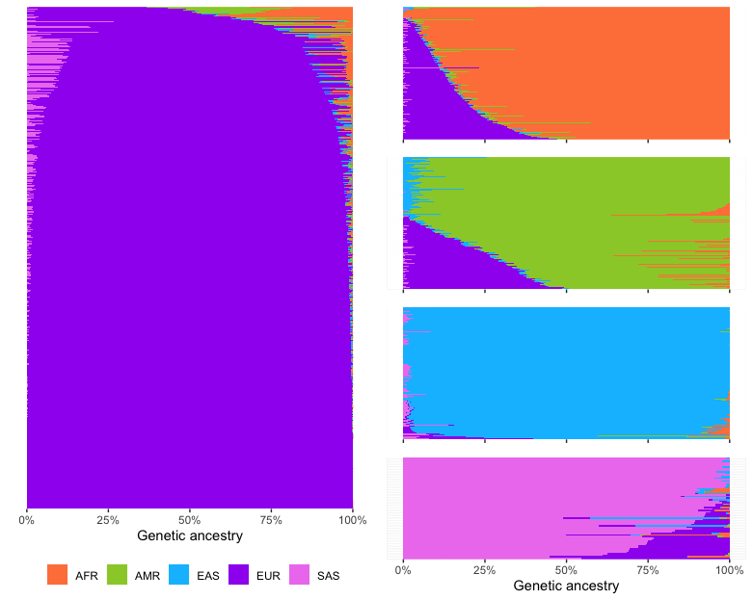
AFR and AMR have higher rates of admixture
AFR
AMR
EUR
EAS
SAS
Notes:
blood derived normal > solid tissue normal

Slide 6
Multiple ancestries
878 (8.09%) paticipant’s dominant population changed between tissue types

Slide 7
Ancestry differences by cancer type

Slide 8
Ancestry differences vs mutational burden

Slide 9
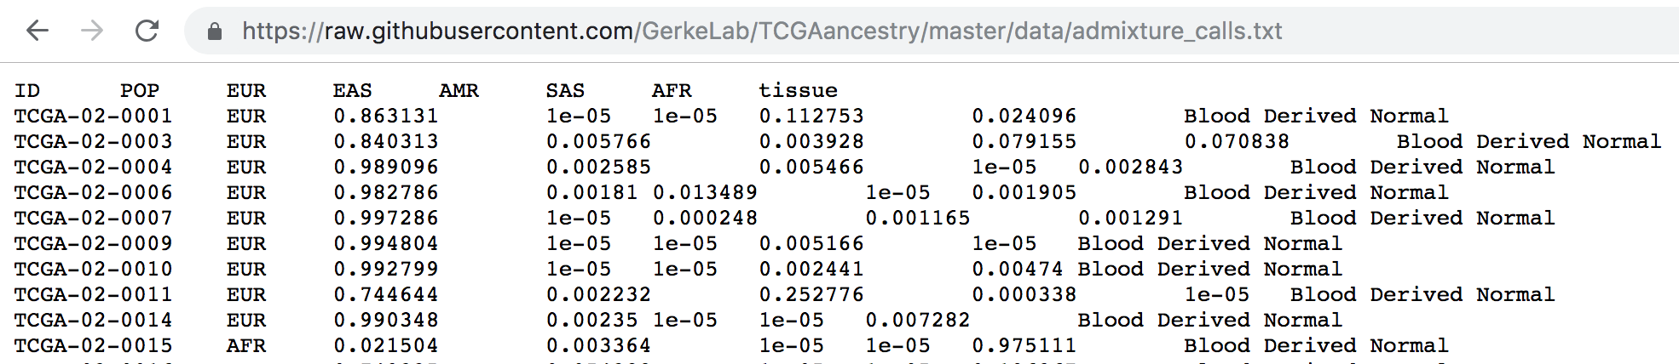
Accessing the data
Available at : https://github.com/GerkeLab/TCGAancestry
Free
Full access to data as well as code and links to additional resources
Easy to download files
over 500G genotype data -> 3.5 MB ancestry calls and standard errors

Slide 10
Appendix Slides

Slide 11
Acronym | Full name
LAML | Acute Myeloid Leukemia
ACC | Adrenocortical carcinoma
BLCA | Bladder Urothelial Carcinoma
LGG | Brain Lower Grade Glioma
BRCA | Breast invasive carcinoma
CESC | Cervical squamous cell carcinoma and endocervical adenocarcinoma
CHOL | Cholangiocarcinoma
LCML | Chronic Myelogenous Leukemia
COAD | Colon adenocarcinoma
CNTL | Controls
ESCA | Esophageal carcinoma
FPPP | FFPE Pilot Phase II
GBM | Glioblastoma multiforme
HNSC | Head and Neck squamous cell carcinoma
KICH | Kidney Chromophobe
KIRC | Kidney renal clear cell carcinoma
KIRP | Kidney renal papillary cell carcinoma
LIHC | Liver hepatocellular carcinoma
LUAD | Lung adenocarcinoma
LUSC | Lung squamous cell carcinoma
DLBC | Lymphoid Neoplasm Diffuse Large B-cell Lymphoma
MESO | Mesothelioma
MISC | Miscellaneous
OV | Ovarian serous cystadenocarcinoma
PAAD | Pancreatic adenocarcinoma
PCPG | Pheochromocytoma and Paraganglioma
PRAD | Prostate adenocarcinoma
READ | Rectum adenocarcinoma
SARC | Sarcoma
SKCM | Skin Cutaneous Melanoma
STAD | Stomach adenocarcinoma
TGCT | Testicular Germ Cell Tumors
THYM | Thymoma
THCA | Thyroid carcinoma
UCS | Uterine Carcinosarcoma
UCEC | Uterine Corpus Endometrial Carcinoma
UVM | Uveal Melanoma

