Slide 1
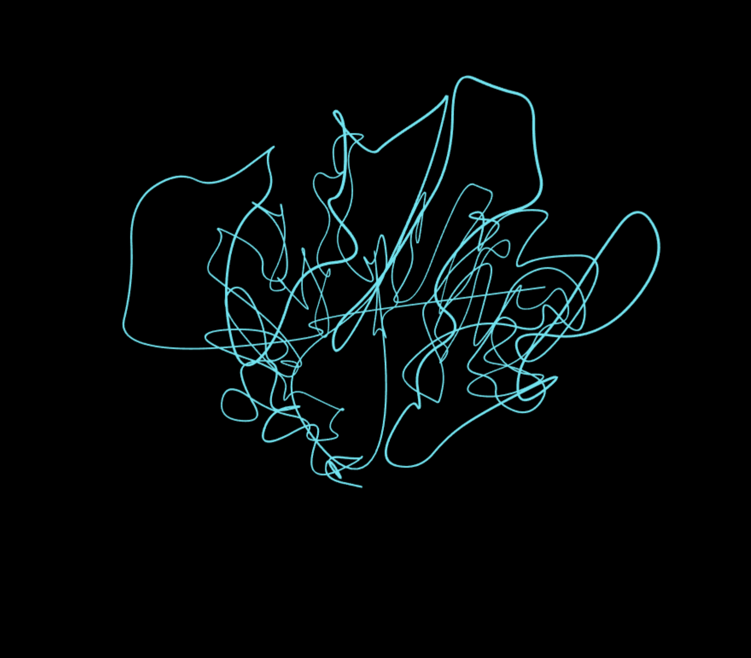
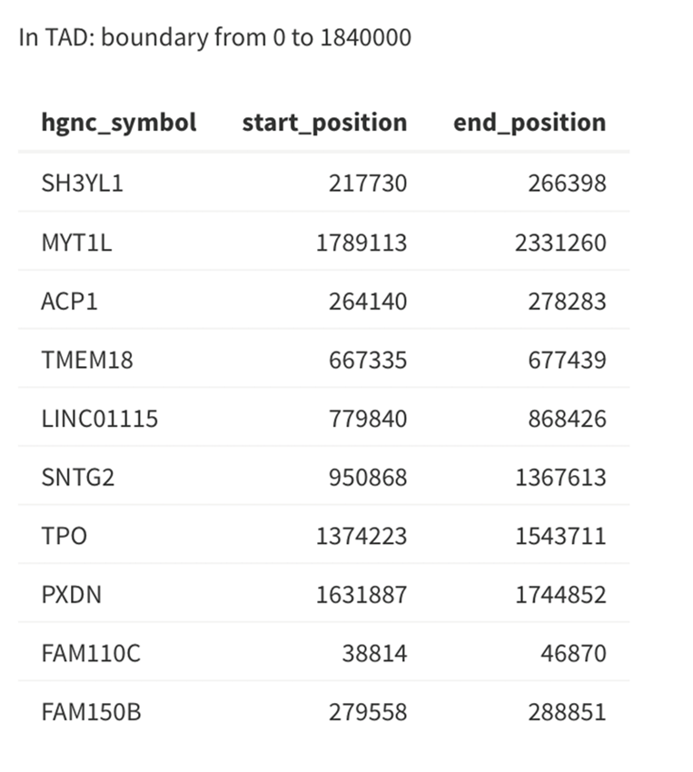
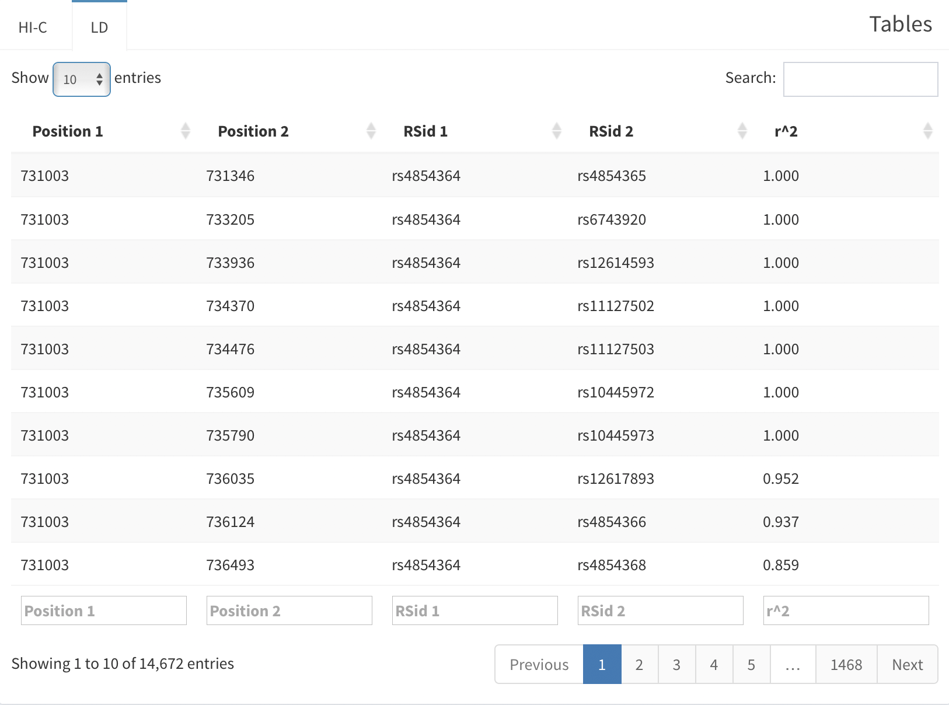
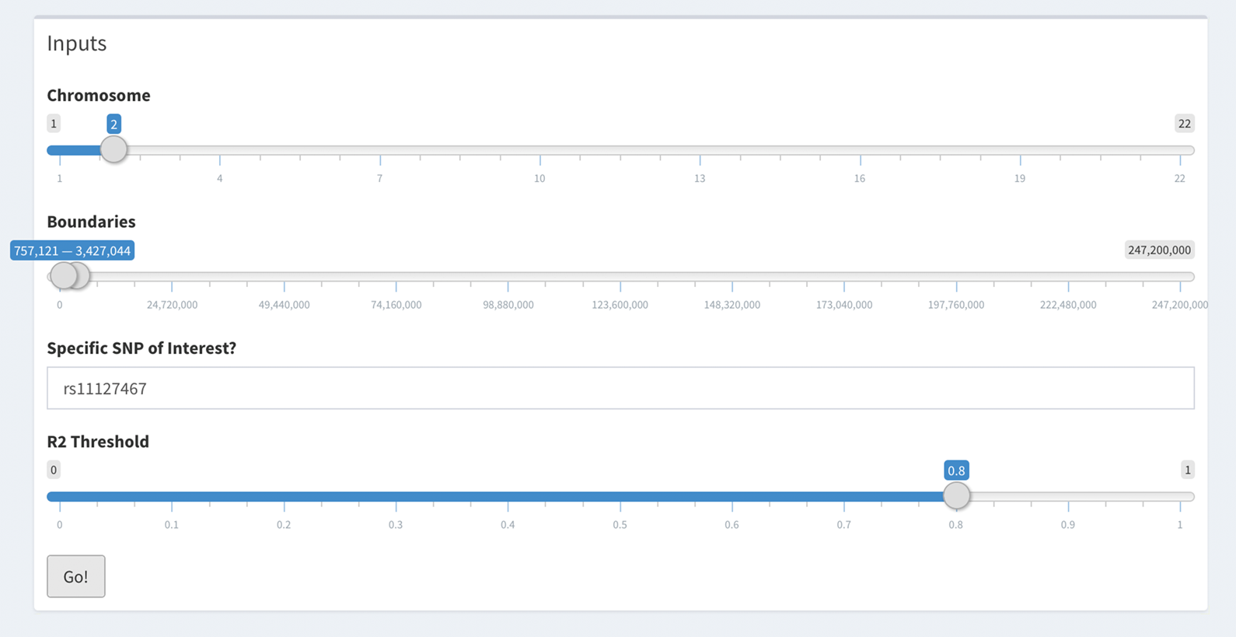
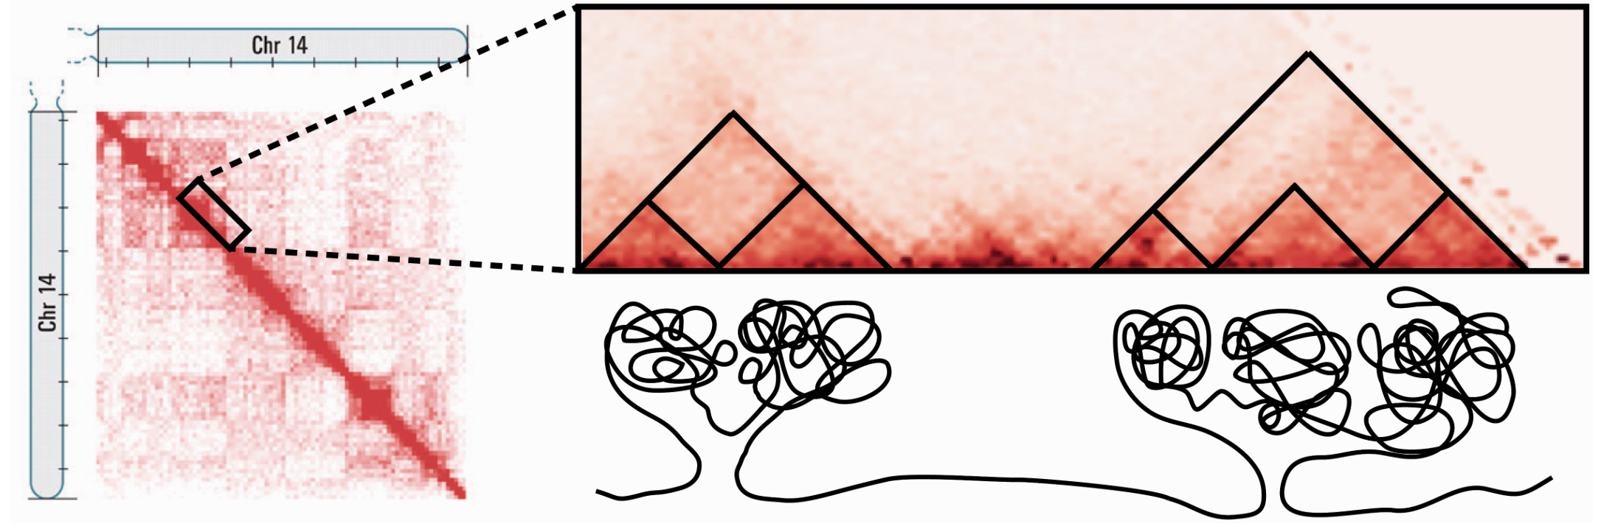
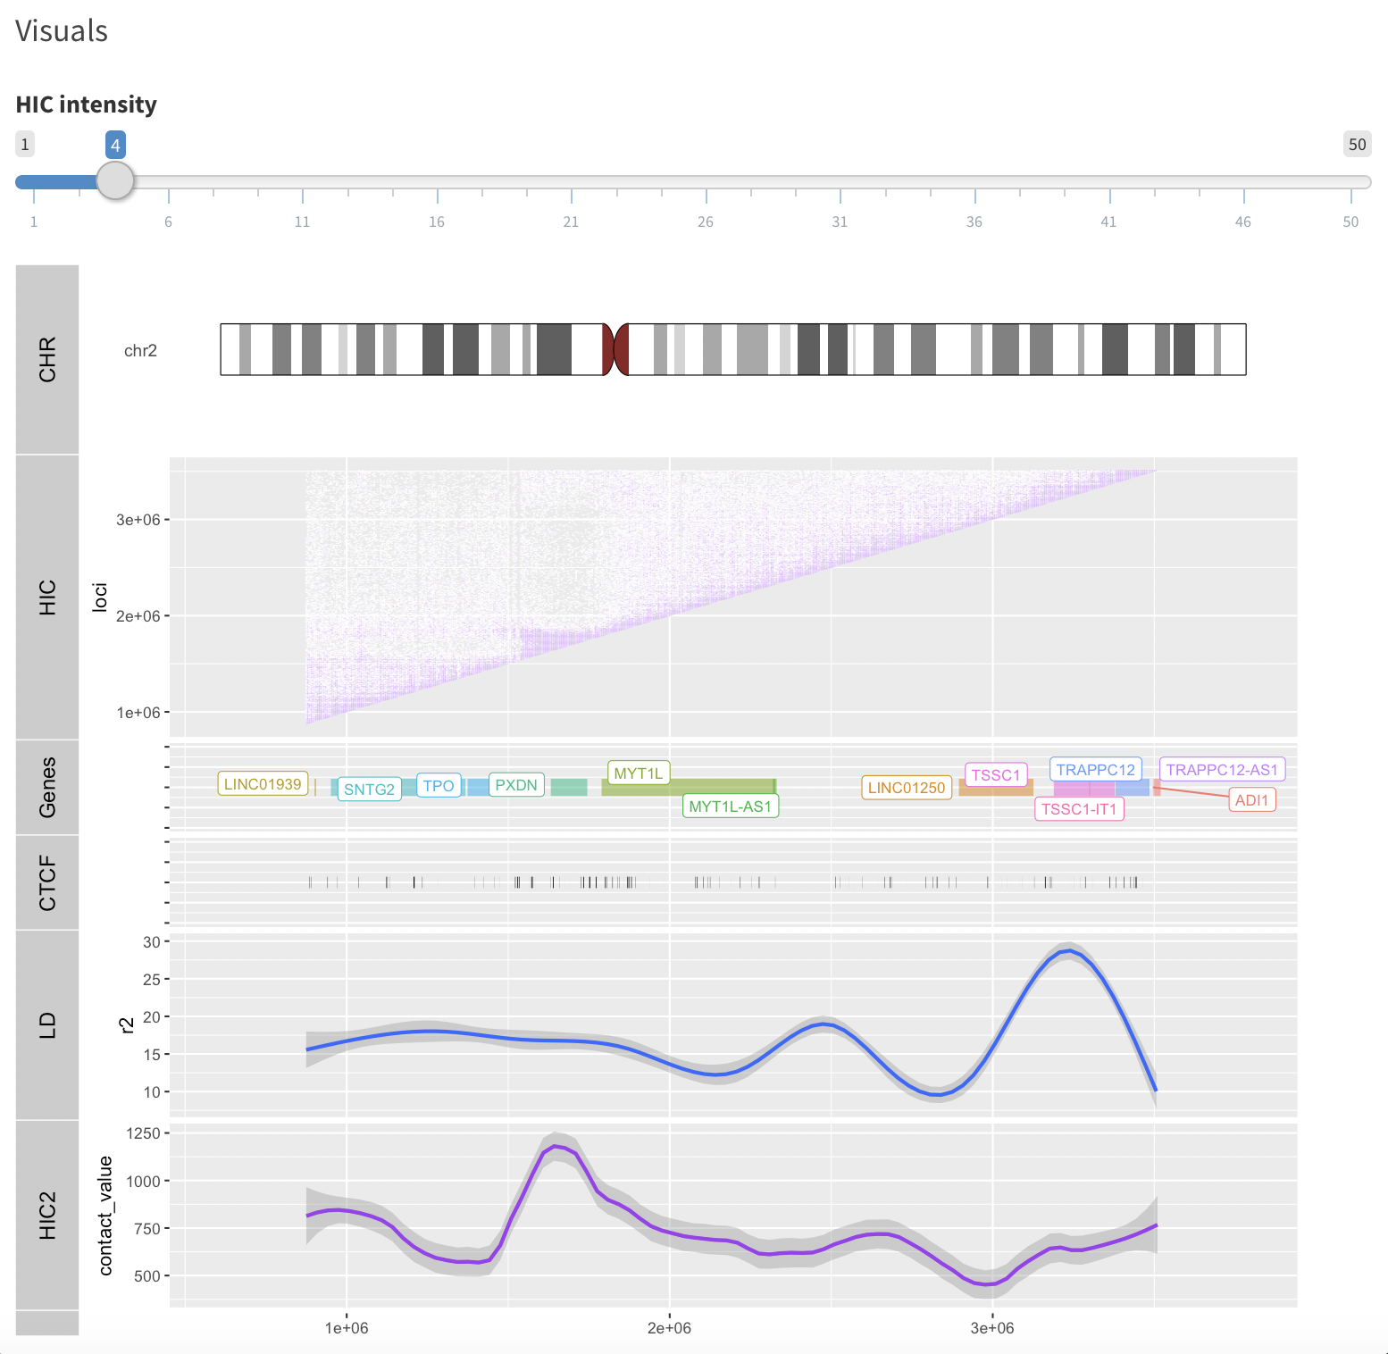
EpiTAD Viewer: A Software Application for Visualizing and Contextualizing HI-C Data in Genetic Epidemiology
Jordan Creed*, Alvaro Monteiro, Travis Gerke⁺
Tampa, Florida
Background
EpiTAD Viewer
Usage
Uptake of the Hi-C assay has driven recent genome-wide mapping of topologically associated domains (TADs) at varying resolutions. Widespread integration of chromosome structure data into various research pipelines may be limited by a dearth of user-friendly software applications that link to other genomic databases and resources. To meet this need, we present a user-friendly Shiny web application and R package that integrates information from various resources into a single comprehensive tool .
App output consists of two major components, one involving tabular output and the other being the visualization component. The user inputs loci of interest (dbSNP rs id and genomic location) and an r² threshold for defining the LD block. Genomic location is determined by a user provided boundary measured in bp, and has no size restrictions.
INPUTS:
Methods
Hi-C is a high-throughput sequencing technique that enables estimation of 3-D genomic structure through chromatin interactions. A resulting contact data matrix is often viewed in the form of heatmaps, with the frequency of contact shown as color intensity. The interactions between loci are best visualized in this way and therefore useful in defining TADs and their boundaries based on these interactions.¹
Current Hi-C browsers, such as the Hi-C Browser, tend to focus on Hi-C visualization only²
EpiTAD visuals include Hi-C visual as both a contact map and as a single vector along with: Linkage Disequilibrium (LD), transcript regions, CCCTC-binding factor (CTCF) sites
Developed using R and Java and compiled using Shiny
OUTPUT:
Visual
  User defined Hi-C intensity cutoff
Visual image scaled to user boundaries
  Individual tracks
  Traditional Hi-C contact map
  Genes
  CTCF sites
  Single vector summations:
    R²
    Raw Hi-C contact
Tables
Linkage Disequilibrium
  All SNPs above the user set threshold that are within the boundaries or in high LD with the SNP of interest
  Includes: chromosome locations, RS IDs, r²
  Interactive
Topologically Associating Domains
  If the SNP is in a TAD and the TAD’s location
  If in a TAD: genes and gene locations
Image from: Caleb Weinreb, Benjamin J. Raphael; Identification of hierarchical chromatin domains. Bioinformatics 2016; 32 (11): 1601-1609. doi: 10.1093/bioinformatics/btv485
Conclusions
Data Sources
System Details
The browser is unique from other Hi-C visualization tools as it integrates details from other genomic databases into a single, user-friendly tool that incorporates commonly needed information for genetic epidemiology studies. The resulting web app may prove broadly a useful component of in silico functional genomics discovery.
  Backend Data
    Calculated LD
      Originally vfrom HapMap
      HapMap values not stored
    Raw interchromosomal Hi-C values
      Rao et al.
      IMR90 cell line
    Pre-defined TAD boundaries
      Dixon et al.
  Real-time genetic annotation query
    Via BiomaRt
Windows and Mac system
Browser plug-in in development
Requires:
  Latest version of R
  Access to the internet
Free
Open source
No programming knowledge required by user
References
1. Lieberman-Aiden E, van Berkum NL, Williams L, et al. Comprehensive mapping of long range interactions reveals folding principles of the human genome. Science (New York, NY). 2009;326(5950):289-293. doi:10.1126/science.1181369.
2. Yardımcı GG, Noble WS. Software tools for visualizing Hi-C data. Genome Biol. 2017;18(1):26.
3. Dixon JR, Selvaraj S, Yue F, et al. Topological Domains in Mammalian Genomes Identified by Analysis of Chromatin Interactions. Nature. 2012;485(7398):376-380. doi:10.1038/nature11082.
4. Rao, S. S. P., Huntley, M. H., Durand, N. C., Stamenova, E. K., Bochkov, I. D., Robinson, J. T. & Aiden, E. L. (2014). A 3D map of the human genome at kilobase resolution reveals principles of chromatin looping. Cell, 159(7), 1665-1680.

