Slide 1
Terrarium
A simulator for the decisions that only come round once a decade
Invented worlds, honest machinery. Live a decade of economic history that never happened — then find out whether your decisions helped or hurt.
Introduction and methodology · July 2026

Slide 2
Contents
1
Why it needs to exist
4
6
The liquidity squeeze
9
2
The data hides the risk
5
7
Scoring: decision alpha
10
3
What using it looks like
6
8
A world is a fan, not a line
11
4
How a decade is built
7
9
Tested before published
12
5
Specified, not learned
8
Appendix — methodology at a glance; references.
2

Slide 3
Four things to take away
Practice is impossible in this job
The data understates the risk
A full career contains three or four market cycles. Surgeons and pilots train on simulators; people allocating hundreds of billions learn on the job, once, slowly.
Private assets are appraised, not traded, so their reported values are smoothed. The risk being carried is genuinely hard to see — even for professionals, even afterwards.
Terrarium gives you the reps
Plausible, never predictive
It invents complete, coherent decades you can live through month by month, making real decisions without knowing what comes next.
These are invented worlds, labelled as such. The claim is not that they will happen — it is that they are defensible, tested, and reproducible by anyone.
Bottom line: the point is not whether you made money, but whether your decisions helped or hurt.
3

Slide 4
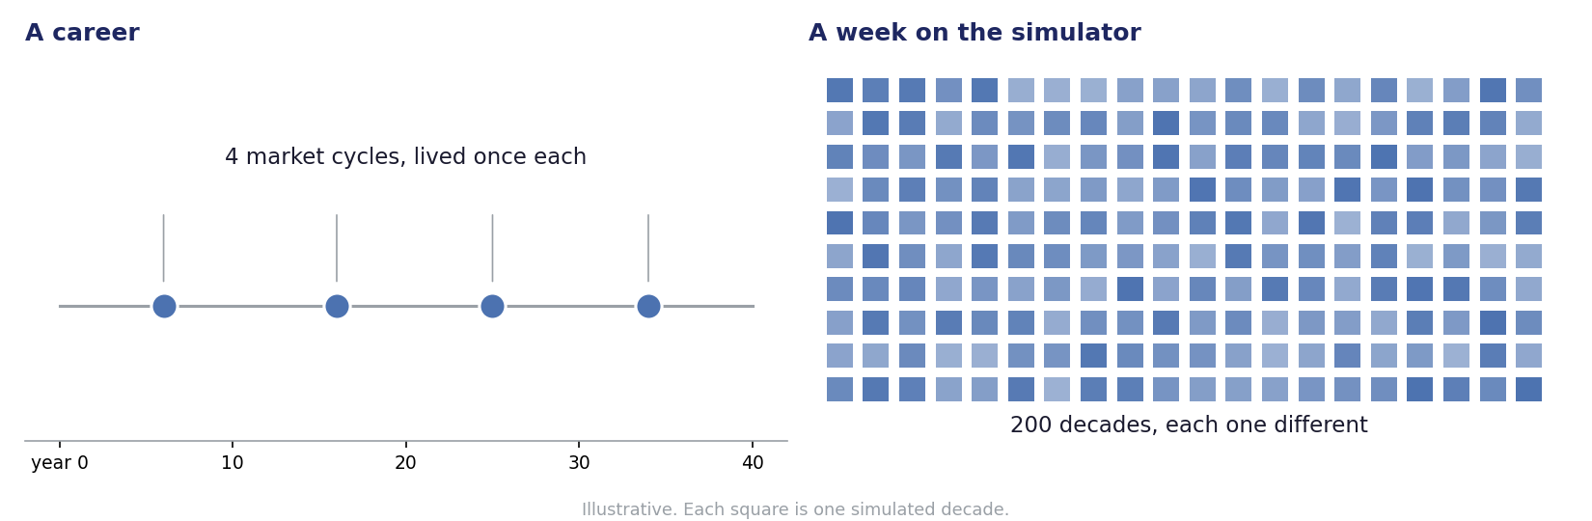
A career gives you four attempts at a hard skill
Slow feedback, few repetitions, and the same handful of episodes everyone else learned from
An investment professional lives through three or four genuine market cycles in forty years — and each one arrives once, in real time, with real consequences.
The simulator does not make the decisions easier. It makes them repeatable, which is the only way anyone has ever got better at anything.
4

Slide 5
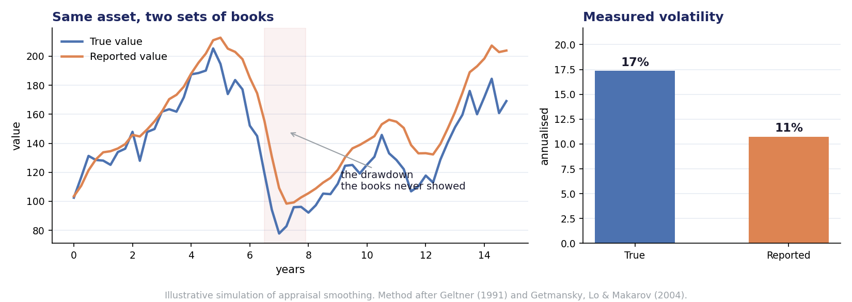
Private assets are calmer on paper than in life
Appraisers anchor on last quarter's value, so reported returns are a smoothed version of real ones
2
values carried for every private asset: true and reported
1 click
to switch between them, mid-decade
30 yrs
of published research behind the correction
Terrarium corrects reported returns before using them, then deliberately re-applies the smoothing so you can watch the gap open in real time.
A model trained on smoothed marks inherits their understatement of risk — which would defeat the whole purpose.
Illustrative simulation. Correction methods after Geltner (1991) and Getmansky, Lo & Makarov (2004).
5

Slide 6
What using it actually looks like
Compile, live, decide, review — the loop is the product
Describe a world in a sentence
1
"Inflation stays stubborn for years." "Credit dries up in 2027." The system turns that into a complete, internally consistent decade — or you pick one from the library.
Live it month by month
2
The decade reveals itself in sequence, like a live tape, with news arriving as things happen. There is no fast-forward to the answer, which is what makes a decision feel like one.
Decide, without knowing what comes next
3
Once a year the committee meets and you act — rebalance, commit, de-risk, hold. Each choice is recorded with the information you actually had at the time.
Find out what your decisions were worth
4
At the end, every decision is annotated with what it cost or earned, against a version of your portfolio that did nothing at all.
6

Slide 7
A decade is built in four layers, slowest first
Each layer constrains the one below it — which is what makes ten years hang together instead of drifting
decades
L1
Climate
The slow backdrop: the inflation environment, where real interest rates sit, trend growth.
Estimated from a century of history across many countries
years
L2
Seasons
The regime spine — expansion, slowdown, recession, recovery, and the stressed states in between.
Specified by us, documented, and varied deliberately
months
L3
Weather
Every market moving together — equities, rates, credit, inflation, commodities, currencies.
The one layer genuinely learned from data
days
L4
Events
Named things that happen: a bank fails, a fund gates, a spread breaches. Trouble clusters.
Arrival rate depends on the season above
Then the monthly paths are reconciled so they add up exactly to what the slower layers said the decade would be.
7

Slide 8
The structure is written down; only the hard part is learned
Written down, and open to argument
Learned from data
The four layers, the regime definitions, and the rules for how one state becomes another.
The constraints that keep a world economically sensible — prices cannot go negative, rates cannot fall below a floor.
The cash-flow mechanics: how capital calls, distributions and asset values behave over a fund's life.
All of it versioned, so any result records exactly which specification produced it.
One thing only: how markets move together month to month.
The method is the one behind modern image and video generation, applied to time series.
It assumes nothing about the shape of the distribution — no bell curve, no named family. Whatever shape the history has, including its extremes, is what it learns.
It is told what kind of decade to produce rather than asked for a random one.
The usual approach learns the whole world and hides it where nobody can look — fine for video games, useless in front of a risk committee. This one can be read, argued with, and changed.
8

Slide 9
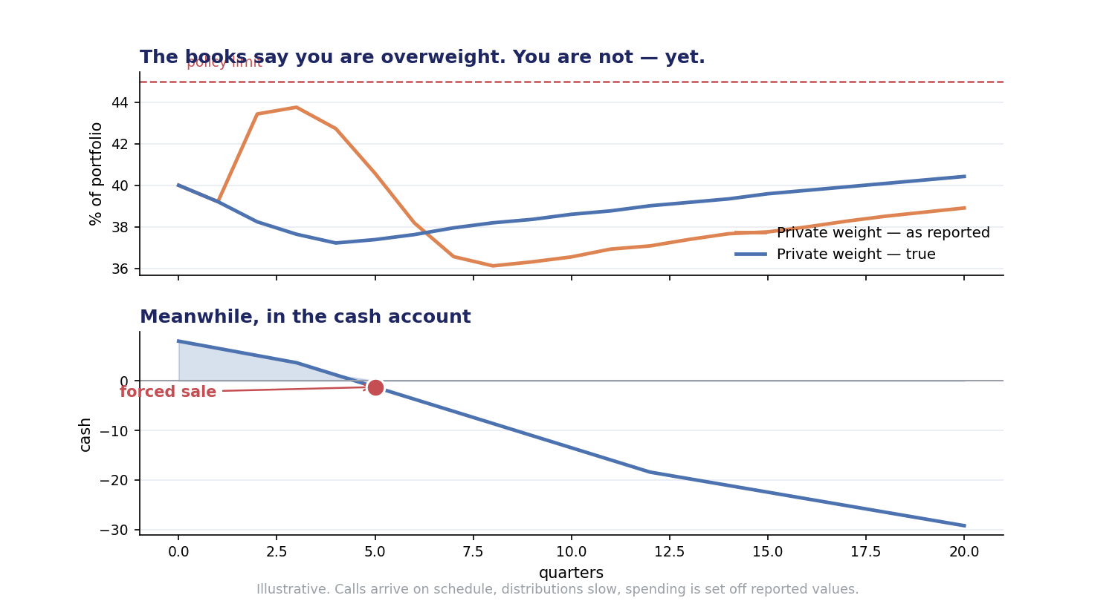
Being overweight is arithmetic. Being forced to sell is the problem.
Public holdings fall at once, private marks lag, spending is set off the lagging numbers, calls arrive anyway
The books say your private weight is climbing through the policy limit. On a true basis it is falling — the reported number is an artefact of stale marks.
Meanwhile spending stays high because it is calculated off those same reported values, capital calls arrive on schedule, and distributions dry up.
Eventually something has to be sold, and the things that can be sold are rarely the things you wanted to sell.
Illustrative. Cash-flow mechanics follow the Takahashi–Alexander framework, extended so call and distribution rates respond to market conditions.
9

Slide 10
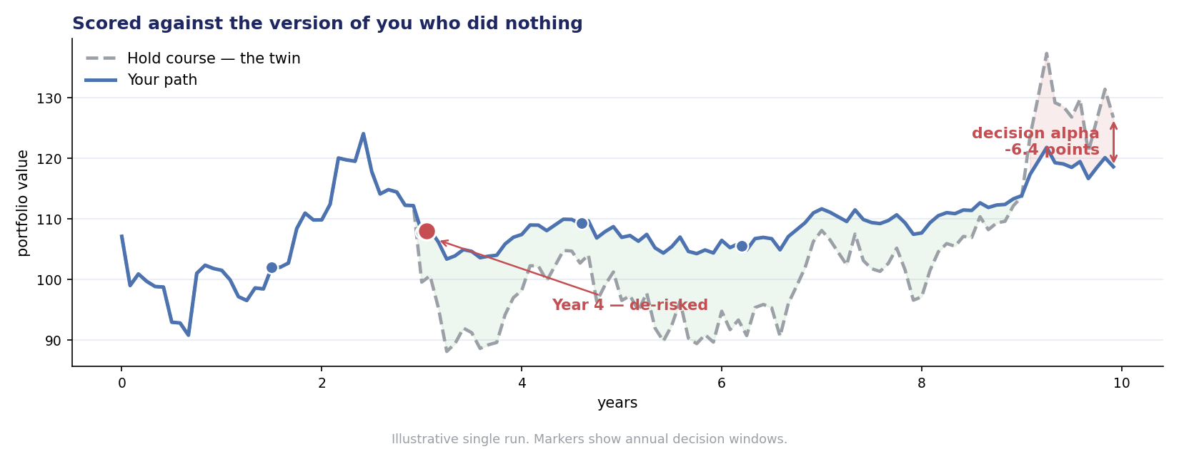
You are scored against the version of you who did nothing
Markets mostly decide whether you made money. This measures whether your decisions helped.
A second line tracks the portfolio you would have held if you had never acted. Watching the two separate — sometimes in your favour, often not — is where the product explains itself without a manual.
Afterwards each decision is annotated with what it was worth, in the style of a chess engine review: year four, de-risked, minus eleven points.
10

Slide 11
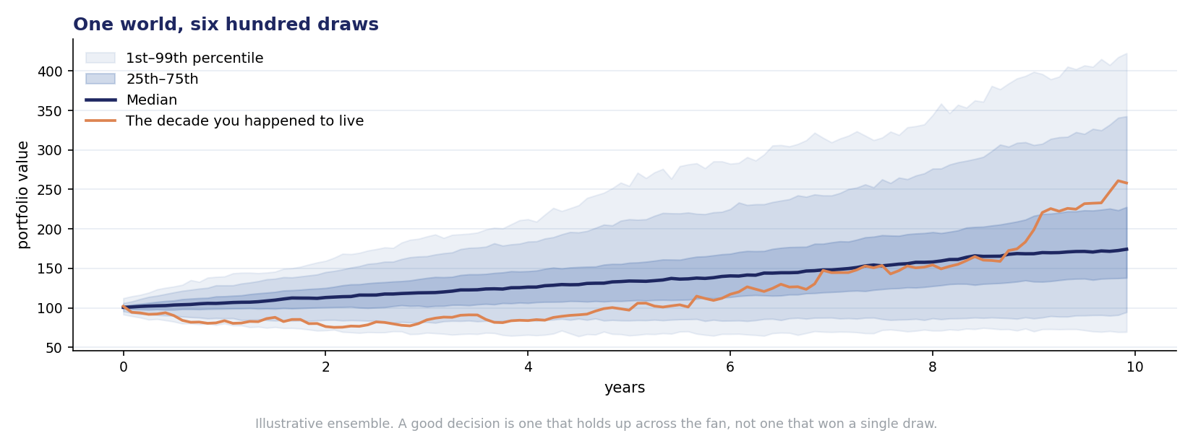
A world is a fan of possibilities, not a line
The same scenario, drawn hundreds of times — because one decade is a sample of one
The decade you live is one draw from the world you chose.
Scoring across many draws separates a robust decision from a lucky one — which is the whole intellectual argument of the product, turned into a scoreboard.
It is also why nothing here is a forecast. A fan is a statement about what is plausible, not about what will happen.
11

Slide 12
Every world is tested before anyone plays it
Thresholds are fixed before models are trained, so the tests can actually fail
Test | The plain-English question | Standard
Statistical realism | Does it behave like real markets — fat tails, calm and stormy spells, faster falls than rises? | Pre-set tolerance bands
Tail accuracy | Does it get the worst outcomes right, not just the average ones? | Backtest error bounds
Indistinguishability | Can a classifier tell a synthetic decade from a real one? | Close to a coin flip
Usefulness | Do models trained on synthetic data still work on real data? | Limited degradation
Memorisation | Is it inventing, or quietly replaying history? | Distance floor from real paths
Unseen regimes | Trained without the 1970s, can it still produce one? | Our own severe test
The battery is published, and the numbers that count as a pass are written down before any model is trained.
Every run also writes a record sufficient to replay it exactly, so any score or published result can be re-run by someone else.
If the engine is wrong, it will be wrong in public, in ways people can verify.
12

Slide 13
What it is for
Six things that are hard to get any other way
1
Repetition
2
Visible risk
Reps at decisions that otherwise arrive three or four times in a career.
The gap between what the books say and what is actually being carried, watched rather than read about.
3
Liquidity as a felt constraint
4
A shared language
Forced selling as something that happens to you, not a paragraph in a risk report.
The same decade, the same events, played by a whole team — the only difference is what each person decided.
5
A replayable record
6
A test bed for AI allocators
Every score resolves to a record anyone can re-run. Unusual for a simulator; essential for a serious one.
A world with a known ground truth that can be run ten thousand times is one way to find out whether an AI is any good at this.
Not investment advice. Simulated worlds, labelled as such; no real firm or person appears in one.
13

Slide 14
Appendix — methodology at a glance
What is settled, what is a deliberate choice, and what is still open
Component | Approach | Status | Anchor
Long-run backdrop | Estimated from a multi-country macro panel reaching back more than a century | Settled | Jordà–Schularick–Taylor
Regime spine | Human-defined states, documented and varied in a robustness grid | Our choice | No direct precedent
Market generator | Conditional deep generative model; architecture selection in progress | In progress | Diffusion / flow-matching family
Tail accuracy | Worst-case error for a fixed set of benchmark strategies enters the training objective | Settled | Cont et al. (2025)
De-smoothing | Reported private returns corrected before use; smoothing re-applied for display | Settled | Geltner; Getmansky–Lo–Makarov
Cash flows | Industry-standard pacing recursions, extended so rates respond to market conditions | Settled | Takahashi–Alexander; Robinson–Sensoy
Calibration data | Public sources for the published engine; proprietary work kept separate and versioned apart | By design | Reproducibility claim
Narrative layer | Language models write the story and never touch the numbers | Constitutional | Structural, not prompt-enforced
14

Slide 15
Appendix — references
Load-bearing sources. Full bibliography sits in the model documentation pack.
Geltner, D. (1991). Smoothing in appraisal-based returns. Journal of Real Estate Finance and Economics.
Getmansky, M., Lo, A. & Makarov, I. (2004). An econometric model of serial correlation and illiquidity in hedge fund returns. Journal of Financial Economics.
Cont, R. (2001). Empirical properties of asset returns: stylized facts and statistical issues. Quantitative Finance.
Cont, R., Cucuringu, M., Xu, R. & Zhang, C. (2025). Tail-GAN: learning to simulate tail risk scenarios. Management Science.
Takahashi, D. & Alexander, S. (2002). Illiquid alternative asset fund modeling. Journal of Portfolio Management.
Robinson, D. & Sensoy, B. (2016). Cyclicality, performance measurement, and cash flow liquidity in private equity. Journal of Financial Economics.
Jordà, Ò., Schularick, M. & Taylor, A. Macrohistory Database (long-run cross-country macro-financial panel).
Flaig, S. & Junike, G. (2022, 2023). Scenario generation for market risk models using generative networks; and their validation.
Buehler, H., Horvath, B., Lyons, T., Perez Arribas, I. & Wood, B. (2020). A data-driven market simulator for small data environments.
Krah, A.-S., Nikolić, Z. & Korn, R. (2020). Machine learning in least-squares Monte Carlo proxy modeling.
Bezzina, F. & Vella, V. (2024). Enhancing portfolio construction with synthetic data.
Denton, F. (1971). Adjustment of monthly or quarterly series to annual totals.
15

