Slide 1
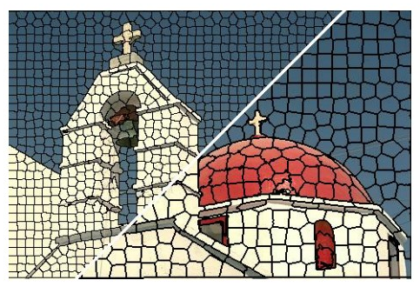
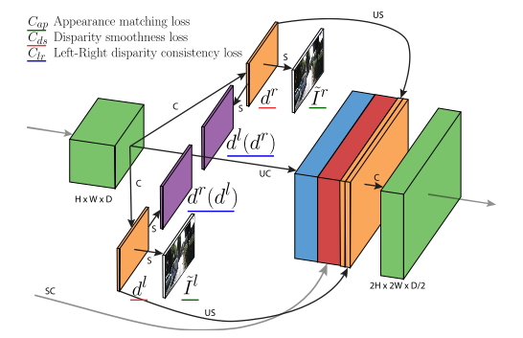
Deeplearning Lab: Piecewise monocular depth estimation by plane fitting
Weekly Topic: Grasb the idea of s.o.t.a literature

Slide 2
Superpixel Benchmarks

Slide 3
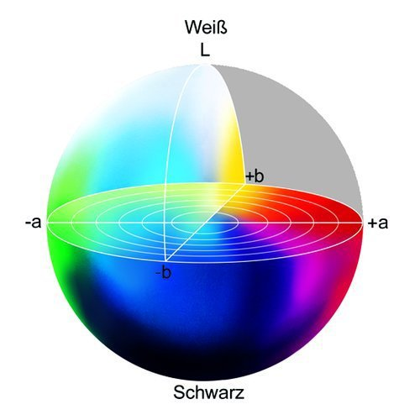
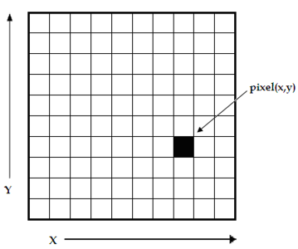
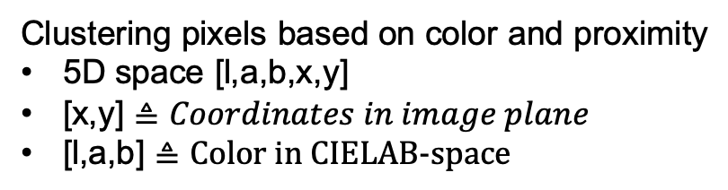

s1 SLIC- Simple linear iterative clustering
Clustering pixels based on color and proximity
5D space [l,a,b,x,y]
[x,y] $≜Coordinates in image plane$
[l,a,b] $≜\text{Color} \text{in} \text{CIELAB}\text{−}\text{space}$
white
L $≜$ Brightness
black
https://www.researchgate.net/figure/
A-digital-image-is-a-2D-array-of-pixels
-Each-pixel-is-characterised-by-its-x-y_fig1_221918148
https://www.heise.de/ct/imgs/04/1/4/8/7/2/5/1/Lab-Farbraum-ead9d79b2a394144.jpeg

Slide 4
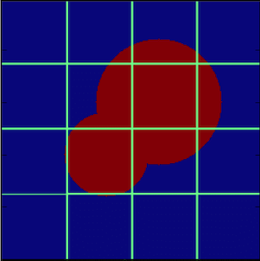


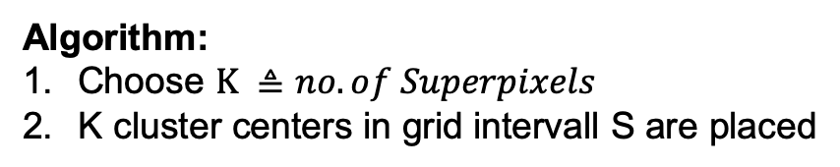
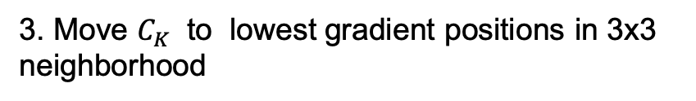
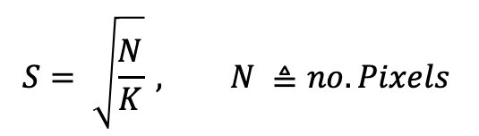

s1 SLIC- Simple linear iterative clustering
Algorithm:
Choose $K ≜no. of Superpixels$
K cluster centers in grid intervall S are placed
S
$$S^{2}$$
$$C_{k}=\left[l_{k},a_{k},b_{k},x_{k},y_{k}\right], k ε \left[1,K\right]$$
$$S= \sqrt{\frac{N}{K}} , N ≜no. Pixels$$
$$C_{k}$$
N = 256x256p
3. Move $C_{K}$ to lowest gradient positions in 3x3
neighborhood
$$G\left(x,y\right)= {\left\|I\left(x+1,y\right)−I\left(x−1,y\right)\right\|}^{2 }+{\left\|I\left(x,y+1\right)−I\left(x,y−1\right)\right\|}^{2}$$

Slide 5
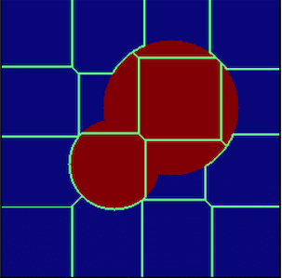
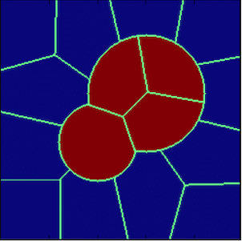
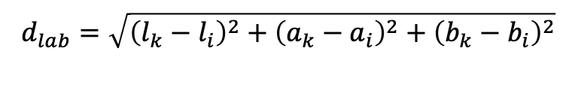
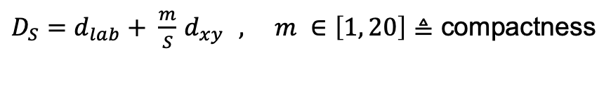
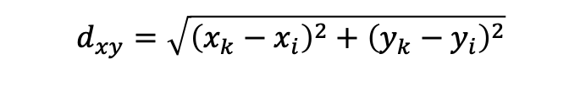
s1 SLIC- Simple linear iterative clustering
4. Associate pixels to nearest $C_{k} →superpixel$
Search area: 2S x 2S
$$d_{lab}=\sqrt{{\left(l_{k}−l_{i}\right)}^{2}+{\left(a_{k}−a_{i}\right)}^{2}+{\left(b_{k}−b_{i}\right)}^{2}}$$
$$d_{xy}=\sqrt{{\left(x_{k}−x_{i}\right)}^{2}+{\left(y_{k}−y_{i}\right)}^{2}}$$
$D_{S}=d_{lab}+ \frac{m}{S}$ $d_{xy } , m ∈\left[1, 20\right]≜$ compactness
5. C$alculate new C_{k }$by averaging all pixels associated to $C_{k }$
6. Repeat 4. & 5. till convergence or threshhold is reached.
https://www.researchgate.net/figure/A-cartoon-showing-the-progress-of-the-SLIC-algorithm-for-a-simple-case-The-top-left_fig3_322652376

Slide 6
s2 Learning Superpixels With segmentation aware infinity loss

Slide 7
s3 real time coarse to fine topologically preserving segmentation

Slide 8
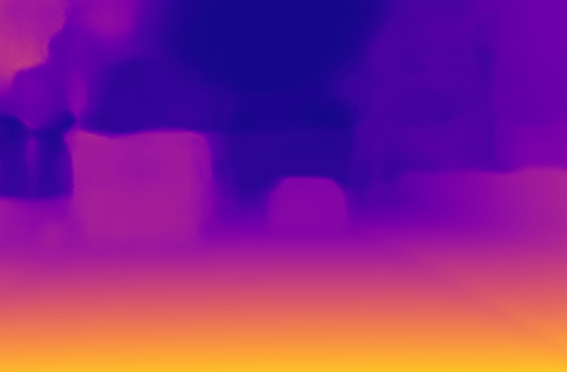
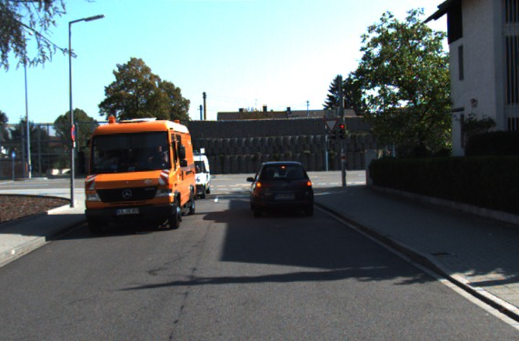
m1_1 unsupervised monocular depth estimation with left right consistency
used for training
LR Loss
Loss
R
R
R
L
L
L
L
R
Input
colors
CNN
Output
disparities
Sampler
Output
colors
Target
colors
8

Slide 9
m1_1 architecture
CNN (inspired by DispNET)
ENCODER DECODER (inspired by Shelhamer)
composed of two main parts - an encoder (from cnv1 to cnv7b) and decoder (fromupcnv7)
The decoder uses skip connectionsfrom the encoder’s activation blocks, enabling it to resolve higher resolution detail
Skips
Encoder
Decoder
Outputs

Slide 10
m1_1 concept I: overview
CCN that learns to perform single depth estimation despite the absence of groundtruth depth data
Fully convolutional architecture inspired by DispNET
Poses monocular depth estimation as an image reconstruction problem
Train with added binocular color image instead of using ground truth data
It learns to predict pixel-level correspondence between pairs of rectified stereo images that have known camera baseline
Training loss that enforces left-right depth consistency inside the network
Code available for TensorFlow
Evaluated on KITTI

Slide 11
m1_1 concept II: detail
Approach: novel view synthesis: generate the corresponding right view from an input left image by: combination of the scan line from the left image weighted by the probability of each disparity INTUITION: given a calibrated pair of binocular cameras: learn a function that is able to reconstruct one image from the other, based on that we have learned something about the 3D shape of the scene that is being imaged
minimizes photometric loss, disparity smoothness loss and left right consistency loss during learning
Introduced new novel depth estimation training loss to train image pairs without requiring supervision in from of groundtruth data

Slide 12



m1_1 concept III: novel depth estimation
per-pixel scene depth:
Find: Dense correspondence field $d^{r}$ that when applied to left image would reconstruct the right image (and vice versa)
Reconstructed image:
d corresponds to the image disparity - a scalar value per pixel that the model will learn to predict.
Given the baseline distance b between the cameras and the camera focal length f, we can then trivially recover the depth: from the predicted disparity: $\hat{d}$= $\frac{b ∗f}{d}$

Slide 13
m1_1 concept IV: how depth is estimated
Network estimates depth by inferring the disparities that warp the left image to match the right one
Network generates predicted image with backwarp mapping using bilinear sampler resulting in a fully differentiable image formation model
Predict disparity maps for both views by sampling from the opposite input images (avoids artefacts in depth image)

Slide 14
m1_1 related literature
architecture inspired by DispNET (produces correspondence field between two images), N. Mayer, E. Ilg, P. H¨ausser, P. Fischer, D. Cremers, A. Dosovitskiy, and T. Brox. A large dataset to train convolutional networks for disparity, optical flow, and scene flow estimation
Bilinear sampling to ensure differentiable training loss -> image sampler by spatial network transformer, M. Jaderberg, K. Simonyan, A. Zisserman, and K. Kavukcuoglu. Spatial transformer networks. In NIPS, 2015
Encoder Decoder structure by V. Patraucean, A. Handa, and R. Cipolla. Spatio-temporal video autoencoder with differentiable memory. arXiv preprint arXiv:1511.06309, 2015
Generate corresponding right view from an input left image J. Xie, R. Girshick, and A. Farhadi. Deep3d: Fully automatic 2d-to-3d video conversion with deep convolutional neural networks. In ECCV, 2016.

Slide 15
m1_1 loss function
1. Appearance Matching Loss
2. Disparity Smoothness Loss
3. Left-Right Disparity Smoothness Loss

Slide 16
m1_1 known limitations
Since method relies on image reconstruction term, specular and transparent surfaces produce inconsistent depth (assumes lambardian world)
Disparity Error maps show inconsistency for close-by-objects, texture-less regions and occlusion boundaries

Slide 17
m1_2 digging into self_ supervised monocular depth prediction

Slide 18
m2_1 Unsupervised Learning of Depth and Ego-Motion from Video

