Slide 1
Deeplearning Lab: General information on superpixel algorithms

Slide 2
Classification of superpixel algorithms
Watershed-based: Watershed, Compact Watershed, Morphological Superpixel Segmentations, Water Pixels
Density-based: Edge-Augmented Mean Shift, Quick Shift
Graph-based: Normalized Cuts, Felzenwalb and Huttenlocher, Random Walks, Constant Intensity Superpixels, Entropy Rate Superpixels, Boolean Optimization Superpixels, Proposals for Objects from Improved Seeds and Energies
Contour evolution: Turbo Pixels, Eikonal Region Growing Clustering
Path-based: Path Finder, Topology Preserving Superpixels
Clustering-based: Simple Linear Iterative Clustering, Depth-Adaptive Superpixels, VCells, Voxel-Cloud Connectivity Segmentation, Preemptive SLIC, Linear Spectral Clustering
Energy Optimization: Contour Relaxed Superpixels, Superpixels Exracted via Energy-driven Sampling, Convexitiy Constrained Superpixels, Extended Topology Preserving Segmentation
Wavelet-based: Superpixels from Edge-Avoiding Wavelets

Slide 3
Databases 1. General
There are multiple databases for RGBD:
http://www.michaelfirman.co.uk/RGBDdatasets/
Most interesting ones:
Street environments: KITTI
In house environments: NYU Dataset v2
Category/classification: Kinect RGBD Dataset for Category Modeling
Idea: Maybe train also with object databases to retrieve better contours

Slide 4
Databases 2. Superpixel specific ones
BSDS500 [40]. The Berkeley Segmentation Dataset 500 (BSDS500) was the first to be used for superpixel algorithm evaluation. It contains 500 images and provides at least 5 high-quality ground truth segmentations per image. The images represent simple outdoor scenes, showing landscape, buildings, animals and humans, where foreground and background are usually easily identified. Nevertheless, natural scenes where segment boundaries are not clearly identifiable, contribute to the difficulty of the dataset.
SBD [41]. The Stanford Background Dataset (SBD) combines 715 images from several datasets. As result, the dataset contains images of varying size, quality and scenes. The images show outdoor scenes such as landscape, animals or street scenes. In contrast to the BSDS500 dataset the scenes tend to be more complex, often containing multiple foreground objects or scenes without clearly identifiable foreground.
NYUV2 [42]. The NYU Depth Dataset V2 (NYUV2) contains 1449 images including pre-processed depth. The provided ground truth is of lower quality compared to the BSDS500 dataset. The images show varying indoor scenes of private apartments and commercial accommodations which are often cluttered and badly lit.
SUNRGBD [43]. The Sun RGB-D dataset (SUNRGBD) contains 10335 images including pre-processed depth. The dataset combines images from the NYUV2 dataset and other datasets with newly acquired images. The images show cluttered indoor scenes with bad lighting taken from private apartments as well as commercial accomodations.
Fash [44]. The Fashionista dataset (Fash) contains 685 images which have previously been used for clothes parsing. The images show the full body of fashion bloggers in front of various backgrounds.
Example images from these datasets can be found in Figure 1. Further information on image size and training/test split can be found in Table 2.
http://davidstutz.de/projects/superpixel-benchmark/

Slide 5
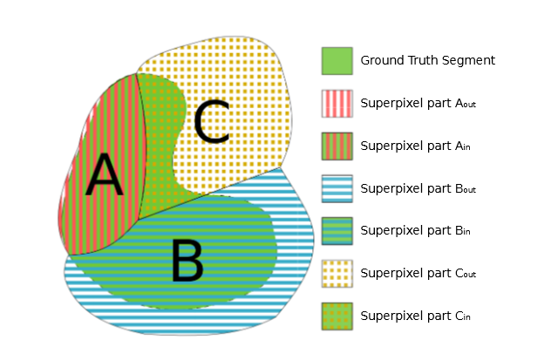
Superpixel Benchmarks
1. Stutz et. Al. (cited a lot for benchmarking the state of the art superpixel)
https://arxiv.org/abs/1612.01601: Average Miss Rate (AMR), Average Undersegmentation Error (AUE) and Average Unexplained Variation (AUV)
2. https://pdfs.semanticscholar.org/9b60/9d135d68b814bbed0b5dad12e8f8955fdcd8.pdf: Also for boundary recall

Slide 6
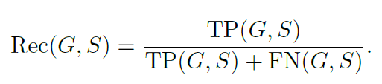
Superpixel Benchmark Parameters
Boundary Recall (Rec)
is the most commonly used metric to asses boundary adherence given ground truth
FN(G; S) be the number of false negative boundary pixels
TP(G; S) be the number of true positive boundary pixels

Slide 7
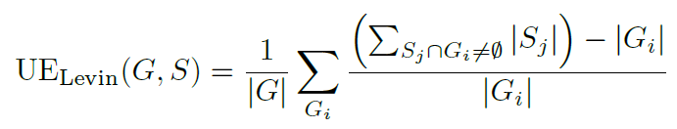
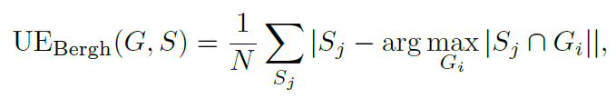
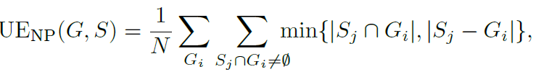
Superpixel Benchmark Parameters
Undersegmentation Error (UE)
Measures the “leakage" of superpixels with respect to G
Different approaches
Original (Levinshtein et al.)
Thresholded leakage (van den Bergh et al. and Neubert and Protzel)

Slide 8
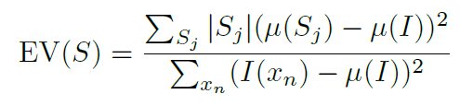
Superpixel Benchmark Parameters
Explained Variation (EV)
quanties the quality of a superpixel segmentation without relying on ground truth
µ (Sj) and µ(I) are the mean color of superpixel Sj and the image I

Slide 9
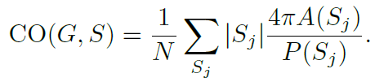
Superpixel Benchmark Parameters
Compactness (CO)
compares the area A(Sj) of each superpixel Sj with the area of a circle (the most compact 2-dimensional shape) with same perimeter P(Sj ), i.e. higher is better.

Slide 10
Comparision results Stutz et al.
Resulting ranking:
ETPS
SEEDS
ERS
CRS
ERGC
SLIC

Slide 11
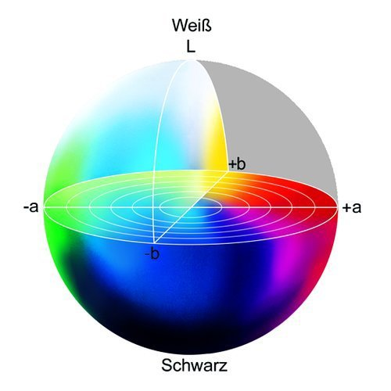
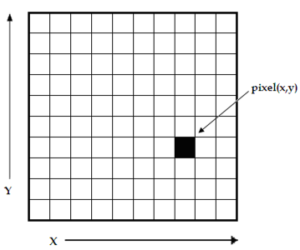
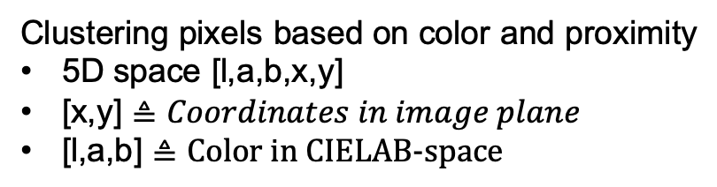

s1 SLIC- Simple linear iterative clustering
Clustering pixels based on color and proximity
5D space [l,a,b,x,y]
[x,y] $≜Coordinates in image plane$
[l,a,b] $≜\text{Color} \text{in} \text{CIELAB}\text{−}\text{space}$
white
L $≜$ Brightness
black
https://www.researchgate.net/figure/
A-digital-image-is-a-2D-array-of-pixels
-Each-pixel-is-characterised-by-its-x-y_fig1_221918148
https://www.heise.de/ct/imgs/04/1/4/8/7/2/5/1/Lab-Farbraum-ead9d79b2a394144.jpeg

Slide 12
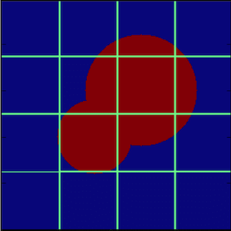


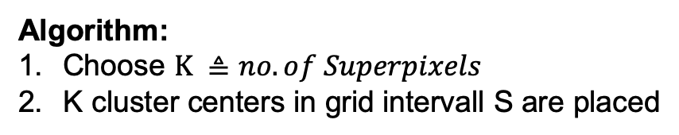
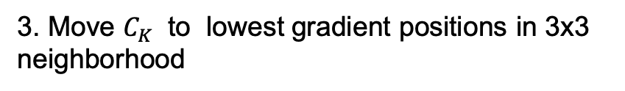
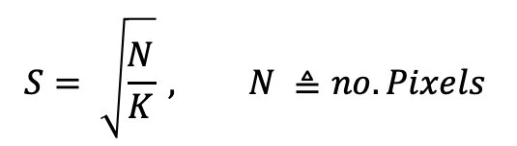

s1 SLIC- Simple linear iterative clustering
Algorithm:
Choose $K ≜no. of Superpixels$
K cluster centers in grid intervall S are placed
S
$$S^{2}$$
$$C_{k}=\left[l_{k},a_{k},b_{k},x_{k},y_{k}\right], k ε \left[1,K\right]$$
$$S= \sqrt{\frac{N}{K}} , N ≜no. Pixels$$
$$C_{k}$$
N = 256x256p
3. Move $C_{K}$ to lowest gradient positions in 3x3
neighborhood
$$G\left(x,y\right)= {\left\|I\left(x+1,y\right)−I\left(x−1,y\right)\right\|}^{2 }+{\left\|I\left(x,y+1\right)−I\left(x,y−1\right)\right\|}^{2}$$

Slide 13
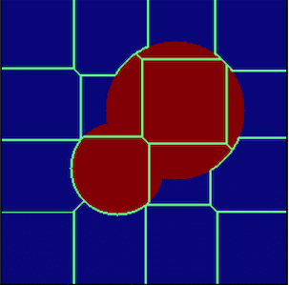
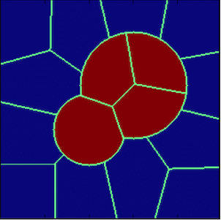
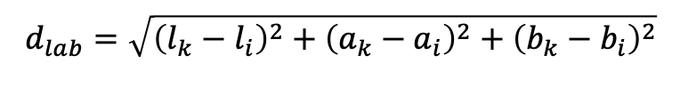
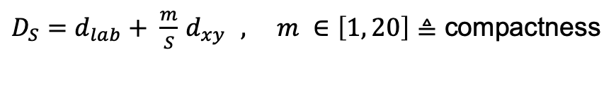
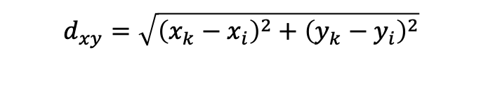
s1 SLIC- Simple linear iterative clustering
4. Associate pixels to nearest $C_{k} →superpixel$
Search area: 2S x 2S
$$d_{lab}=\sqrt{{\left(l_{k}−l_{i}\right)}^{2}+{\left(a_{k}−a_{i}\right)}^{2}+{\left(b_{k}−b_{i}\right)}^{2}}$$
$$d_{xy}=\sqrt{{\left(x_{k}−x_{i}\right)}^{2}+{\left(y_{k}−y_{i}\right)}^{2}}$$
$D_{S}=d_{lab}+ \frac{m}{S}$ $d_{xy } , m ∈\left[1, 20\right]≜$ compactness
5. C$alculate new C_{k }$by averaging all pixels associated to $C_{k }$
6. Repeat 4. & 5. till convergence or threshhold is reached.
https://www.researchgate.net/figure/A-cartoon-showing-the-progress-of-the-SLIC-algorithm-for-a-simple-case-The-top-left_fig3_322652376

Slide 14
s2 Learning Superpixels With segmentation aware infinity loss

Slide 15
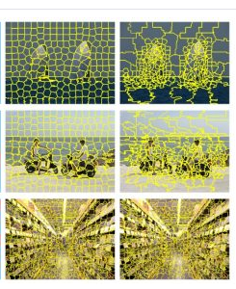
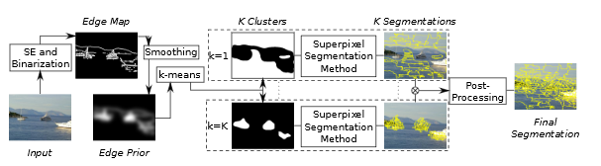
Edge Adaptive Seeding for Superpixel Segmentation
“Generating more seeds in areas with more edges and vise versa.
This follows the assumption that edges distinguish objects and thus are a good indicator of the level of clutter in an image region.”
Left: SLIC,
Right: SLIC with
adaptive Seeding
https://www.inf.uni-hamburg.de/en/inst/ab/cv/media/wilms-frintrop-paper-gcpr2017.pdf
https://davidstutz.de/edge-adaptive-seeding-superpixel-segmentation-wilms-frintrop/

Slide 16
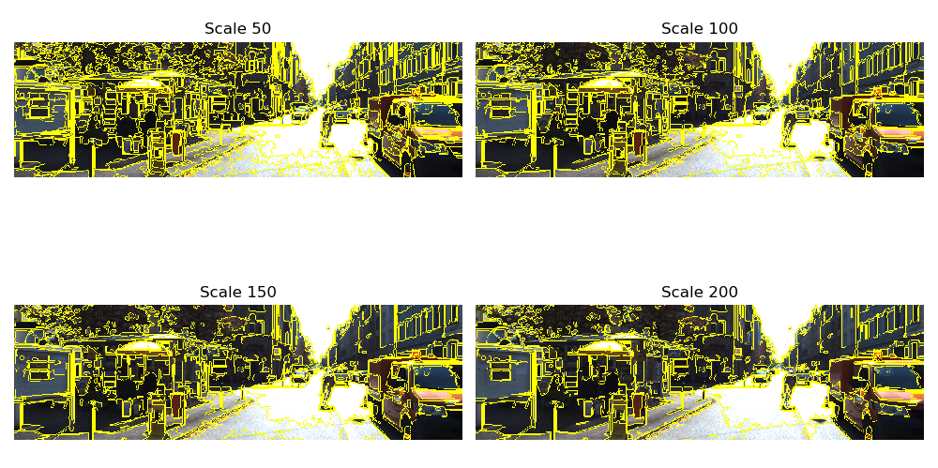
Parameter for Felzenshalb 1. Scale

Slide 17
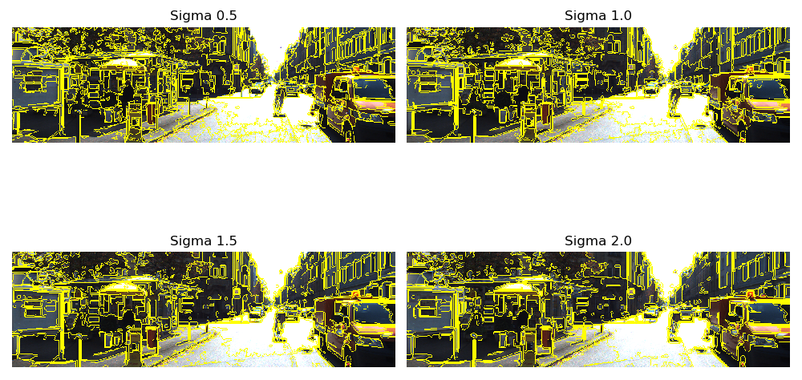
Parameter for Felzenshalb 2. Sigma

Slide 18
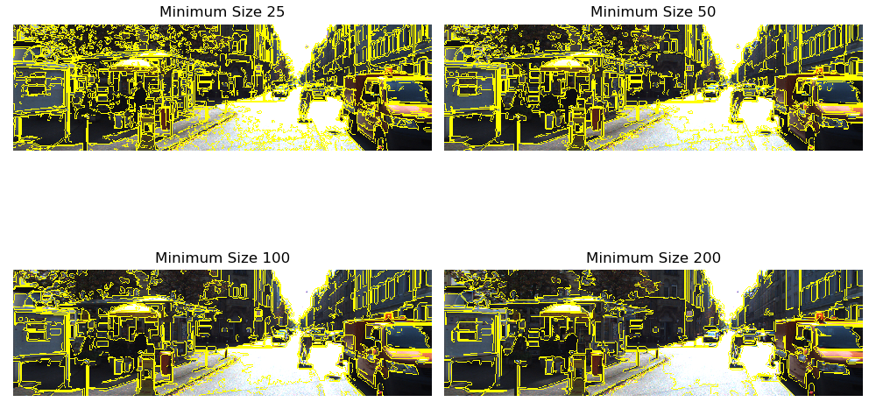
Parameter for Felzenshalb 3. Minimum size

