Slide 1
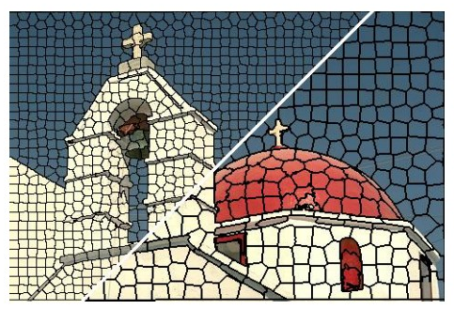
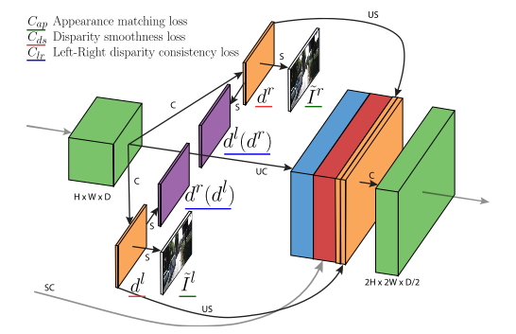
Deeplearning Lab: Piecewise monocular depth estimation by plane fitting
Weekly Topic: Grasb the idea of s.o.t.a literature

Slide 2
Superpixel Benchmarks

Slide 3
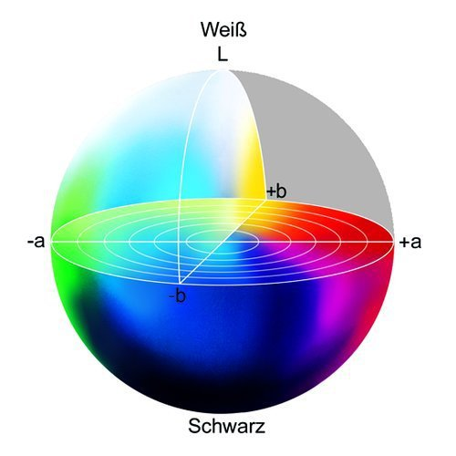
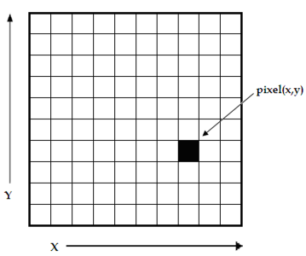

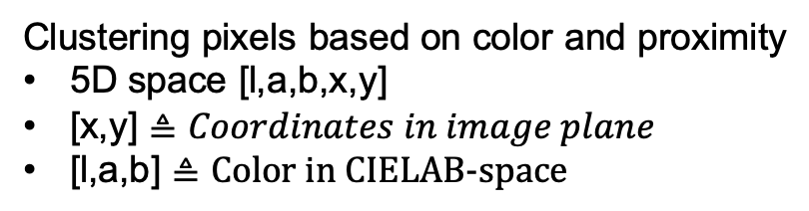
s1 SLIC- Simple linear iterative clustering
Clustering pixels based on color and proximity
5D space [l,a,b,x,y]
[x,y] $≜Coordinates in image plane$
[l,a,b] $≜\text{Color} \text{in} \text{CIELAB}\text{−}\text{space}$
white
L $≜$ Brightness
black
https://www.researchgate.net/figure/
A-digital-image-is-a-2D-array-of-pixels
-Each-pixel-is-characterised-by-its-x-y_fig1_221918148
https://www.heise.de/ct/imgs/04/1/4/8/7/2/5/1/Lab-Farbraum-ead9d79b2a394144.jpeg

Slide 4
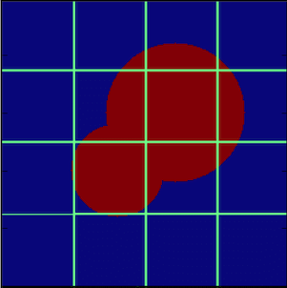


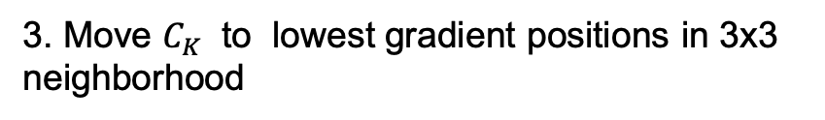
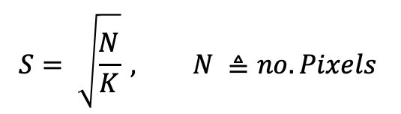

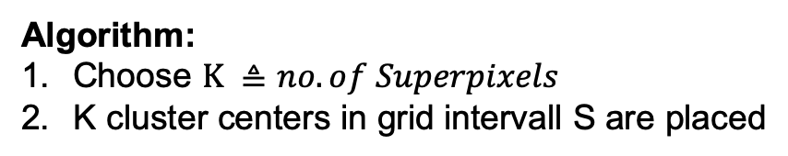
s1 SLIC- Simple linear iterative clustering
Algorithm:
Choose $K ≜no. of Superpixels$
K cluster centers in grid intervall S are placed
S
$$S^{2}$$
$$C_{k}=\left[l_{k},a_{k},b_{k},x_{k},y_{k}\right], k ε \left[1,K\right]$$
$$S= \sqrt{\frac{N}{K}} , N ≜no. Pixels$$
$$C_{k}$$
N = 256x256p
3. Move $C_{K}$ to lowest gradient positions in 3x3
neighborhood
$$G\left(x,y\right)= {\left\|I\left(x+1,y\right)−I\left(x−1,y\right)\right\|}^{2 }+{\left\|I\left(x,y+1\right)−I\left(x,y−1\right)\right\|}^{2}$$

Slide 5
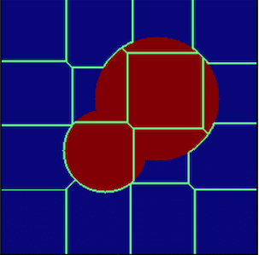
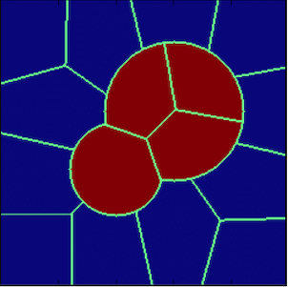
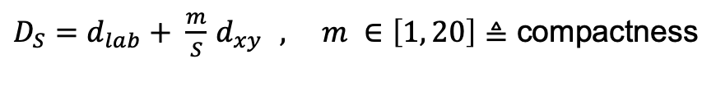
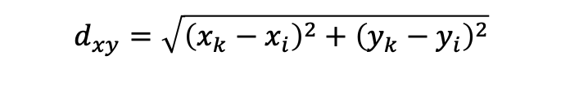
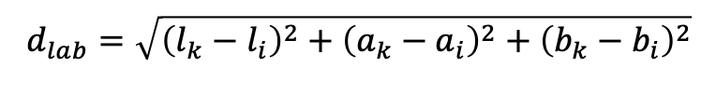
s1 SLIC- Simple linear iterative clustering
4. Associate pixels to nearest $C_{k} →superpixel$
Search area: 2S x 2S
$$d_{lab}=\sqrt{{\left(l_{k}−l_{i}\right)}^{2}+{\left(a_{k}−a_{i}\right)}^{2}+{\left(b_{k}−b_{i}\right)}^{2}}$$
$$d_{xy}=\sqrt{{\left(x_{k}−x_{i}\right)}^{2}+{\left(y_{k}−y_{i}\right)}^{2}}$$
$D_{S}=d_{lab}+ \frac{m}{S}$ $d_{xy } , m ∈\left[1, 20\right]≜$ compactness
5. C$alculate new C_{k }$by averaging all pixels associated to $C_{k }$
6. Repeat 4. & 5. till convergence or threshhold is reached.
https://www.researchgate.net/figure/A-cartoon-showing-the-progress-of-the-SLIC-algorithm-for-a-simple-case-The-top-left_fig3_322652376

Slide 6
s2 Learning Superpixels With segmentation aware infinity loss

Slide 7
s3 real time coarse to fine topologically preserving segmentation

Slide 8
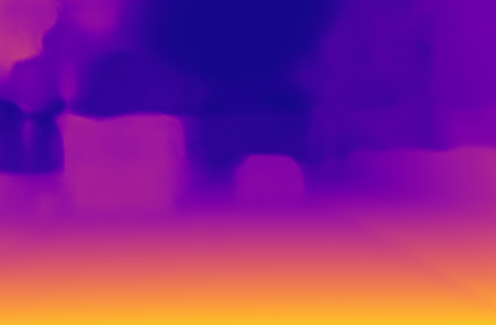
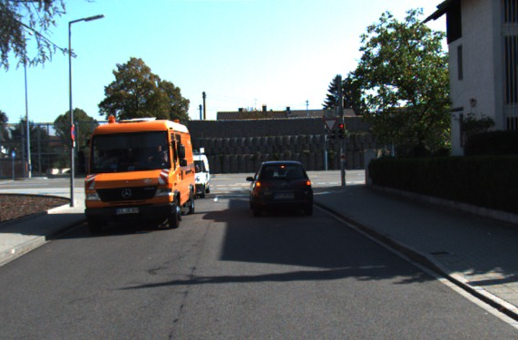
m1_1 unsupervised monocular depth estimation with left right consistency
used for training
LR Loss
Loss
R
R
R
L
L
L
L
R
Input
colors
CNN
Output
disparities
Sampler
Output
colors
Target
colors

Slide 9
m1_1 concept

Slide 10
m1_1 lost function

Slide 11
m1_1 related literature

Slide 12
m1_2 digging into self_ supervised monocular depth prediction

Slide 13
m2_1 Unsupervised Learning of Depth and Ego-Motion from Video

