Slide 1
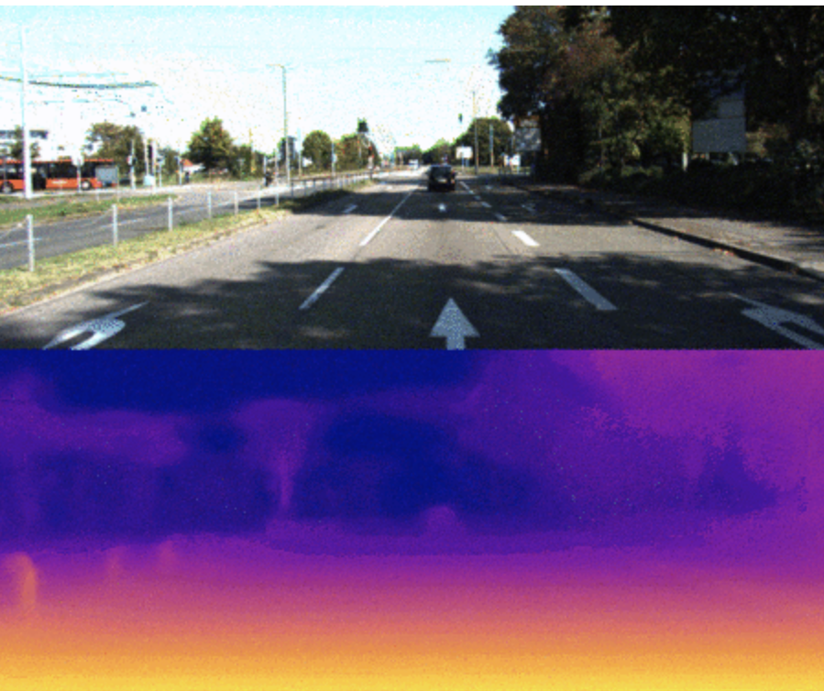
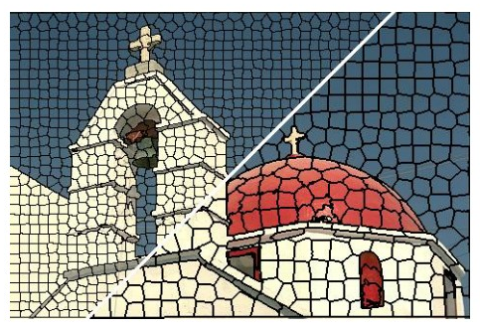
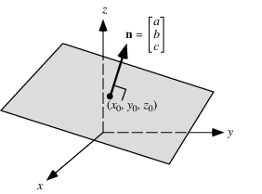
Final Presentation: Piecewise monocular depth estimation by plane fitting
Group 2: Felix Wirth, Korbinian Kunst, Helge Dörsan, Jan Ceccejus
Notes:
benefit of estimating plane coefficients instead of directly estimating depth values is that they can effectively represent depth values of multiple pixels by estimating only 3 coefficients

Slide 2

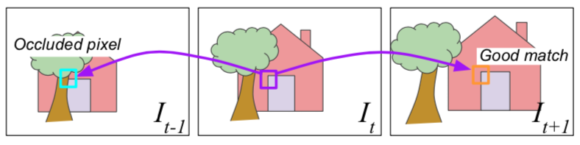

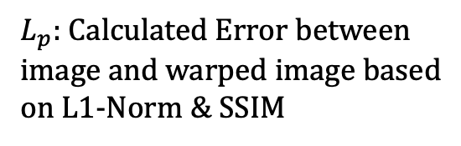

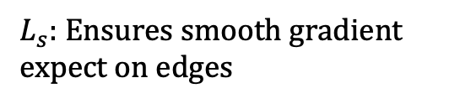
Architecture LOSS: Digging Into Self-Supervised Monocular Depth Estimation [1]
Baseline - Loss
Minimum Photometric Error
$L_{p}:$Calculated Error between image and warped image based on L1-Norm & SSIM
$$L_{p}$$
$L = μ min\left(PE\left(I_{t},I_{t→t^{′ }}\right)\right)+ λ ( \left|{∂_{x}d}_{t}\right|∗e^{\left\{−\left|{∂_{x}I}_{t}\right|\right\}}$ + $\left|{∂_{y} d}_{t}\right|∗e^{\left\{−\left|∂_{y}I_{t}\right|\right\}}$)
$$L_{s}$$
$L_{s}:$Ensures smooth gradient expect on edges

Slide 3

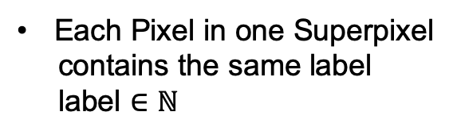
Loss Function Superpixel in Loss Function
Superpixel explained
1
1
2
2
1
2
3
3
3
3
3
Superpixel: Group of Pixels
Each Pixel in one Superpixel
contains the same label
label $∈ℕ$

Slide 4
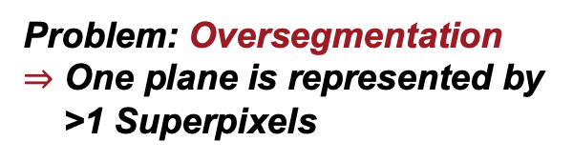
Loss Function Superpixel in Loss Function
Concept Idea
Use Superpixel information in implementing loss function
1
Problem: Oversegmentation
$⇒$ One plane is represented by
>1 Superpixels
1
2
3
1
Join Superpixels on same surface
Minimize disparity gradient $\left|∂_{x}d_{t}\right| \&\left|∂_{y}d_{t}\right|$ inside one plane
Let edges be rough

Slide 5




Loss Function Binary & Continuous Superpixel Loss
Mathematical Implementation
Superpixel - Loss
Goal – Create Superpixel mask
$L_{s}= λ ( \left|{∂_{x}d}_{t}\right|∗μ_{x}$ + $\left|{∂_{y} d}_{t}\right|{∗ μ}_{y})$
SP-Loss binary
SP-Loss continuous
0 , on edges
$e^{\left\{−\left|{∂_{x/y}I}_{t}\right|\right\}}$ , on SP edges
$$μ_{x/y}=$$
$$μ_{x/y}=$$
1 , inside plane
1 , inside SP

Slide 6

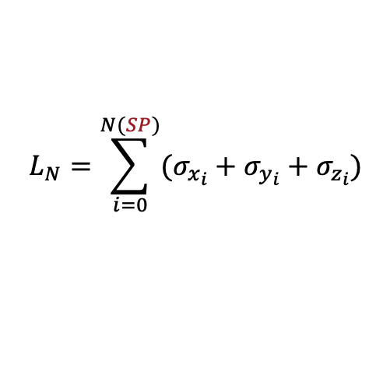



Loss Function Normals in Loss Function
Concept Idea
Implementation
$$L_{N}=\sum_{i=0}^{N(SP)}{(σ_{x_{i}}+σ_{y_{i}}+σ_{z_{i}})}$$
$$L=μL_{p}+λL_{s}+αL_{N}$$
Force normals to be equal inside SPs
$L_{p}$: Photometric Loss
Treat superpixels as planes represented by one normal vector
$L_{s}$: Smoothness Loss
$L_{N}$: Normal Loss

Slide 7



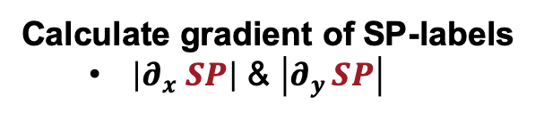

Loss Function Superpixel Binary Loss Function
Mathematical Implementation
Binary SP-Loss
as part of the smoothness loss
$λ ( \left|{∂_{x}d}_{t}\right|∗e^{\left\{−\left|{∂_{x}I}_{t}\right|\right\}}$ + $\left|{∂_{y} d}_{t}\right|∗e^{\left\{−\left|∂_{y}I_{t}\right|\right\}}$
Goal
Calculate gradient of SP-labels
$\left|∂_{x} SP\right|$ & $\left|∂_{y }SP\right|$
$L_{s}= λ ( \left|{∂_{x}d}_{t}\right|∗μ_{x}$ + $\left|{∂_{y} d}_{t}\right|{∗ μ}_{y})$
If $\left|∂_{x/y} SP\right|$ ~= 0 & $\left|{∂_{x/y} I}_{t}\right|<threshold:$
$\left|∂_{x/y} SP\right|$ = 0
else:
$\left|∂_{x/y} SP\right|$ = 1
0 , on edges
$$μ_{x/y}=$$
1 , inside plane

Slide 8



Loss Function Superpixel Continuous Loss Function
Mathematical Implementation
Continuous SP-Loss
as part of the smoothness loss
$λ ( \left|{∂_{x}d}_{t}\right|∗e^{\left\{−\left|{∂_{x}I}_{t}\right|\right\}}$ + $\left|{∂_{y} d}_{t}\right|∗e^{\left\{−\left|∂_{y}I_{t}\right|\right\}}$
Goal
Calculate gradient of SP-labels
$\left|∂_{x} SP\right|$ & $\left|∂_{y }SP\right|$
$L_{s}= λ ( \left|{∂_{x}d}_{t}\right|∗μ_{x}$ + $\left|{∂_{y} d}_{t}\right|{∗ μ}_{y})$
If $\left|∂_{x/y} SP\right|$ ~= 0 :
$\left|∂_{x/y} SP\right|$ = $e^{\left\{−\left|{∂_{x/y}I}_{t}\right|\right\}}$
else:
$\left|∂_{x/y} SP\right|$ = 1
$e^{\left\{−\left|{∂_{x/y}I}_{t}\right|\right\}}$ , on SP-edges
$$μ_{x/y}=$$
1 , inside SP

Slide 9



Architecture LOSS: Digging Into Self-Supervised Monocular Depth Estimation [1]
$$Photometric Error L_{p}$$
SSIM
L1- Norm
Depth
Pose
$I_{t→t^{′ }}$= $I_t<proj(D_{t},T_{t→t^{′} },K)>$
$$L= μ∗min\left( \frac{α}{2} \left(1 −SSIM\left(I_{t},I_{t→t^{′ }}\right)\right)+\left(1−α\right) \left\|I_{t}−I_{t→t^{′ }}\right\|\right)$$
$+ λ ( \left|{∂_{x}d}_{t}\right|∗e^{\left\{−\left|{∂_{x}I}_{t}\right|\right\}}$ + $\left|{∂_{y} d}_{t}\right|∗e^{\left\{−\left|∂_{y}I_{t}\right|\right\}}$)
$$Smoothness Loss{ L}_{s}$$
${∂_{i}d}_{t}:Gradient smoothness$
$e^{\left\{∂_{x}\left|I_{t}\right|\right\}}:Edge aware smoothness$
Disparity

