Slide 1
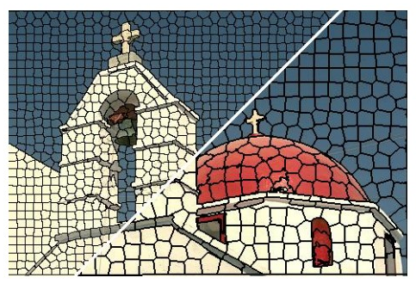
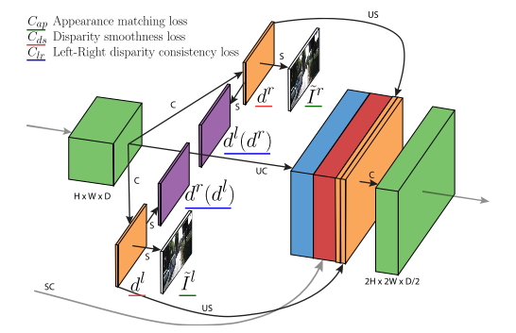
Deeplearning Lab: Piecewise monocular depth estimation by plane fitting
Weekly Topic: Grasb the idea of s.o.t.a literature

Slide 2
Superpixel Benchmarks

Slide 3
s1 SLIC

Slide 4
s2 Learning Superpixels With segmentation aware infinity loss

Slide 5
s3 real time coarse to fine topologically preserving segmentation

Slide 6
m1_1 unsupervised monocular depth estimation with left right consistency

Slide 7
m1_2 digging into self_ supervised monocular depth prediction

Slide 8
m2_1 Unsupervised Learning of Depth and Ego-Motion from Video

