Slide 1
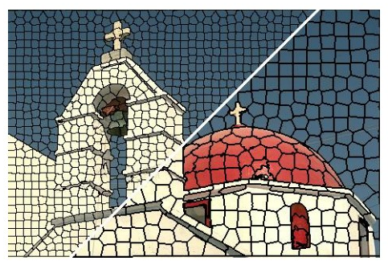
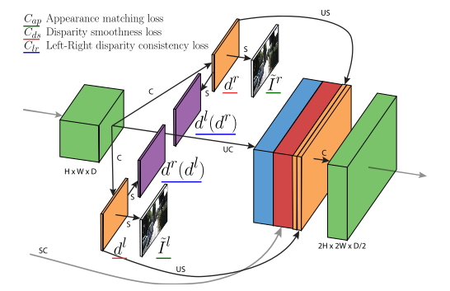
Deeplearning Lab: Piecewise monocular depth estimation by plane fitting
Weekly Topic: Grasb the idea of s.o.t.a literature

Slide 2
Superpixel Benchmarks

Slide 3
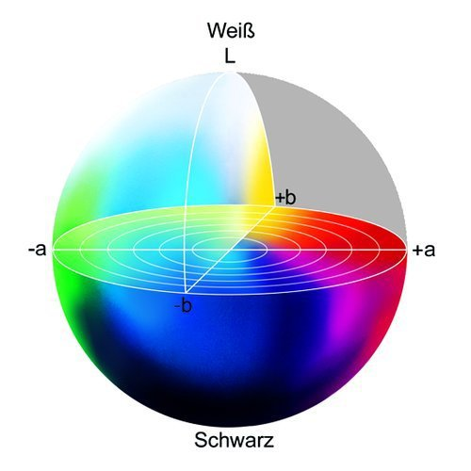
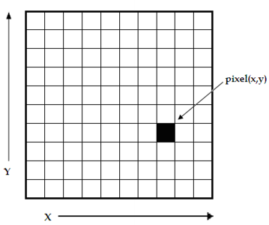
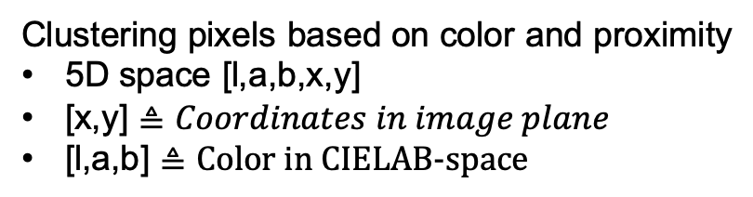

s1 SLIC- Simple linear iterative clustering
Clustering pixels based on color and proximity
5D space [l,a,b,x,y]
[x,y] $≜Coordinates in image plane$
[l,a,b] $≜\text{Color} \text{in} \text{CIELAB}\text{−}\text{space}$
white
L $≜$ Brightness
black
https://www.researchgate.net/figure/
A-digital-image-is-a-2D-array-of-pixels
-Each-pixel-is-characterised-by-its-x-y_fig1_221918148
https://www.heise.de/ct/imgs/04/1/4/8/7/2/5/1/Lab-Farbraum-ead9d79b2a394144.jpeg

Slide 4
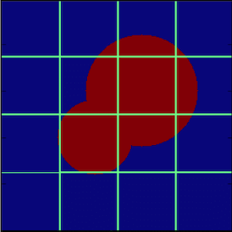


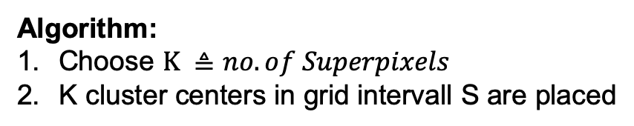
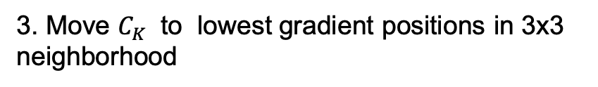
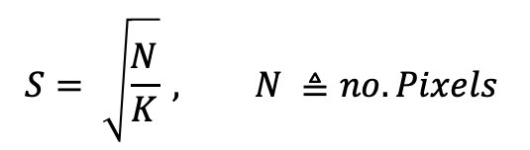

s1 SLIC- Simple linear iterative clustering
Algorithm:
Choose $K ≜no. of Superpixels$
K cluster centers in grid intervall S are placed
S
$$S^{2}$$
$$C_{k}=\left[l_{k},a_{k},b_{k},x_{k},y_{k}\right], k ε \left[1,K\right]$$
$$S= \sqrt{\frac{N}{K}} , N ≜no. Pixels$$
$$C_{k}$$
N = 256x256p
3. Move $C_{K}$ to lowest gradient positions in 3x3
neighborhood
$$G\left(x,y\right)= {\left\|I\left(x+1,y\right)−I\left(x−1,y\right)\right\|}^{2 }+{\left\|I\left(x,y+1\right)−I\left(x,y−1\right)\right\|}^{2}$$

Slide 5
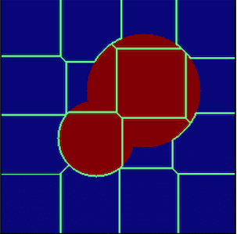
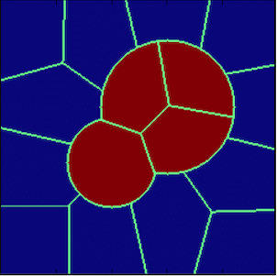
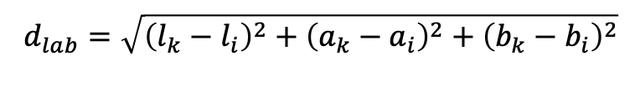
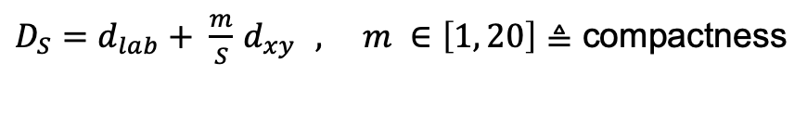
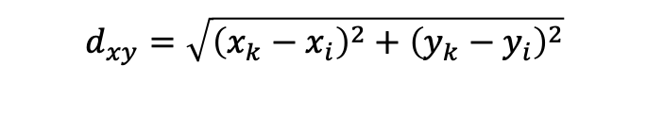
s1 SLIC- Simple linear iterative clustering
4. Associate pixels to nearest $C_{k} →superpixel$
Search area: 2S x 2S
$$d_{lab}=\sqrt{{\left(l_{k}−l_{i}\right)}^{2}+{\left(a_{k}−a_{i}\right)}^{2}+{\left(b_{k}−b_{i}\right)}^{2}}$$
$$d_{xy}=\sqrt{{\left(x_{k}−x_{i}\right)}^{2}+{\left(y_{k}−y_{i}\right)}^{2}}$$
$D_{S}=d_{lab}+ \frac{m}{S}$ $d_{xy } , m ∈\left[1, 20\right]≜$ compactness
5. C$alculate new C_{k }$by averaging all pixels associated to $C_{k }$
6. Repeat 4. & 5. till convergence or threshhold is reached.
https://www.researchgate.net/figure/A-cartoon-showing-the-progress-of-the-SLIC-algorithm-for-a-simple-case-The-top-left_fig3_322652376

Slide 6
s2 Learning Superpixels With segmentation aware infinity loss

Slide 7
s3 real time coarse to fine topologically preserving segmentation

Slide 8
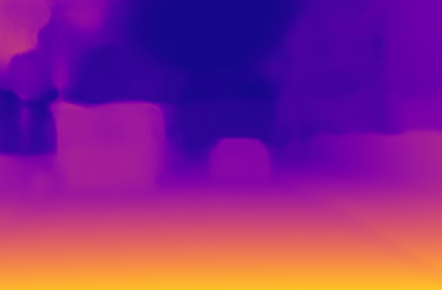
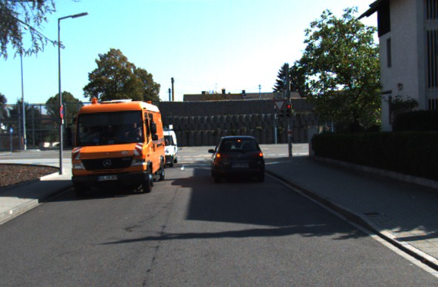
m1_1 unsupervised monocular depth estimation with left right consistency
used for training
LR Loss
Loss
R
R
R
L
L
L
L
R
Input
colors
CNN
Output
disparities
Sampler
Output
colors
Target
colors
8

Slide 9
m1_1 concept
CCN that learns to perform single depth estimation despite the absence of groundtruth depth data
It learns to predict pixel-level correspondence between pairs of rectified stereo images that have known camera baseline
Training loss that enforces left-right depth consistency inside the network
Code available for TensorFlow
Evaluated on KITTI

Slide 10
m1_1 related literature
architecture inspired by DispNET (procudes correspondence field between two images), N. Mayer, E. Ilg, P. H¨ausser, P. Fischer, D. Cremers, A. Dosovitskiy, and T. Brox. A large dataset to train convolutional networks for disparity, optical flow, and scene flow estimation
image sampler by spatial network transformer, M. Jaderberg, K. Simonyan, A. Zisserman, and K. Kavukcuoglu. Spatial transformer networks. In NIPS, 2015
Encoder Decoder structure by V. Patraucean, A. Handa, and R. Cipolla. Spatio-temporal video autoencoder with differentiable memory. arXiv preprint arXiv:1511.06309, 2015
Generate corresponding right view from an input left image J. Xie, R. Girshick, and A. Farhadi. Deep3d: Fully automatic 2d-to-3d video conversion with deep convolutional neural networks. In ECCV, 2016.

Slide 11
m1_1 architecture
CNN
ENCODER DECODER
Skips
Encoder
Decoder
Outputs

Slide 12
m1_1 loss function
1. Appearance Matching Loss
2. Disparity Smoothness Loss
3. Left-Right Disparity Smoothness Loss

Slide 13
m1_1 known limitations
Since method relies on image reconstruction term, specular and transparent surfaces produce inconsistent depth
Disparity Error maps show inconsistency for close-by-objects, texture-less regions and occlusion boundaries

Slide 14
m1_2 digging into self_ supervised monocular depth prediction

Slide 15
m2_1 Unsupervised Learning of Depth and Ego-Motion from Video

