Slide 1
Midterm Presentation: Piecewise monocular depth estimation by plane fitting
Group 2: Felix Wirth, Korbinian Kunst, Helge Dörsam, Jan Ceccejus

Slide 2
Agenda
Overview incl. Goal
History and Architecture
Superpixel
Results
Forecast and Approaches
Review

Slide 3
Overview incl. Goal
Overview Felix, with support of Jan for Goal of Normals

Slide 4
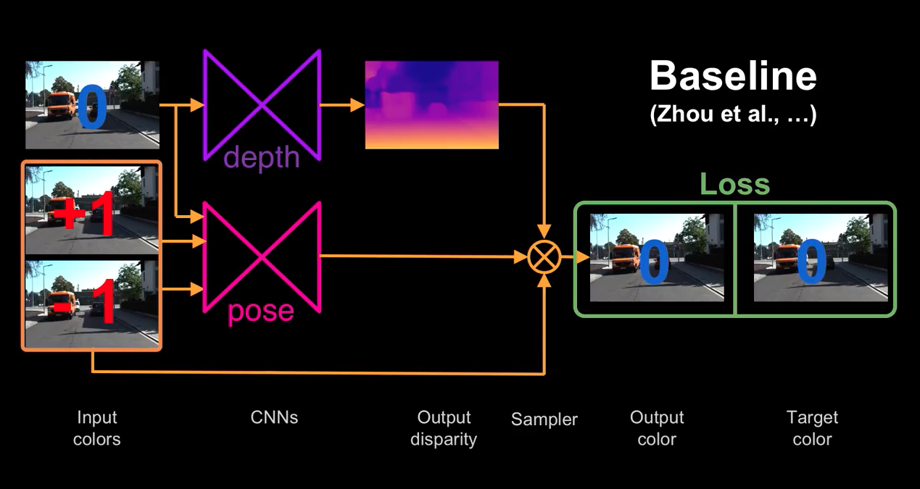
History and Architecture

Slide 5
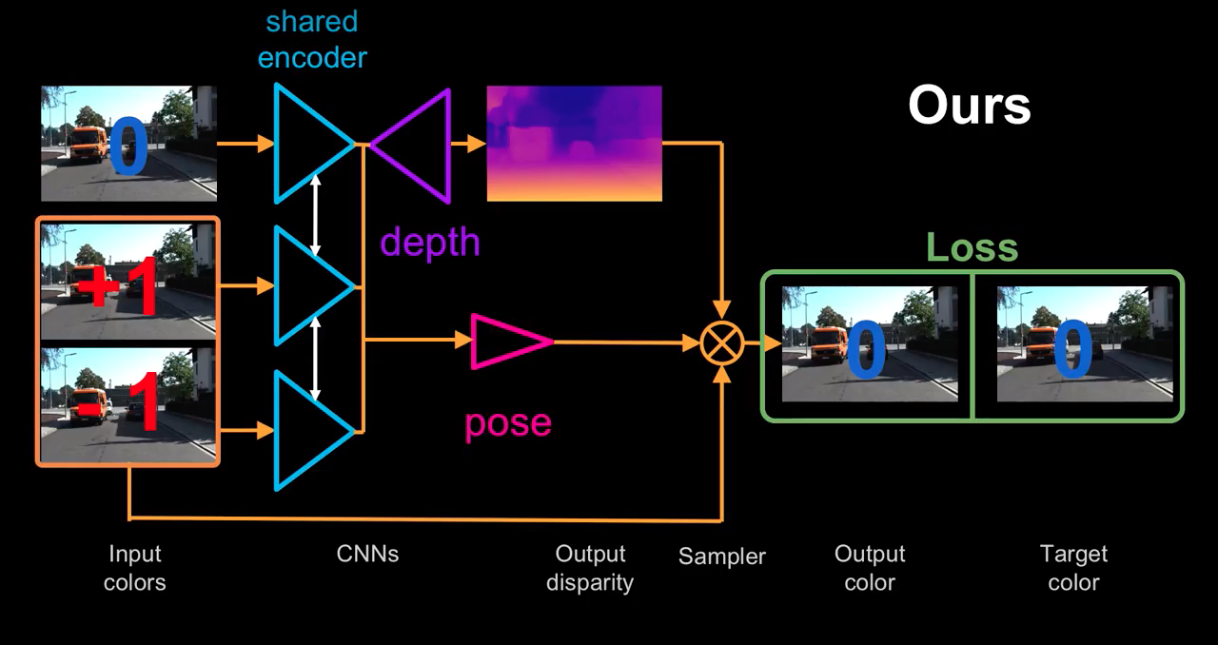
History and Architecture
Reconstruct image with disparity
and Pose, calculate loss

Slide 6
Loss

Slide 7
Superpixel
Helge

Slide 8
Results
Korbi und Helge

Slide 9
Forecast and Approaches
Felix and Jan

Slide 10
Review
Whole Group: Comparison between whats our state what do we want to achieve

