Slide 1
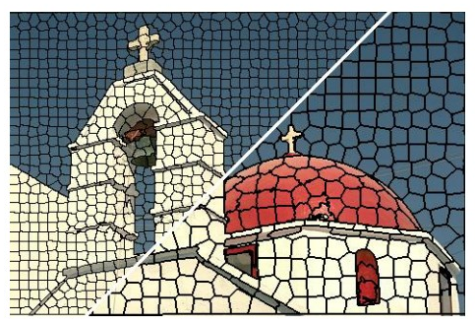
Midterm Presentation: Piecewise monocular depth estimation by plane fitting
Group 2: Felix Wirth, Korbinian Kunst, Helge Dörsan, Jan Ceccejus

Slide 2
Agenda
Overview incl. Goal
History and Architecture
Superpixel
Results
Forecast and Approaches
Review

Slide 3
Overview incl. Goal
Overview Felix, with support of Jan for Goal of Normals

Slide 4
History and Architecture
Felix and Korbi

Slide 5
Superpixel
Helge

Slide 6
Results
Korbi und Helge

Slide 7
Forecast and Approaches Normals
Jan

Slide 8
Forecast and Approaches Implementation of Superpixels in Net
Possibilites of implementation of Superpixels inside the net
As Input into Net:
in the Encoder as a Segmentation File (1 dim)
in the Encoder as a 3 Dim Image (colored Segmentation)
in the Encoder as a 3 Dim Image (via edges)
As seperate Path in Net
As its own module as a building block of the net inspired by [1]
In the Loss Function

Slide 9
Forecast and Approaches Scribble of possible SuperPixelPooling

Slide 10
Review
Whole Group: Comparison between whats our state what do we want to achieve

