Slide 1
Introduction to Git and GitHub
Wu Wenjing
Chen Yanxu
Jiang Haodi

Slide 2
Part 1: What and why?
What is Git?
What is GitHub?
Why shall we learn to use them?

Slide 3
Two Concepts
- Version control
- Git

Slide 4

Version control
Version control is a system that helps to track and manage changes made to a file or a set of files.
All of these changes are then tracked and can be reverted if need be.
It provides the freedom to collaborate and develop without too much worry.

Slide 5

Git
is a specific open-source version control system created by Linus Torvalds in 2005.
Specifically, Git is a distributed version control system, which means that the entire codebase and history is available on every developer's computer.

Slide 6
GitHub
GitHub is a cloud-based service that hosts a version control system called Git.
Nowadays GitHub hosts over 100 million repositories (repos), the majority of which are open-source projects.

Slide 7
Why is it so popular?
- Open-source
- User-friendly
- Free!!!
- Made for cooperation

Slide 8
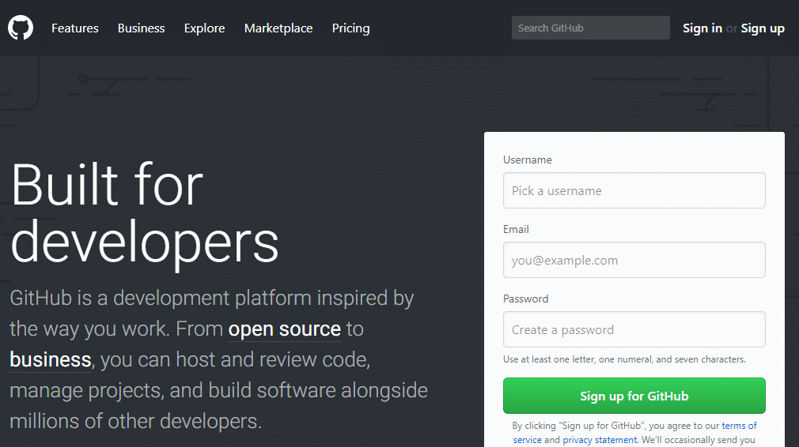
Just for developers/coders?
Absolutely NOT!

Slide 9
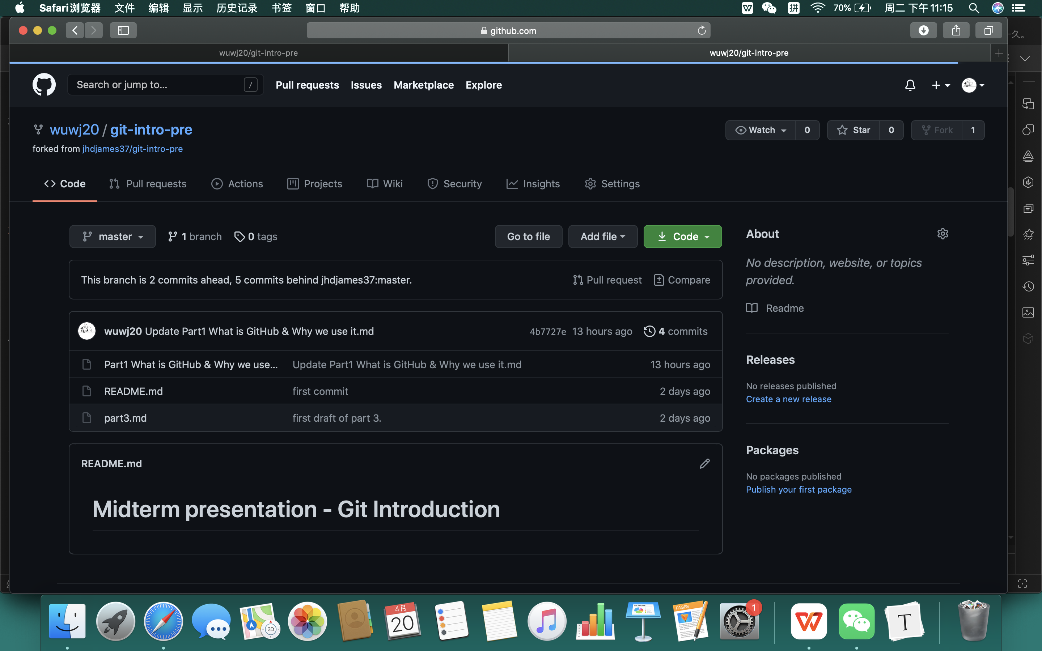
GitHub isn't just for developers
- Be a source for learning
- Cooperate on any type of files
- Write a book
- Used for a group presentation

Slide 10
Part 2: Using GitHub as a cloud disk.
Basic usage of Git and GitHub.

Slide 11
Goal:
  To use git and GitHub like a cloud disk.
Take notes if you want to learn it well.

Slide 12
Steps
- Install
  Install git.
- Configure
  Configure your account on GitHub.
- Create
  Create a repo on GitHub.
- Interact
  `pull`, `add`, `commit` and `push`.

Slide 13
Steps
- Install
  Install git.
- Configure
  Configure your account on GitHub.
- Create
  Create a repo on GitHub.
- Interact
  `pull`, `add`, `commit` and `push`.

Slide 14
Install
Windows
  https://git-scm.com/downloads
Linux
  Ubuntu: `apt-get install git`.
  Other systems: equivalent command.
MacOS
  Use homebrew to install, or
  Install Xcode, which includes git.

Slide 15
Install
Use the search engine!

Slide 16
Steps
- Install
  Install git.
- Configure
  Configure your account on GitHub.
- Create
  Create a repo on GitHub.
- Interact
  `pull`, `add`, `commit` and `push`.

Slide 17
Configure
Create an account.
Open the command line, and type:
`ssh-keygen -t rsa -C "youremail@example.com"`

Slide 18
Configure
Find the .ssh folder in your home directory,
  which contents 2 files:
id_rsa and id_rsa.pub.
id_rsa is private.
  Do NOT show it to anyone!
id_rsa.pub is public.
  It is safe to share it with others.

Slide 19
Configure
GitHub > Settings > SSH and GPG keys > New SSH key
Paste the content of id_rsa.pub.

Slide 20
Steps
- Install
  Install git.
- Configure
  Configure your account on GitHub.
- Create
  Create a repo on GitHub.
- Interact
  `pull`, `add`, `commit` and `push`.

Slide 21
Create
Create a repo on GitHub.
`git clone git@github.com:username/reponame.git`

Slide 22
Steps
- Install
  Install git.
- Configure
  Configure your account on GitHub.
- Create
  Create a repo on GitHub.
- Interact
  `pull`, `add`, `commit` and `push`.

Slide 23
Interact
After changed some file:
`git add filename`
`git commit -m "blahblah"`
`git push origin master`
`git pull`

Slide 24
Part 3: Version Control.
Advanced usage of Git and GitHub.

Slide 25
Version Control
- Stores each version of your work.
- See changes between commits.
  (Tips: instead of doc and docx, documents should be stored in **Text-Only** format, such as markdown and LaTeX)

Slide 26
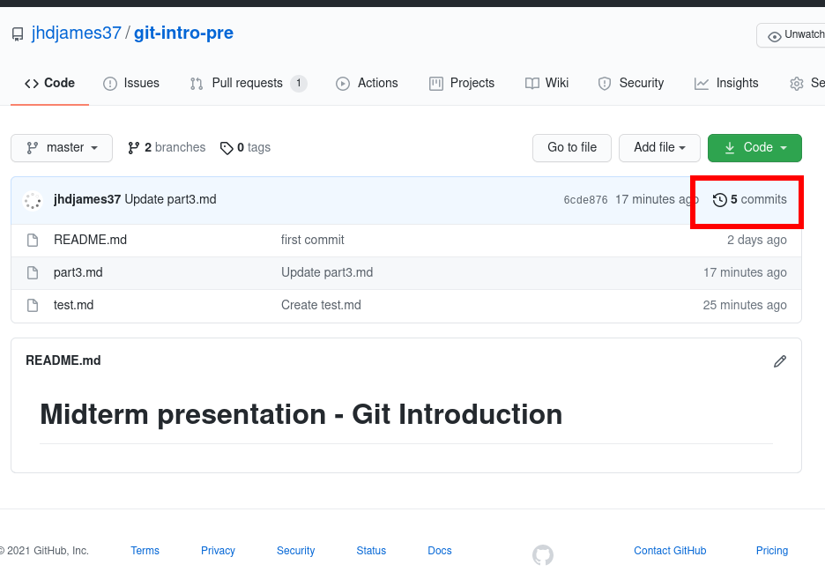
Example

Slide 27
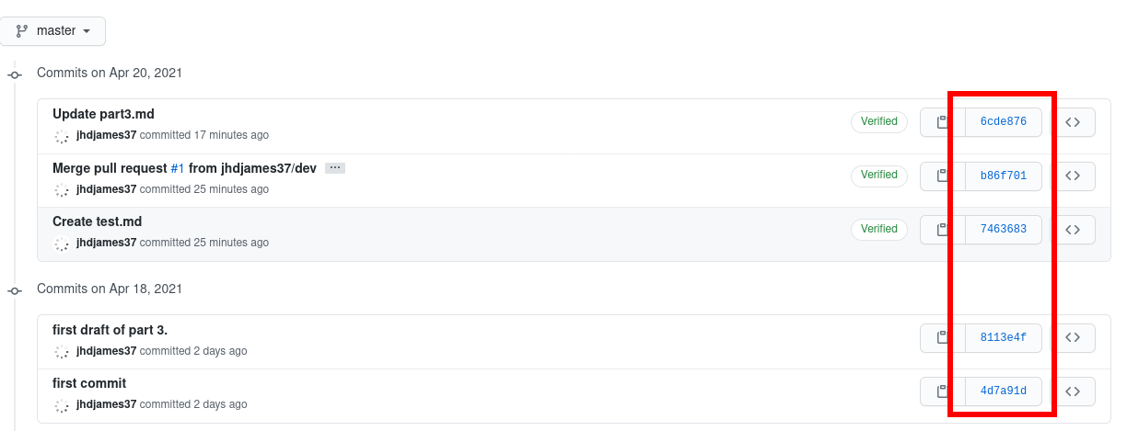
Example

Slide 28
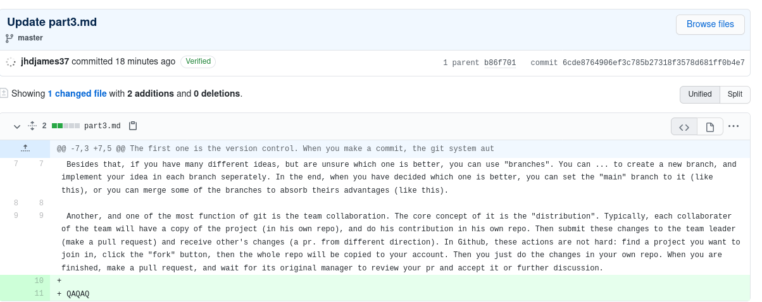
Example

Slide 29
Example

Slide 30
Version Control
Stores each version of your work.
See changes between commits.
  (Tips: instead of doc and docx, documents should be stored in text-only formats, such as markdown and LaTeX)
Restore previous version.
To avoid files such as “final.docx”,”final-1.docx”, “final1-1.docx”, “final-1-1-1.docx”, ...

Slide 31
Branches
Can store different files/versions in each branch.
Merge some branches through pull requests.

Slide 32
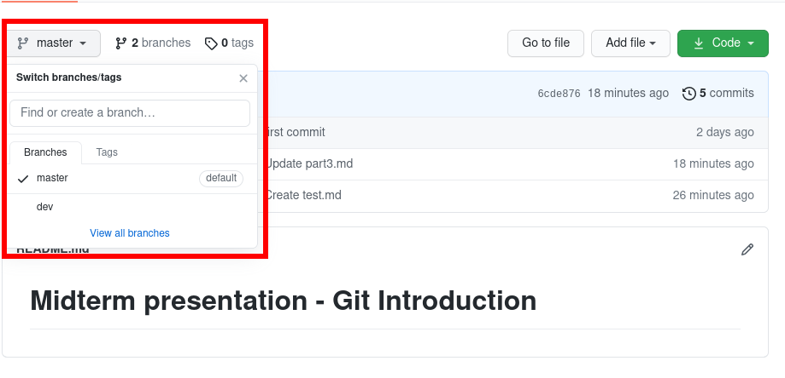
Example

Slide 33
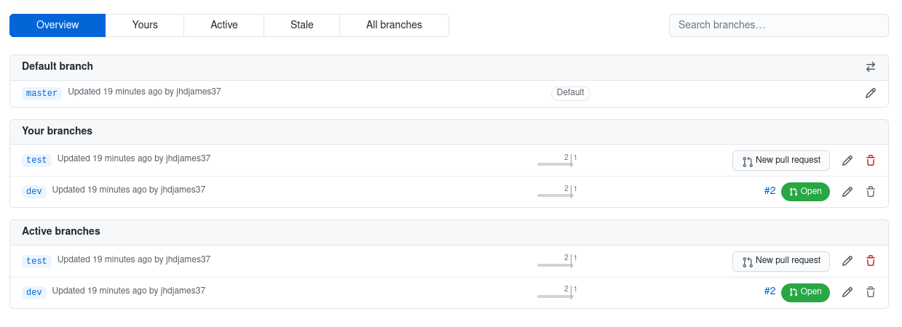
Example

Slide 34
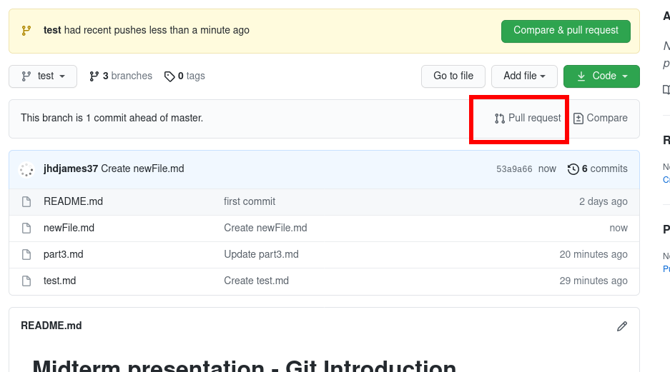
Example - Merging through pull requests

Slide 35
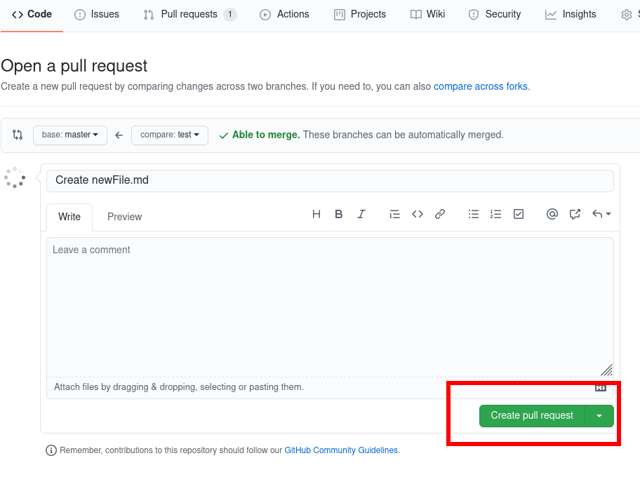
Example

Slide 36
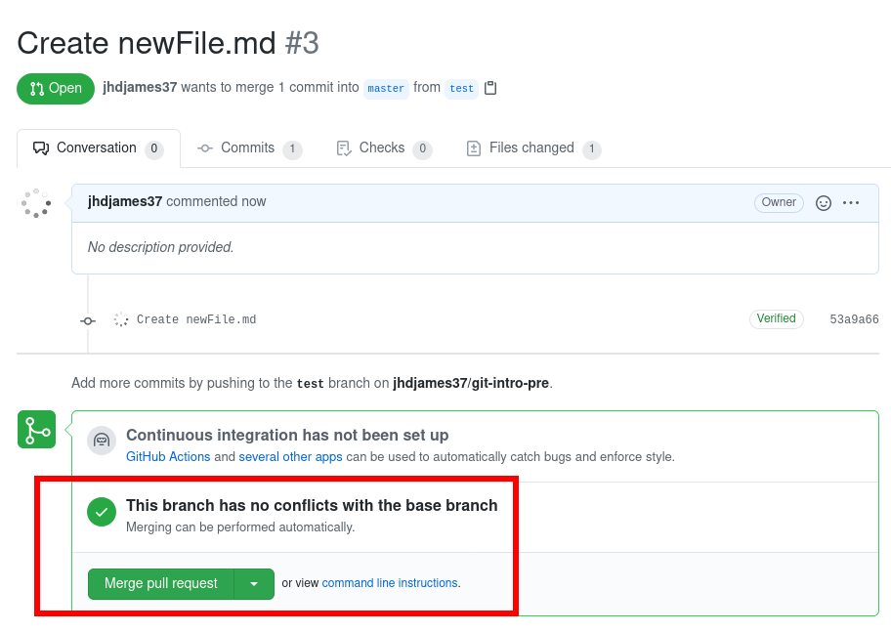
Example

Slide 37
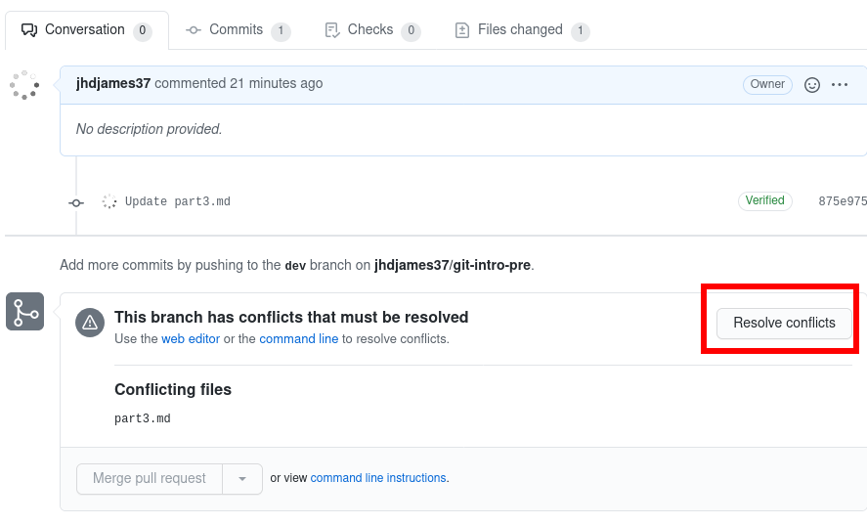
Example

Slide 38
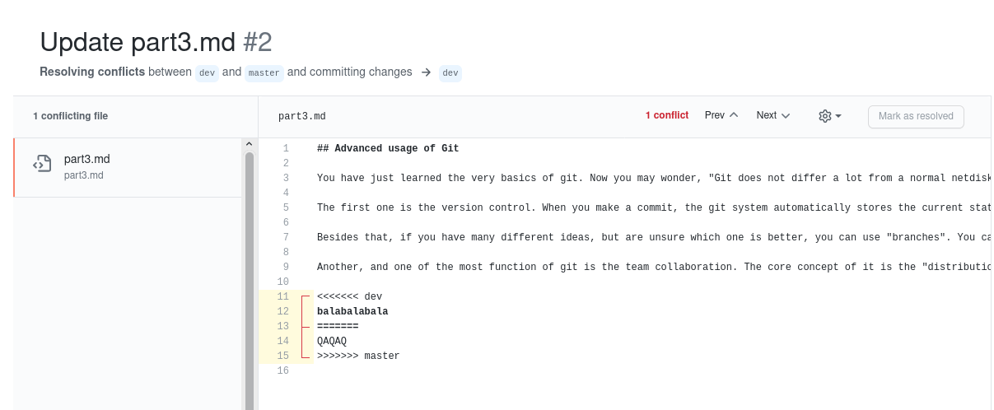
Example

Slide 39
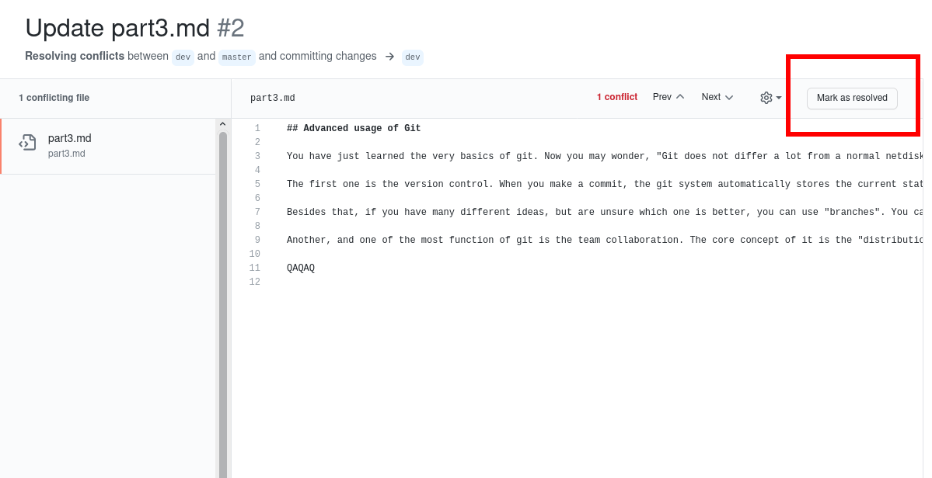
Example

Slide 40
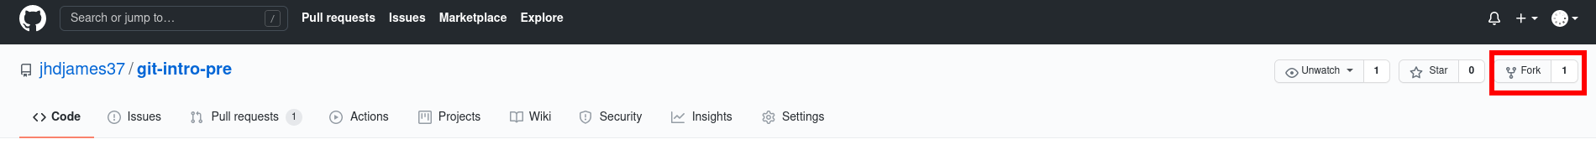
Team collaboration
Distribution: each one has one copy of the repo (by forking from the main repo)
Submit and receive changes through pull requests
In fact, the procedure is almost the same as pull requests between branches.
practice: https://github.com/komeiji-satori/Dress

