Slide 1
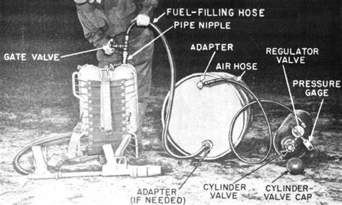
Portability Analyzer Getting from here to there…
Joe Healy – Microsoft – Tampa, FL
Cloud Solution Architect
jhealy@microsoft.com

Slide 2
Portabililty Analyzer
Install from Extensions and Updates
Excel report on code readiness
https://docs.microsoft.com/en-us/dotnet/standard/analyzers/portability-analyzer

Slide 3
When Should You Port To .NET Core
Need .NET Core Features (e.g. Cross-Platform)
New Project
Able to Upgrade Individual Component / Service

Slide 4
When Shouldn’t You Port To .NET Core
Working Code, No Compelling Business Reason
Need Features Not In .NET Core (Pretty Few Now)

Slide 5
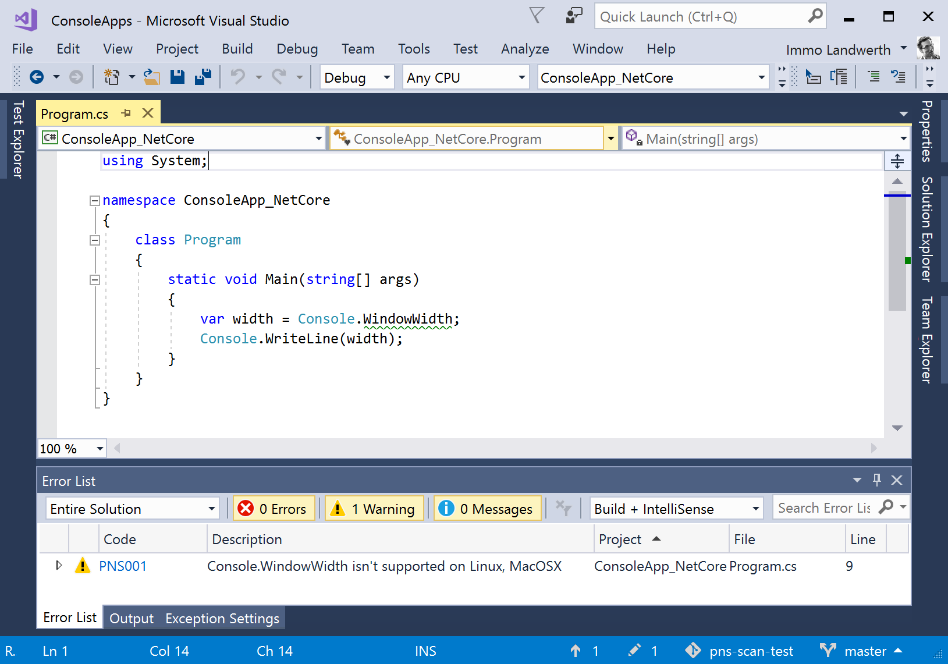
Platform-Compat Analyzer

Slide 6
Porting a Library
DEMO
Notes:
Create a .NET Framework class library
Reference the NQuery NuGet package from this new library
Create a new .NET Standard 2.0 class library and copy the class library code in

Slide 7
ASP.NET Considerations
Modules / Handlers
Startup / Configuration
Front-end (static) files
Identity
Entity Framework (migrations, etc.)
Tool: Routing

Slide 8
Steps
Get ready
Learn with a new / internal application
Prepare Your Existing Application
Update to new release / patterns
Refactor to services
Test coverage (unit, integration, user interface)
Create a New Application
Select the nearest match
Copy / reference code

Slide 9
Porting an ASP.NET MVC 5 Application
DEMO
Notes:
https://docs.microsoft.com/en-us/aspnet/core/migration/proper-to-2x/

Slide 10

.NET Core 2.1 to .NET Core 5.0
DEMO

Slide 11
Q&A
Code snippets at https://github.com/jhealy/RoslynAnalyzerProofs

