Slide 1
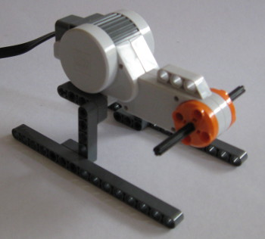
Basic Motor Mount

Slide 2

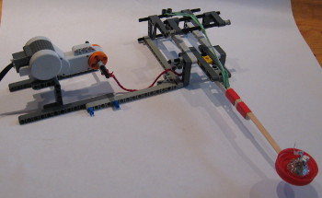
Basic Motor Mount
Pull a pin that releases a catapult.
View Video (Not active)

Slide 3
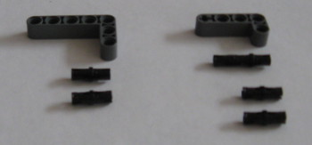
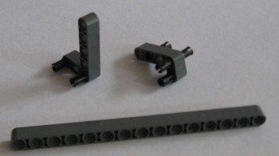
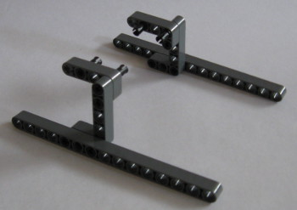
Basic Motor

Slide 4
Basic Motor Mount

