Slide 1
Micro
Blaze
tetris_vga Pcore
ILMB
DLMB
cfg
VGA Driver
scr/lvl
VGA out
GPIO
Controls
next
PLB bus
Rasterizer
Timers
game-board

Slide 2
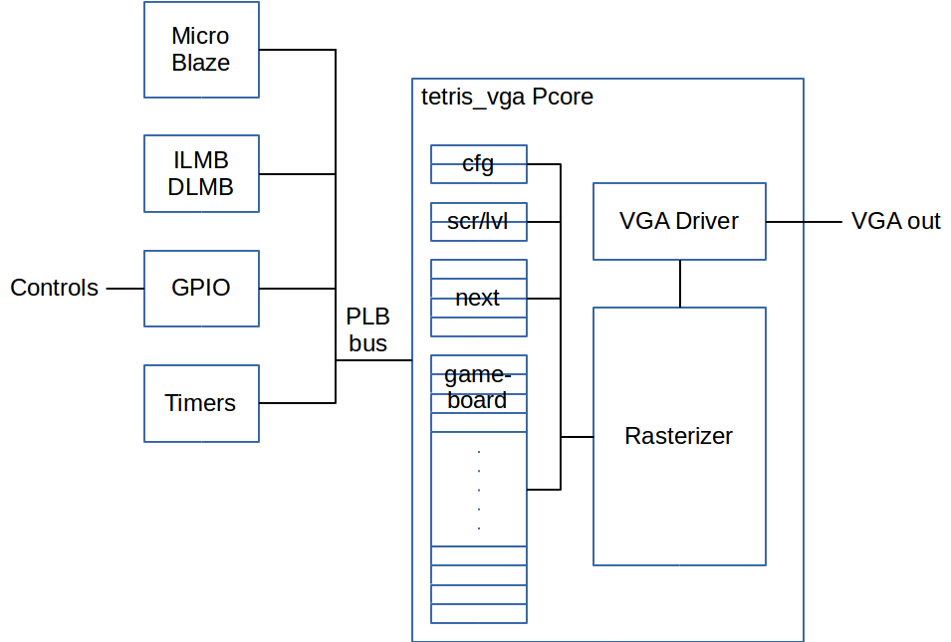

Slide 3
GAME OVER
DISPLAY
ROTATE
PLAY
DISPLAY
CHECK
FALL
NEXT
CLEAR
ROTATE
LEFT
RIGHT

Slide 4
