Slide 1
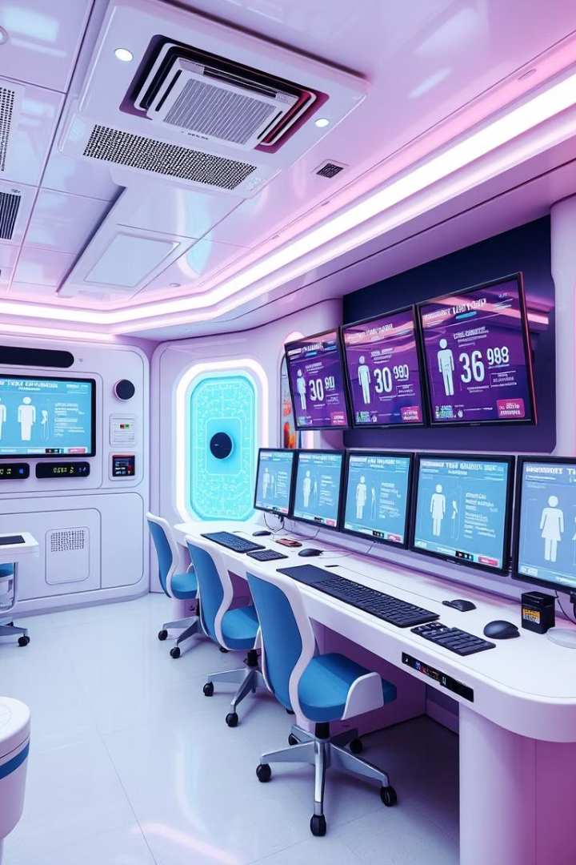

AI-Powered Vision System for Monitoring Public Hygiene
This paper proposes an AI-powered vision-based monitoring system leveraging the Common Objects in Bathroom (COB) dataset to detect and assess cleanliness levels in public restrooms. The system uses YOLOv8 for robust identification of sanitary fixtures and hygiene-related indicators. A hygiene score is computed using weighted heuristics derived from object presence, spatial relationships, and temporal consistency.
Results indicate a high degree of accuracy in identifying cleanliness violations, with an mAP of 0.81 and real-time detection capabilities on edge devices. The system demonstrates potential for integration in smart city infrastructures for autonomous hygiene auditing.

Slide 2
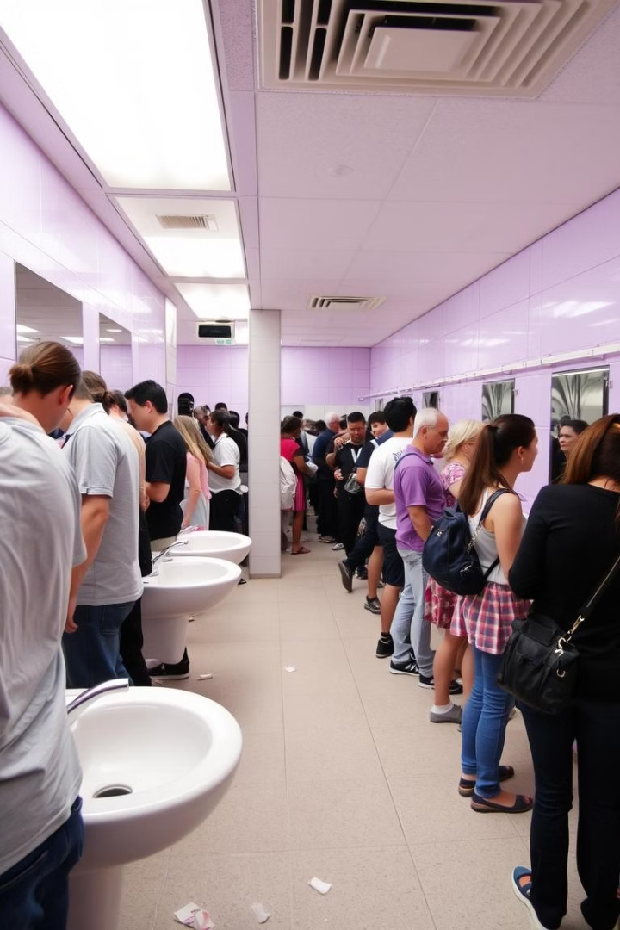
Introduction: The Need for Smart Hygiene Monitoring
Public Health
Manual Limitations
Maintaining hygienic conditions in public restrooms is crucial for public health and user satisfaction.
Traditional manual inspections are inconsistent, labor-intensive, and subject to oversight.
Smart Infrastructure
There is an increasing need for intelligent systems capable of autonomously evaluating sanitation levels.
Computer vision presents a promising alternative for monitoring public hygiene. This work investigates the application of an AI-powered vision system using the Common Objects in Bathroom (COB) dataset for automated restroom cleanliness assessment.

Slide 3

Related Work: Integrating AI into Hygiene Monitoring
IoT-Based Solutions
Vision-Based Monitoring
Early works focused on IoT-based solutions, involving sensors to detect foot traffic and soap usage. These approaches lack visual context.
Recent research explores vision-based monitoring for sanitation in public environments. Restroom-specific monitoring remains underexplored due to privacy concerns.
Our contribution lies in applying high-precision object detection models (YOLOv8) to hygiene-centric interpretations, extending the COB dataset with custom cleanliness annotations, and evaluating system performance for real-world feasibility.

Slide 4
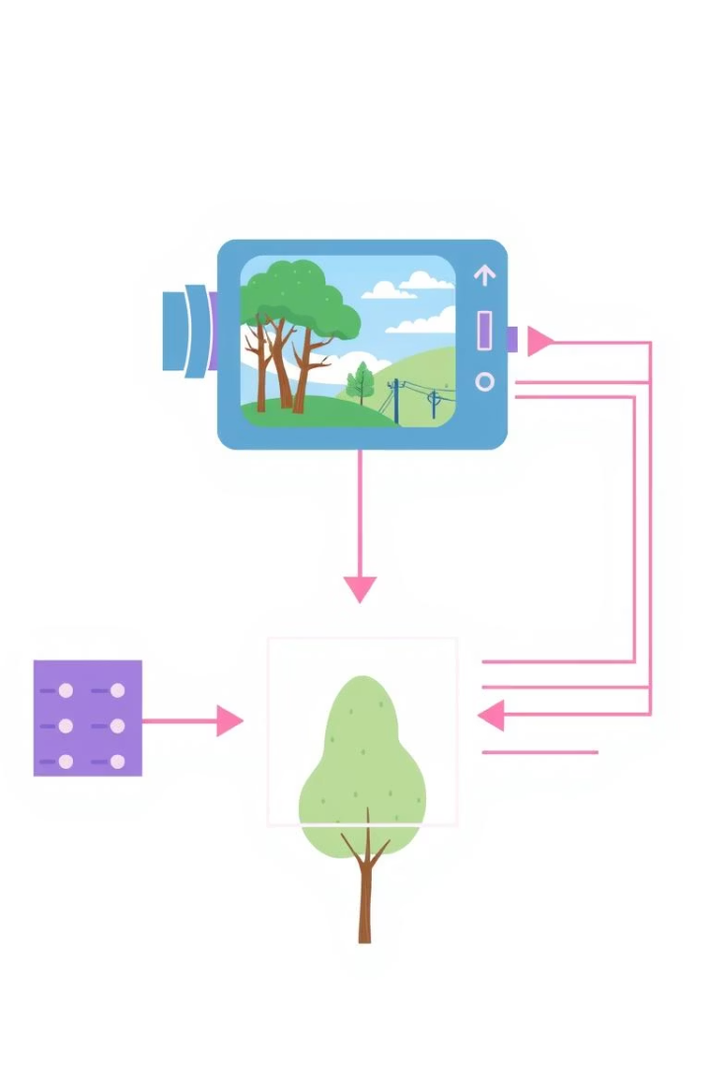



Proposed Methodology: System Architecture Overview
Object Detection
Deep convolutional neural network (YOLOv8) for object detection.
Dataset Preprocessing
Preprocessing and annotation of the COB dataset for hygiene-related features.
Hygiene Inference
Hygiene inference module generates cleanliness scores.
The COB dataset provides RGB images annotated with bounding boxes and object categories. To adapt this dataset for hygiene evaluation, we performed additional annotations on a subset to include visual cleanliness indicators.

Slide 5
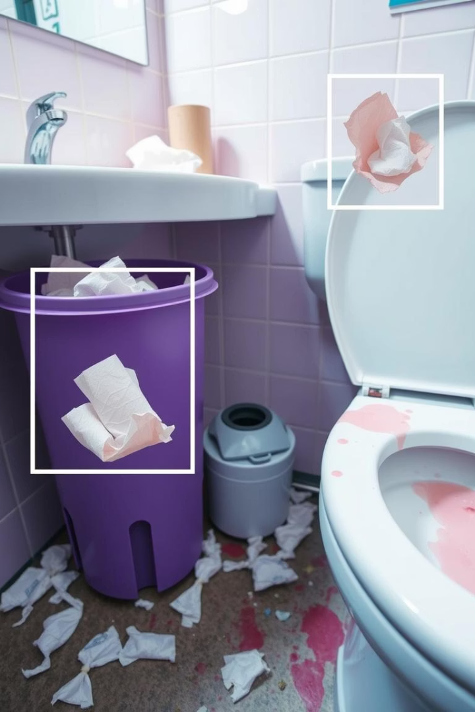
Dataset Preprocessing and Annotation
Overflowing Trash Bins
Detection of bins exceeding capacity.
Used Tissues on Floor
Identification of discarded tissues.
Stains on Toilets/Sinks
Recognition of unsanitary marks.
Empty Paper Holders
Detection of depleted supply.
Images were categorized into three hygiene levels: clean, moderately dirty, and very dirty, based on expert review and object combination heuristics. LabelImg was used for additional annotation, and labels were formatted to YOLOv8 requirements.

Slide 6
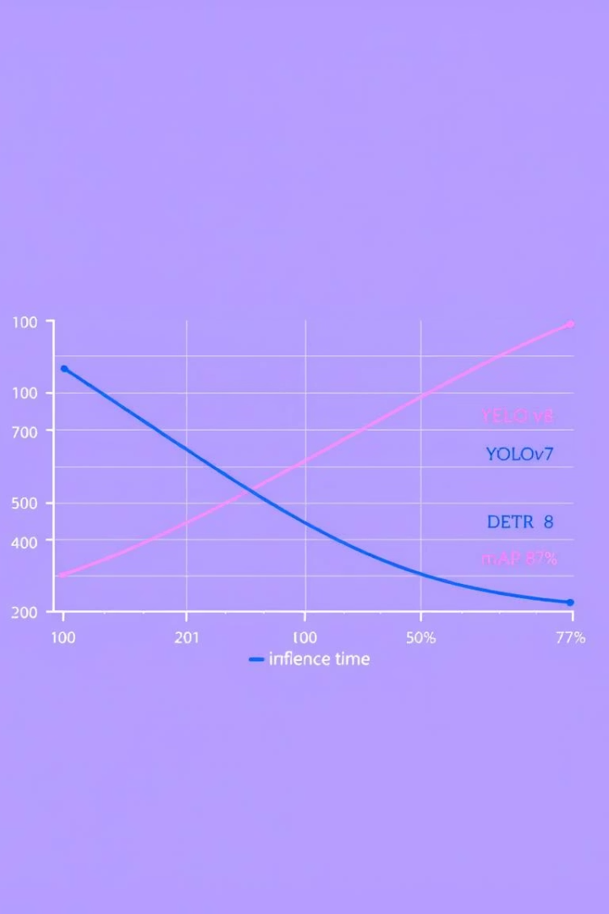
Experimental Setup and Results
0.87
0.83
Precision
Recall
The precision of the YOLOv8 model.
The recall of the YOLOv8 model.
0.81
mAP@0.5
The mAP@0.5 of the YOLOv8 model.
The YOLOv8n model was trained on the augmented COB dataset. Real-time inference was tested on an NVIDIA Jetson Nano. While YOLOv8n achieved only 12 FPS, it was sufficient for low-frequency monitoring.

Slide 7
Discussion: System Robustness and Limitations
System Robustness
Dataset Limitations
The model generalizes well across various restroom layouts and lighting conditions. Performance degrades slightly in occluded scenes or when object visibility is low.
The COB dataset lacks temporal continuity and explicit cleanliness labels in its original form. The dataset is primarily based on domestic-style restrooms.
Deploying vision systems in restrooms introduces significant privacy concerns. Our proposed system focuses on ceiling-mounted, object-focused cameras that avoid direct human subject detection. Edge processing ensures data is not transmitted externally unless hygiene thresholds are breached.

Slide 8
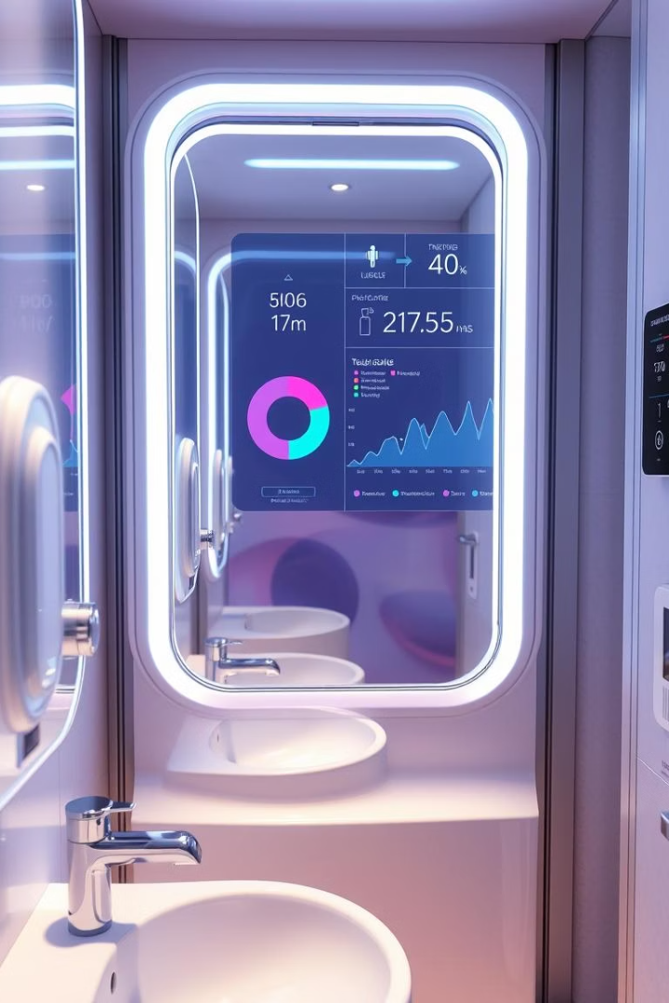
Conclusion and Future Work
Temporal Modeling
Introduce time-series tracking to detect prolonged cleanliness issues.
Dataset Expansion
Curate a large-scale hygiene-specific dataset with diverse public restroom environments.
Multimodal Fusion
Combine vision data with IoT sensors for robust hygiene assessments.
This paper presented a deep learning-powered computer vision system for monitoring public hygiene in restrooms using the Common Objects in Bathroom (COB) dataset. By advancing vision-based hygiene monitoring, this research contributes to smarter, safer, and more responsive urban public spaces.

