Slide 1


Summer School 2025
Basics of Python, Notebooks & ML
Introduction to scientific modules in Python and ML libraries
June 9, 2025
Dr. Susana García-Abellán

Slide 2
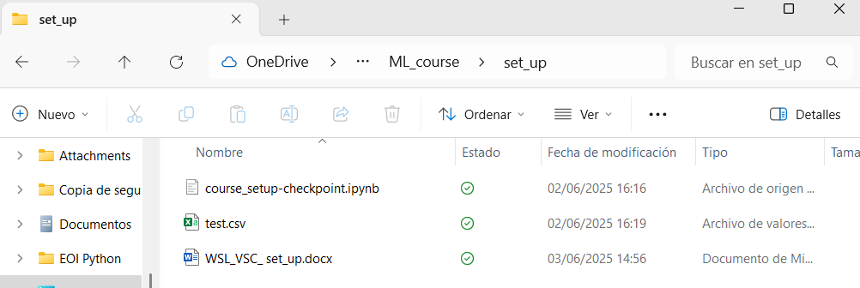
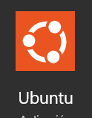
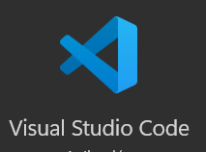
setup
Previous installation

Slide 3
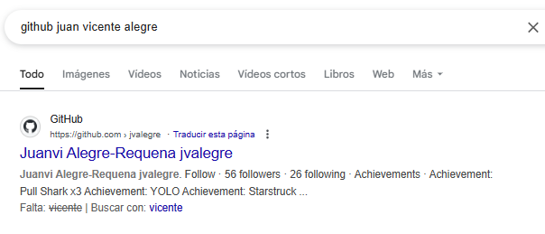
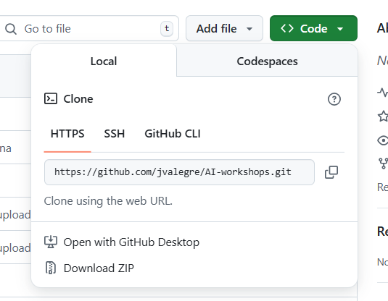
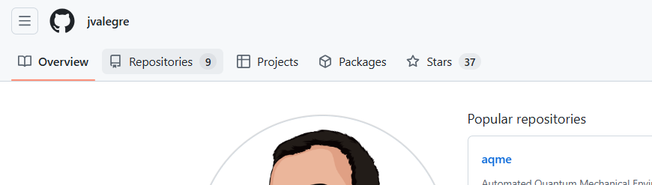
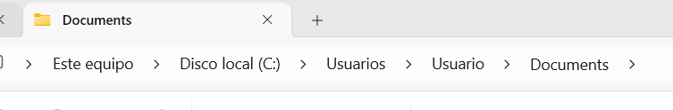
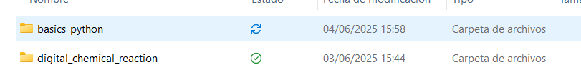
setup
Before starting
1.
3.
2.
4.
c/Users/your_user/ Documents/ML_course

Slide 4
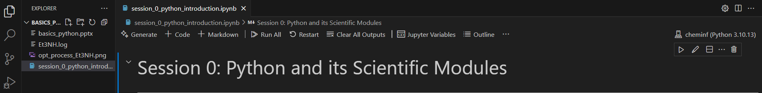
setup
For this session
Open the Ubuntu terminal and type:
conda activate cheminf
cd /
cd mnt/c/Users/your_user/Documents/ML_course/basics_python
ls
4.
code .
Select cheminf kernel and jupyter notebook

Slide 5
Summer School 2025
Basics of Python, Notebooks & ML
Introduction to scientific modules in Python and ML libraries
June 9, 2025
Dr. Susana García-Abellán

Slide 6
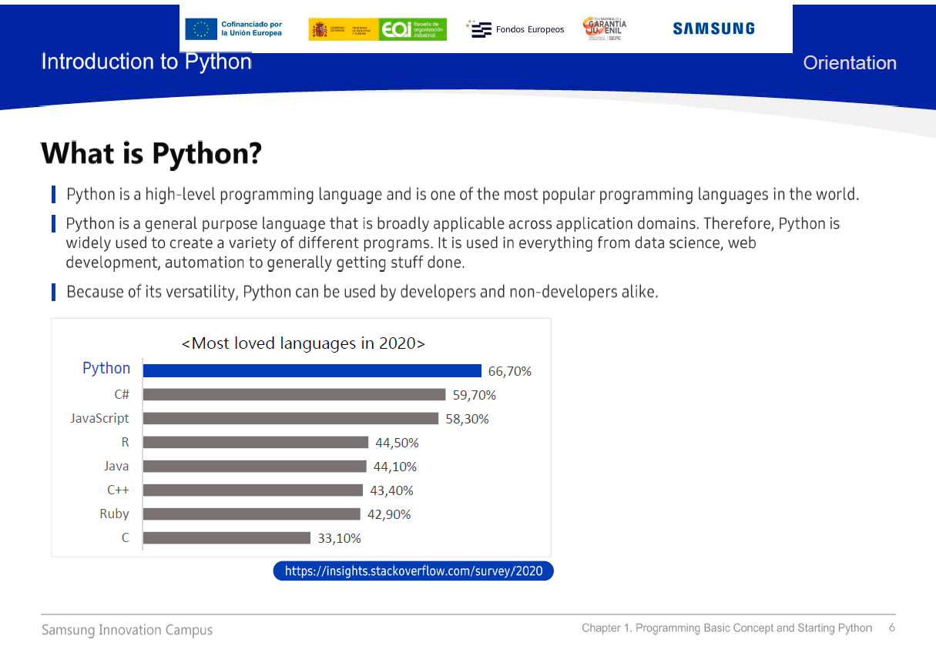

Slide 7
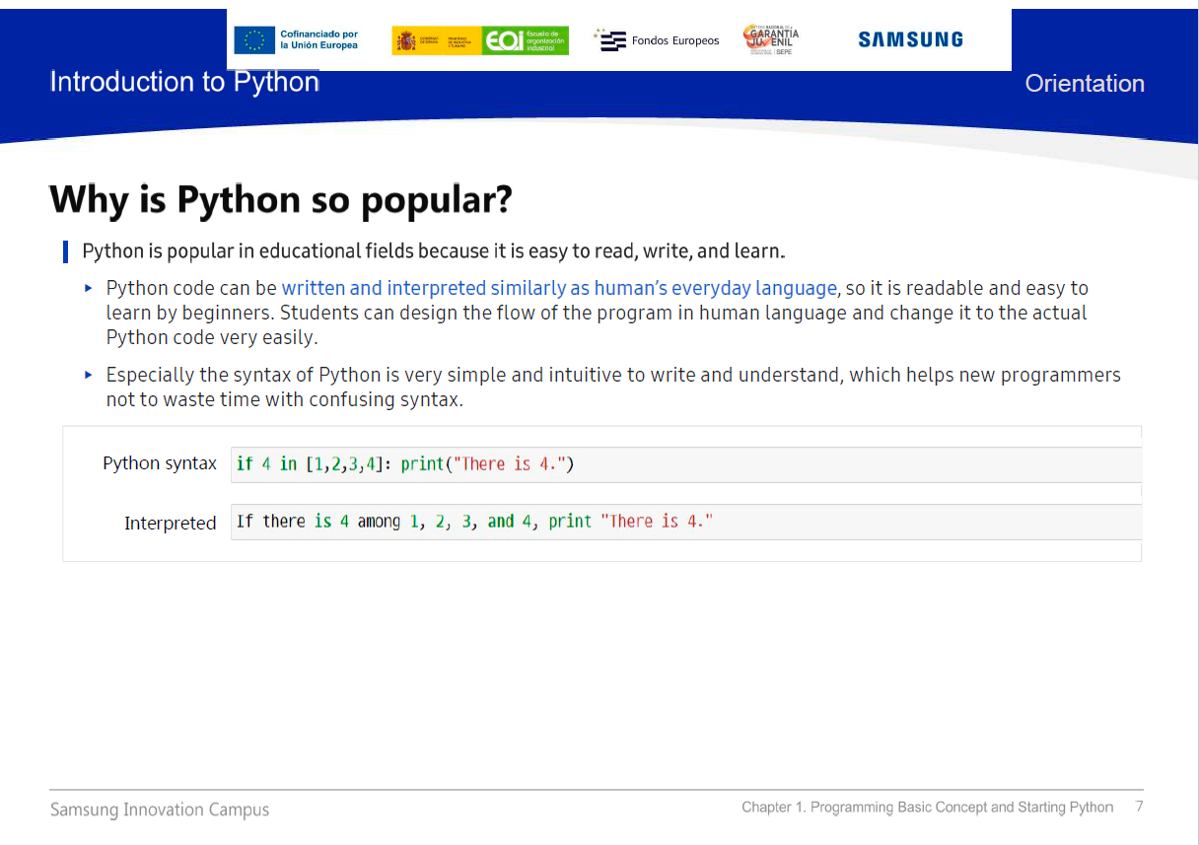

Slide 8
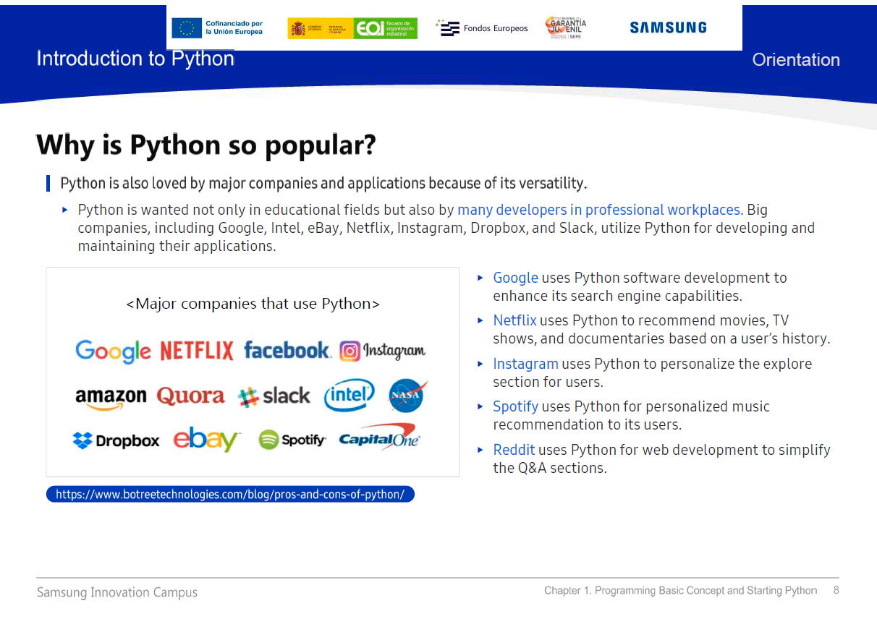

Slide 9
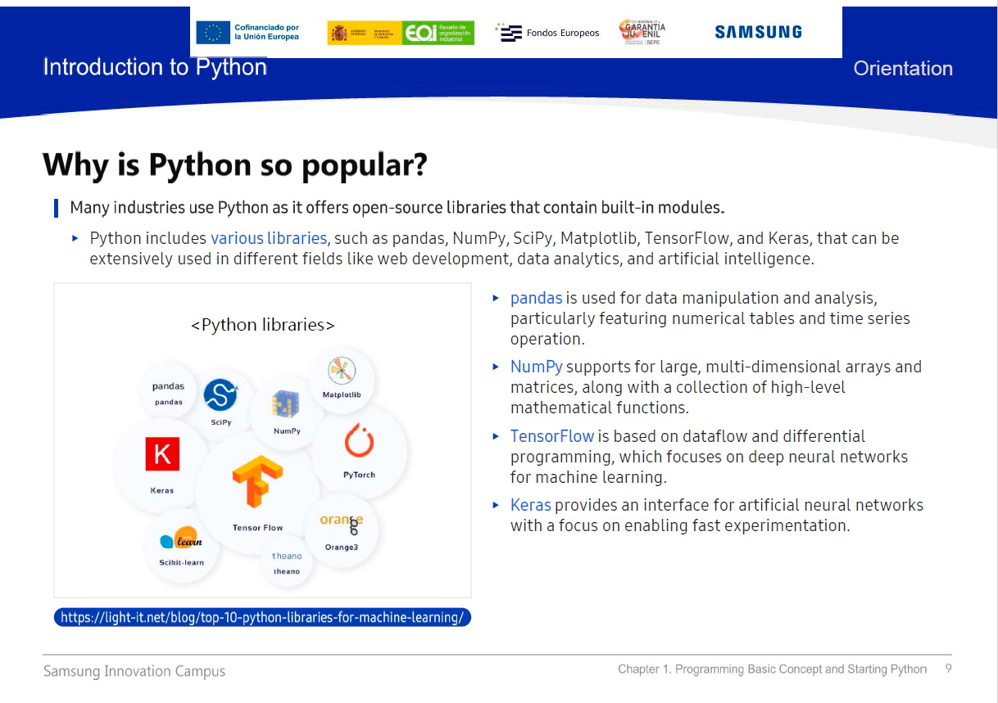
NumPy: Numerical calculations and array operations.
Pandas: Data manipulation and analysis.
Matplotlib: Data visualization.
SciKitLearn: Machine learning and predictive analytics.
SciPy: Numerical methods and optimization.
RDKit: open-source cheminformatics toolkit that allows the manipulation of chemical information, including SMILES parsing, molecular descriptor calculation, substructure searching, and chemical reaction modeling.

Slide 10
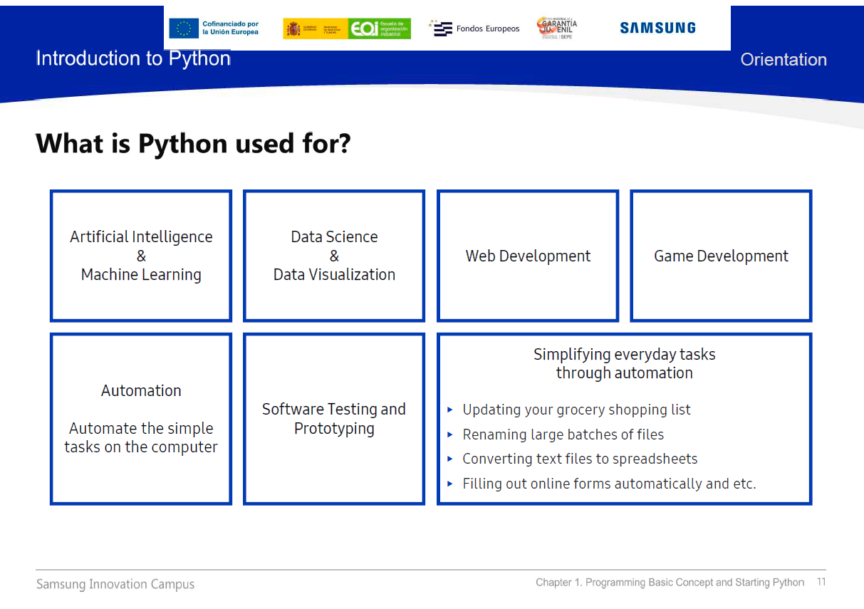

Slide 11
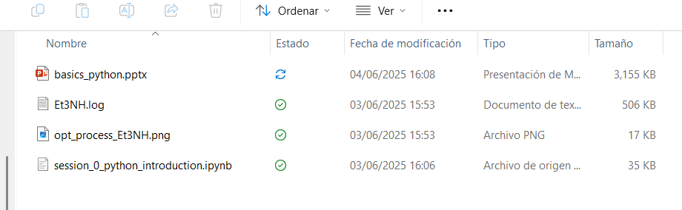
Visual Studio Code
Visual Studio Code is a lightweight, open-source code editor developed by Microsoft. It supports many programming languages and includes features like syntax highlighting, debugging, Git integration, extensions, and Jupyter notebook support.
.ipynb : Interactive Python Notebook
A Jupyter Notebook is an interactive environment that lets you write and run code (usually Python), display results, visualize data, and include text or images, all in one document. It's widely used in data science, machine learning, and scientific research for its ability to combine code and explanation seamlessly.

Slide 12
Summer School 2025
Basics of Python, Notebooks & ML
Introduction to scientific modules in Python and ML libraries
June 9, 2025
Dr. Susana García-Abellán

