Slide 1

External sorting
R & G – Chapter 13
Guest Lecturer:
Brian Cooper
Yahoo! Research

Slide 2












A little bit about Y!
Yahoo! is the most visited website in the world
  Sorry Google
  500 million unique visitors per month
  74 percent of U.S. users use Y! (per month)
  13 percent of U.S. users’ online time is on Y!

Slide 3
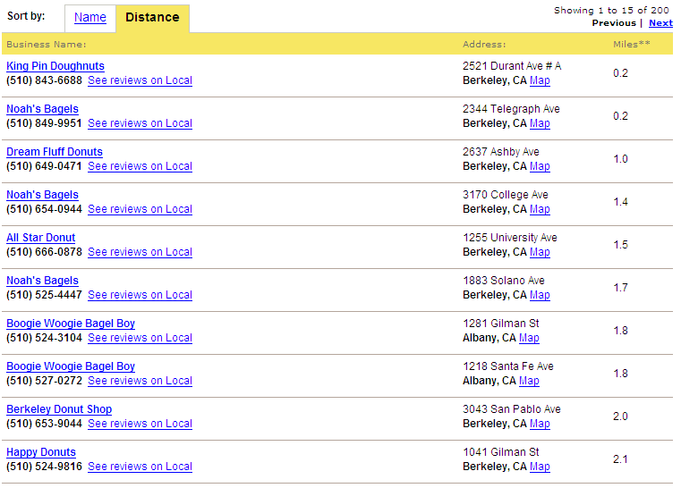
Why sort?

Slide 4
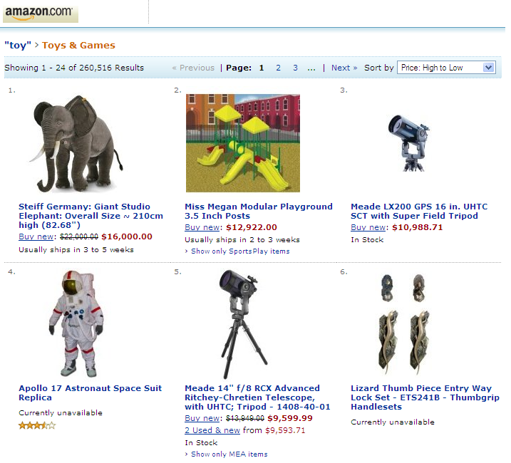

Slide 5
Why sort?
Users usually want data sorted
Sorting is first step in bulk-loading a B+ tree
Sorting useful for eliminating duplicates
Sort-merge join algorithm involves sorting
Banana
Grapefruit
Apple
Orange
Mango
Kiwi
Strawberry
Blueberry
Apple
Banana
Blueberry
Grapefruit
Kiwi
Mango
Orange
Strawberry

Slide 6
So?
Don’t we know how to sort?
  Quicksort
  Mergesort
  Heapsort
  Selection sort
  Insertion sort
  Radix sort
  Bubble sort
  Etc.
Why don’t these work for databases?

Slide 7
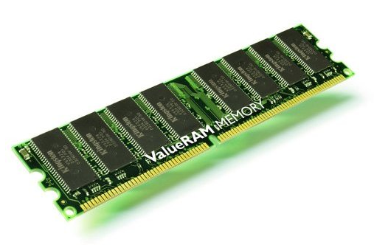
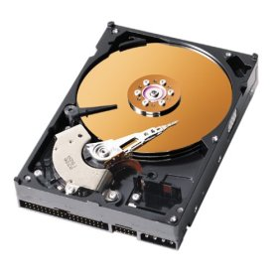
Key problem in database sorting
4 GB: $300
480 GB: $300
How to sort data that does not fit in memory?

Slide 8
Example: merge sort
Banana
Banana
Banana
Grapefruit
Grapefruit
Banana
Grapefruit
Grapefruit
Apple
Apple
Apple
Apple
Orange
Orange
Orange
Orange
Mango
Kiwi
Mango
Mango
Kiwi
Strawberry
Kiwi
Kiwi
Mango
Blueberry
Strawberry
Blueberry
Strawberry
Blueberry
Blueberry
Strawberry

Slide 9
Example: merge sort
Banana
Apple
Apple
Grapefruit
Banana
Banana
Grapefruit
Blueberry
Apple
Orange
Grapefruit
Orange
Kiwi
Mango
Orange
Kiwi
Strawberry
Mango
Blueberry
Kiwi
Blueberry
Mango
Strawberry
Strawberry

Slide 10
Isn’t that good enough?
Consider a file with N records
Merge sort is O(N lg N) comparisons
We want to minimize disk I/Os
  Don’t want to go to disk O(N lg N) times!
Key insight: sort based on pages, not records
  Read whole pages into RAM, not individual records
  Do some in-memory processing
  Write processed blocks out to disk
  Repeat

Slide 11
2-way sort
Pass 0: sort each page
Pass 1: merge two pages into one run
Pass 2: merge two runs into one run
…
Sorted!
Unsorted
Sorted
RAM
Sorted
Sorted
Sorted
RAM
Sorted
Sorted
Sorted
RAM

Slide 12
What did that cost us?
P pages in the file
Each pass: read and wrote P pages
How many passes?
  Pass 0
  Pass 1: went from P pages to P/2 runs
  Pass 2: went from P/2 runs to P/4 runs
  …
  Total number of passes: ⎡Log₂ P⎤ + 1
Total cost: 2P * (⎡Log₂ P⎤ + 1)

Slide 13
What did that cost us?
Why is this better than plain old merge sort?
  N >> P
  So O(N lg N) >> O(P lg P)
Example:
  1,000,000 record file
    8 KB pages
    100 byte records
    = 80 records per page
    = 12,500 pages
  Plain merge sort: 41,863,137 disk I/O’s
  2-way external merge sort: 365,241 disk I/O’s
  4.8 days versus 1 hour

Slide 14
Can we do better?
2-way merge sort only uses 3 memory buffers
  Two buffers to hold input records
  One buffer to hold output records
    When that buffer fills up, flush to disk
Usually we have a lot more memory than that
  Set aside 100 MB for sort scratch space = 12,800 buffer pages
Idea: read as much data into memory as possible each pass
  Thus reducing the number of passes
  Recall total cost:
2P *
Passes

Slide 15
External merge sort
Assign B input buffers and 1 output buffer
Pass 0: Read in runs of B pages, sort, write to disk
Pass 1: Merge B runs into one
  For each run, read one block
  When a block is used up, read next block of run
Pass 2: Merge B runs into one
…
Sorted!

Slide 16
Example
Input
Output

Slide 17
Example
Input
Output

Slide 18
Example
Input
Output

Slide 19
Example
Input
Output

Slide 20
Example
Input
Output

Slide 21
Example
Input
Output

Slide 22
Example
Input
Output

Slide 23
Example
Input
Output

Slide 24
Example
Input
Output

Slide 25
Example
Input
Output

Slide 26
Example
Input
Output

Slide 27
Example
Input
Output

Slide 28
Example
Input
Output

Slide 29
Example
Input
Output

Slide 30
Example
Input
Output

Slide 31
Example
Input
Output

Slide 32
Example
Input
Output

Slide 33
What did that cost us?
P pages in file, B buffer pages in RAM
P/B runs of size B
Each pass: read and write P pages
How many passes?
  ⎡Log_{B-1} ⎡ P/B ⎤ ⎤ + 1
Total cost: 2P * ⎡Log_{B-1} ⎡ P/B ⎤ ⎤ + 1

Slide 34
Example
1,000,000 records in 12,500 pages
Use 10 buffer pages in memory
4 passes
100,000 disk I/Os
  17 minutes versus 1 hour for 2-way sort

Slide 35
Can I do two passes?
Pass 0: sort runs
Pass 1: merge runs
Given B buffers
Need:
  No more than B-1 runs
  Each run no longer than B pages
Can do two passes if P ≤ B * (B-1)
Question: what’s the largest file we can sort in three passes? N passes?

Slide 36
Make I/Os faster
Cost = I/Os is a simplification
  Sequential I/Os are cheaper than random I/Os
Read blocks of pages at a time
  X = Blocking factor
  B = buffer pages
  (B/X – X) input “buffer blocks”, one output “buffer block”
Result
  Fewer runs merged per pass = more passes
  Less time per I/O = quicker passes
  Tradeoff!
    Maximize total sort time by choosing X given B, P and I/O latencies

Slide 37
Overlap computation and I/O
Problem: CPU must wait for I/O
  Suppose I need to read a new block
    Stop merging
    Initiate I/O
    Wait
    Complete I/O
    Resume merging

Slide 38
Solution: double buffering
Keep a second set of buffers
  Process one set while waiting for disk I/O to fill the other set
Input
Output

Slide 39
Solution: double buffering
Keep a second set of buffers
  Process one set while waiting for disk I/O to fill the other set
Input
Output

Slide 40
Solution: double buffering
Keep a second set of buffers
  Process one set while waiting for disk I/O to fill the other set
Input
Output

Slide 41
Solution: double buffering
Keep a second set of buffers
  Process one set while waiting for disk I/O to fill the other set
Input
Output

Slide 42
Solution: double buffering
Keep a second set of buffers
  Process one set while waiting for disk I/O to fill the other set
Input
Output

Slide 43
Solution: double buffering
Keep a second set of buffers
  Process one set while waiting for disk I/O to fill the other set
Input
Output

Slide 44
What if the data is already sorted?
Yay!
Often this happens because of a B+ tree index
  Leaf level of a B+ tree has all records in sorted order
  Two possibilities: B+ tree is clustered or unclustered

Slide 45
Clustered B+ tree
Sweep through leaf layer, reading data blocks in order
Lime
Pear
Blueberry
Kiwi
Nectarine
Tomato
Lime - Mango
Tomato - Wolfberry
Apple - Banana
Blueberry - Grapefruit
Pear - Strawberry
Kiwi - Lemon
Nectarine - Orange

Slide 46
Clustered B+ tree
Sweep through leaf layer, reading leaf blocks in order
Lime
Pear
Blueberry
Kiwi
Nectarine
Tomato
Apple - Banana
Blueberry - Grapefruit
Kiwi - Lemon
Lime - Mango
Nectarine - Orange
Pear - Strawberry
Tomato - Wolfberry

Slide 47
What did that cost us?
Traverse B+ tree to left-most leaf page
Read all leaf pages
  For each leaf page, read data pages
Data not in B+ tree:
  Height + Width + Data pages
Data in B+ tree:
  Height + Width

Slide 48
Example
1,000,000 records, 12,500 data pages
Assume keys are 10 bytes, disk pointers are 8 bytes
  So ≈ 300 entries per 8 KB B+ tree page (if two-thirds full)
Data not in B+ tree
  12,500 entries needed = 42 leaf pages
  Two level B+tree
  Total cost: 1 + 42 + 12,500 = 12,543 I/Os
  2 minutes versus 17 minutes for external merge sort
Data in B+ tree
  Three level B+ tree, 12,500 leaf pages
  Total cost: 2 + 12,500 = 12,502 I/Os
  Also about 2 minutes

Slide 49
What if the B+ tree is unclustered?
We know the proper sort order of the data
But retrieving the data is hard!

Slide 50
What if the B+ tree is unclustered?
Result is that in the worst case, may need one disk I/O per record
  Even though we know the sort order!
Usually external merge sort is better in these cases
  Unless all you need is the set of keys

Slide 51
Summary
Sorting is very important
Basic algorithms not sufficient
  Assume memory access free, CPU is costly
  In databases, memory (e.g. disk) access is costly, CPU is (almost free)
Try to minimize disk accesses
  2-way sort: read and write records in blocks
  External merge sort: fill up as much memory as possible
  Blocked I/O: try to do sequential I/O
  Double buffering: read and compute at the same time
  Clustering B+ tree: the data is already sorted. Hooray!
  Unclusered B+ tree: no help at all

Slide 52


