Slide 1

Implementation of Relational Operations
R&G - Chapters 12 and 14

Slide 2
Introduction
Today’s topic: QUERY PROCESSING
Some database operations are EXPENSIVE
Can greatly improve performance by being “smart”
  e.g., can speed up 1,000,000x over naïve approach
Main weapons are:
  clever implementation techniques for operators
  exploiting relational algebra “equivalences”
  using statistics and cost models to choose among these.

Slide 3
A Really Bad Query Optimizer
For each Select-From-Where query block
  Create a plan that:
    Forms the cross product
    of the FROM clause
    Applies the WHERE clause
Then, as needed:
  Apply the GROUP BY clause
  Apply the HAVING clause
  Apply any projections and output expressions
  Apply duplicate elimination and/or ORDER BY
σ_{predicates}
×
…
_{tables}

Slide 4
Cost-based Query Sub-System
Select *
From Blah B
Where B.blah = blah
Queries
Query Parser
Query Optimizer
Plan Generator
Plan Cost Estimator
Catalog Manager
Schema
Statistics
Query Plan Evaluator

Slide 5
The Query Optimization Game
Goal is to pick a “good” plan
  Good = low expected cost, under cost model
  Degrees of freedom:
    access methods
    physical operators
    operator orders
Roadmap for this topic:
  First: implementing individual operators
  Then: optimizing multiple operators

Slide 6

Relational Operations
We will consider how to implement:
  Selection ( σ ) Select a subset of rows.
  Projection ( π ) Remove unwanted columns.
  Join ( ) Combine two relations.
  Set-difference ( - ) Tuples in reln. 1, but not in reln. 2.
  Union ( ∪ ) Tuples in reln. 1 and in reln. 2.
Q: What about Intersection?

Slide 7
Schema for Examples
Sailors (sid: integer, sname: string, rating: integer, age: real)
Reserves (sid: integer, bid: integer, day: dates, rname: string)
Similar to old schema; rname added for variations.
Sailors:
  Each tuple is 50 bytes long, 80 tuples per page, 500 pages.
  |S|=500, p_{S}=80.
Reserves:
  Each tuple is 40 bytes, 100 tuples per page, 1000 pages.
  |R|=1000, p_{R}=100.

Slide 8
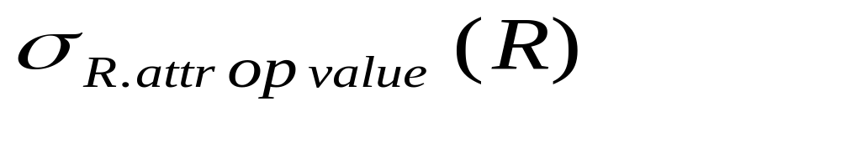
Simple Selections
SELECT *
FROM Reserves R
WHERE R.rname < ‘C%’
How best to perform? Depends on:
  what indexes are available
  expected size of result
Size of result approximated as
(size of R) * selectivity
  selectivity estimated via statistics – we will discuss shortly.
Notes:
11

Slide 9
Our options …
If no appropriate index exists:
  Must scan the whole relation
  cost = |R|. For “reserves” = 1000 I/Os.

Slide 10
Our options …
With index on selection attribute:
  1. Use index to find qualifying data entries
  2. Retrieve corresponding data records
  Total cost = cost of step 1 + cost of step 2
  For “reserves”, if selectivity = 10% (100 pages, 10000 tuples):
    If clustered index, cost is a little over 100 I/Os;
    If unclustered, could be up to 10000 I/Os! … unless …
Index entries
UNCLUSTERED
CLUSTERED
direct search for
data entries
Data entries
Data entries
(Index File)
(Data file)
Data Records
Data Records

Slide 11
Refinement for unclustered indexes
  1. Find qualifying data entries.
  2. Sort the rid’s of the data records to be retrieved.
  3. Fetch rids in order.
  Each data page is looked at just once (though # of such pages likely to be higher than with clustering).
UNCLUSTERED
Data entries
(Index File)
(Data file)
Data Records

Slide 12
General Selection Conditions
(day<8/9/94 AND rname=‘Paul’) OR bid=5 OR sid=3
First, convert to conjunctive normal form (CNF):
  (day<8/9/94 OR bid=5 OR sid=3 ) AND
  (rname=‘Paul’ OR bid=5 OR sid=3)
We only discuss the case with no ORs
Terminology:
  A B-tree index matches terms that involve only attributes in a prefix of the search key. e.g.:
  Index on <a, b, c> matches a=5 AND b= 3, but not b=3.
Notes:
13

Slide 13
2 Approaches to General Selections
Approach I:
Find the cheapest access path
retrieve tuples using it
Apply any remaining terms that don’t match the index
  Cheapest access path: An index or file scan that we estimate will require the fewest page I/Os.
Notes:
14

Slide 14
Cheapest Access Path - Example
query: day < 8/9/94 AND bid=5 AND sid=3
some options:
B+tree index on day; check bid=5 and sid=3 afterward.
hash index on <bid, sid>; check day<8/9/94 afterward.
How about a B+tree on <rname,day>?
How about a B+tree on <day, rname>?
How about a Hash index on <day, rname>?

Slide 15
2 Approaches to General Selections
Approach II: use 2 or more matching indexes.
1. From each index, get set of rids
2. Compute intersection of rid sets
3. Retrieve records for rids in intersection
4. Apply any remaining terms
  EXAMPLE: day<8/9/94 AND bid=5 AND sid=3
  Suppose we have an index on day, and another index on sid.
  Get rids of records satisfying day<8/9/94.
  Also get rids of records satisfying sid=3.
  Find intersection, then retrieve records, then check bid=5.
Notes:
15

Slide 16
Projection
SELECT DISTINCT
R.sid, R.bid
FROM Reserves R
Issue is removing duplicates.
Use sorting!!
  1. Scan R, extract only the needed attributes
  2. Sort the resulting set
  3. Remove adjacent duplicates
  Cost:
  Reserves with size ratio 0.25 = 250 pages.
  With 20 buffer pages can sort in 2 passes, so: 1000 +250 + 2 * 2 * 250 + 250 = 2500 I/Os
Notes:
16

Slide 17
Projection -- improved
Modify the external sort algorithm:
  Modify Pass 0 to eliminate unwanted fields.
  Modify Passes 1+ to eliminate duplicates.
  Cost:
  Reserves with size ratio 0.25 = 250 pages.
  With 20 buffer pages can sort in 2 passes, so:
    Read 1000 pages
    Write 250 (in runs of 40 pages each)
    Read and merge runs
  Total cost = 1000 + 250 +250 = 1500.

Slide 18
Other Projection Tricks
If an index search key contains all wanted attrs:
Do index-only scan
  Apply projection techniques to data entries (much smaller!)
If a B+Tree index search key prefix has all wanted attrs:
Do in-order index-only scan
  Compare adjacent tuples on the fly (no sorting required!)
Notes:
18

Slide 19
Query Execution Framework
SELECT DISTINCT name, gpa
FROM Students
One possible query execution plan:
name, gpa
Distinct
name, gpa
Sort
name, gpa
HeapScan

Slide 20
Iterators
iterator
Relational operators are all subclasses of the class iterator:
class iterator {
void init();
tuple next();
void close();
iterator &inputs[];
// additional state goes here
}
Note:
  Edges in the graph are specified by inputs (max 2, usually)
  Any iterator can be input to any other!

Slide 21
Example: Sort
class Sort extends iterator {
void init();
tuple next();
void close();
iterator &inputs[1];
int numberOfRuns;
DiskBlock runs[];
RID nextRID[];
}
init():
  generate the sorted runs on disk (passes 0 to n-1)
  Allocate runs[] array and fill in with disk pointers.
  Initialize numberOfRuns
  Allocate nextRID array and initialize to first RID of each run
next():
  nextRID array tells us where we’re “up to” in each run
  find the next tuple to return based on nextRID array
  advance the corresponding nextRID entry
  return tuple (or EOF -- “End of Fun” -- if no tuples remain)
close():
  deallocate the runs and nextRID arrays

Slide 22
Postgres Version
src/backend/executor/nodeSort.c
  ExecInitSort (init)
  ExecSort (next)
  ExecEndSort (close)
The encapsulation stuff is hardwired into the Postgres C code
  Postgres predates even C++!
  See src/backend/execProcNode.c for the code that
  “dispatches the methods” explicitly!

Slide 23
Joins
SELECT *
FROM Reserves R1, Sailors S1
WHERE R1.sid=S1.sid
Joins are very common.
R × S is large; so, R × S followed by a selection is inefficient.
Many approaches to reduce join cost.
Join techniques we will cover today:
  Nested-loops join
  Index-nested loops join
  Sort-merge join

Slide 24
Simple Nested Loops Join
R S:
foreach tuple r in R do
foreach tuple s in S do
if r_{i} == s_{j} then add <r, s> to result
Cost = (p_{R}*|R|)*|S| + |R| = 100*1000*500 + 1000 IOs
  At 10ms/IO, Total time: ???
What if smaller relation (S) was “outer”?
What assumptions are being made here?
What is cost if one relation can fit entirely in memory?

Slide 25
Page-Oriented Nested Loops Join
R S:
foreach page b_{R} in R do
foreach page b_{S} in S do
foreach tuple r in b_{R} do
foreach tuple s in b_{S}do
if r_{i} == s_{j} then add <r, s> to result
Cost = |R|*|S| + |R| = 1000*500 + 1000
If smaller relation (S) is outer, cost = 500*1000 + 500
Much better than naïve per-tuple approach!

Slide 26
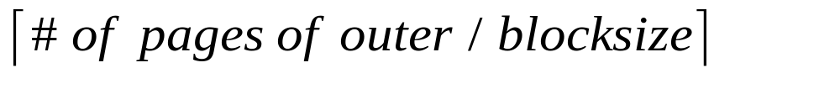
Block Nested Loops Join
Page-oriented NL doesn’t exploit extra buffers :(
Idea to use memory efficiently:
R & S
Join Result
block of R tuples
(B-2 pages)
. . .
. . .
. . .
Input buffer for S
Output buffer
Cost: Scan outer + (#outer blocks * scan inner)
  #outer blocks =

Slide 27
Examples of Block Nested Loops Join
Say we have B = 100+2 memory buffers
Join cost = |outer| + (#outer blocks * |inner|)
  #outer blocks = |outer| / 100
With R as outer (|R| = 1000):
  Scanning R costs 1000 IO’s (done in 10 blocks)
  Per block of R, we scan S; costs 10*500 I/Os
  Total = 1000 + 10*500.
With S as outer (|S| = 500):
  Scanning S costs 500 IO’s (done in 5 blocks)
  Per block of S, we can R; costs 5*1000 IO’s
  Total = 500 + 5*1000.

Slide 28
Index Nested Loops Join
R S:
foreach tuple r in R do
foreach tuple s in S where r_{i} == s_{j} do
add <r, s> to result
lookup(r_{i})
R:
r_{i}
INDEX on S
Data entries
S:
s_{j}
Data Records

Slide 29
Index Nested Loops Join
R S:
foreach tuple r in R do
foreach tuple s in S where r_{i} == s_{j} do
add <r, s> to result
Cost = |R| + (|R|*p_{R}) * cost to find matching S tuples
  If index uses Alt. 1, cost = cost to traverse tree from root to leaf.
  For Alt. 2 or 3:
    Cost to lookup RID(s); typically 2-4 IO’s for B+Tree.
    Cost to retrieve records from RID(s); depends on clustering.
      Clustered index: 1 I/O per page of matching S tuples.
      Unclustered: up to 1 I/O per matching S tuple.

Slide 30
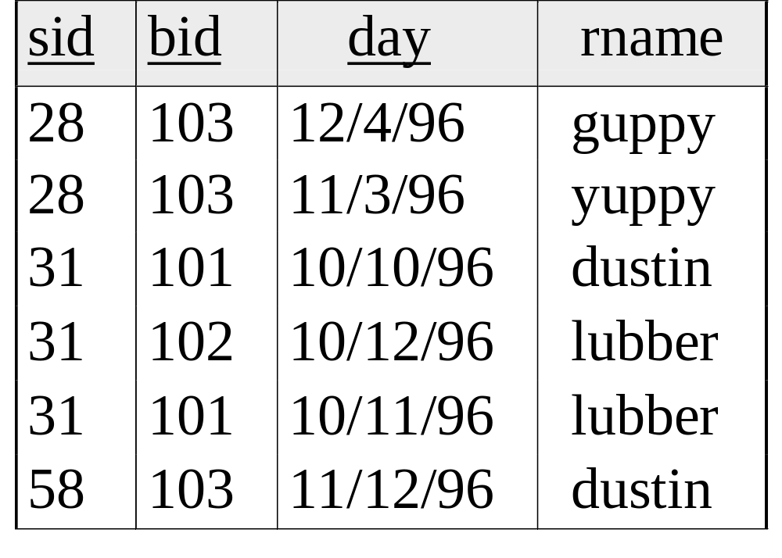
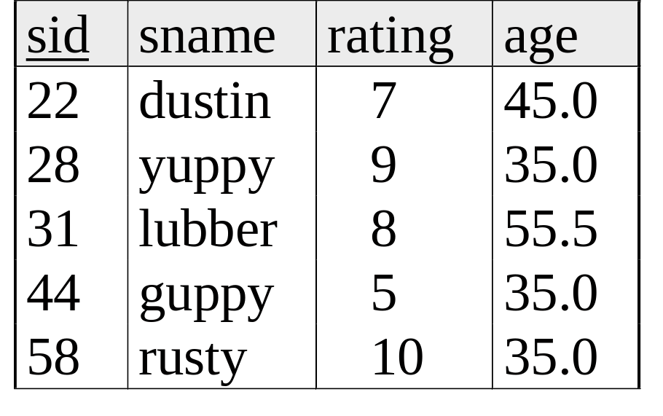
Sort-Merge Join
  Sort R on join attr(s)
  Sort S on join attr(s)
  Scan sorted-R and sorted-S in tandem, to find matches
Example:
SELECT *
FROM Reserves R1, Sailors S1
WHERE R1.sid=S1.sid

Slide 31
Cost of Sort-Merge Join
Cost: Sort R + Sort S + (|R|+|S|)
  But in worst case, last term could be |R|*|S| (very unlikely!)
  Q: what is worst case?
Suppose B = 35 buffer pages:
Both R and S can be sorted in 2 passes
Total join cost = 4*1000 + 4*500 + (1000 + 500) = 7500
Suppose B = 300 buffer pages:
Again, both R and S sorted in 2 passes
Total join cost = 7500
Block-Nested-Loop cost = 2500 … 15,000

Slide 32
Other Considerations …
1. An important refinement:
  Do the join during the final merging pass of sort !
  If have enough memory, can do:
  1. Read R and write out sorted runs
  2. Read S and write out sorted runs
  3. Merge R-runs and S-runs, and find R S matches
  Cost = 3*|R| + 3*|S|
  Q: how much memory is “enough” (will answer next time …)
>
<
2. Sort-merge join an especially good choice if:
  one or both inputs are already sorted on join attribute(s)
  output is required to be sorted on join attributes(s)
  Q: how to take these savings into account? (stay tuned …)

Slide 33
Summary
A virtue of relational DBMSs:
queries are composed of a few basic operators
  The implementation of these operators can be carefully tuned
Many alternative implementation techniques for each operator
  No universally superior technique for most operators.
Must consider available alternatives
  Called “Query optimization” -- we will study this topic soon!
Notes:
22

