Slide 1
Schema Refinement and Normalization
Nobody realizes that some people expend tremendous energy merely to be normal.
Albert Camus

Slide 2
Normal Forms
Recall FDs, Armstrong’s Axioms, Attr. Closures.
Q1: is any refinement needed??!
If a relation is in a normal form (BCNF, 3NF etc.):
  we know that certain problems are avoided/minimized.
  helps decide whether decomposing a relation is useful.
Role of FDs in detecting redundancy:
  Consider a relation R with 3 attributes, ABC.
    No (non-trivial) FDs hold: There is no redundancy here.
    Given A → B: If A is not a key, then several tuples could have the same A value, and if so, they’ll all have the same B value!
1st Normal Form – all attributes are atomic
  i.e. the relational model
1st ⊃2nd (of historical interest) ⊃ 3rd ⊃ Boyce-Codd ⊃ …

Slide 3
Boyce-Codd Normal Form (BCNF)
Reln R with FDs F is in BCNF if, for all X → A in F⁺
  A ∈ X (called a trivial FD), or
  X is a superkey for R.
In other words: “R is in BCNF if the only non-trivial FDs over R are key constraints.”
If R in BCNF, then every field of every tuple records information that cannot be inferred using FDs alone.
  Say we know FD X → A holds this example relation:
Can you guess the value of the missing attribute?
Yes, so relation is not in BCNF
X | Y | A
5 | y1 | 7
5 | y2 | ?

Slide 4
Decomposition of a Relation Schema
If a relation is not in a desired normal form, it can be decomposed into multiple relations that each are in that normal form.
Suppose that relation R contains attributes A1 ... An. A decomposition of R consists of replacing R by two or more relations such that:
  Each new relation scheme contains a subset of the attributes of R, and
  Every attribute of R appears as an attribute of at least one of the new relations.

Slide 5
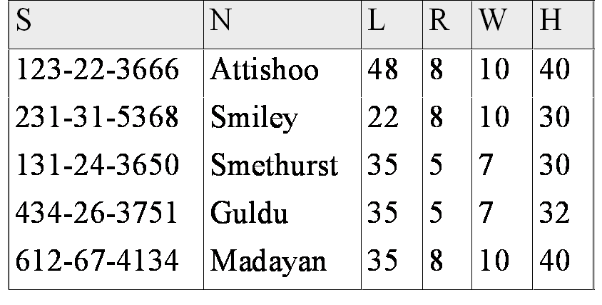
Example (same as before)
Hourly_Emps
SNLRWH has FDs S → SNLRWH and R → W
Q: Is this relation in BCNF?
No, The second FD causes a violation; W values repeatedly associated with R values.

Slide 6
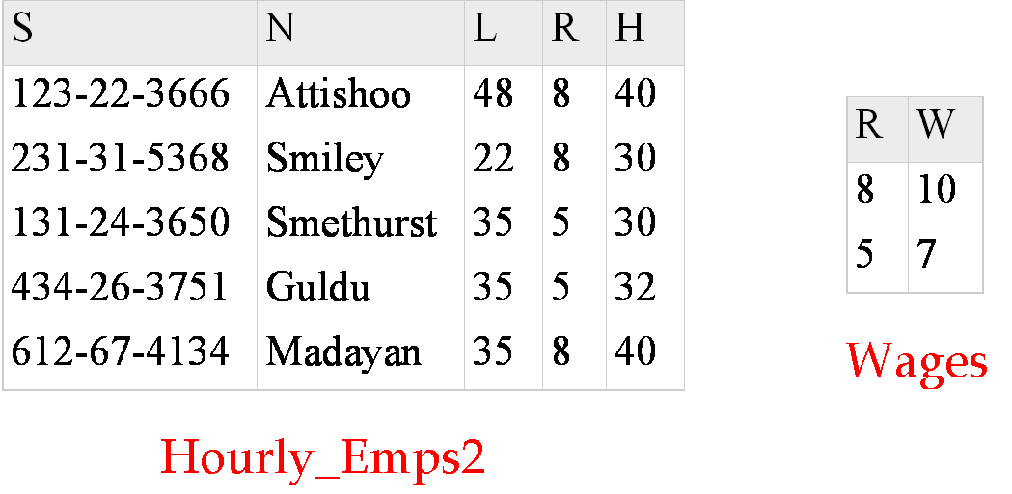
Decomposing a Relation
Easiest fix is to create a relation RW to store these associations, and to remove W from the main schema:
Q: Are both of these relations are now in BCNF?
Decompositions should be used only when needed.
  Q: potential problems of decomposition?

Slide 7
Problems with Decompositions
There are three potential problems to consider:
  1) May be impossible to reconstruct the original relation! (Lossy Decomposition)
    Fortunately, not in the SNLRWH example.
  2) Dependency checking may require joins (not Dependency Preserving)
    Fortunately, not in the SNLRWH example.
  3) Some queries become more expensive.
    e.g., How much does Guldu earn?
    Tradeoff: Must consider these issues vs. redundancy.
      (Well, not usually #1)

Slide 8
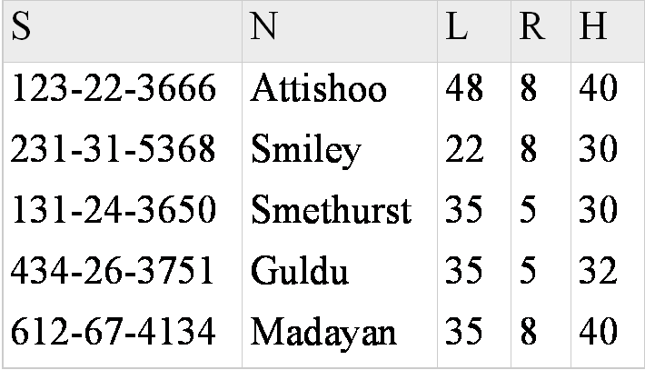
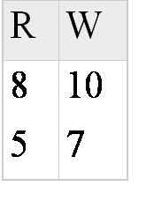

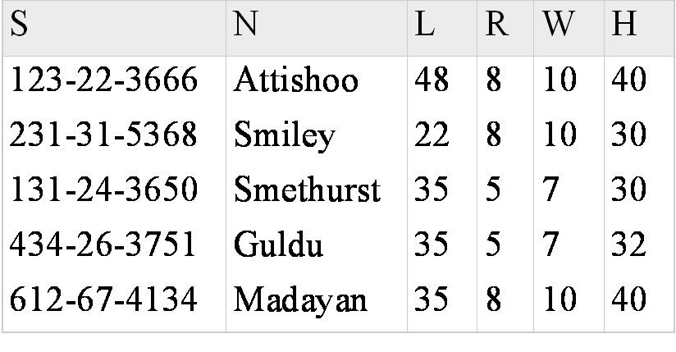
Lossless Decomposition (example)
=

Slide 9
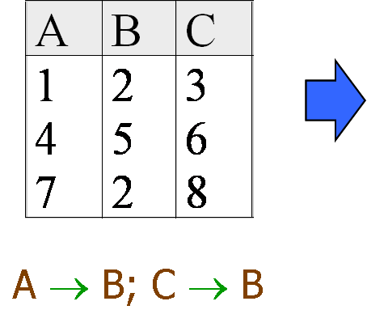
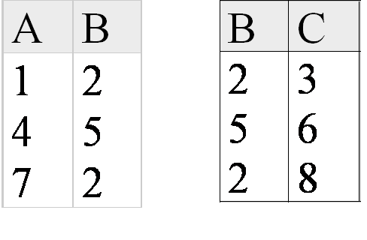
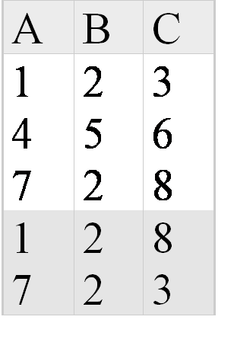
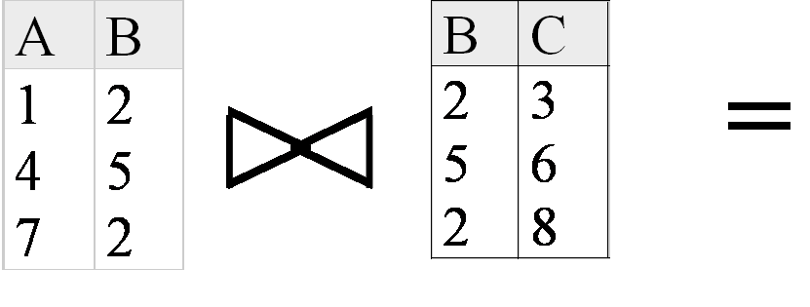
Lossy Decomposition (example)

Slide 10
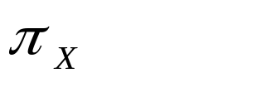
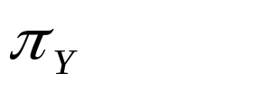

Lossless Join Decompositions
Decomposition of R into X and Y is lossless w.r.t. a set of FDs F if, for every instance r that satisfies F:
  (r) (r) = r
It is always true that r (r) (r)
  In general, the other direction does not hold! If it does, the decomposition is lossless-join.
Definition extended to decomposition into 3 or more relations in a straightforward way.
It is essential that all decompositions used to deal with redundancy be lossless! (Avoids Problem #1)

Slide 11
More on Lossless Decomposition
The decomposition of R into X and Y is lossless with respect to F if and only if the closure of F contains:
  X ∩ Y → X, or
  X ∩ Y → Y
  in example: decomposing ABC into AB and BC is lossy, because intersection (i.e., “B”) is not a key of either resulting relation.
Useful result: If W → Z holds over R and W ∩ Z is empty, then decomposition of R into R-Z and WZ is loss-less.
i.e. the common attributes form a superkey for one side or the other

Slide 12
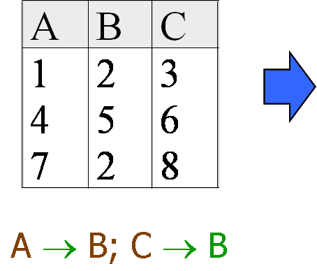
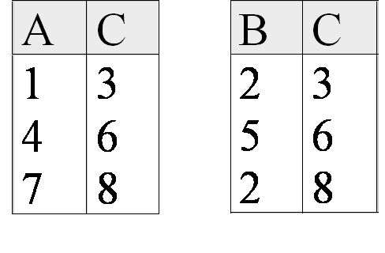
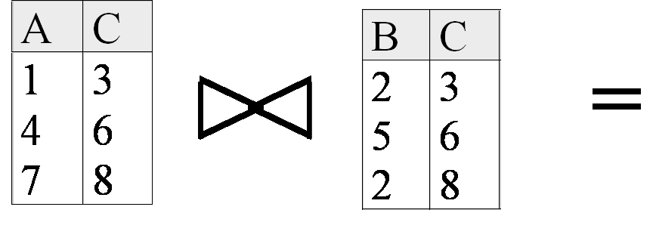
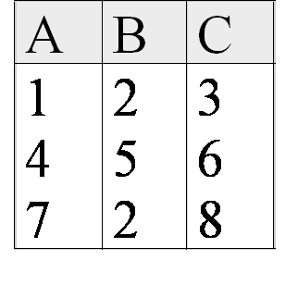
Lossless Decomposition (example)
But, now we can’t check A → B without doing a join!

Slide 13
Dependency Preserving Decomposition
Dependency preserving decomposition (Intuitive):
  If R is decomposed into X, Y and Z, and we enforce the FDs that hold individually on X, on Y and on Z, then all FDs that were given to hold on R must also hold. (Avoids Problem #2 on our list.)
    Why do we care??
Projection of set of FDs F : If R is decomposed into X and Y the projection of F on X (denoted F_{X} ) is the set of FDs U → V in F⁺ (closure of F , not just F ) such that all of the attributes U, V are in X. (same holds for Y of course)

Slide 14
Dependency Preserving Decompositions (Contd.)
Decomposition of R into X and Y is dependency preserving if (F_{X} ∪ F_{Y} ) ⁺ = F ⁺
  i.e., if we consider only dependencies in the closure F ⁺ that can be checked in X without considering Y, and in Y without considering X, these imply all dependencies in F ⁺.
Important to consider F ⁺ in this definition:
  ABC, A → B, B → C, C → A, decomposed into AB and BC.
  Is this dependency preserving? Is C → A preserved?????
    note: F ⁺ contains F ∪ {A → C, B → A, C → B}, so…
F_{AB} contains A →B and B → A; F_{BC} contains B → C and C → B
So, (F_{AB} ∪ F_{BC})⁺ contains C → A

Slide 15
Decomposition into BCNF
Consider relation R with FDs F. If X → Y violates BCNF, decompose R into R - Y and XY (guaranteed to be loss-less).
  Repeated application of this idea will give us a collection of relations that are in BCNF; lossless join decomposition, and guaranteed to terminate.
  e.g., CSJDPQV, key C, JP → C, SD → P, J → S
  {contractid, supplierid, projectid,deptid,partid, qty, value}
  To deal with SD → P, decompose into SDP, CSJDQV.
  To deal with J → S, decompose CSJDQV into JS and CJDQV
  So we end up with: SDP, JS, and CJDQV
Note: several dependencies may cause violation of BCNF. The order in which we ``deal with’’ them could lead to very different sets of relations!

Slide 16
BCNF and Dependency Preservation
In general, there may not be a dependency preserving decomposition into BCNF.
  e.g., CSZ, CS → Z, Z → C
  Can’t decompose while preserving 1st FD; not in BCNF.
Similarly, decomposition of CSJDPQV into SDP, JS and CJDQV is not dependency preserving (w.r.t. the FDs JP → C, SD → P and J → S).
{contractid, supplierid, projectid,deptid,partid, qty, value}
  However, it is a lossless join decomposition.
  In this case, adding JPC to the collection of relations gives us a dependency preserving decomposition.
    but JPC tuples are stored only for checking the f.d. (Redundancy!)

Slide 17
Third Normal Form (3NF)
Reln R with FDs F is in 3NF if, for all X → A in F⁺
  A ∈ X (called a trivial FD), or
  X is a superkey of R, or
  A is part of some candidate key (not superkey!) for R.
  (sometimes stated as “A is prime”)
Minimality of a key is crucial in third condition above!
If R is in BCNF, obviously in 3NF.
If R is in 3NF, some redundancy is possible. It is a compromise, used when BCNF not achievable (e.g., no ``good’’ decomp, or performance considerations).
  Lossless-join, dependency-preserving decomposition of R into a collection of 3NF relations always possible.

Slide 18
What Does 3NF Achieve?
If 3NF violated by X → A, one of the following holds:
  X is a subset of some key K (“partial dependency”)
    We store (X, A) pairs redundantly.
    e.g. Reserves SBDC (C is for credit card) with key SBD and S → C
  X is not a proper subset of any key. (“transitive dep.”)
    There is a chain of FDs K → X → A
    So we can’t associate an X value with
    a K value unless we also associate an A
    value with an X value (different K’s,
    same X implies same A!)
    – problem with initial SNLRWH example.
But: even if R is in 3NF, these problems could arise.
  e.g., Reserves SBDC (note: “C” is for credit card here), S → C, C → S is in 3NF (why?)
  Even so, for each reservation of sailor S, same (S, C) pair is stored.
Thus, 3NF is indeed a compromise relative to BCNF.
  You have to deal with the partial and transitive dependency issues in your application code!
X
A
X
A
Vs.
A
X

Slide 19
An Aside: Second Normal Form
Like 3NF, but allows transitive dependencies:
    Reln R with FDs F is in 2NF if, for all X → A in F⁺
      A ∈ X (called a trivial FD), or
      X is a superkey of R, or
      X is not part of any candidate key for R.
      (i.e. “X is not prime”)
There’s no reason to use this in practice
  And we won’t expect you to remember it

Slide 20
Decomposition into 3NF
Obviously, the algorithm for lossless join decomp into BCNF can be used to obtain a lossless join decomp into 3NF (typically, can stop earlier) but does not ensure dependency preservation.
To ensure dependency preservation, one idea:
  If X → Y is not preserved, add relation XY.
  Problem is that XY may violate 3NF! e.g., consider the addition of CJP to `preserve’ JP → C. What if we also have J → C ?
Refinement: Instead of the given set of FDs F, use a minimal cover for F.

Slide 21
Minimal Cover for a Set of FDs
Minimal cover G for a set of FDs F:
  Closure of F = closure of G.
  Right hand side of each FD in G is a single attribute.
  If we modify G by deleting an FD or by deleting attributes from an FD in G, the closure changes.
Intuitively, every FD in G is needed, and ``as small as possible’’ in order to get the same closure as F.
e.g., A → B, ABCD → E, EF → GH, ACDF → EG has the following minimal cover:
  A → B, ACD → E, EF → G and EF → H
M.C. implies Lossless-Join, Dep. Pres. Decomp!!!
  (in book, p. 627)

Slide 22
Summary of Schema Refinement
BCNF: each field contains information that cannot be inferred using only FDs.
  ensuring BCNF is a good heuristic.
Not in BCNF? Try decomposing into BCNF relations.
  Must consider whether all FDs are preserved!
Lossless-join, dependency preserving decomposition into BCNF impossible? Consider 3NF.
  Same if BCNF decomp is unsuitable for typical queries
  Decompositions should be carried out and/or re-examined while keeping performance requirements in mind.
Note: even more restrictive Normal Forms exist (we don’t cover them in this course, but some are in the book.)

