Slide 1
CS186: Introduction to Database Systems
Joe Hellerstein
Fall 2007

Slide 2
Queries for Today
What?
Why?
Who?
How?
For instance?

Slide 3
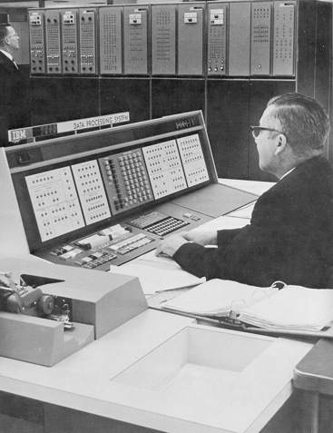
What: Database Systems Then

Slide 4
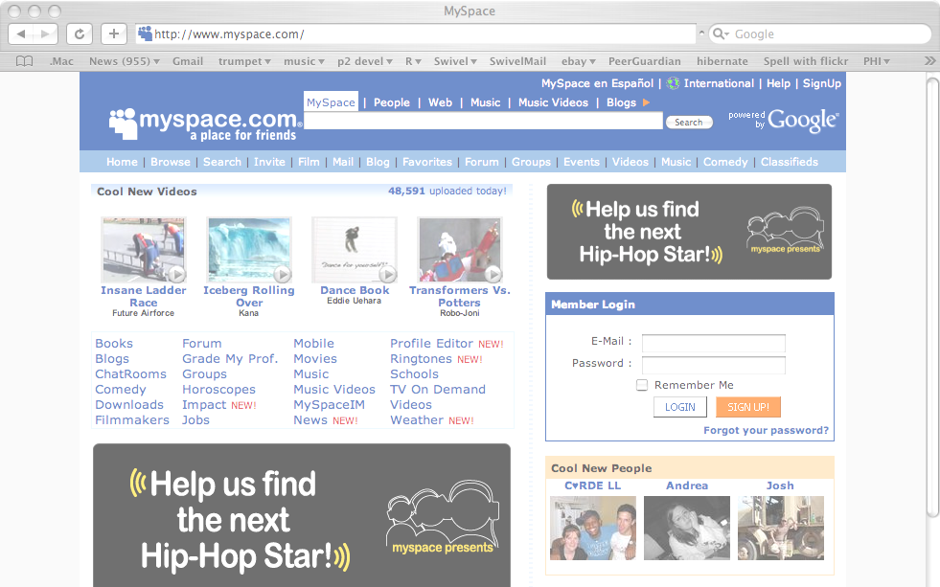
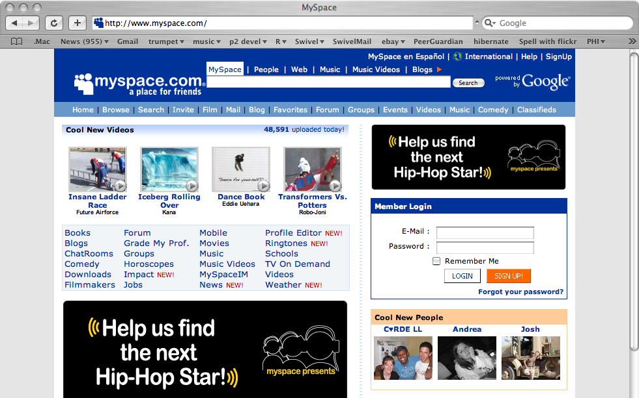
What: Database Systems Today

Slide 5
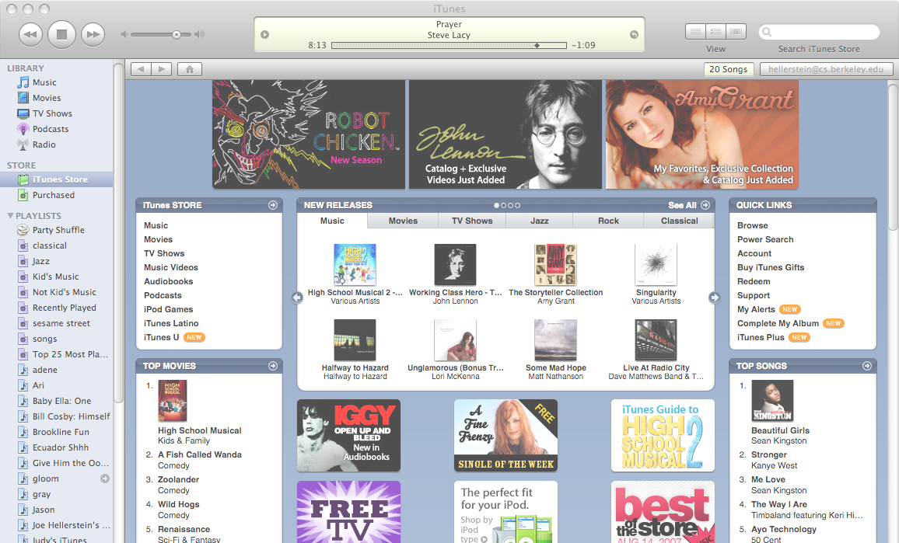
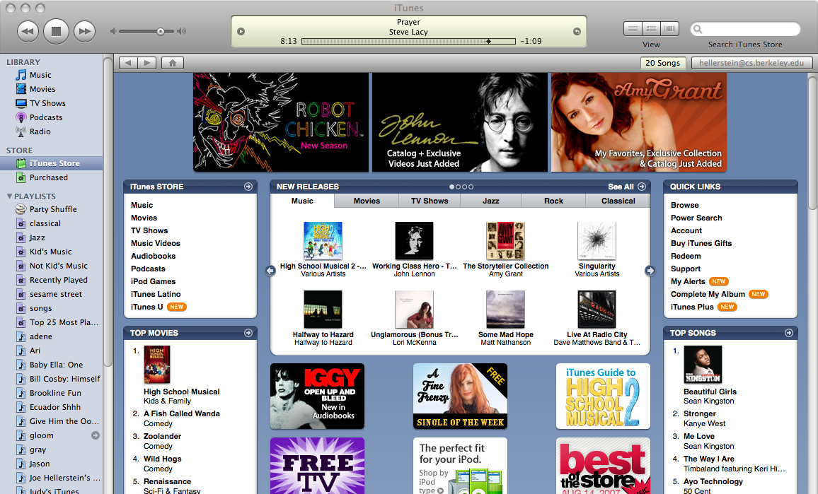
What: Database Systems Today

Slide 6
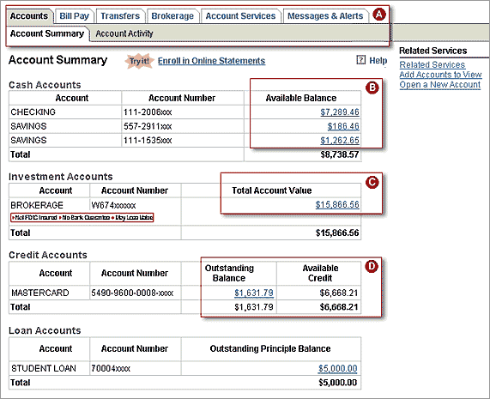
What: Database Systems Today

Slide 7
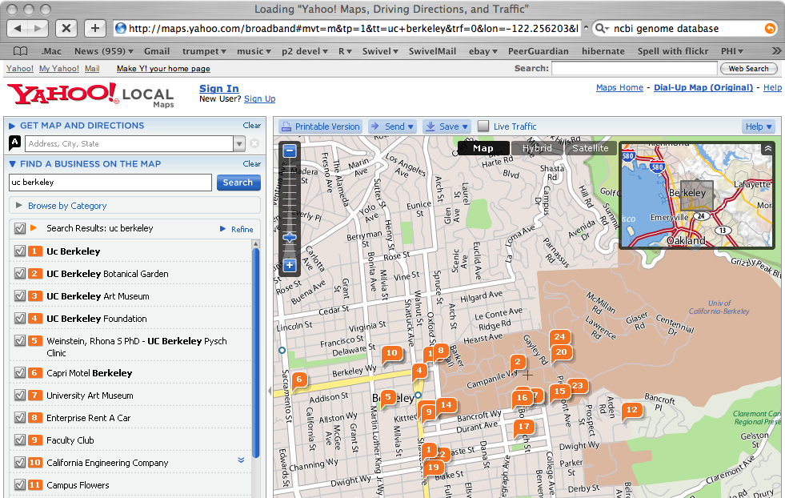
What: Database Systems Today

Slide 8
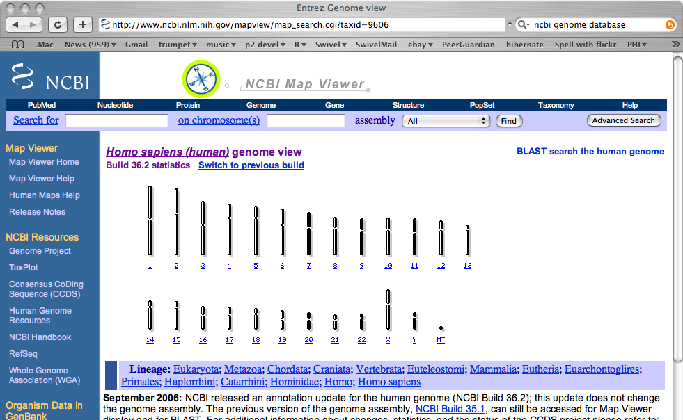
What: Database Systems Today

Slide 9
So… What is a Database?
We will be broad in our interpretation
A Database:
  A very large, integrated collection of data.
Typically models a real-world “enterprise”
  Entities (e.g., teams, games)
  Relationships (e.g. The A’s are playing in the World Series)
Might surprise you how flexible this is
  Web search:
    Entities: words, documents
    Relationships: word in document, document links to document.
  P2P filesharing:
    Entities: words, filenames, hosts
    Relationships: word in filename, file available at host

Slide 10
What is a Database Management System?
A Database Management System (DBMS) is:
  A software system designed to store, manage, and facilitate access to databases.
Typically this term used narrowly
  Relational databases with transactions
    E.g. Oracle, DB2, SQL Server
  Mostly because they predate other large repositories
    Also because of technical richness
  When we say DBMS in this class we will usually follow this convention
    But keep an open mind about applying the ideas!

Slide 11
What: Is the WWW a DBMS?
That’s a complicated question!
The “surface web”: docs and search
  Crawler indexes pages on the web
  Keyword-based search for pages
Web-cache SW at Google/Yahoo is a kind of DBMS
Notes
  source data is mostly “prose”: unstructured and untyped
  public interface is search only:
    can’t modify the data
    can’t get summaries, complex combinations of data
  few guarantees provided for freshness of data, consistency across data items, fault tolerance, …

Slide 12
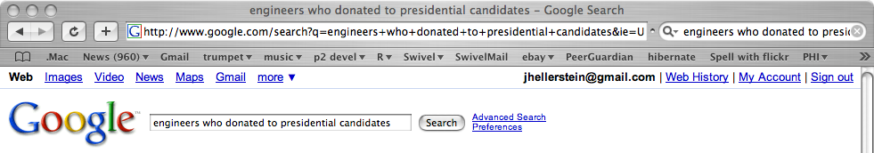
What: “Search” vs. Query
Try actors who donated to presidential candidates in your favorite search engine.
Now try engineers who donated to presidential candidates
If it isn’t “published”, it can’t be searched!

Slide 13


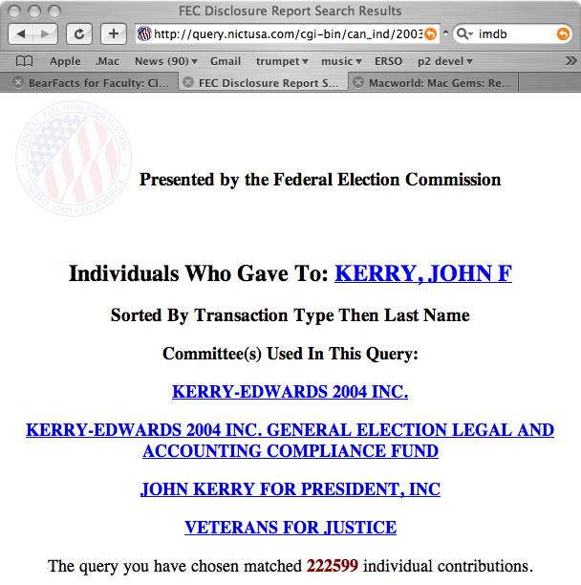
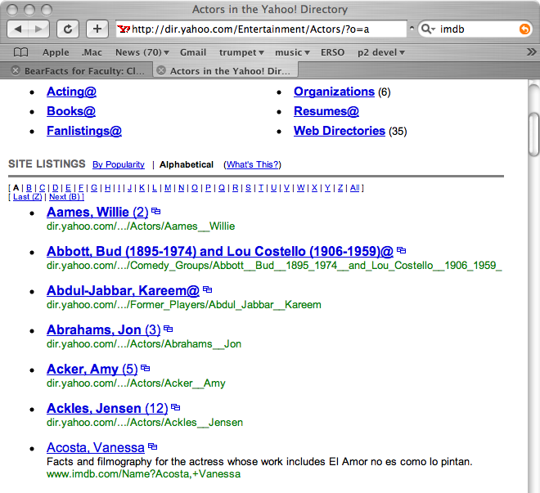

What: A “Database Query” Approach

Slide 14
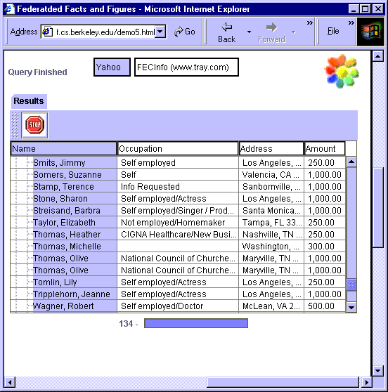
“Yahoo Actors” JOIN “FECInfo”
(Courtesy of the Telegraph research group @Berkeley)
Q: Did it Work?

Slide 15
What: Is a File System a DBMS?
Thought Experiment 1:
  You and your project partner are editing the same file.
  You both save it at the same time.
  Whose changes survive?
A) Yours
B) Partner’s
C) Both
D) Neither
E) ???
Thought Experiment 2:
  You’re updating a file.
  The power goes out.
  Which changes survive?
A) All
B) None
C) All Since Last Save
D) ???

Slide 16
What: Is a File System a DBMS?
Thought Experiment 1:
  You and your project partner are editing the same file.
  You both save it at the same time.
  Whose changes survive?
Q: How do you write
programs over a
subsystem when it
promises you only “???” ?
A) Yours
B) Partner’s
C) Both
D) Neither
E) ???
Thought Experiment 2:
  You’re updating a file.
  The power goes out.
  Which changes survive?
A: Very, very carefully!!
A) All
B) None
C) All Since Last Save
D) ???

Slide 17
OS Support for Data Management
Data can be stored in RAM
  this is what every programming language offers!
  RAM is fast, and random access
  Isn’t this heaven?
Every OS includes a File System
  manages files on a magnetic disk
  allows open, read, seek, close on a file
  allows protections to be set on a file
  drawbacks relative to RAM?

Slide 18
Database Management Systems
What more could we want than a file system?
  Simple, efficient ad hoc¹ queries
  concurrency control
  recovery
  benefits of good data modeling
S.M.O.P.²? Not really…
  as we’ll see this semester
  in fact, the OS often gets in the way!
¹ad hoc: formed or used for specific or immediate problems or needs
²SMOP: Small Matter Of Programming

Slide 19
Current Commercial Outlook
Relational DBs a major part of the software industry
  Oracle, IBM, Microsoft, HP, Teradata, Sybase, …
Open Source coming on strong
  Relational: MySQL, PostgreSQL, Apache Derby, SQLite, Ingres, …
  text-Search: Lucene, Ferret, …
Well-known benchmarks (TPC, TREC)
Tons of applications, related industries
  Alphabet soup!
Related database technologies have niches
  P2P, XML repositories, etc.

Slide 20
What systems will we cover?
We will be try to be broad and touch upon
  Relational DBMS (e.g. Oracle, SQL Server, DB2, Postgres)
  Document search engines (e.g. Google, Yahoo! Search, Lucene, Ferret)
Ground things in relevant applications

Slide 21
Quiz Question
Name some widely-used applications

Slide 22
Why take this class?
Database systems are at the core of CS
They are incredibly important to society
The topic is intellectually rich
A capstone course for undergrad
It isn’t that much work
Looks good on your resume
Let’s spend a little time on each of these

Slide 23
Why take this class?
A. Database systems are the core of CS
Shift from computation to information
  True in corporate computing for years
  Web made this clear for “the rest of us” by the end of 90’s
  Increasingly true of scientific computing
Need for DB technology has exploded in the last years
  Corporate: retail swipe/clickstreams, “customer relationship mgmt”, “supply chain mgmt”, “data warehouses”, etc.
  Web: not just “documents”. Search engines, maps, e-commerce, blogs, wikis, social networks. Web 2.0.
  Scientific: digital libraries, genomics, satellite imagery, physical sensors, simulation data
  Personal: Music, photo, & video libraries. Email archives. File contents (“desktop search”).

Slide 24

Why take this class?
B. DBs are incredibly important to society
“Knowledge is power.” -- Sir Francis Bacon
“With great power comes great responsibility.” -- Spiderman's Uncle Ben
- Policy-makers should understand technological possibilities.
- Informed Technologists needed in public discourse on usage.

Slide 25
Why take this class?
C. The topic is intellectually rich.
representing information
  data modeling
languages and systems for querying data
  complex queries & query semantics*
  over massive data sets
concurrency control for data manipulation
  controlling concurrent access
  ensuring transactional semantics
reliable data storage
  maintain data semantics even if you pull the plug
  * semantics: the meaning or relationship of meanings of a sign or set of signs

Slide 26
Why take this class?
D. The course is a capstone.
We will see
  Algorithms and cost analyses
  System architecture and implementation
  Resource management and scheduling
  Language design, semantics and optimization
  AI topics including logic and planning
  Statistical modeling of data

Slide 27
Why take this class?
E. It isn’t that much work.
Bad news: It is a fair bit of work.
  varies from year to year
Good news: the course is front loaded
  Most of the hard work is in the first half of the semester
  Load balanced with most other classes

Slide 28
Why take this class?
F. Looks good on my resume.
Yes, but why? This is not a course for:
  Oracle administrators
  IBM DB2 engine developers
    Though it’s useful for both!
It is a course for well-educated computer scientists
  Database system concepts and techniques increasingly used “outside the box”
    Ask your friends at Microsoft, Yahoo!, Google, Apple, etc.
    Actually, they may or may not realize it!
  A rich understanding of these issues is a basic and (un?)fortunately unusual skill.

Slide 29
Who?
Instructor
  Prof. Joe Hellerstein
  cs186profs@db.cs.berkeley.edu
TAs
  David Chu
  Eirinaios Michelakis

Slide 30
How? Workload
Projects with a “real world” focus:
  Modify the internals of a “real” open-source database system: PostgreSQL
    Serious C system hacking in a ~500KLoc codebase
    Measure the benefits of our changes
  Build web-based applications
    Using Ruby on Rails, PostgreSQL, Ferret text search
Other homework assignments and/or quizzes
Exams – 1 Midterm & 1 Final
Projects to be done in groups of 2
  Pick your partner ASAP
The course is “front-loaded”
  most of the hard work is in the first half

Slide 31
How? Administrivia
http://inst.eecs.berkeley.edu/~cs186
Office Hours:
  JMH:
    Tues 12:30-1:30
    Thurs 11:00-12:00 (in 685 Soda)
  DC: Mon 1-2
  EM: Fri 11-12 (locations TBA)
Discussion Sections WILL meet this week

Slide 32
How? Administrivia, cont.
textbook
  Database Management Systems, 3rd Edition
    Ramakrishnan and Gehrke
  Agile Web Development with Rails, 2nd edition
    e-book is fine (better?)
  Programming Ruby, 2nd edition
    Free online
Grading, hand-in policies, etc. will be on Web Page
Cheating policy: zero tolerance
  We have the technology…

Slide 33
How? Administrivia, cont.
Team Projects
  Teams of 2
  Think about this now!
Class bulletin board - ucb.class.cs186
  read it regularly and post questions/comments.
  mail broadcast to all TAs will not be answered
  mail to the cs186 course account will not be answered
Class Blog for announcements

Slide 34
Agenda for the rest of today
A “free tasting” of central concepts in DB field:
  queries and search
  data independence
  transactions
Next Time
  the Relational data model
  object-relational mapping using Ruby on Rails
Today’s lecture is from Chapter 1 in R&G
Read Chapter 2 for next class.

Slide 35
Describing Data: Data Models
A data model is a collection of concepts for describing data.
A schema is a description of a particular collection of data, using a given data model.
The relational model of data is the most widely used model today.
  Main concept: relation, basically a table with rows and columns.
  Every relation has a schema, which describes the columns, or fields.
Notes:
5

Slide 36
Example: University Database
Schema:
  Students(sid text,
  name text,
  login text,
  age integer,
  gpa float)
  Courses(cid text,
  cname text,
  credits integer)
  Enrolled(sid text,
  cid text,
  grade text)
Notes:
7

Slide 37



Levels of Abstraction
Users
Views describe how users see the data.
Conceptual schema defines logical structure
Physical schema describes the files and indexes used.
View 1
View 2
View 3
Conceptual Schema
Physical Schema
DB
Notes:
6

Slide 38
Example: University Database
Conceptual schema:
  Students(sid text, name text,
  login text, age integer,
  gpa float)
  Courses(cid text, cname text,
  credits integer)
  Enrolled(sid text, cid text,
  grade text)
Physical schema:
  Relations stored as unordered files.
  Index on first column of Students.
External Schema (View):
  Course_info(cid text,
  enrollment integer)
Notes:
7

Slide 39
Data Independence
Applications insulated from how data is structured and stored.
Logical data independence: Protection from changes in logical structure of data.
Physical data independence: Protection from changes in physical structure of data.
Q: Why is this particularly important for DBMS?
Because databases and their associated applications persist.

Slide 40
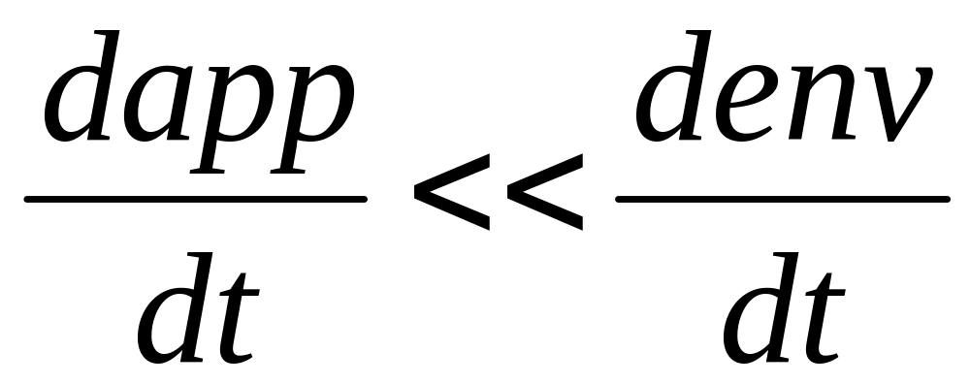
Hellerstein’s Inequality

Slide 41
Agenda …
A “free tasting” of central concepts in DB field:
  queries (vs. search)
  data independence
  transactions

Slide 42
Concurrent execution of user programs
Why?
  Utilize CPU while waiting for disk I/O
    (database programs make heavy use of disk)
  Avoid short programs waiting behind long ones
    e.g. ATM withdrawal while bank manager sums balance across all accounts

Slide 43
Concurrent execution
Interleaving actions of different programs: trouble!
  Example:
  Bill transfers $100 from savings to checking
    Savings –= 100; Checking += 100
  Meanwhile, Bill’s wife requests account info.
  Bad interleaving:
    Savings –= 100
    Print balances
    Checking += 100
  Printout is missing $100 !

Slide 44
Concurrency Control
DBMS ensures such problems don’t arise
Users can pretend they are using a single-user system. (called “Isolation”)
  Thank goodness!

Slide 45
Key concept: Transaction
an atomic sequence of database actions (reads/writes)
takes DB from one consistent state to another
transaction
consistent state 1
consistent state 2

Slide 46
Example
checking: $200
savings: $1000
transaction
checking: $300
savings: $900
Here, consistency is based on our knowledge of banking “semantics”
In general, up to writer of transaction to ensure transaction preserves consistency
DBMS provides (limited) automatic enforcement, via integrity constraints
  e.g., balances must be >= 0

Slide 47
Concurrent transactions
Goal: execute xacts {T1, T2, … Tn}, and ensure a consistent outcome
One option: “serial” schedule (one after another)
Better: allow interleaving of xact actions, as long as outcome is equivalent to some serial schedule

Slide 48
Possible Enforcement Methods
Optimistic: permit arbitrary interleaving, then check equivalence to serial sched.
Pessimistic: xacts set locks on data objects, such that illegal interleaving is impossible

Slide 49
Locking example
    T1 (Bill): Savings –= 100; Checking += 100
    T2 (Bill’s wife): Print(Checking); Print(Savings)
  T1 and T2 both lock Savings and Checking objects
  If T1 locks Savings & Checking first, T2 must wait

Slide 50
A wrinkle …
    T1 (Bill): Savings –= 100; Checking += 100
    T2 (Bill’s wife): Print(Checking); Print(Savings)
  Suppose:
    T1 locks Savings
    T2 locks Checking
    Now neither transaction can proceed!
  called “deadlock”
  DBMS will abort and restart one of T1 and T2
  Need “undo” mechanism that preserves consistency
  Undo mechanism also necessary if system crashes between “Savings –= 100” and “Checking += 100” …

Slide 51
Ensuring Transaction Properties
DBMS ensures:
  atomicity even if xact aborted (due to deadlock, system crash, …)
  durability of committed xacts, even if system crashes.
Idea: Keep a log of all actions carried out by the DBMS:
  Record all DB modifications in log, before they are executed
  To abort a xact, undo logged actions in reverse order
  If system crashes, must:
    1) undo partially executed xacts (ensures atomicity)
    2) redo committed xacts (ensures durability)
  trickier than it sounds!

Slide 52
Architecture of a DBMS …

Slide 53
Typical DBMS architecture
Query Optimization
and Execution
Relational Operators
Files and Access Methods
concurrency control,
logging & recovery
Buffer Management
Disk Space Management
DB
Notes:
22

Slide 54
A text search engine
Less “system” than DBMS
  Uses OS files for storage
  Just one access method
  One hardwired query
    regardless of search string
Typically no concurrency or recovery management
  Read-mostly
  Batch-loaded, periodically
  No updates to recover
  OS a reasonable choice
Smarts: text tricks
  Search string modifier (e.g. “stemming” and synonyms)
  Ranking Engine (sorting the output, e.g. by word or document popularity)
  Vague semantics: WYGIWIGY
Search String Modifier
Ranking Engine
The Query
}
Simple
DBMS
The Access Method
OS
Buffer Management
Disk Space Management
DB
Notes:
22

Slide 55
Advantages of a Traditional DBMS
Data independence
Efficient data access
Data integrity & security
Data administration
Concurrent access, crash recovery
Reduced application development time
So why not use them always?
  Expensive/complicated to set up & maintain
  This cost & complexity must be offset by need
  General-purpose, not suited for special-purpose tasks (e.g. text search!)

Slide 56

Databases make these folks happy ...
Web & enterprise app developers
Computing infrastructure providers
DBMS vendors, programmers
  Oracle, IBM, MS …
End users in many fields
  Business, education, science, …
Database administrators (DBAs)
…must understand how a DBMS works
Notes:
21

Slide 57
Summary
Relational DBMS: maintain/query structured data
  broadly applicable
  can manipulate data and exploit semantics
  recovery from system crashes
  concurrent access
  robust application development and evolution
  data integrity and security
Text search engine
  similar to relations underneath
  many “application-specific” smarts

Slide 58
Summary, cont
Levels of abstraction & data independence.
  Hellerstein’s inequality
  classic idea, resonates in the most modern SW
Goals of the course
  How to be a sophisticated user of database technology
  What goes on inside a DBMS and search engine
  How to architect data-intensive systems

