Slide 1
ER & Relational: Digging Deeper
R &G - Chapters 2 & 3
Notes:
1

Slide 2
Databases Model the Real World
“Data Model” allows us to translate real world things into structures computers can store
Many models: Relational, E-R, O-O, Network, Hierarchical, etc.
Relational
  Rows & Columns
  Keys & Foreign Keys to link Relations
Enrolled
Students
sid
cid
grade
53666
Carnatic101
C
sid
name
login
age
gpa
53666
Reggae203
B
53666
Jones
jones@cs
18
3.4
53650
Topology112
A
53688
Smith
smith@eecs
18
3.2
53666
History105
B
53650
Smith
smith@math
19
3.8

Slide 3
Aggregation
name
ssn
lot
Used to model a relationship involving a relationship set.
Allows us to treat a relationship set as an entity set for purposes of participation in (other) relationships.
Employees
Monitors
until
started_on
since
dname
pid
pbudget
did
budget
Projects
Sponsors
Departments
Aggregation vs. ternary relationship?
Monitors is a distinct relationship, with a descriptive attribute.
Also, can say that each sponsorship is monitored by at most one employee.
Notes:
2

Slide 4
Conceptual Design Using the ER Model
ER modeling can get tricky!
Design choices:
  Should a concept be modeled as an entity or an attribute?
  Should a concept be modeled as an entity or a relationship?
  Identifying relationships: Binary or ternary? Aggregation?
Note constraints of the ER Model:
  A lot of data semantics can (and should) be captured.
  But some constraints cannot be captured in ER diagrams.
    We’ll refine things in our logical (relational) design
Notes:
3

Slide 5
Entity vs. Attribute
Should address be an attribute of Employees or an entity (related to Employees)?
Depends upon how we want to use address information, and the semantics of the data:
    If we have several addresses per employee, address must be an entity (since attributes cannot be set-valued).
    If the structure (city, street, etc.) is important, address must be modeled as an entity (since attribute values are atomic).

Slide 6
Entity vs. Attribute (Cont.)
from
to
name
dname
ssn
lot
did
budget
Works_In2 does not allow an employee to work in a department for two or more periods.
Similar to the problem of wanting to record several addresses for an employee: we want to record several values of the descriptive attributes for each instance of this relationship.
Employees
Works_In2
Departments
name
dname
ssn
lot
did
budget
Employees
Works_In3
Departments
from
Duration
to
Notes:
5

Slide 7
Entity vs. Relationship
OK as long as a manager gets a separate discretionary budget (dbudget) for each dept.
What if manager’s dbudget covers all managed depts?
(can repeat value, but such redundancy is problematic)
since
dbudget
name
dname
ssn
lot
did
budget
Employees
Manages2
Departments
name
ssn
lot
dname
Employees
did
budget
Departments
is_manager
managed_by
since
apptnum
Mgr_Appts
dbudget
Notes:
6

Slide 8
Now you try it
Try this at home - Courses database:
Courses, Students, Teachers
Courses have ids, titles, credits, …
Courses have multiple sections that have time/rm and exactly one teacher
Must track students’ course schedules and transcripts including grades, semester taken, etc.
Must track which classes a professor has taught
Database should work over multiple semesters

Slide 9
These things get pretty hairy!
Many E-R diagrams cover entire walls!
A modest example:

Slide 10
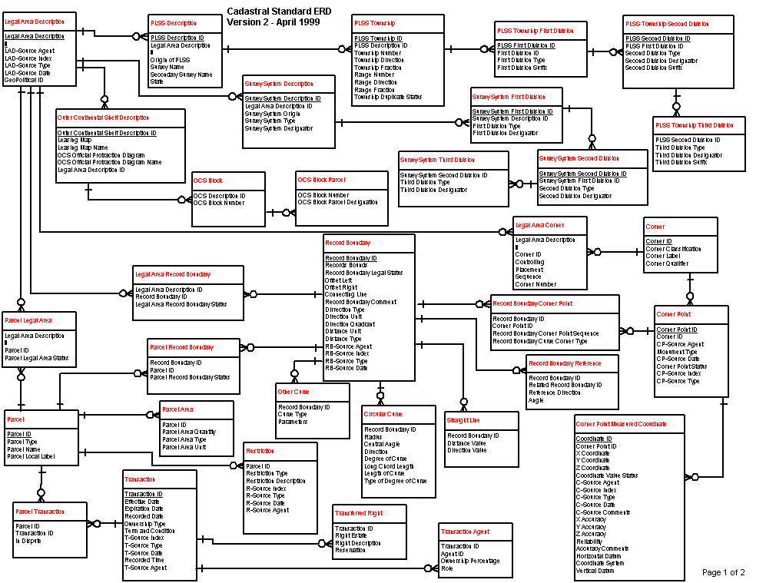
A Cadastral E-R Diagram
cadastral: showing or recording property boundaries, subdivision lines, buildings, and related details
Source: US Dept. Interior Bureau of Land Management,
Federal Geographic Data Committee Cadastral Subcommittee
http://www.fairview-industries.com/standardmodule/cad-erd.htm

Slide 11
Converting ER to Relational
Fairly analogous structure
But many simple concepts in ER are subtle to specify in relations

Slide 12
Logical DB Design: ER to Relational
Entity sets to tables.
ssn
name
lot
123-22-3666
Attishoo
48
name
231-31-5368
Smiley
22
ssn
lot
131-24-3650
Smethurst
35
Employees
CREATE TABLE Employees
(ssn CHAR(11),
name CHAR(20),
lot INTEGER,
PRIMARY KEY (ssn))
Notes:
3
The slides for this text are organized into several modules. Each lecture contains about enough material for a 1.25 hour class period. (The time estimate is very approximate--it will vary with the instructor, and lectures also differ in length; so use this as a rough guideline.) This covers Lectures 1 and 2 (of 6) in Module (5).
Module (1): Introduction (DBMS, Relational Model)
Module (2): Storage and File Organizations (Disks, Buffering, Indexes)
Module (3): Database Concepts (Relational Queries, DDL/ICs, Views and Security)
Module (4): Relational Implementation (Query Evaluation, Optimization)
Module (5): Database Design (ER Model, Normalization, Physical Design, Tuning)
Module (6): Transaction Processing (Concurrency Control, Recovery)
Module (7): Advanced Topics

Slide 13
Relationship Sets to Tables
CREATE TABLE Works_In(
ssn CHAR(1),
did INTEGER,
since DATE,
PRIMARY KEY (ssn, did),
FOREIGN KEY (ssn)
REFERENCES Employees,
FOREIGN KEY (did)
REFERENCES Departments)
In translating a many-to-many relationship set to a relation, attributes of the relation must include:
  1) Keys for each participating entity set (as foreign keys). This set of attributes forms a superkey for the relation.
  2) All descriptive attributes.
ssn
did
since
123-22-3666
51
1/1/91
123-22-3666
56
3/3/93
231-31-5368
51
2/2/92
Notes:
5

Slide 14
Review: Key Constraints
Each dept has at most one manager, according to the key constraint on Manages.
since
name
dname
ssn
lot
did
budget
Employees
Manages
Departments
Translation to
relational model?
1-to-1
1-to Many
Many-to-1
Many-to-Many
Notes:
6

Slide 15
Translating ER with Key Constraints
since
Since each department has a unique manager, we could instead combine Manages and Departments.
name
dname
ssn
lot
did
budget
Employees
Manages
Departments
CREATE TABLE Manages(
ssn CHAR(11),
did INTEGER,
since DATE,
PRIMARY KEY (did),
FOREIGN KEY (ssn) REFERENCES Employees,
FOREIGN KEY (did) REFERENCES Departments)
CREATE TABLE Dept_Mgr(
did INTEGER,
dname CHAR(20),
budget REAL,
ssn CHAR(11),
since DATE,
PRIMARY KEY (did),
FOREIGN KEY (ssn)
REFERENCES Employees)
Vs.
Notes:
7

Slide 16
Review: Participation Constraints
Does every department have a manager?
  If so, this is a participation constraint: the participation of Departments in Manages is said to be total (vs. partial).
    Every did value in Departments table must appear in a row of the Manages table (with a non-null ssn value!)
since
since
name
name
dname
dname
ssn
did
did
budget
lot
budget
Employees
Manages
Departments
Works_In
since
Notes:
8

Slide 17
Participation Constraints in SQL
We can capture participation constraints involving one entity set in a binary relationship, but little else (without resorting to CHECK constraints which we’ll learn later).
CREATE TABLE Dept_Mgr(
did INTEGER,
dname CHAR(20),
budget REAL,
ssn CHAR(11) NOT NULL,
since DATE,
PRIMARY KEY (did),
FOREIGN KEY (ssn) REFERENCES Employees,
ON DELETE NO ACTION)
Notes:
9

Slide 18
Review: Weak Entities
A weak entity can be identified uniquely only by considering the primary key of another (owner) entity.
  Owner entity set and weak entity set must participate in a one-to-many relationship set (1 owner, many weak entities).
  Weak entity set must have total participation in this identifying relationship set.
name
ssn
lot
cost
pname
age
Employees
Policy
Dependents
Notes:
10

Slide 19
Translating Weak Entity Sets
Weak entity set and identifying relationship set are translated into a single table.
  When the owner entity is deleted, all owned weak entities must also be deleted.
CREATE TABLE Dep_Policy (
pname CHAR(20),
age INTEGER,
cost REAL,
ssn CHAR(11) NOT NULL,
PRIMARY KEY (pname, ssn),
FOREIGN KEY (ssn) REFERENCES Employees,
ON DELETE CASCADE)
Notes:
11

Slide 20
Summary of Conceptual Design
Conceptual design follows requirements analysis,
  Yields a high-level description of data to be stored
ER model popular for conceptual design
  Constructs are expressive, close to the way people think about their applications.
  Note: There are many variations on ER model
    Both graphically and conceptually
Basic constructs: entities, relationships, and attributes (of entities and relationships).
Some additional constructs: weak entities, ISA hierarchies (see text if you’re curious), and aggregation.
Notes:
11

Slide 21
Summary of ER (Cont.)
Several kinds of integrity constraints:
  key constraints
  participation constraints
Some foreign key constraints are also implicit in the definition of a relationship set.
Many other constraints (notably, functional dependencies) cannot be expressed.
Constraints play an important role in determining the best database design for an enterprise.
Notes:
12

Slide 22
Summary of ER (Cont.)
ER design is subjective. There are often many ways to model a given scenario!
Analyzing alternatives can be tricky, especially for a large enterprise. Common choices include:
  Entity vs. attribute, entity vs. relationship, binary or n-ary relationship, whether or not to use ISA hierarchies, aggregation.
Ensuring good database design: resulting relational schema should be analyzed and refined further.
  Functional Dependency information and normalization techniques are especially useful.
Notes:
13

