Slide 1
SQL: The Query Language
Part 2
R & G - Chapter 5
The important thing is not to
stop questioning.
Albert Einstein
Notes:
The slides for this text are organized into several modules. Each lecture contains about enough material for a 1.25 hour class period. (The time estimate is very approximate--it will vary with the instructor, and lectures also differ in length; so use this as a rough guideline.) This covers Lectures 3 and 4 (of 6) in Module (3).
Module (1): Introduction (DBMS, Relational Model)
Module (2): Storage and File Organizations (Disks, Buffering, Indexes)
Module (3): Database Concepts (Relational Queries, DDL/ICs, Views and Security)
Module (4): Relational Implementation (Query Evaluation, Optimization)
Module (5): Database Design (ER Model, Normalization, Physical Design, Tuning)
Module (6): Transaction Processing (Concurrency Control, Recovery)
Module (7): Advanced Topics

Slide 2
Example Database
Sailors
Boats
sid | sname | rating | age
22 | Dustin | 7 | 45
31 | Lubber | 8 | 55
95 | Bob | 3 | 63
bid | bname | color
101 | Interlake | blue
102 | Interlake | red
103 | Clipper | green
104 | Marine | red
Reserves
sid | bid | day
22 | 101 | 10/10/06
95 | 103 | 11/12/06

Slide 3
Conceptual SQL Evaluation
SELECT [DISTINCT] target-list
FROM relation-list
WHERE qualification
GROUP BY grouping-list
HAVING group-qualification
Project away columns
(just keep those used in SELECT, GBY, HAVING)
SELECT
[DISTINCT]
Eliminate duplicates
Apply selections
(eliminate rows)
WHERE
HAVING
Eliminate groups
Relation cross-product
FROM
GROUP BY
Form groups & aggregate

Slide 4
Sorting the Results of a Query
ORDER BY column [ ASC | DESC] [, ...]
Can order by any column in SELECT list, including expressions or aggs:
SELECT S.rating, S.sname, S.age
FROM Sailors S, Boats B, Reserves R
WHERE S.sid=R.sid
AND R.bid=B.bid AND B.color=‘red’
ORDER BY S.rating, S.sname;
SELECT S.sid, COUNT (*) AS redrescnt
FROM Sailors S, Boats B, Reserves R
WHERE S.sid=R.sid
AND R.bid=B.bid AND B.color=‘red’
GROUP BY S.sid
ORDER BY redrescnt DESC;

Slide 5
Null Values
Field values in a tuple are sometimes unknown (e.g., a rating has not been assigned) or inapplicable (e.g., no spouse’s name).
  SQL provides a special value null for such situations.
The presence of null complicates many issues. E.g.:
  Special operators needed to check if value is/is not null.
  Is rating>8 true or false when rating is equal to null? What about AND, OR and NOT connectives?
  We need a 3-valued logic (true, false and unknown).
  Meaning of constructs must be defined carefully. (e.g., WHERE clause eliminates rows that don’t evaluate to true.)
  New operators (in particular, outer joins) possible/needed.

Slide 6
Joins
SELECT (column_list)
FROM table_name
[INNER | {LEFT |RIGHT | FULL } OUTER] JOIN table_name
ON qualification_list
WHERE …
Explicit join semantics needed unless it is an INNER join
(INNER is default)

Slide 7
Inner Join
Only the rows that match the search conditions are returned.
SELECT s.sid, s.name, r.bid
FROM Sailors s INNER JOIN Reserves r
ON s.sid = r.sid
Returns only those sailors who have reserved boats
SQL-92 also allows:
SELECT s.sid, s.name, r.bid
FROM Sailors s NATURAL JOIN Reserves r
“NATURAL” means equi-join for each pair of attributes with the same name

Slide 8
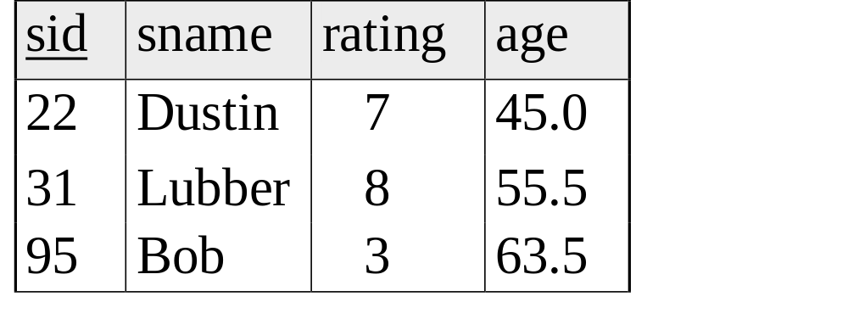
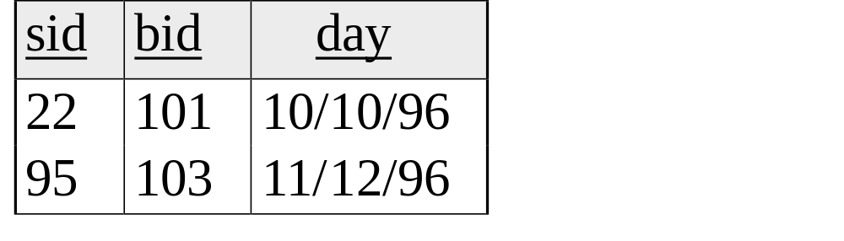
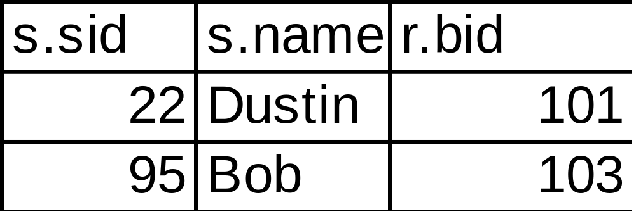
SELECT s.sid, s.name, r.bid
FROM Sailors s INNER JOIN Reserves r
ON s.sid = r.sid

Slide 9
Left Outer Join
Left Outer Join returns all matched rows, plus all unmatched rows from the table on the left of the join clause
(use nulls in fields of non-matching tuples)
SELECT s.sid, s.name, r.bid
FROM Sailors s LEFT OUTER JOIN Reserves r
ON s.sid = r.sid
Returns all sailors & information on whether they have reserved boats

Slide 10
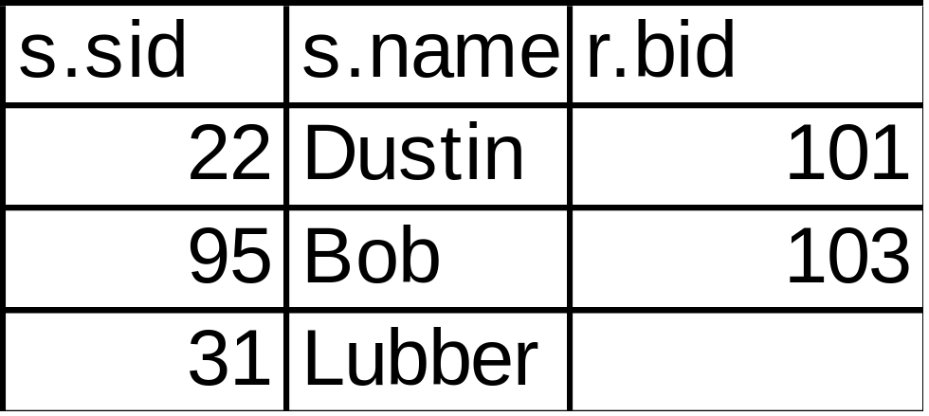
SELECT s.sid, s.name, r.bid
FROM Sailors s LEFT OUTER JOIN Reserves r
ON s.sid = r.sid

Slide 11
Right Outer Join
Right Outer Join returns all matched rows, plus all unmatched rows from the table on the right of the join clause
SELECT r.sid, b.bid, b.name
FROM Reserves r RIGHT OUTER JOIN Boats b
ON r.bid = b.bid
Returns all boats & information on which ones are reserved.

Slide 12
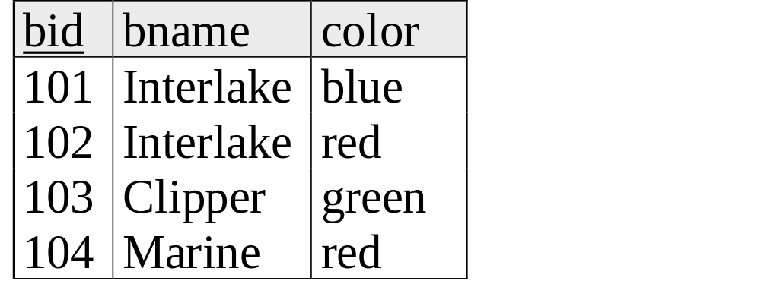
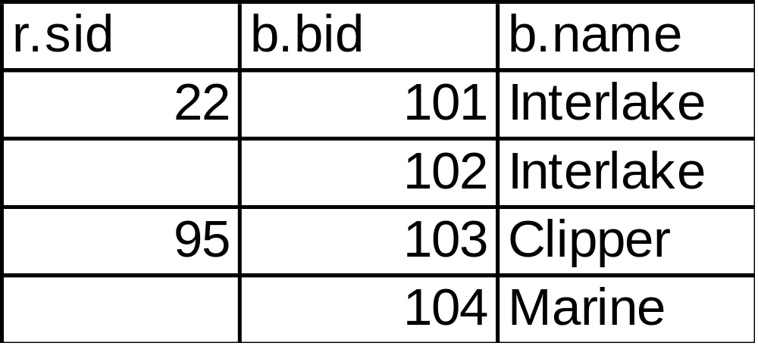
SELECT r.sid, b.bid, b.name
FROM Reserves r RIGHT OUTER JOIN Boats b
ON r.bid = b.bid

Slide 13
Full Outer Join
Full Outer Join returns all (matched or unmatched) rows from the tables on both sides of the join clause
SELECT r.sid, b.bid, b.name
FROM Reserves r FULL OUTER JOIN Boats b
ON r.bid = b.bid
Returns all boats & all information on reservations

Slide 14
SELECT r.sid, b.bid, b.name
FROM Reserves r FULL OUTER JOIN Boats b
ON r.bid = b.bid
Note: in this case it is the same as the ROJ because
bid is a foreign key in reserves, so all reservations must
have a corresponding tuple in boats.

Slide 15
Views: Defining External DB Schemas
CREATE VIEW view_name
AS select_statement
Makes development simpler
Often used for security
Not “materialized”
CREATE VIEW Reds
AS SELECT B.bid, COUNT (*) AS scount
FROM Boats B, Reserves R
WHERE R.bid=B.bid AND B.color=‘red’
GROUP BY B.bid

Slide 16
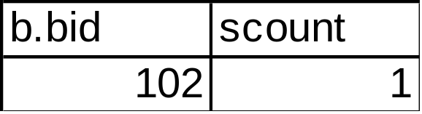
Views Instead of Relations in Queries
CREATE VIEW Reds
AS SELECT B.bid, COUNT (*) AS scount
FROM Boats B, Reserves R
WHERE R.bid=B.bid AND B.color=‘red’
GROUP BY B.bid
Reds
SELECT bname, scount
FROM Reds R, Boats B
WHERE R.bid=B.bid
AND scount < 10

Slide 17
Discretionary Access Control
GRANT privileges ON object TO users [WITH GRANT OPTION]
Object can be a Table or a View
Privileges can be:
  Select
  Insert
  Delete
  References (cols) – allow to create a foreign key that references the specified column(s)
  All
Can later be REVOKEd
Users can be single users or groups
See Chapter 17 for more details.

Slide 18
Two more important topics
Constraints
SQL embedded in other languages

Slide 19
Integrity Constraints (Review)
An IC describes conditions that every legal instance of a relation must satisfy.
  Inserts/deletes/updates that violate IC’s are disallowed.
  Can be used to ensure application semantics (e.g., sid is a key), or prevent inconsistencies (e.g., sname has to be a string, age must be < 200)
Types of IC’s: Domain constraints, primary key constraints, foreign key constraints, general constraints.
  Domain constraints: Field values must be of right type. Always enforced.
  Primary key and foreign key constraints: you know them.
Notes:
5

Slide 20
General Constraints
CREATE TABLE Sailors
( sid INTEGER,
sname CHAR(10),
rating INTEGER,
age REAL,
PRIMARY KEY (sid),
CHECK ( rating >= 1
AND rating <= 10 ))
Useful when more general ICs than keys are involved.
Can use queries to express constraint.
Checked on insert or update.
Constraints can be named.
CREATE TABLE Reserves
( sname CHAR(10),
bid INTEGER,
day DATE,
PRIMARY KEY (bid,day),
CONSTRAINT noInterlakeRes
CHECK (`Interlake’ <>
( SELECT B.bname
FROM Boats B
WHERE B.bid=bid)))
Notes:
8

Slide 21
Constraints Over Multiple Relations
CREATE TABLE Sailors
( sid INTEGER,
sname CHAR(10),
rating INTEGER,
age REAL,
PRIMARY KEY (sid),
CHECK
( (SELECT COUNT (S.sid) FROM Sailors S)
+ (SELECT COUNT (B.bid) FROM
Boats B) < 100 )
Number of boats
plus number of
sailors is < 100
Awkward and wrong!
Only checks sailors!
Only required to hold if the associated table is non-empty.
ASSERTION is the right solution; not associated with either table.
Unfortunately, not supported in many DBMS.
Triggers are another solution.
CREATE ASSERTION smallClub
CHECK
( (SELECT COUNT (S.sid) FROM Sailors S)
+ (SELECT COUNT (B.bid)
FROM Boats B) < 100 )
Notes:
9

Slide 22
Writing Applications with SQL
SQL is not a general purpose programming language.
  + Tailored for data retrieval and manipulation
  + Relatively easy to optimize and parallelize
  Can’t write entire apps in SQL alone
Options:
  Make the query language “Turing complete”
    Avoids the “impedance mismatch”
    but, loses advantages of relational language simplicity
  Allow SQL to be embedded in regular programming languages.
  Q: What needs to be solved to make the latter approach work?

Slide 23
Embedded SQL
DBMS vendors traditionally provided “host language bindings”
  E.g. for C or COBOL
  Allow SQL statements to be called from within a program
  Typically you preprocess your programs
  Preprocessor generates calls to a proprietary DB connectivity library
General pattern
  One call to connect to the right database (login, etc.)
  SQL statements can refer to host variables from the language
Typically vendor-specific
  We won’t look at any in detail, we’ll look at standard stuff
Problem
  SQL relations are (multi-)sets, no a priori bound on the number of records. No such data structure in C.
  SQL supports a mechanism called a cursor to handle this.
Notes:
16

Slide 24
Just to give you a flavor
EXEC SQL SELECT S.sname, S.age
INTO :c_sname,:c_age
FROM Sailors S
WHERE S.sid = :c_sid

Slide 25
Cursors
Can declare a cursor on a relation or query
Can open a cursor
Can repeatedly fetch a tuple (moving the cursor)
Special return value when all tuples have been retrieved.
ORDER BY allows control over the order in which tuples are returned.
    Fields in ORDER BY clause must also appear in SELECT clause.
Can also modify/delete tuple pointed to by a cursor
  A “non-relational” way to get a handle to a particular tuple
There’s an Embedded SQL syntax for cursors
  DECLARE <cursorname> CURSOR FOR <select stmt>
  FETCH FROM <cursorname> INTO <variable names>
  But we’ll peek at JDBC instead
Notes:
16

Slide 26
Database APIs: Alternative to embedding
Rather than modify compiler, add a library with database calls (API)
  special objects/methods
  passes SQL strings from language, presents result sets in a language-friendly way
  ODBC a C/C++ standard started on Windows
  JDBC a Java equivalent
  Most scripting languages have similar things
    E.g. For Perl there is DBI, “oraPerl”, other packages
Mostly DBMS-neutral
  at least try to hide distinctions across different DBMSs

Slide 27
Architecture
Application
ODBC driver
Data Source
    A lookup service maps “data source names” (“DSNs”) to drivers
      Typically handled by OS
    Based on the DSN used, a “driver” is linked into the app at runtime
    The driver traps calls, translates them into DBMS-specific code
    Database can be across a network
    ODBC is standard, so the same program can be used (in principle) to access multiple database systems
    Data source may not even be an SQL database!

Slide 28
ODBC/JDBC
Various vendors provide drivers
  MS bundles a bunch into Windows
  Vendors like DataDirect and OpenLink sell drivers for multiple OSes
Drivers for various data sources
  Relational DBMSs (Oracle, DB2, SQL Server, etc.)
  “Desktop” DBMSs (Access, Dbase, Paradox, FoxPro, etc.)
  Spreadsheets (MS Excel, Lotus 1-2-3, etc.)
  Delimited text files (.CSV, .TXT, etc.)
You can use JDBC/ODBC clients over many data sources
  E.g. MS Query comes with many versions of MS Office (msqry32.exe)
Can write your own Java or C++ programs against xDBC

Slide 29
JDBC
Part of Java, very easy to use
Java comes with a JDBC-to-ODBC bridge
  So JDBC code can talk to any ODBC data source
  E.g. look in your Windows Control Panel or MacOS Utilities folder for JDBC/ODBC drivers!
JDBC tutorial online
  http://developer.java.sun.com/developer/Books/JDBCTutorial/

Slide 30
Ruby on Rails
Rails’ find method gives a simple rowset interface
  Just an array of records
  Unfortunately slurps entire result set into memory.
Rails’ ORM (Object Relational Mapping) goes beyond queries and cursors
  Data modeling and implicit query construction
  The ActiveRecord.find method sometimes generates key/foreign-key joins, for example
Can also do:
  find_by_sql
  ActiveRecord::Base.connection.execute(

Slide 31
API Summary
  APIs are needed to interface DBMSs to programming languages
Embedded SQL uses “native drivers” and is usually faster but less standard
ODBC (used to be Microsoft-specific) for C/C++
JDBC the standard for Java
Scripting languages (PHP, Perl, JSP) are becoming the preferred technique for web-based systems

