Slide 1
Storing Data: Disks and Files
Lecture 3
(R&G Chapter 9)
“Yea, from the table of my memory
I’ll wipe away all trivial fond records.”
-- Shakespeare, Hamlet

Slide 2
Review
Aren’t Databases Great?
Entity-Relationship model
Relational model
SQL
Rails Associations

Slide 3
Disks, Memory, and Files
The BIG picture…
Query Optimization
and Execution
Relational Operators
Files and Access Methods
Buffer Management
Disk Space Management
DB

Slide 4
Disks and Files
DBMS stores information on disks.
In an electronic world, disks are a mechanical anachronism!
This has major implications for DBMS design!
READ: transfer data from disk to main memory (RAM).
WRITE: transfer data from RAM to disk.
Both are high-cost operations, relative to in-memory operations, so must be planned carefully!

Slide 5
Why Not Store Everything in Main Memory?
Costs too much. For ~$1000, PCConnection will sell you either
~17GB of RAM
~88GB of flash
~4.1 TB of disk
Main memory is volatile. We want data to be saved between runs. (Obviously!)

Slide 6
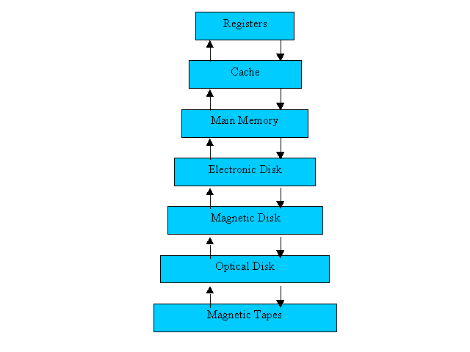
The Storage Hierarchy
Smaller, Faster
Main memory (RAM) for currently used data.
Disk for the main database (secondary storage).
Tapes for archiving older versions of the data (tertiary storage).
Bigger, Slower
Source: Operating Systems Concepts 5th Edition

Slide 7
Jim Gray’s Storage Latency Analogy: How Far Away is the Data?
Andromeda
10
9
Tape /Optical
2,000 Years
Robot
10
6
Disk
Pluto
2 Years
Sacramento
1.5 hr
100
Memory
10
On Board Cache
This Lecture Hall
10 min
2
On Chip Cache
This Room
1
Registers
My Head
1 min

Slide 8
Disks
Secondary storage device of choice.
Main advantage over tapes: random access vs. sequential.
Data is stored and retrieved in units called disk blocks or pages.
Unlike RAM, time to retrieve a disk block varies depending upon location on disk.
Therefore, relative placement of blocks on disk has major impact on DBMS performance!

Slide 9
Components of a Disk
Spindle
Disk head
Tracks
The platters spin (say, 120 rps).
The arm assembly is moved in or out to position a head on a desired track. Tracks under heads make a cylinder (imaginary!).
Sector
Arm movement
Platters
Only one head reads/writes at any one time.
Arm assembly
Block size is a multiple of sector size (which is fixed).

Slide 10
Accessing a Disk Page
Time to access (read/write) a disk block:
seek time (moving arms to position disk head on track)
rotational delay (waiting for block to rotate under head)
transfer time (actually moving data to/from disk surface)
Seek time and rotational delay dominate.
Seek time varies between about 0.3 and 10msec
Rotational delay varies from 0 to 4msec
Transfer rate around .08msec per 8K block
Key to lower I/O cost: reduce seek/rotation delays! Hardware vs. software solutions?

Slide 11
Arranging Pages on Disk
`Next’ block concept:
blocks on same track, followed by
blocks on same cylinder, followed by
blocks on adjacent cylinder
Blocks in a file should be arranged sequentially on disk (by `next’), to minimize seek and rotational delay.
For a sequential scan, pre-fetching several pages at a time is a big win!

Slide 12
Disk Space Management
Lowest layer of DBMS software manages space on disk (using OS file system or not?).
Higher levels call upon this layer to:
allocate/de-allocate a page
read/write a page
Best if a request for a sequence of pages is satisfied by pages stored sequentially on disk!
Responsibility of disk space manager.
Higher levels don’t know how this is done, or how free space is managed.
Though they may make performance assumptions!
Hence disk space manager should do a decent job.

Slide 13
Context
Query Optimization
and Execution
Relational Operators
Files and Access Methods
Buffer Management
Disk Space Management
DB

Slide 14
Buffer Management in a DBMS
Page Requests from Higher Levels
BUFFER POOL
disk page
free frame
MAIN MEMORY
DISK
choice of frame dictated
by replacement policy
DB
Data must be in RAM for DBMS to operate on it!
Buffer Mgr hides the fact that not all data is in RAM

Slide 15
When a Page is Requested ...
Buffer pool information table contains: <frame#, pageid, pin_count, dirty>
If requested page is not in pool:
Choose a frame for replacement. Only “un-pinned” pages are candidates!
If frame is “dirty”, write it to disk
Read requested page into chosen frame
Pin the page and return its address.
If requests can be predicted (e.g., sequential scans)
pages can be pre-fetched several pages at a time!

Slide 16
More on Buffer Management
Requestor of page must eventually unpin it, and indicate whether page has been modified:
dirty bit is used for this.
Page in pool may be requested many times,
a pin count is used.
To pin a page, pin_count++
A page is a candidate for replacement iff pin count == 0 (“unpinned”)
CC & recovery may entail additional I/O when a frame is chosen for replacement.
Write-Ahead Log protocol; more later!

Slide 17
Buffer Replacement Policy
Frame is chosen for replacement by a replacement policy:
Least-recently-used (LRU), MRU, Clock, etc.
Policy can have big impact on # of I/O’s; depends on the access pattern.

Slide 18
LRU Replacement Policy
Least Recently Used (LRU)
for each page in buffer pool, keep track of time when last unpinned
replace the frame which has the oldest (earliest) time
very common policy: intuitive and simple
Works well for repeated accesses to popular pages
Problems?
Problem: Sequential flooding
LRU + repeated sequential scans.
# buffer frames < # pages in file means each page request causes an I/O.
Idea: MRU better in this scenario? We’ll see in HW1!

Slide 19
“Clock” Replacement Policy
A(1)
D(1)
B(p)
An approximation of LRU
Arrange frames into a cycle, store one reference bit per frame
Can think of this as the 2nd chance bit
When pin count reduces to 0, turn on ref. bit
When replacement necessary do for each page in cycle { if (pincount == 0 && ref bit is on) turn off ref bit; else if (pincount == 0 && ref bit is off) choose this page for replacement; } until a page is chosen;
C(1)
Questions:
How like LRU?
Problems?

Slide 20
DBMS vs. OS File System
OS does disk space & buffer mgmt: why not let OS manage these tasks?
Some limitations, e.g., files can’t span disks.
Buffer management in DBMS requires ability to:
pin a page in buffer pool, force a page to disk & order writes (important for implementing CC & recovery)
adjust replacement policy, and pre-fetch pages based on access patterns in typical DB operations.

Slide 21
Context
Query Optimization
and Execution
Relational Operators
Files and Access Methods
Buffer Management
Disk Space Management
DB

Slide 22
Files of Records
Blocks are the interface for I/O, but…
Higher levels of DBMS operate on records, and files of records.
FILE: A collection of pages, each containing a collection of records. Must support:
insert/delete/modify record
fetch a particular record (specified using record id)
scan all records (possibly with some conditions on the records to be retrieved)

Slide 23
Unordered (Heap) Files
Simplest file structure contains records in no particular order.
As file grows and shrinks, disk pages are allocated and de-allocated.
To support record level operations, we must:
keep track of the pages in a file
keep track of free space on pages
keep track of the records on a page
There are many alternatives for keeping track of this.
We’ll consider 2

Slide 24
Heap File Implemented as a List
Data
Page
Data
Page
Data
Page
Full Pages
Header
Page
Data
Page
Data
Page
Data
Page
Pages with
Free Space
The header page id and Heap file name must be stored someplace.
Database “catalog”
Each page contains 2 `pointers’ plus data.

Slide 25
Heap File Using a Page Directory
Data
Page 1
Header
Page
Data
Page 2
Data
Page N
DIRECTORY
The entry for a page can include the number of free bytes on the page.
The directory is a collection of pages; linked list implementation is just one alternative.
Much smaller than linked list of all HF pages!

Slide 26
Indexes (a sneak preview)
A Heap file allows us to retrieve records:
by specifying the rid, or
by scanning all records sequentially
Sometimes, we want to retrieve records by specifying the values in one or more fields, e.g.,
Find all students in the “CS” department
Find all students with a gpa > 3
Indexes are file structures that enable us to answer such value-based queries efficiently.

Slide 27
Record Formats: Fixed Length
F1
F2
F3
F4
L1
L2
L3
L4
Base address (B)
Address = B+L1+L2
Information about field types same for all records in a file; stored in system catalogs.
Finding i’th field done via arithmetic.

Slide 28
Record Formats: Variable Length
Two alternative formats (# fields is fixed):
F1 F2 F3 F4
$
$
$
$
Fields Delimited by Special Symbols
F1 F2 F3 F4
Array of Field Offsets
Second offers direct access to i’th field, efficient storage
of nulls (special don’t know value); small directory overhead.

Slide 29
Page Formats: Fixed Length Records
Slot 1
Slot 1
Slot 2
Slot 2
. . .
Free
Space
. . .
Slot N
Slot N
Slot M
N
1
. . .
0
1
1
M
number
of records
M ... 3 2 1
number
of slots
PACKED
UNPACKED, BITMAP
Record id = <page id, slot #>. In first alternative, moving records for free space management changes rid; may not be acceptable.

Slide 30
Page Formats: Variable Length Records
Rid = (i,N)
Page i
Rid = (i,2)
Rid = (i,1)
20
16
24
N
Pointer
to start
of free
space
N . . . 2 1
# slots
SLOT DIRECTORY
Can move records on page without changing rid; so, attractive for fixed-length records too.

Slide 31
System Catalogs
For each relation:
name, file location, file structure (e.g., Heap file)
attribute name and type, for each attribute
index name, for each index
integrity constraints
For each index:
structure (e.g., B+ tree) and search key fields
For each view:
view name and definition
Plus statistics, authorization, buffer pool size, etc.
Catalogs are themselves stored as relations!

Slide 32
Attr_Cat(attr_name, rel_name, type, position)
attr_name
rel_name
type
position
attr_name
Attribute_Cat
string
1
rel_name
Attribute_Cat
string
2
type
Attribute_Cat
string
3
position
Attribute_Cat
integer
4
sid
Students
string
1
name
Students
string
2
login
Students
string
3
age
Students
integer
4
gpa
Students
real
5
fid
Faculty
string
1
fname
Faculty
string
2
sal
Faculty
real
3

Slide 33
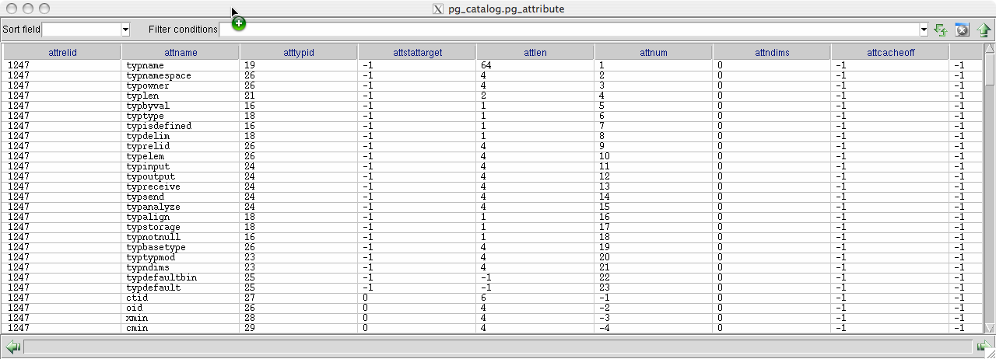
pg_attribute

Slide 34
Summary
Disks provide cheap, non-volatile storage.
Random access, but cost depends on location of page on disk; important to arrange data sequentially to minimize seek and rotation delays.
Buffer manager brings pages into RAM.
Page stays in RAM until released by requestor.
Written to disk when frame chosen for replacement (which is sometime after requestor releases the page).
Choice of frame to replace based on replacement policy.
Tries to pre-fetch several pages at a time.

Slide 35
Summary (Contd.)
DBMS vs. OS File Support
DBMS needs features not found in many OS’s, e.g., forcing a page to disk, controlling the order of page writes to disk, files spanning disks, ability to control pre-fetching and page replacement policy based on predictable access patterns, etc.
Variable length record format with field offset directory offers support for direct access to i’th field and null values.
Slotted page format supports variable length records and allows records to move on page.

Slide 36
Summary (Contd.)
File layer keeps track of pages in a file, and supports abstraction of a collection of records.
Pages with free space identified using linked list or directory structure (similar to how pages in file are kept track of).
Indexes support efficient retrieval of records based on the values in some fields.
Catalog relations store information about relations, indexes and views. (Information that is common to all records in a given collection.)

